Slide 1




Slide 2
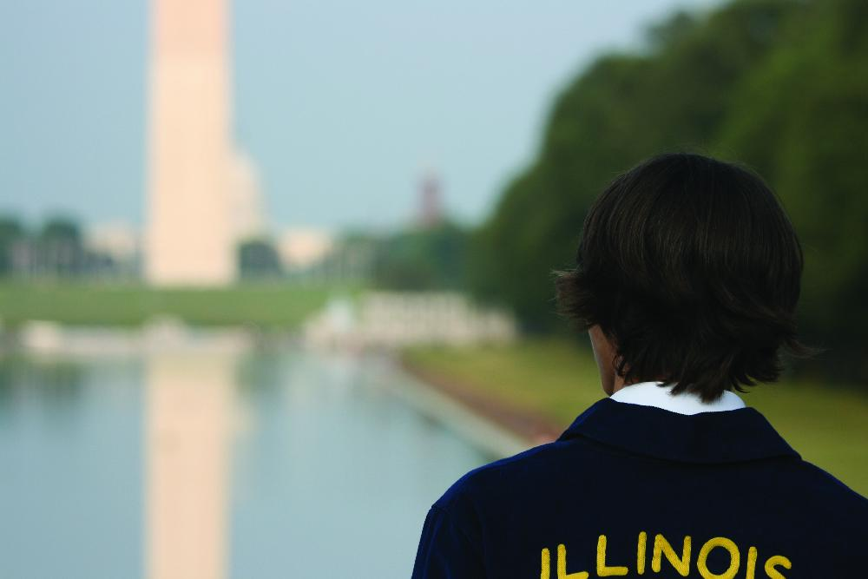

FFA Programs for All Members
212 Degrees
360 Degrees
Washington Leadership Conference

Slide 3
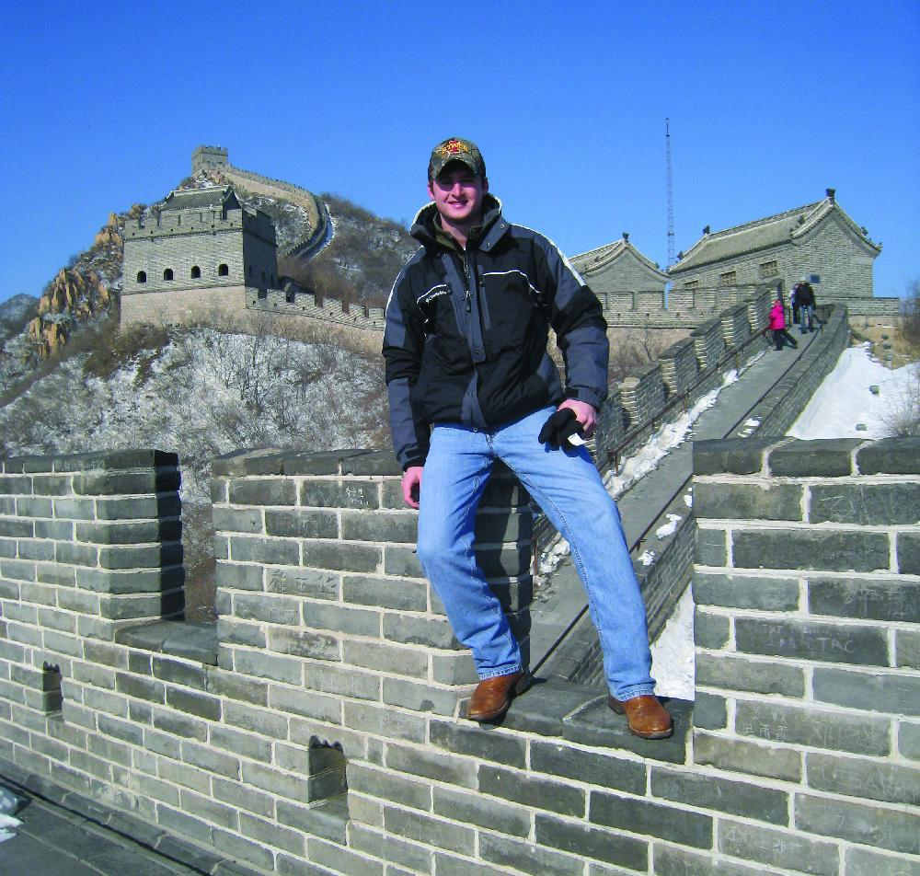
State Officer Programs
Building Leaders and Strong Teams of Officers (BLAST Off)
National Leadership Conference for State Officers (NLCSO)
State Presidents’ Conferences (SPC)
International Leadership Seminar for State Officers (ILSSO)

Slide 4
National FFA Officers
Six student members are selected each year
Members must have received an American FFA Degree and be selected by their state association in order to be eligible
Their schedule resembles that of a corporate CEO, traveling more than 100,000 miles during their year of service

Slide 5
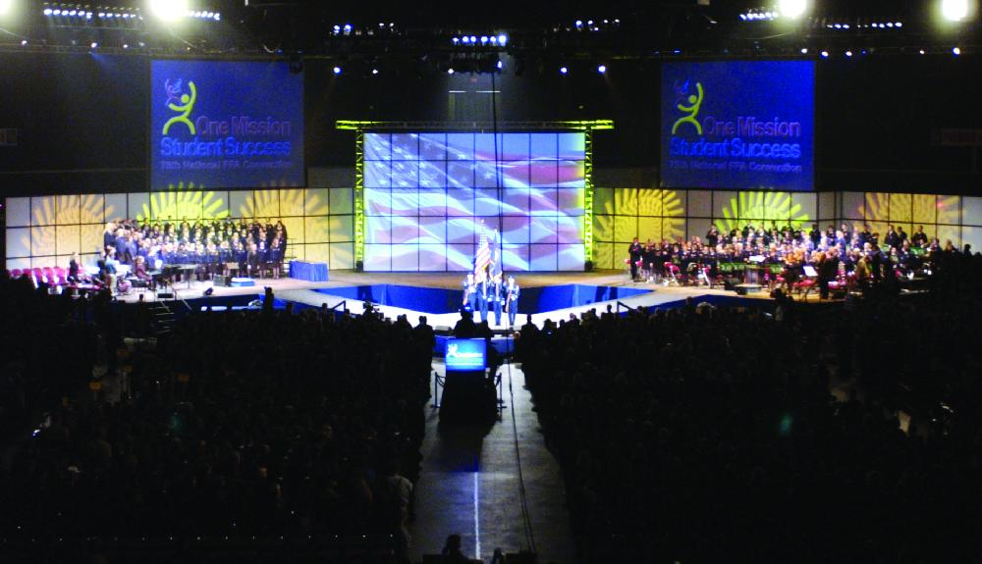
National Convention
Be Part of the Action

Slide 6
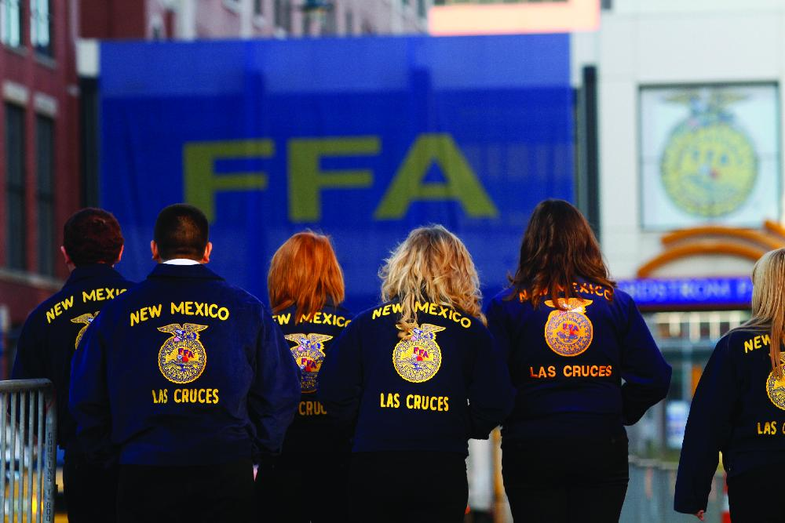
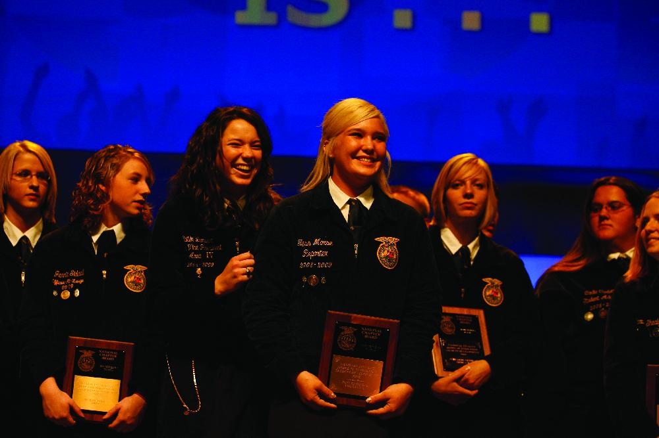
National Convention
National FFA Band
National FFA Chorus
National FFA Talent
Courtesy Core
Career Show
Student Workshops
Concerts
Career Success Tours
Keynote Speakers
And so much more to discover at the national FFA convention!

