Slide 1
July Owls Chat
POA and Infusing Agriscience

Slide 2

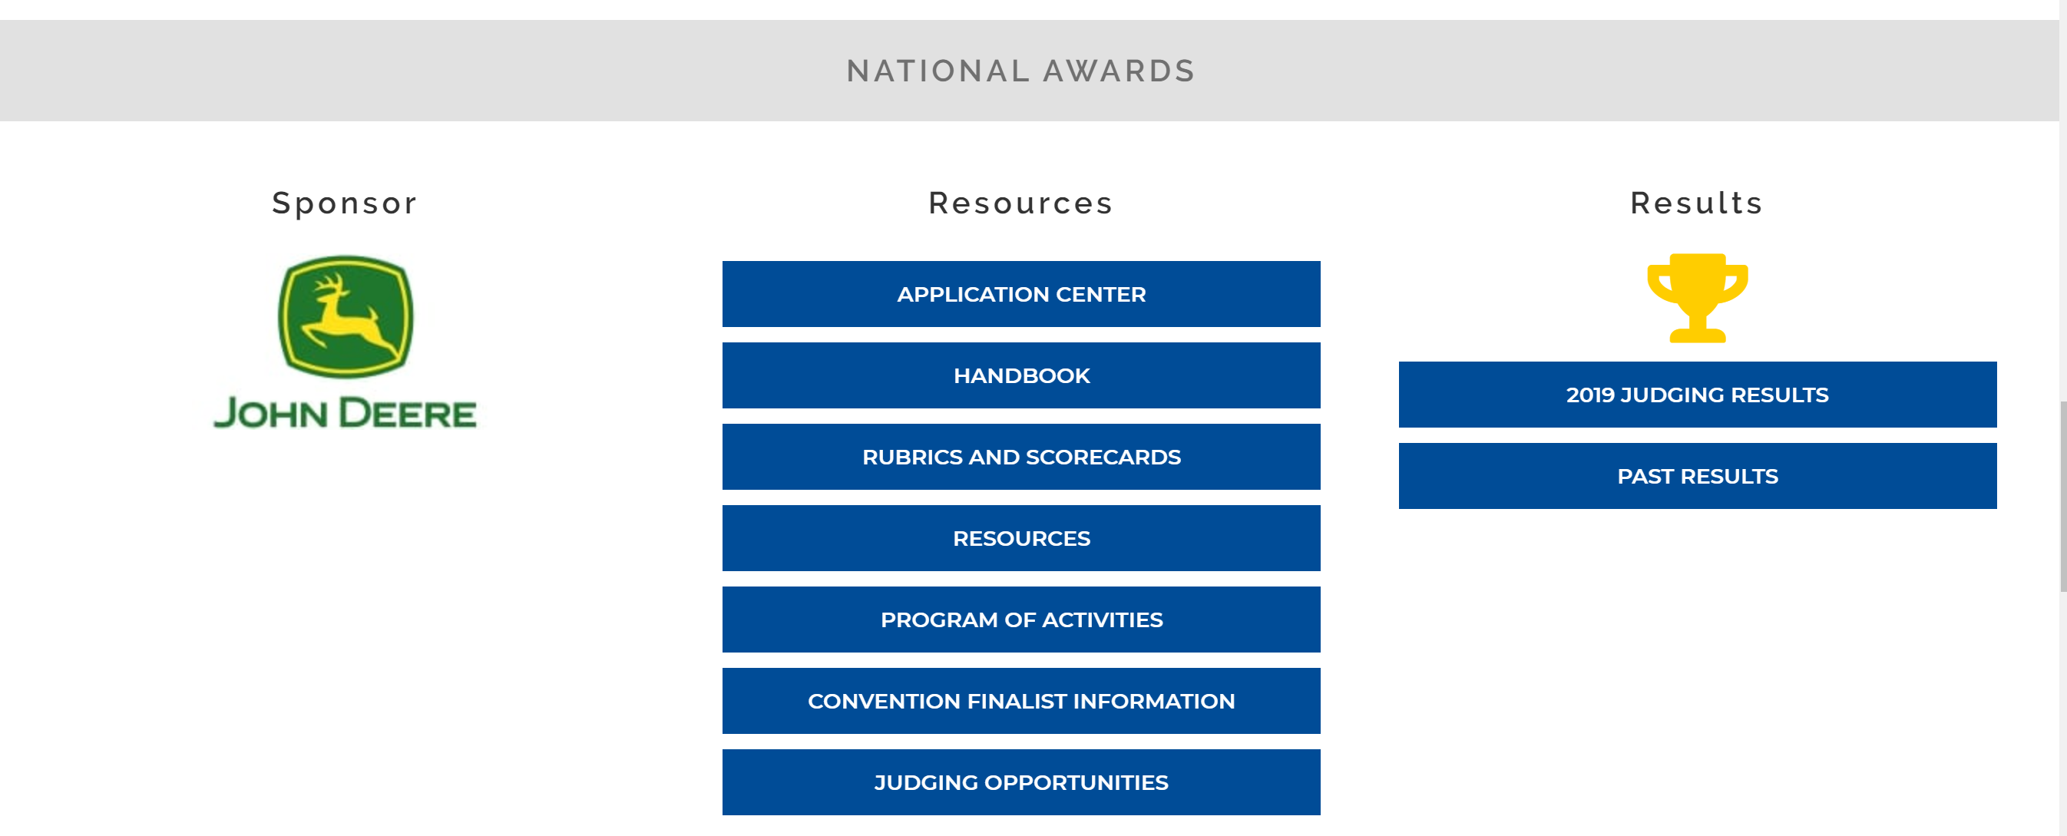
Program of Activities
FREE RESOURCES!!!
Footer description area.

Slide 3
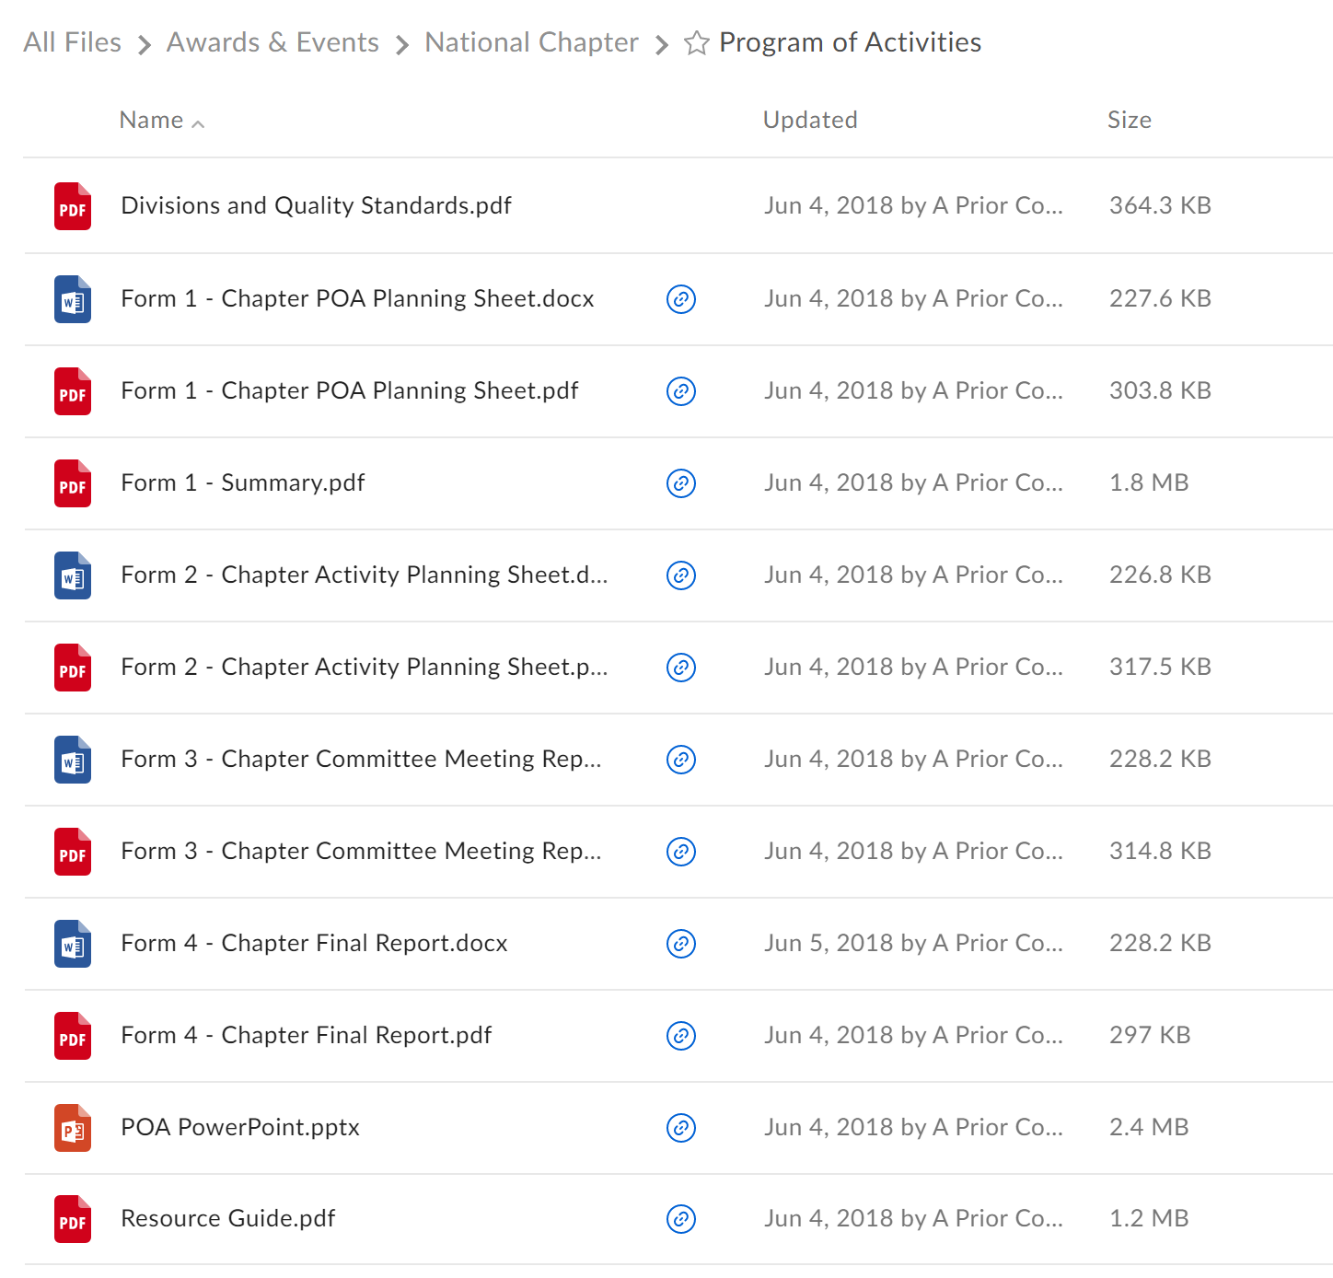
Program of Activities
Footer description area.

Slide 4
Resources
Footer description area.

Slide 5
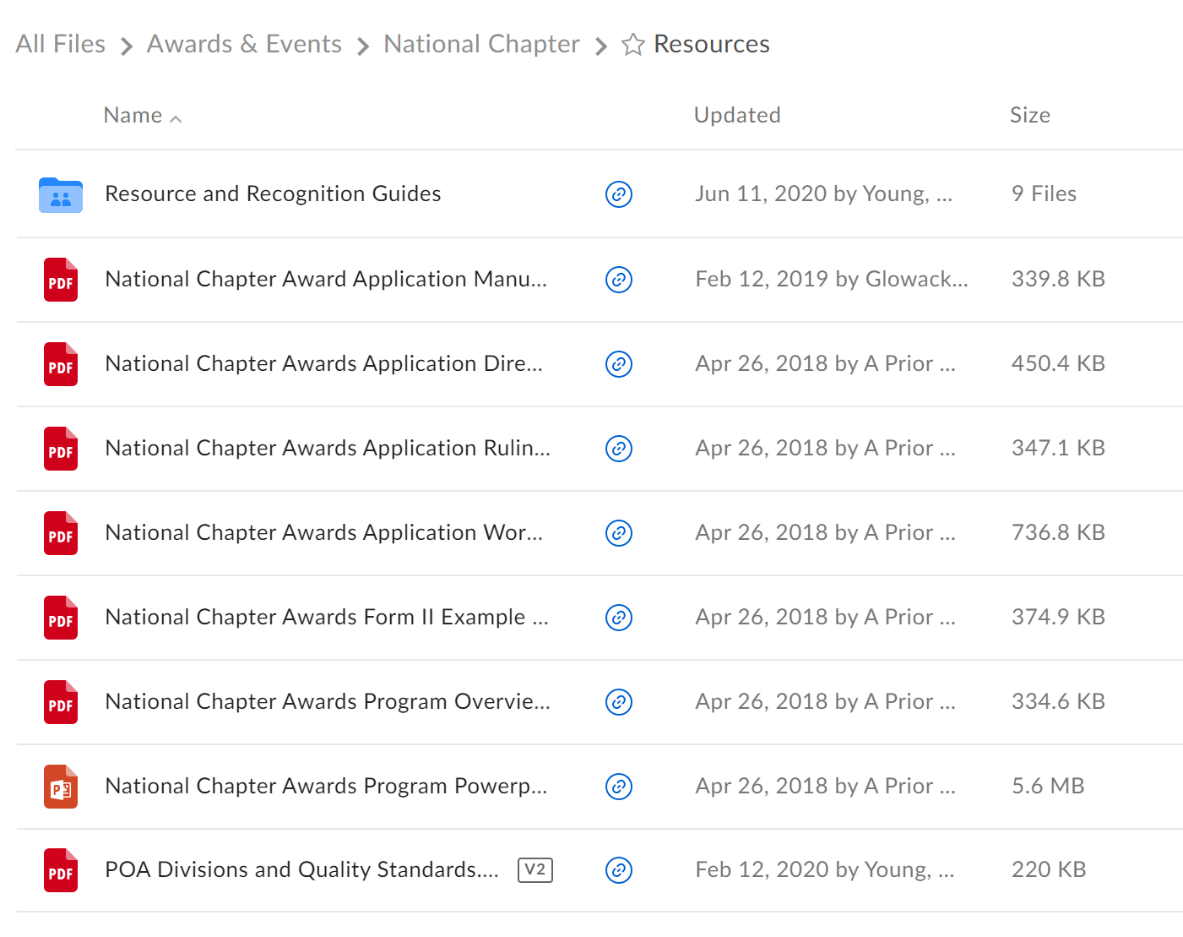
Resources
Footer description area.

Slide 6
Handbook, Rubrics, and Scorecards

Slide 7
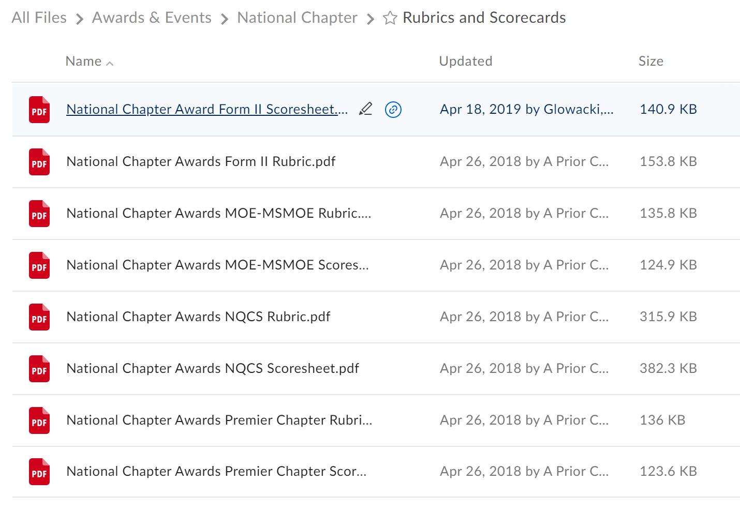
Handbook, Rubrics, and Scorecards

Slide 8
How do I (we) get recognized
Use the POA resources with your chapter officers and committees to plan the activities your chapter will do
Each year your chapter officers should be planning new activities to engage members of the chapter. Reusing activities is okay, just make sure you have different goals to measure. Use the Recognition guides to get new ideas!
Once an activity is complete, have one of your chapter officers or committee write about that activity using the application
Use the rubric to make sure you are getting all the points
Submit application!

Slide 9
Workshops
Interested in hosting a workshop?
Reach out to National FFA – nationalchapter@ffa.org
We can provide some resources to help guide you
You are the best workshop presenter!

Slide 10
Judging
Need help scoring?
Reach out to National FFA – nationalchapter@ffa.org
Provide judge resources and help guide you. (Word versions so you can edit)
You know what works best for your state!

Slide 11

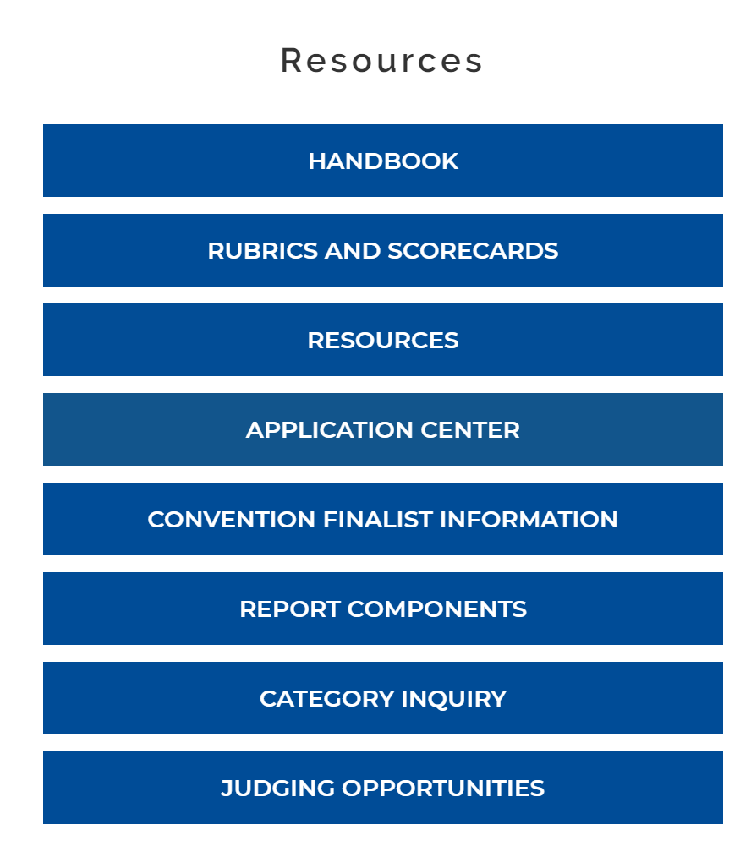
Agriscience Fair

Slide 12
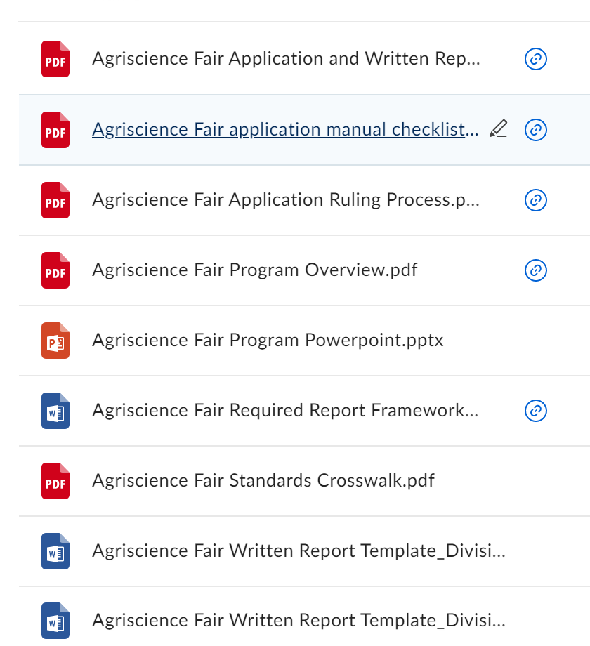
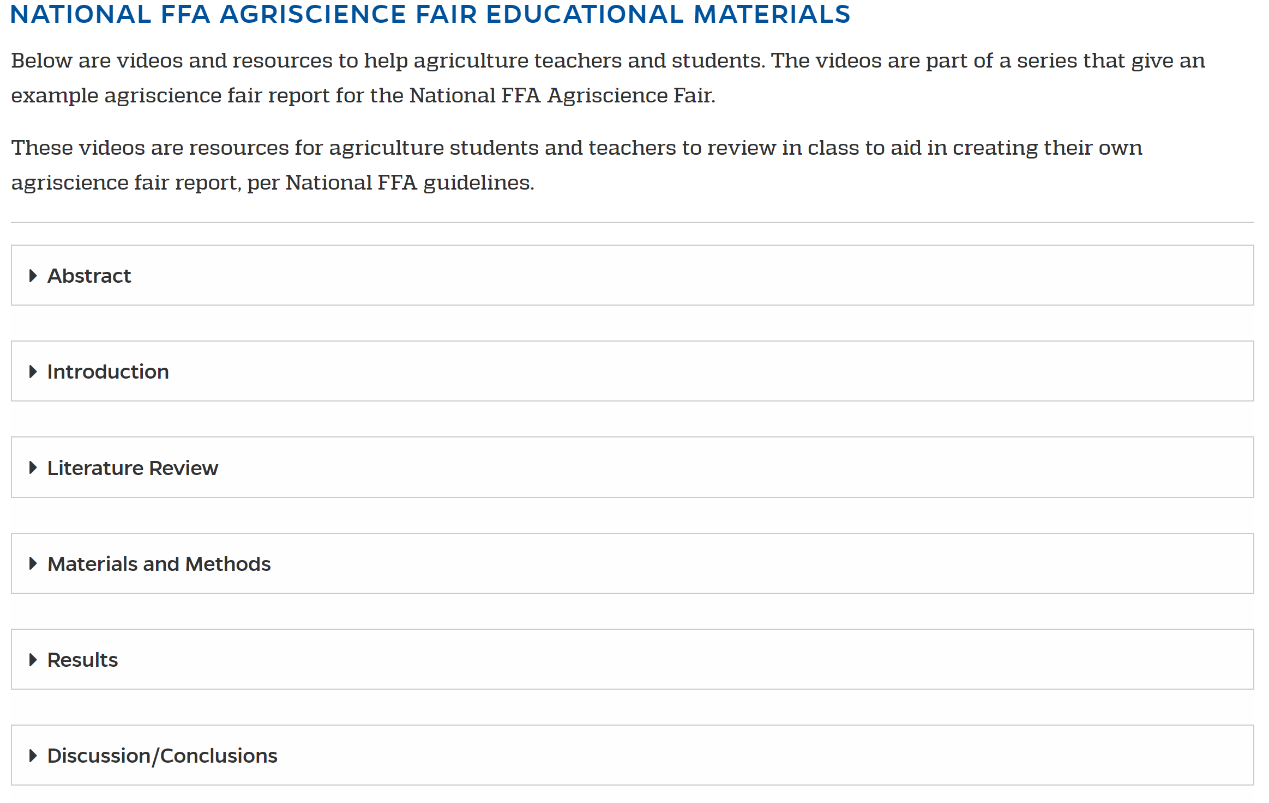
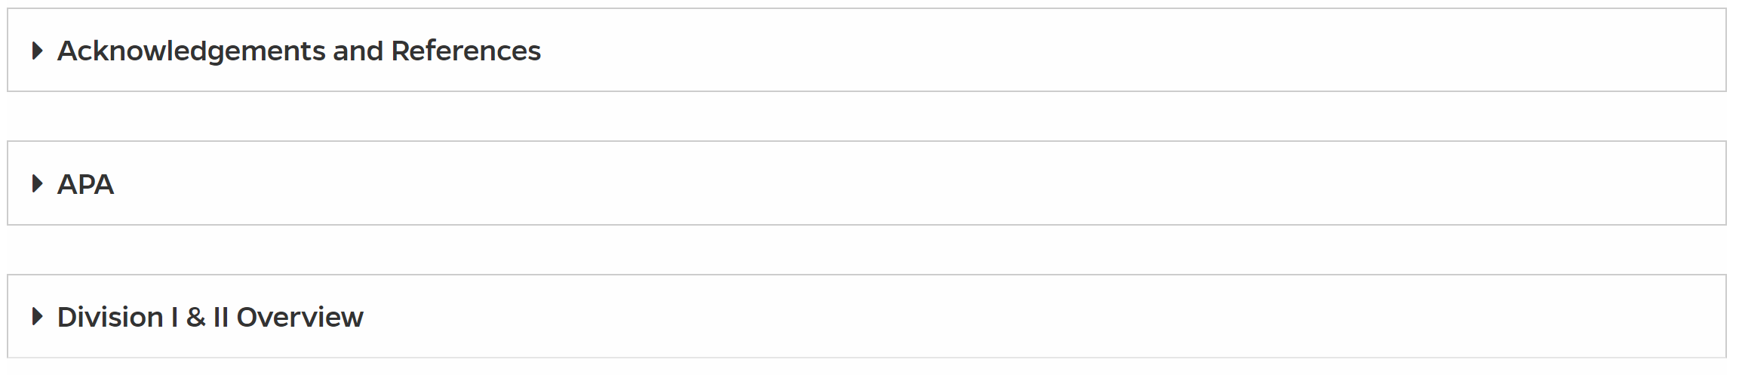
Resources and Report Components

Slide 13
Agriscience Fair

Slide 14
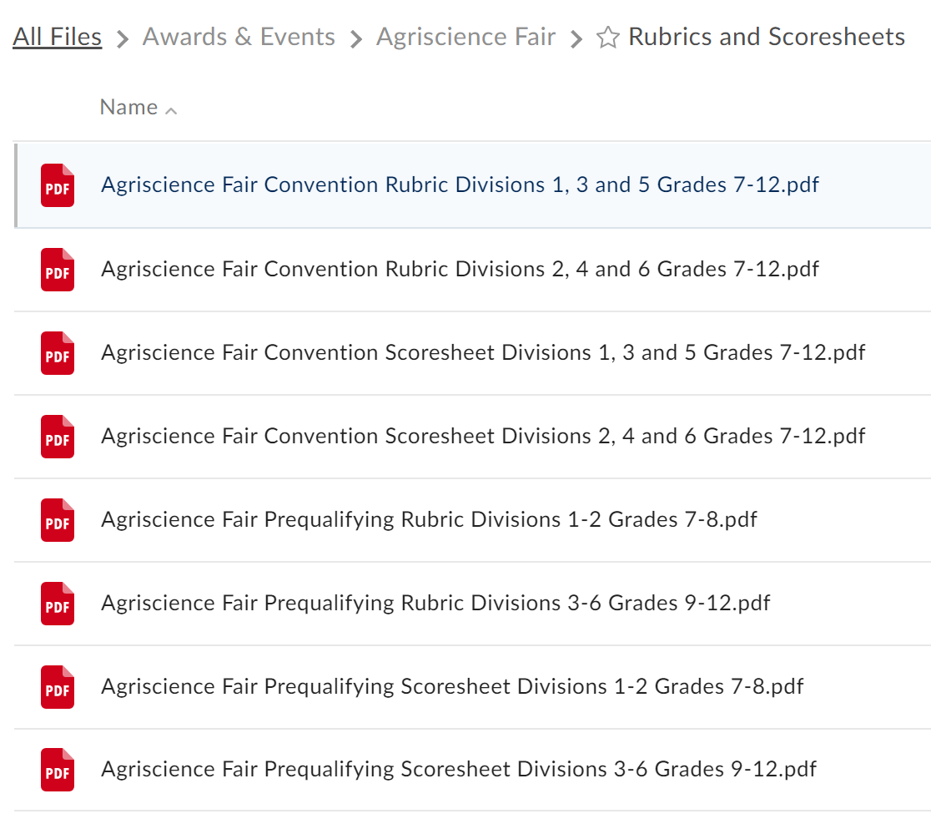
Handbook, Rubrics and Scorecards

Slide 15
Getting started with Agriscience Fair
Introducing the Scientific method
Conducting research with M&Ms
M&M experiment table
The Color Mixture of an M&M
Taste test lesson plan
Taste Test instructions
Taste Test Reflection
Composition notebook
Lab folder example (1); example (2)

Slide 16
Agriscience Fair

Slide 17
Category Inquiry?
Don’t know what category the project belongs?
Using this form you can submit the project for an official ruling.
We work with your state to make sure they are aware of the ruling and it is properly placed
Submit as much information as you can! This allows us to give a more thorough ruling.

Slide 18
Workshops
Interested in hosting a workshop?
Reach out to National FFA – agriscience@ffa.org
We can provide some resources to help guide you
You are the best workshop presenter!

Slide 19
Judging
Need help scoring?
Reach out to National FFA – agriscience@ffa.org
Provide judge resources and help guide you. (Word versions so you can edit)
You know what works best for your state!

Slide 20
Contact info
Madeline Young – National FFA – myoung@ffa.org
Robert Bollier – S.C. teacher - rbollier@lexington1.net
Travis Scherer – IN teacher - scherert@trico.k12.in.us

