Slide 2
What is Cellulosic Ethanol?
Cellulose is the world’s most abundant compound
  Provides cellular structure for trees, grass and all things organic
The industry began research on the cellulosic production process over 15 years ago
Ethanol is a molecule; regardless of the feedstock, the ethanol is identical
While not all countries can produce oil, All countries do possess some form of cellulose
Making energy from waste economically is a win-win for the planet
Notes:
Discuss with students the types of cellulose they would find in their local area.

Slide 3
Integrated Production Model
The Future of Ethanol
Cellulose
Ethanol
Starch
Notes:
Ethanol can now be produced from both cellulosic and starch material for corn.
Click on The Future of Ethanol link and play the video.

Slide 4
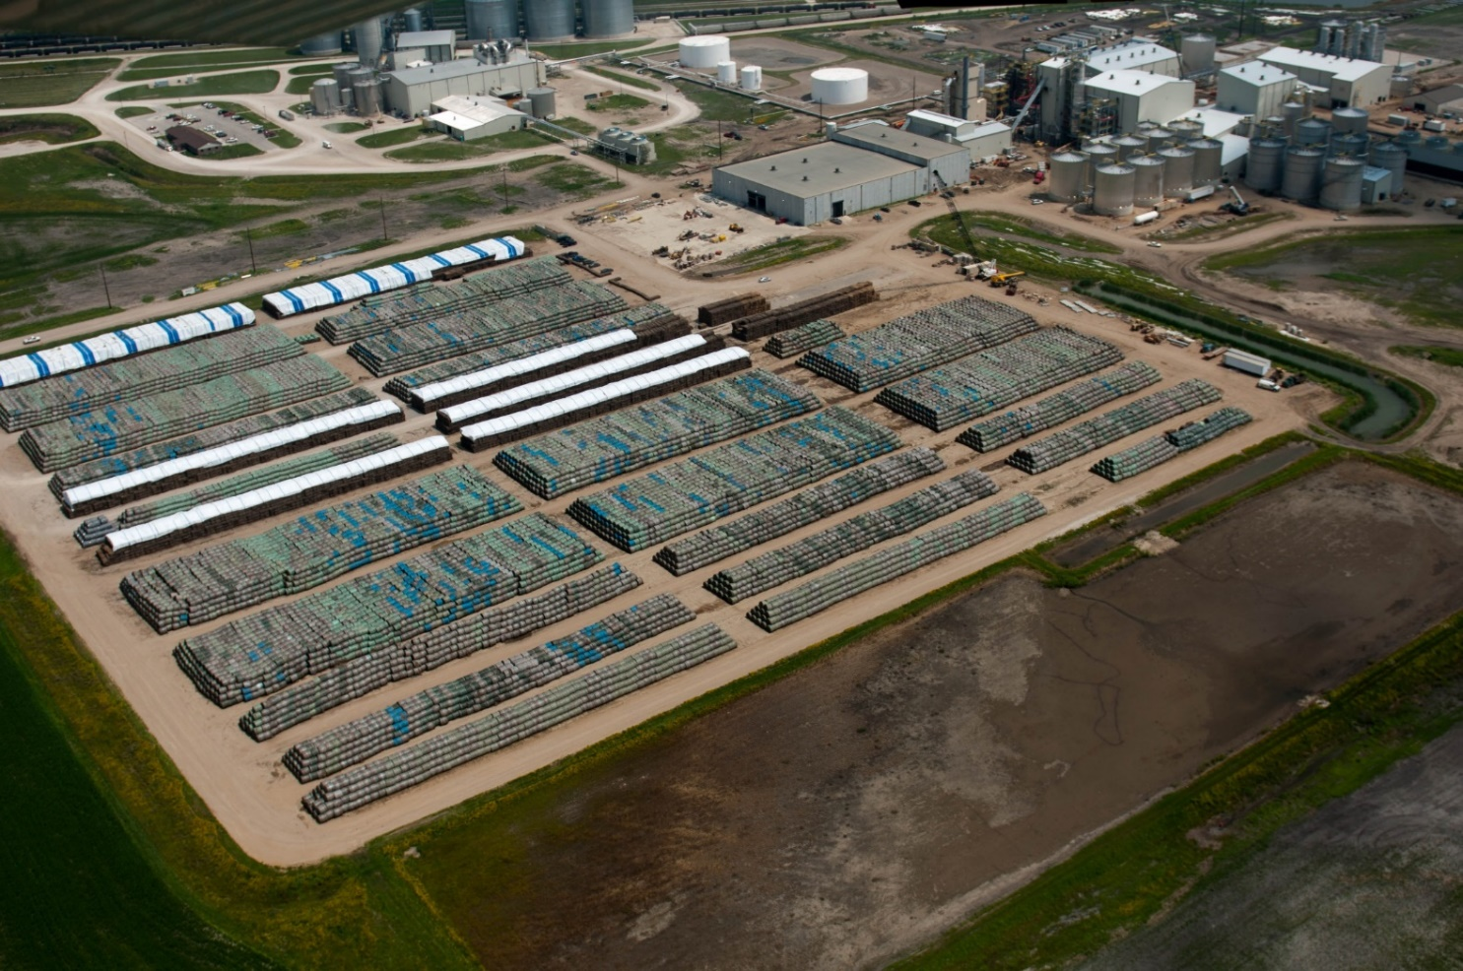
Biomass Stored Onsight
Biomass: A New Opportunity
Notes:
Click on Biomass: A New Opportunity and play the video. Note the space the biomass material occupies.

Slide 5
Presentation Review
Mark or highlight three key points
List two ideas or concepts related to previous knowledge.
List questions you have about this topic.
Keep notes organized and available for use throughout the course.

Slide 6
References
Berven, D., (2018). [POET presentation]. Biofuels past, present and future. Sioux Falls, SD.
POET. (2018). Products and solutions. Retrieved from https://poet.com/products

