Slide 1



Chapter Leadership Responsibilities

Slide 2


Chapter Leadership
President
Preside over meetings according to accepted rules of parliamentary procedure
Appoint committees and serve on them as an ex-officio, nonvoting member
Coordinate the activities of the chapter and evaluate the progress of each division of the POA
Represent the chapter in public relations and official functions

Slide 3
Chapter Leadership
Vice President
Assume all duties of the president if necessary
Develop the POA and serve as an ex-officio, non-voting member of the POA committees
Coordinate all committee work
Work closely with the president and advisor to assess progress toward meeting chapter goals

Slide 4
Chapter Leadership
Secretary
Prepare and post the agenda for each chapter meeting
Prepare and present the minutes of each chapter meeting
Place all committee reports in the Secretary’s file
Be responsible for chapter correspondence
Maintain member attendance and activity records and issue membership cards
Have on hand for each meeting:
  a. The Secretary’s file
  b. Copy of the POA including all standing and special committees
  c. Official FFA Manual and the Official FFA Student Handbook
  d. Copy of the chapter constitution and bylaws

Slide 5
Chapter Leadership
Treasurer
Receive, record and deposit FFA funds and issue receipts
Present monthly treasurer reports at chapter meetings
Collect dues and special assessments
Maintain neat and accurate treasury records
Prepare and submit the membership roster and dues to the National FFA Organization through the state FFA association office in cooperation with the secretary
Serve as chairperson of the finance committee

Slide 6
Chapter Leadership
Reporter
Serve as chair of the POA public relations committee
Plan public information programs with local radio, television, newspaper and service clubs and make use of other opportunities to tell the FFA story
Release news and information to local and regional news media
Publish a chapter newsletter or website
Prepare and maintain a chapter scrapbook
Send local stories to area, district and state reporters and to any specific duties and responsibilities for each school publication
Send articles and photographs to FFA New Horizons and other national and regional publications
Work with local media on radio and television appearances and FFA news
Serve as the chapter photographer

Slide 7
Chapter Leadership
Sentinel
Assist the president in maintaining order
Keep the meeting room, chapter equipment and supplies in proper condition
Welcome guests and visitors
Keep the meeting room comfortable
Take charge of candidates for degree ceremonies
Assist with special features and refreshments

Slide 8
Chapter Leadership
Advisor
Supervise chapter activities year-round
Inform prospective students and parents about the FFA
Instruct students in leadership and personal development
Build school and community support for the program
Encourage involvement of all chapter members in activities
Prepare students for involvement in career development events (CDEs) and leadership programs

Slide 9
Chapter Leadership
Additional Officer a Chapter Might Elect:
Historian
Develop and maintain a scrapbook of memorabilia in which to record the chapter’s history
Research and prepare items of significance of the chapter’s history
Prepare displays of chapter activities and submit stories of former members to the media
Assist the reporter in providing photography for chapter needs

Slide 10
Chapter Leadership
Additional Officer a Chapter Might Elect:
Parliamentarian
Be proficient with parliamentary procedure
Rule on all questions of parliamentary conduct at chapter meetings
Serve as a participant or an ex-officio member of the parliamentary procedure team
Conduct parliamentary procedure workshops at the chapter level
Chair or serve as ex-officio member on the conduct of meetings committee

Slide 11
Chapter Leadership
Additional Officer a Chapter Might Elect:
Chaplain
Present the invocation at banquets and other functions.
Coordinate FFA participation at local area churches during National FFA Week.
Conduct reflections services at summer camps and conferences.

Slide 12
Arranging the Meeting Room
Meeting
Room
P = President
S = Secretary
A = Advisor
VP = Vice President
T = Treasurer
R = Reporter
P
R
S
T
A
VP

Slide 13

Meeting Responsibilities
  - President - presides over meetings, appoints and serves on committees, and coordinates activities of their chapter
  - Vice President - assumes the duties of the President if needed, develops the Program of Activities, and coordinates committee work
Notes:
Each chapter officer has specific responsibilities during a chapter meeting

Slide 14
Meeting Responsibilities
  - Secretary - prepares and posts agendas & minutes, is responsible for chapter correspondence, and maintains member attendance and activities
  - Treasurer - is in charge of FFA funds, collects dues, and presents treasurer’s reports

Slide 15
Meeting Responsibilities
  Reporter - serves as Program of Activities public relations committee chair, releases news to local media, and publishes a chapter website or newsletter
  Sentinel - maintains order, keeps meeting room and supplies in order, and welcomes guests
  Advisor - supervises chapter activities, informs students and parents on FFA and builds community support

Slide 16
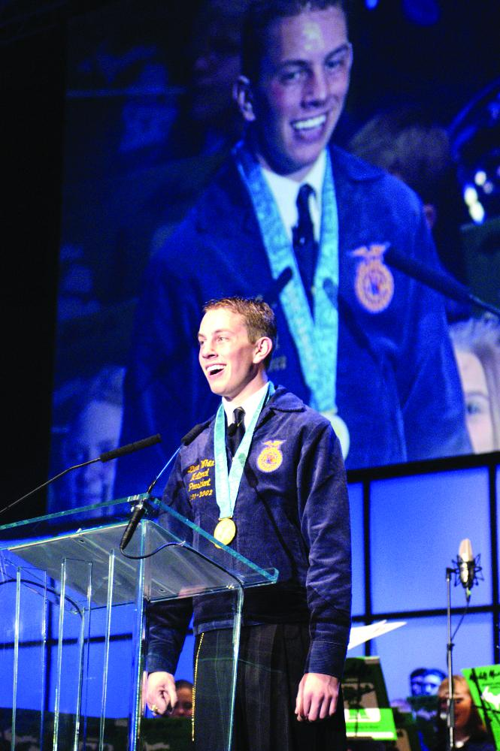
Official Ceremonies
Official Opening Ceremony
Official Closing Ceremony
Degree Ceremonies
Honorary Member Ceremony

