Slide 1



Successful FFA Chapter

Slide 2

Essentials of a Successful FFA Chapter
FFA Knowledge
Membership Diversity
Shared Responsibility
Capable Officers
Challenging Program of Activities
Workable Constitution and Bylaws
Proper Equipment and Records
Well-planned, Regularly-held Chapter Meetings
Adequate Financing
School and Community Support

Slide 3
Program of Activities
Chapter POAs serve as a road map of the activities and events in which chapter members will organize and participate.
POA Divisions -
Student Development: Promote personal and group activities that improve life skills.
Chapter Development: Encourage students to work together.
Community Development: Cooperate with other groups to make the community a better place to live and work.

Slide 4
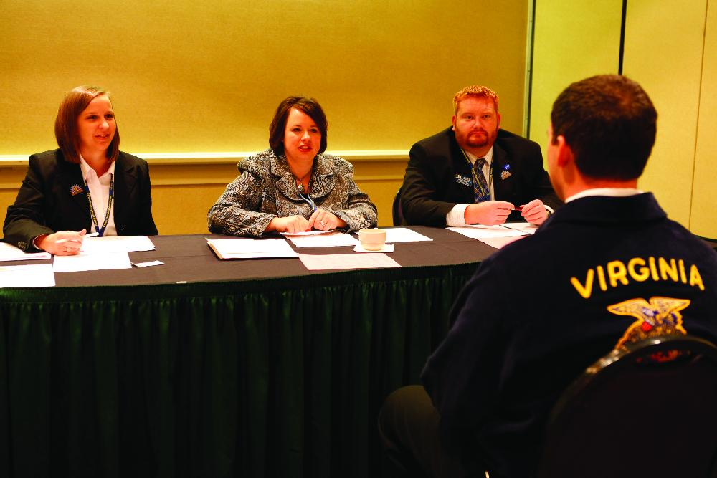
Student Development
Quality Standards
Leadership
Healthy Lifestyle
Career Success
Scholarship
Personal Growth

Slide 5
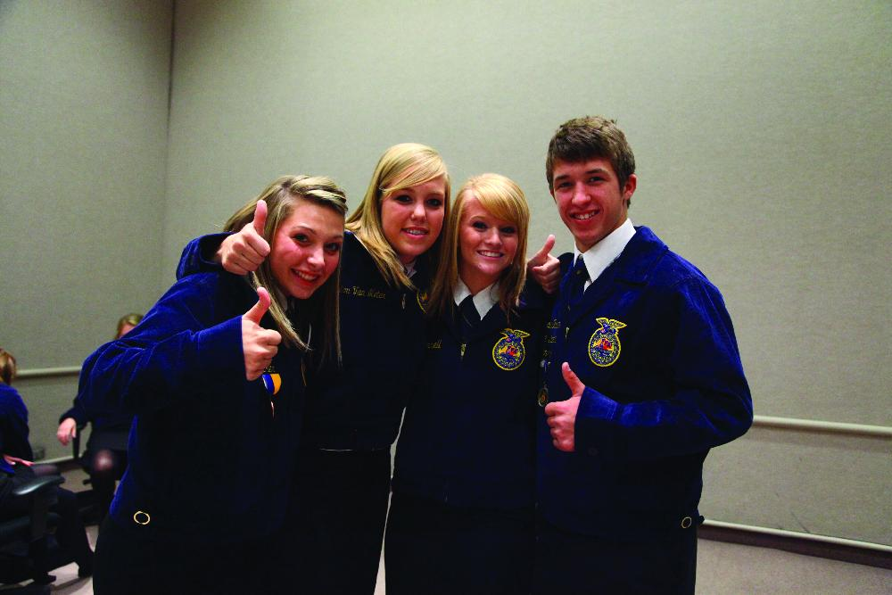
Chapter Development
Quality Standards
Chapter Recruitment
Financial
Public Relations
Cooperation
Support Group

Slide 6
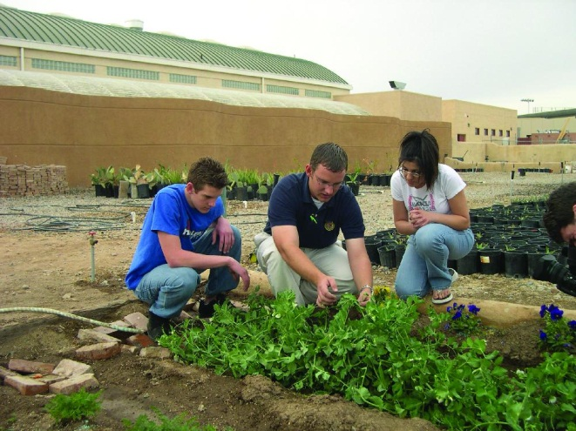
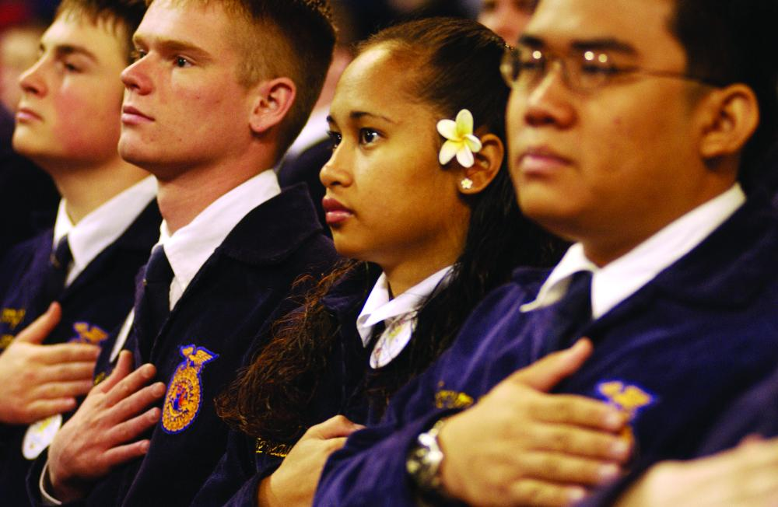
Community Development
Quality Standards
Economic Development
Environmental
Human Resources
Citizenship
Agricultural Promotion

Slide 7

Chapter Activities
FFA Week
Chapter Banquet
Fundraising
Service Learning
Partnerships
Recruitment

Slide 8
Chapter Leadership
Expectations of Chapter Officers
A genuine desire to be part of a leadership team.
A willingness to accept responsibility.
A sincere desire to work with all chapter members in meeting their leadership, personal and chapter goals.

Slide 9
Chapter Leadership
Expectations of Chapter Officers (continued)
A commitment to lead by example.
A knowledge and understanding of the chapter, state and national FFA constitution, bylaws and programs.
A working knowledge of parliamentary procedure.
An ability to memorize and recite their parts in the official ceremonies.

