Slide 1

Entering the Sales World
National FFA Educator Resource

Slide 2
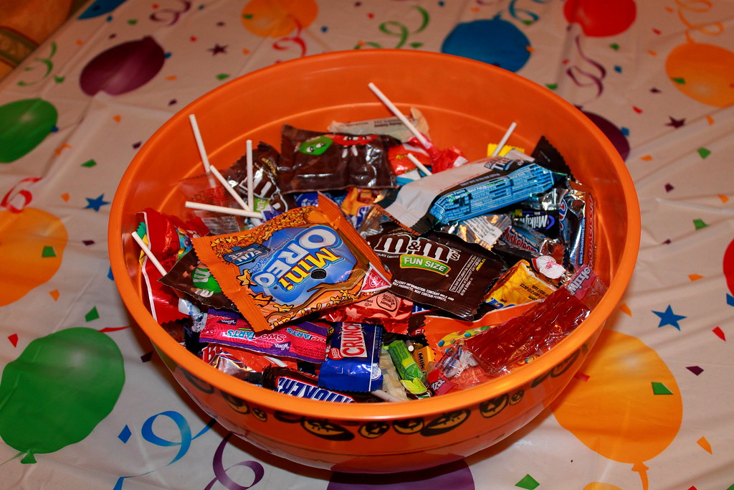
Bell Ringer
Choose one of the two pieces of candy that are on display. You will create a 15- to 30-second pitch on why someone should buy that particular type of candy. The student with the best pitch will get to keep the candy (one person for each piece of candy).

Slide 3




Introduction

Slide 4

What Is a “Sale”?
The exchange of a commodity for money; the action of selling something

Slide 5
Two Areas of Sales in Agriculture
Selling to farmers and ranchers: Companies sell products to the farmer or rancher that they need for production.
  Animal Feed
  Seeds
  Equipment
Selling for farmers and ranchers: Companies sell products the farmer or rancher produced.
  Produce in a market
  Products in a feed store
  Products for further processing

Slide 6
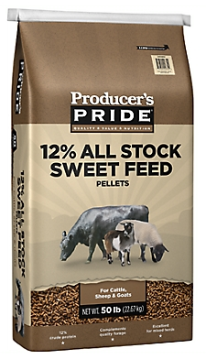

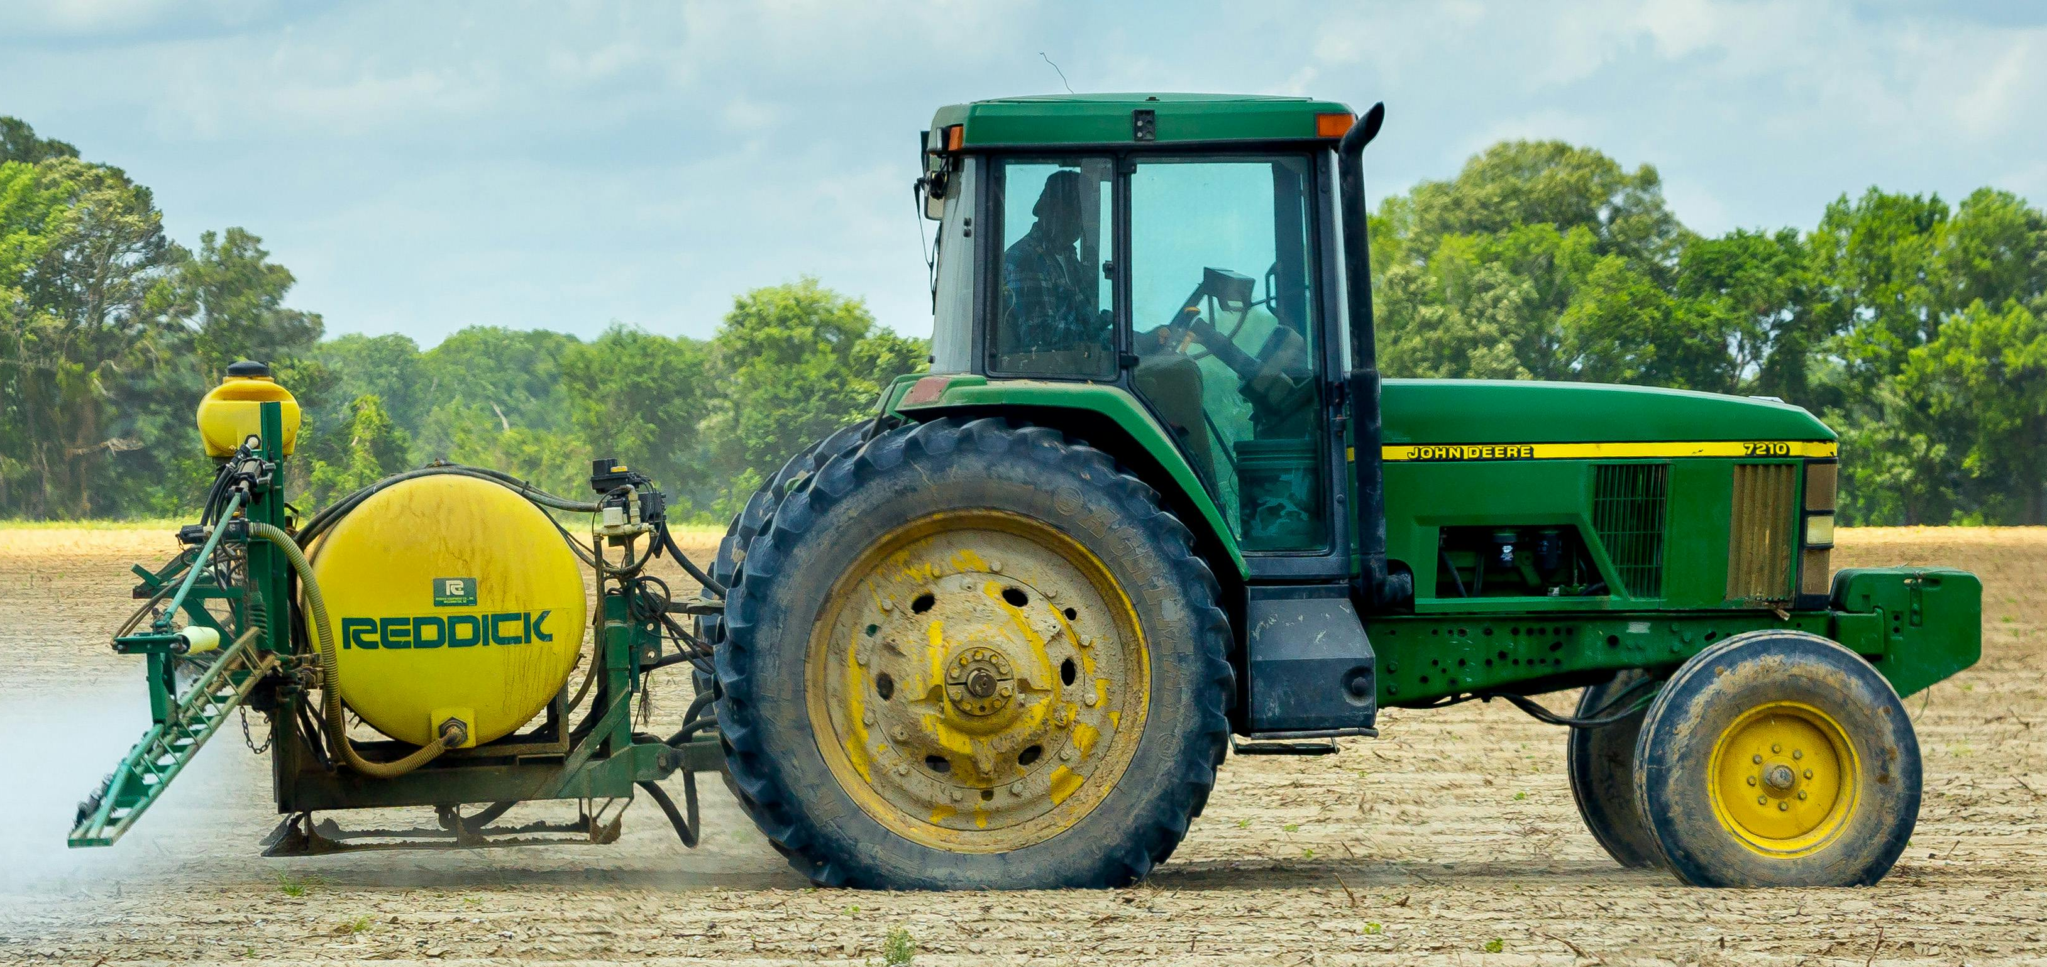
Two Types of Products in Agriculture
Tangible
  Animals
  Fiber
  Crops
  Machinery
  Seeds
  Plants
  Tools
  Lumber
Intangible
  Insurance
  Pricing
  Educational publications
  Training
  Weather services

Slide 7

Sales Representatives in Agriculture
Sell agricultural products and services to a farm or ranch.
Travel to locations within their assigned territories or regions.
Serve as the connection between the farm or ranch and the company when orders are placed.
Educate customers about the products/services and how to use them.

Slide 8
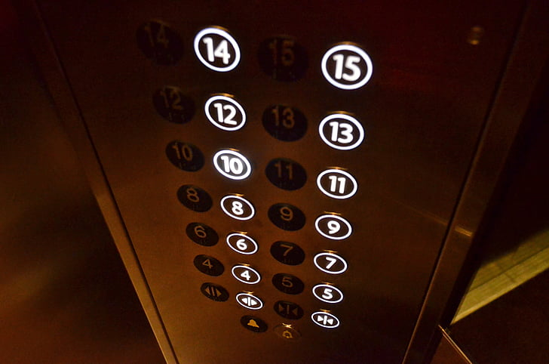
Elevator Pitches
An elevator pitch is a brief way of introducing yourself, getting across a key point or two and making a connection with someone.
Let’s watch this example: https://youtu.be/SA5eYjdijvI?si=Q8V9DmuE-M4fgaDh

Slide 9
Elevator Pitches
Working with a partner, now you will get to create your own elevator pitch for a product.
One person will start as the sales representative and will draw a Product Card.
The other person will start as the consumer and will draw a Consumer Card.
The consumer will explain their role to the sales representative.
The sales representative has one minute to create an elevator pitch that will help sell their product to the consumer.
After the minute is over, the sales representative will deliver their elevator pitch to the consumer.
Consumer will score the pitch.
STOP

Slide 10
Elevator Pitches
Now, swap roles and repeat the instructions.
One person will start as the sales representative and will draw a Product Card.
The other person will start as the consumer and will draw a Consumer Card.
The consumer will explain their role to the sales representative.
The sales representative has one minute to create an elevator pitch that will help sell their product to the consumer.
After the minute is over, the sales representative will deliver their elevator pitch to the consumer.
Consumer will score the pitch.
STOP

Slide 11

Six Steps of the Sales Process
Prospecting
Identifying and connecting with promising leads for prospective clients to see if they might need your product or service

Slide 12

Six Steps of the Sales Process
Qualifying Prospects
Determine whether your prospective client is customer material and whether they’re likely to show interest in what you are offering based on BANT.
  Budget: Do they have the ability to spend?
  Authority: Do we know who the decision maker is?
  Need: Does the prospect have an urgent business problem to address?
  Timing: Do we know a time frame in which they will need a solution?

Slide 13

Six Steps of the Sales Process
Researching Prospects
Conduct more research to arm yourself with all the necessary information to be an effective sales representative.
  You need to understand your prospective client’s objectives, values, challenges and needs.

Slide 14

Six Steps of the Sales Process
Product Presentation
Build a presentation to make a lasting impression on your prospective client by tailoring your presentation to the client specifically, highlighting all the ways in which your product or service will serve their needs.

Slide 15

Six Steps of the Sales Process
Handling Objections
Be prepared to resolve the objections from your prospective client by practicing active listening and understanding what the objections are based on.

Slide 16

Six Steps of the Sales Process
The Close
Close the deal and make the sale to your prospective client, turning them, hopefully, into a customer for life.

Slide 17

The Art of Sales
Working in a group, your team will create a formal sales presentation to present in class. Your group will be assigned a Bayer product and a client scenario. Completing the worksheet will help you build your presentation.

