Slide 1

National FFA
Virtual
Parliamentary Procedure
How do we apply critical thinking to parliamentary situations?
Presented by National FFA Parliamentary Procedure Leadership Development Event Committee Members - Will Fett and Brandon Walters

Slide 2
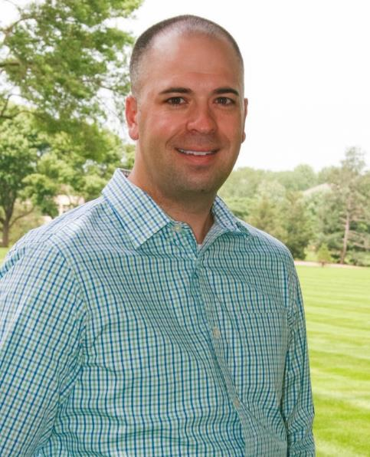
A little bit about me…
Background:
Grew up in Montana
Went to Montana State University in Bozeman
Studied agriculture education
Taught high school in Sheridan, Montana (agriculture)
Taught English in Korea for a year
Earned MBA and masters in agriculture economics at Purdue University and Indiana University
Worked for the National FFA Foundation in Indianapolis
Current:
Executive Director of the Iowa Agriculture Literacy Foundation
Past-President of the National Agriculture in the Classroom Organization
Parliamentary Credentials:
Registered Parliamentarian, National Association of Parliamentarians
Eastern Iowa Parliamentarians, vice president
National FFA Parliamentary Procedure LDE organizing committee and judge
National FFA Alumni Association, parliamentarian 2016
Competed in the National FFA Parliamentary Procedure CDE as a student (team gold)
Coached two National FFA Parliamentary Procedure CDE teams as a teacher
Will Fett
wfett@iowaagliteracy.org
Notes:
How many have studied parliamentary procedure?
How many have competed in parliamentary procedure?
How many is this the first time?

Slide 3

A little bit about me…
Background:
Originally from Mississippi and returned there after living in Alabama, South Carolina, and Georgia.
Bachelor’s Degree in Political Science from the University of Mississippi.
Master’s Degree in Political Science from Auburn University at Montgomery.
Previously worked in government, then worked in the private sector in tech education regulatory compliance, then returned to government.
Current:
Government administrator for the State of Mississippi.
Parliamentary Credentials:
Professional Registered Parliamentarian, National Association of Parliamentarians
Chairman, Membership Committee, American Institute of Parliamentarians
President, Mississippi Association of Parliamentarians
Parliamentarian, Electronic Association of Parliamentarians
Secretary and Board Member, Young Professionals in Parliamentary Procedure
National FFA Parliamentary Procedure LDE organizing committee
Former Chairman, Youth Committee, National Association of Parliamentarians
Competed in Parli Pro as part of the Technology Student Association; Nationally Ranked Teams, First Place National Individual Award.
Brandon Walters
brandonhwalters@gmail.com
Notes:
How many have studied parliamentary procedure?
How many have competed in parliamentary procedure?
How many is this the first time?

Slide 4
Agenda
Reference
Process
How-To Example
Challenge

Slide 5
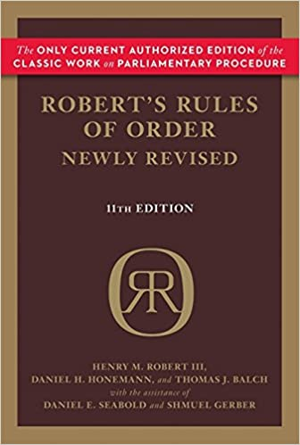
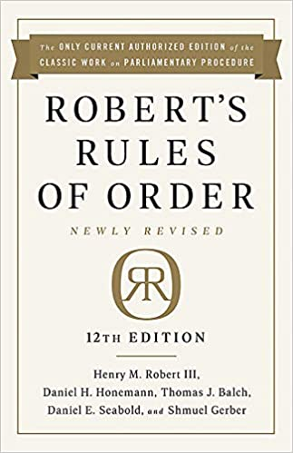
Reference - Robert’s Rules of Order
12th Edition was released in September 2020
Assuming not everyone has had a chance to obtain a copy
For the purpose of this activity we will use the 11th Edition which has been in print since 2011
Notes:
2017 research scenarios

Slide 6
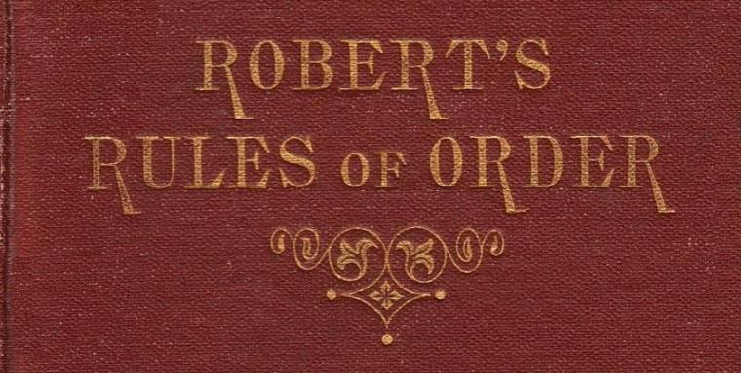
Critical Thinking Process
Make this book your best friend!
Pick out keywords from the scenario.
Look up keywords in the index.
Flip to the main section of pages and read the passages.
Try to apply RONR to the scenario.
Notes:
2017 research scenarios

Slide 7
How-To Example
At the November regular meeting of the Blooming Hills FFA chapter, there were questions about the chapter’s quorum, or the minimum number of members who must be present to transact business. Which of the following is NOT true about a quorum?
  Since the chapter has a roll of members and if the quorum is not stated in the bylaws, the quorum is a majority of all the members.
  In the absence of a quorum, any business transacted, except for the motions to fix the time to which to adjourn, adjourn, recess, or take measures to obtain quorum, is null and void.
  A quorum may be set aside by a majority of the members present.
  If the chair notices the absence of a quorum, he or she must declare the fact before taking a vote or stating a question on a new motion.
Notes:
Groups write a song to help themselves remember this order
10 minutes to create
2 minutes per group to present

Slide 8
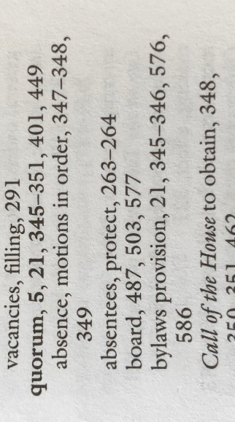
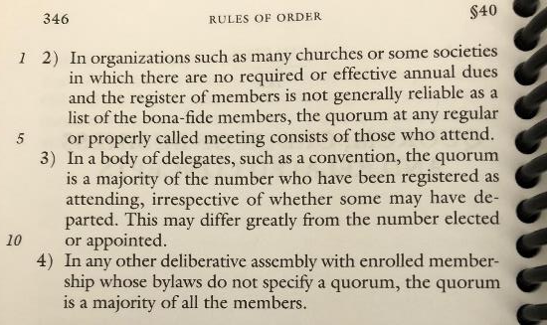
How-To Example (continued)
At the November regular meeting of the Blooming Hills FFA chapter, there were questions about the chapter’s quorum, or the minimum number of members who must be present to transact business. Which of the following is NOT true about a quorum?
  Since the chapter has a roll of members and if the quorum is not stated in the bylaws, the quorum is a majority of all the members.
  In the absence of a quorum, any business transacted, except for the motions to fix the time to which to adjourn, adjourn, recess, or take measures to obtain quorum, is null and void.
  A quorum may be set aside by a majority of the members present.
  If the chair notices the absence of a quorum, he or she must declare the fact before taking a vote or stating a question on a new motion.
RONR 11th Edition, p. 346, lines 11-13
#1 is True
Notes:
Groups write a song to help themselves remember this order
10 minutes to create
2 minutes per group to present

Slide 9
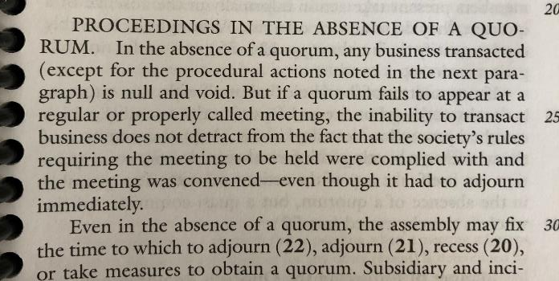
How-To Example (continued)
At the November regular meeting of the Blooming Hills FFA chapter, there were questions about the chapter’s quorum, or the minimum number of members who must be present to transact business. Which of the following is NOT true about a quorum?
  Since the chapter has a roll of members and if the quorum is not stated in the bylaws, the quorum is a majority of all the members.
  In the absence of a quorum, any business transacted, except for the motions to fix the time to which to adjourn, adjourn, recess, or take measures to obtain quorum, is null and void.
  A quorum may be set aside by a majority of the members present.
  If the chair notices the absence of a quorum, he or she must declare the fact before taking a vote or stating a question on a new motion.
RONR 11th Edition, p. 347, lines 21-32
#2 is True
Notes:
Groups write a song to help themselves remember this order
10 minutes to create
2 minutes per group to present

Slide 10
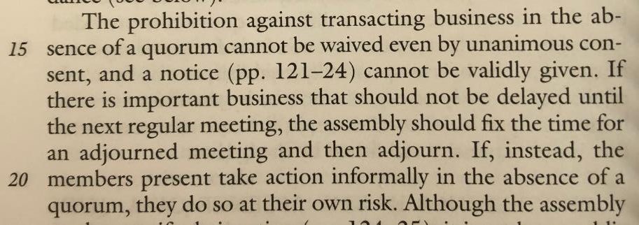
How-To Example (continued)
At the November regular meeting of the Blooming Hills FFA chapter, there were questions about the chapter’s quorum, or the minimum number of members who must be present to transact business. Which of the following is NOT true about a quorum?
  Since the chapter has a roll of members and if the quorum is not stated in the bylaws, the quorum is a majority of all the members.
  In the absence of a quorum, any business transacted, except for the motions to fix the time to which to adjourn, adjourn, recess, or take measures to obtain quorum, is null and void.
  A quorum may be set aside by a majority of the members present.
  If the chair notices the absence of a quorum, he or she must declare the fact before taking a vote or stating a question on a new motion.
RONR 11th Edition, p. 348, lines 14-16
#3 is False
Notes:
Groups write a song to help themselves remember this order
10 minutes to create
2 minutes per group to present

Slide 11
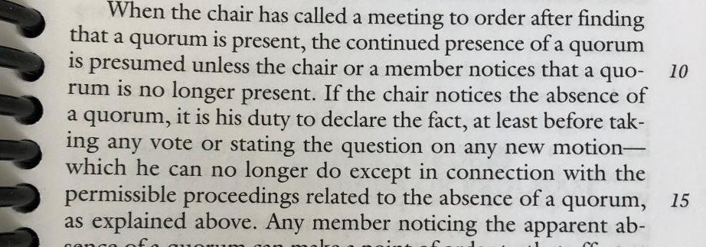
How-To Example (continued)
At the November regular meeting of the Blooming Hills FFA chapter, there were questions about the chapter’s quorum, or the minimum number of members who must be present to transact business. Which of the following is NOT true about a quorum?
  Since the chapter has a roll of members and if the quorum is not stated in the bylaws, the quorum is a majority of all the members.
  In the absence of a quorum, any business transacted, except for the motions to fix the time to which to adjourn, adjourn, recess, or take measures to obtain quorum, is null and void.
  A quorum may be set aside by a majority of the members present.
  If the chair notices the absence of a quorum, he or she must declare the fact before taking a vote or stating a question on a new motion.
RONR 11th Edition, p. 349, lines 11-13
#4 is True
Notes:
Groups write a song to help themselves remember this order
10 minutes to create
2 minutes per group to present

Slide 12
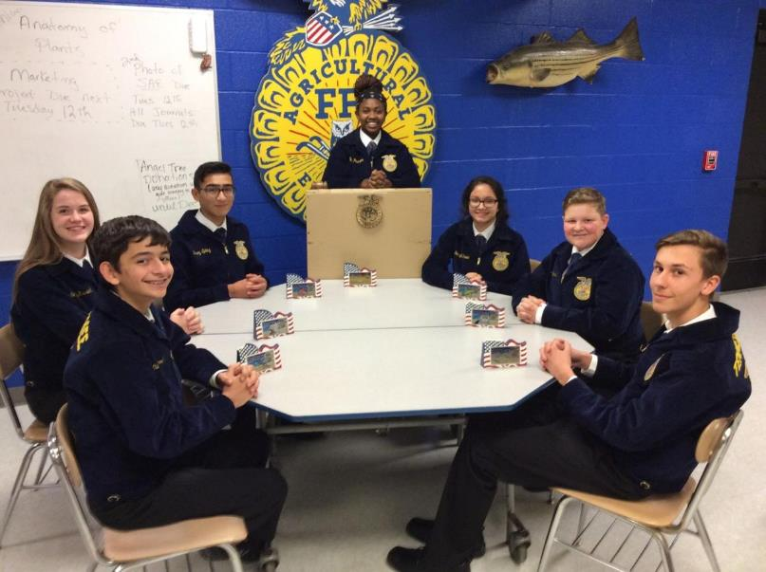
challenge
You will be presented with five scenarios.
Each scenario will have five related questions.
Use RONR 11th Edition as your reference.
Apply critical thinking to each parliamentary situation and select the best response.
Good luck!

