Slide 1
Floriculture Equipment and
Supply Identification List
Revised 2025
Lesson Objectives:
1. Identify equipment used in the retail floriculture industry.
2. Categorize floral crops commonly used in floral design.
Footer description area.

Slide 2
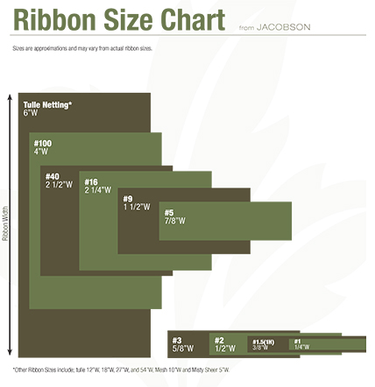
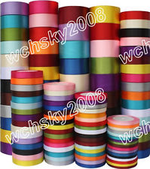
Ribbon
Ribbon can be satin, sheer and/or wired.
Used for decoration and for holding together arrangements
Commonly used sizes are #3, #9, #40 and #100.
http://www.jacobsonfloral.com/public/_assets/media/2015/JFS.RibbonSizeChart2015_web.jpg
http://thumbs.ebaystatic.com/images/m/mRuN7402S7nxftiFBEXJjvA/s-l225.jpg

Slide 3
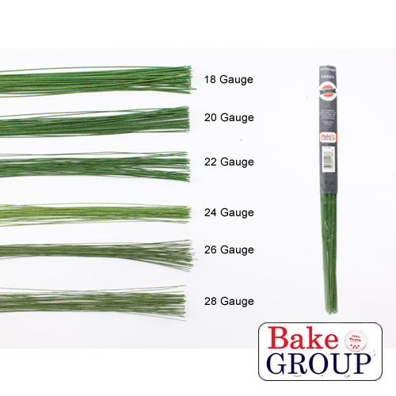
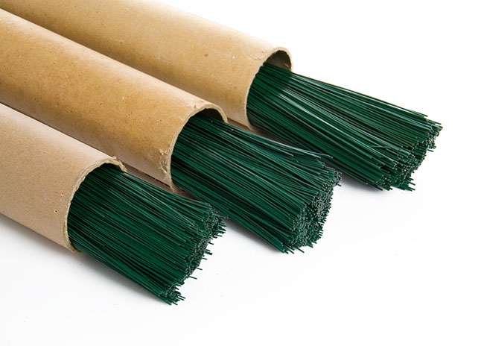
Floral Wire
Thin, long wire used to strengthen and combine stem.
Sold based on diameter size or gauge.
18- and 28-gauge are commonly used
The lower the number the thicker the wire. The higher the number the thinner the wire is
http://cdn1.bigcommerce.com/server5200/4m7zoyl/products/469/images/818/Green_Floral_Wires__59867.1375234001.1280.1280.jpg?c=2
http://www.koch.com.au/blog/wp-content/uploads/2013/04/florist_wire.jpg

Slide 4
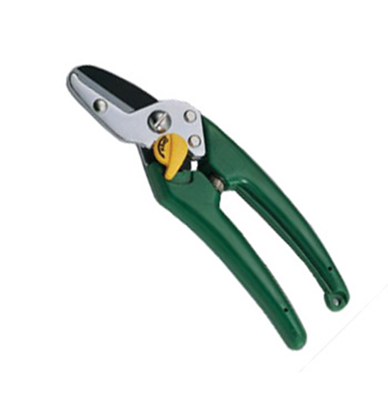
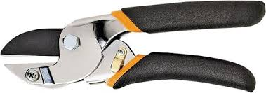
Anvil-and-blade pruner
Anvil cutting tools have one blade that closes onto a cutting block. They are ideal for thicker stems and woody pruning. An anvil cut is more powerful than a bypass cut with minimal effort required.

Slide 5
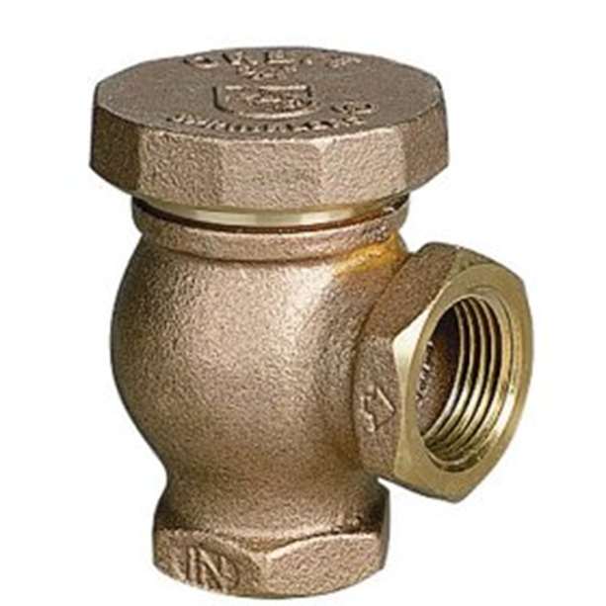
Backflow preventer
Is a backflow prevention device used in plumbing to prevent backflow of non-potable liquids into the drinking water system. It is usually constructed of brass and resembles a 90-degree elbow with a hood on its top to allow air to enter the water system if a siphon attempts to form.

Slide 6
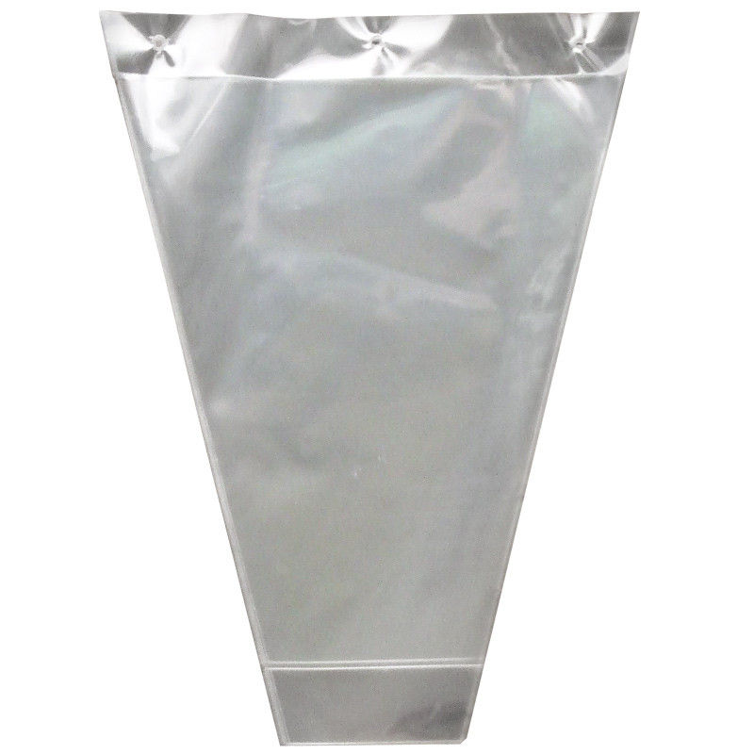
Bouquet Sleeve
Protective cover for flowers or foliage
Made of clear or colored cellophane
http://www.flowerwrappingsleeves.com/photo/pl5938526-transparent_floral_sleeves_plastic_flower_wrapping_sleeve_with_bopp_cpp_pp_hdpe.jpg

Slide 7
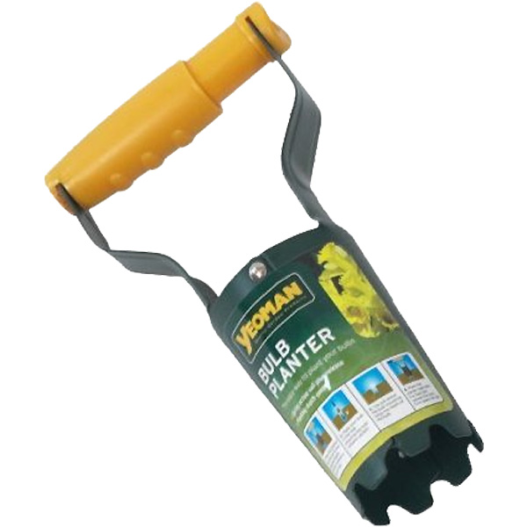
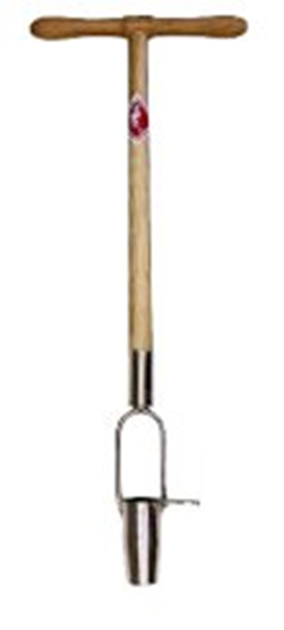
Bulb planter
A bulb planter is a horticultural tool designed to make planting bulbs easier and more efficient, particularly when planting large quantities, by creating precise holes and minimizing soil disturbance

Slide 8
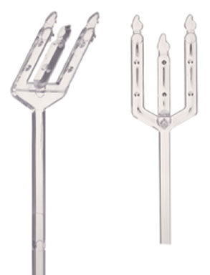
Cardette
Used to hold enclosure cards in floral arrangements
Vary in size, shape and color
http://www.floradec.com/prodimg/SYN-47%2048.jpg

Slide 9
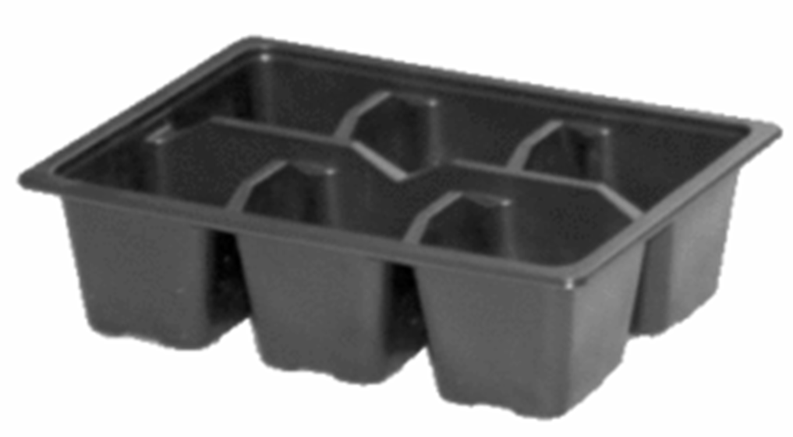
Cell pack containers
Are plastic trays with individual compartments used for starting seeds and seedlings, offering a convenient and efficient way to grow multiple plants in a compact space before transplanting

Slide 10
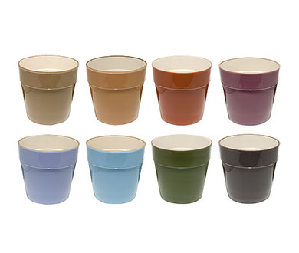
Ceramic Container
Ceramic containers are used to hold mixed flower arrangements.
Containers can be simple or ornate, big or small, and in various colors and shapes.
https://posts.mode.com/wp-content/uploads/2008/06/glazedceramic.jpg

Slide 11
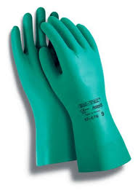
Chemical resistant gloves
Protection against harsh chemicals, ensuring your safety in various industries.

Slide 12
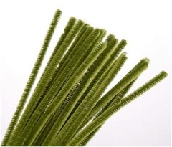
Chenille Stem
Also known as a pipe cleaner
Comes in assorted colors and lengths
Used to secure ribbon and other decorations in floral work where the chenille stem can be hidden in the arrangement or wreath based on its color
https://o.quizlet.com/i/z5pbJsAoFMhB3ms1nI0ECw_m.jpg

Slide 13
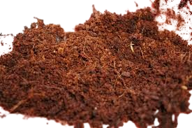
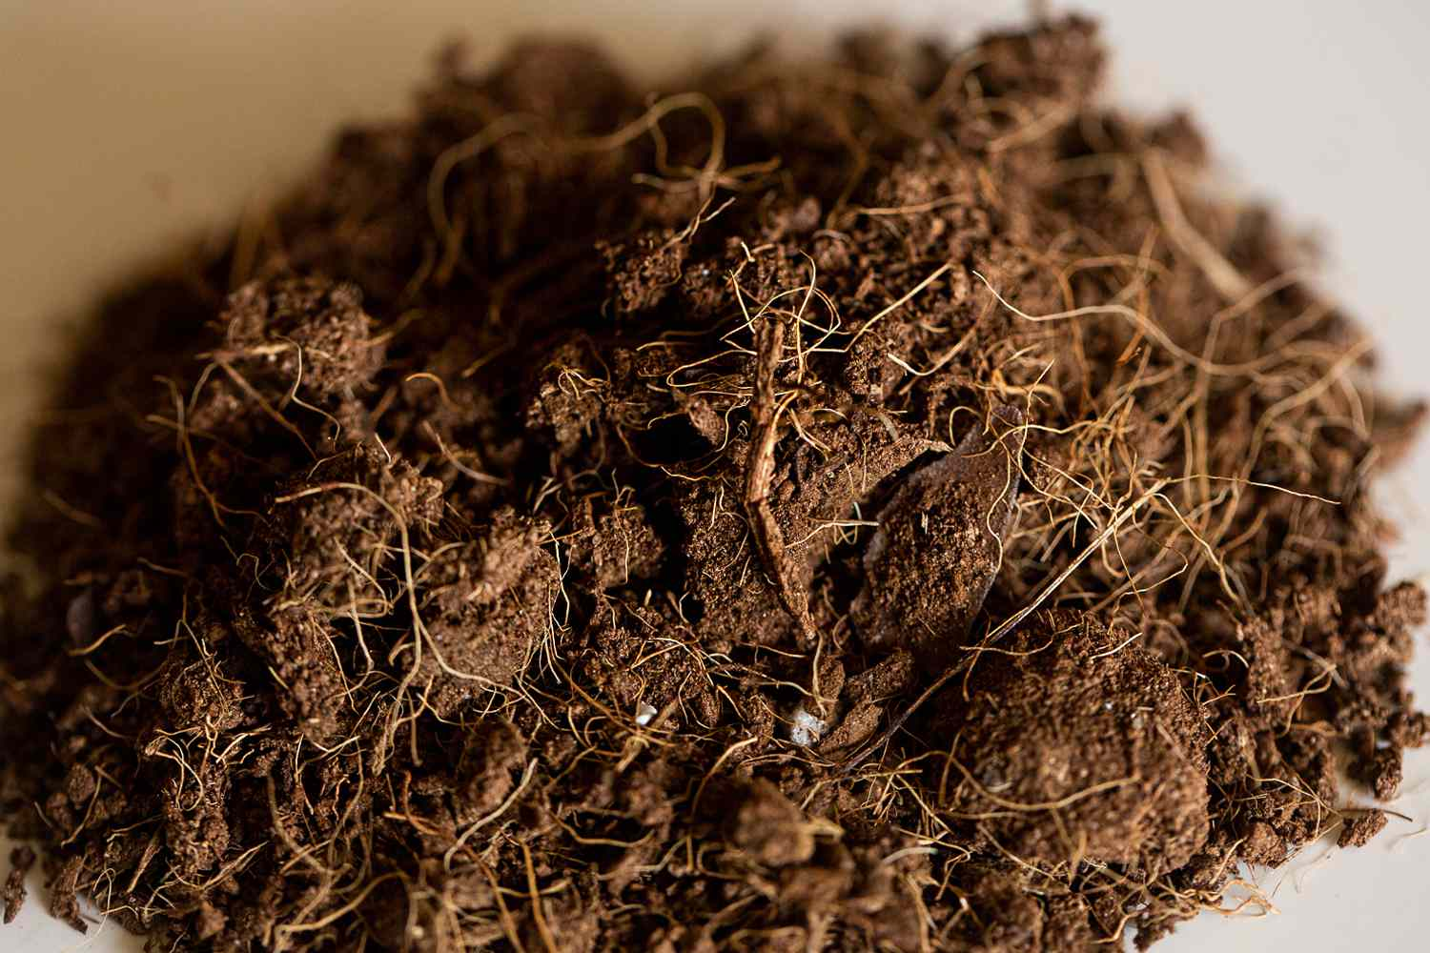
Coconut coir
Coconut coir, a sustainable and renewable alternative to peat moss, is increasingly popular in horticulture for its excellent water retention, aeration, and ability to create a healthy growing medium. It's used in various applications, including seed starting, potting mixes, hydroponics, and as a soil amendment.

Slide 14
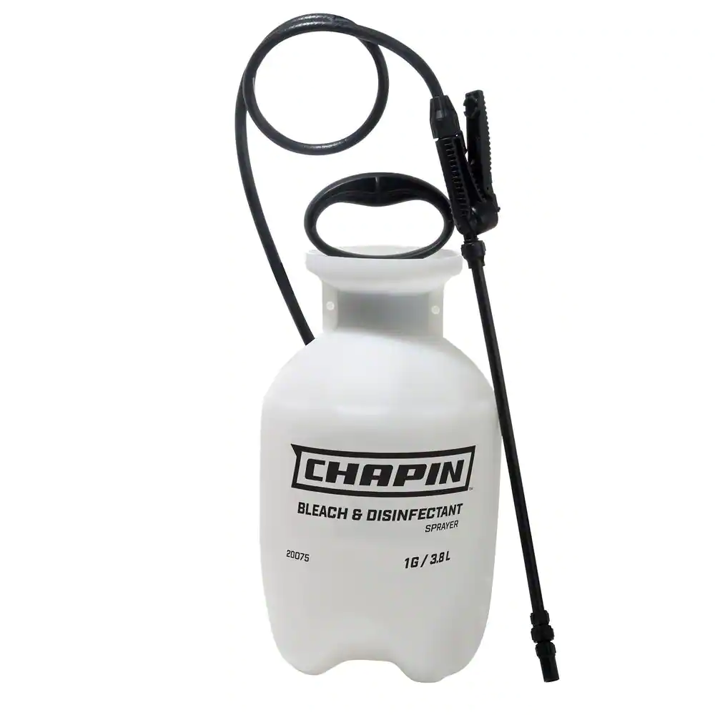
Compressed air sprayer
They provide a fast and effective method of spot treatments for weed, insect, disease and fertilizer applications. These sprayers allow farmers and ranchers to treat small problem areas where treating an entire area may not be cost effective.

Slide 15
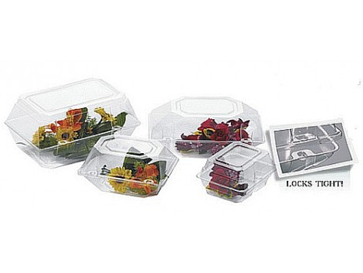
Corsage Box
Protects corsage after purchase and during travel.
Varies in size
http://www.floralsupply.com/media/catalog/product/cache/1/image/470x353/9df78eab33525d08d6e5fb8d27136e95/c/o/corsage_2.jpg

Slide 16
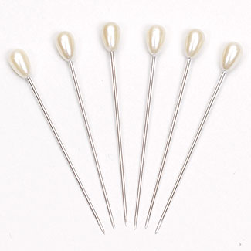
Corsage Pins
Used to fasten corsage
Top is decorative, usually pearled or jeweled
Decorative end is typically larger and more ornate than a boutonniere pin
http://www.fss.com/images/products/K2.jpg

Slide 17
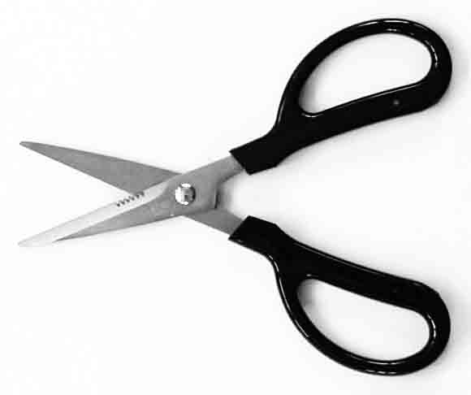
Corsage Snips
Smaller blades than typical shears
Used to make cuts in smaller pieces or in tight areas
https://sproulefloristsupply.ca/resources/products/gallery/p_NDY2/main/3213ap15.jpg

Slide 18
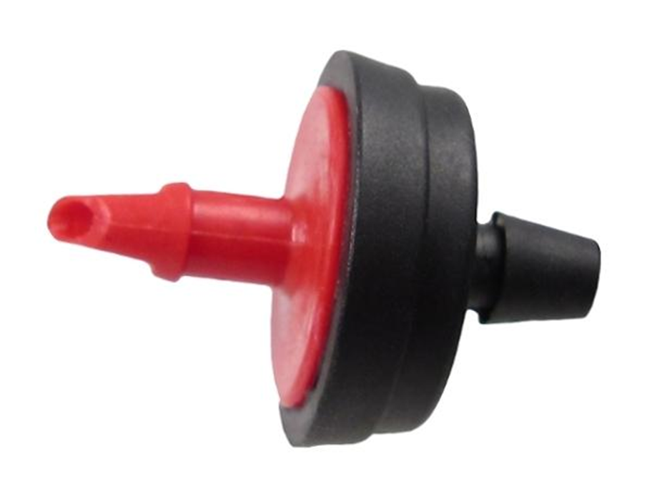
Drip emitter, irrigation
Drip emitters, also known as drippers, are designed to slowly release water directly to the soil near plant roots, minimizing water loss through evaporation and runoff.

Slide 19
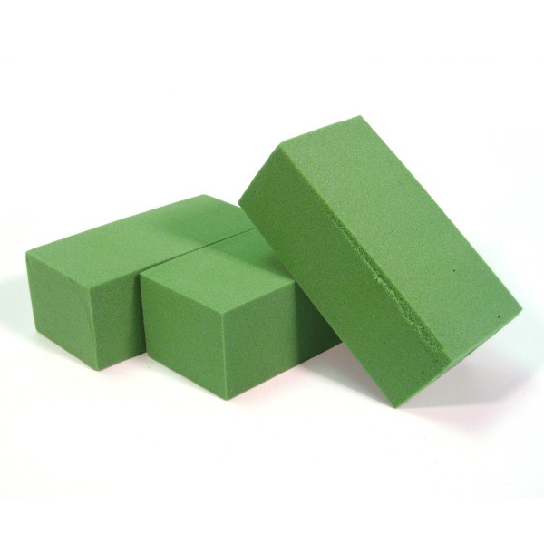
Dry Foam
Used to anchor flowers and foliage in an arrangement
Unlike floral or oasis foam, it doesn’t need to be soaked in water prior to use.
Because this foam doesn’t hold water, only use with silk and artificial plants.
http://www.theuniversityflorist.com/supplies/dry-foam

Slide 20
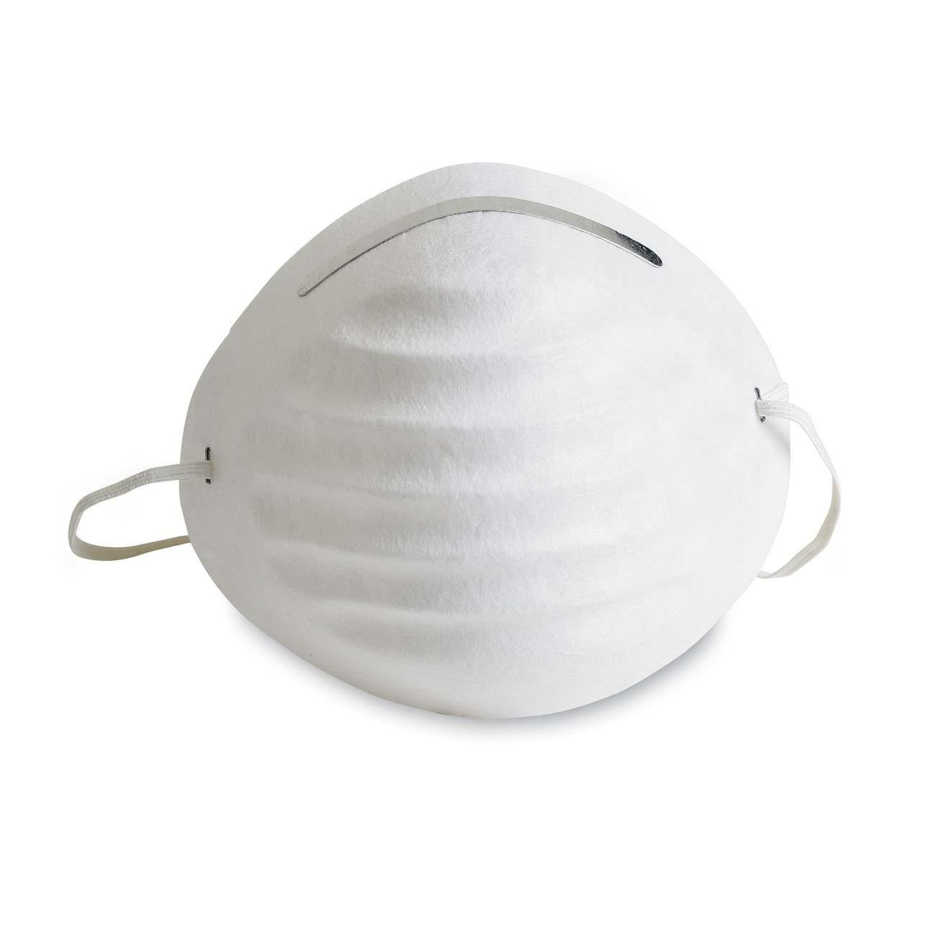
Dust mask
Dust masks are disposable, lightweight masks that cover the nose and mouth, filtering out dust and other airborne particles.

Slide 21
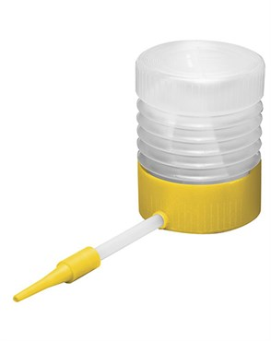
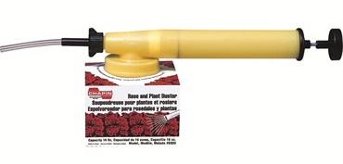
Duster
Is a quick, efficient way to apply pesticide and fungicide powders in your garden or on potted plants

Slide 22
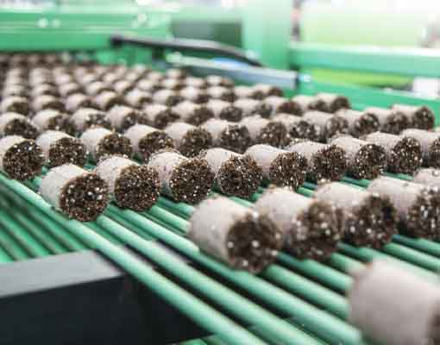
Ellepot propagation cubes
Ellepot propagation cubes, a sustainable alternative to plastic pots, are used in horticulture for their ability to promote healthy root development, facilitate easy transplanting, and reduce waste, making them suitable for various crops like vegetables, fruits, and nursery stock.

Slide 23


Enclosure Card
Used to deliver a message on a floral arrangement
Printed on durable cardstock and can be decorated for any holiday or special occasion
https://www.nashvillewraps.com/gift-cards-tags/florist-cards/p-122/ac5958

Slide 24
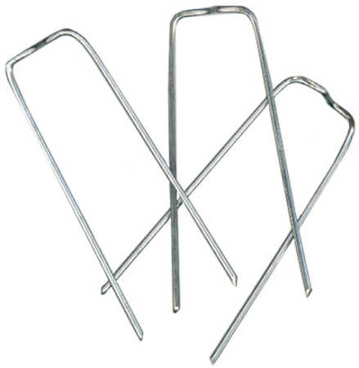
Fern Greening Pins
Greening pins are used for securing moss or foliage to floral foam.
http://factorydirectcraft.com/pimages/20060412092738-741540/silver_metal_greening_pins.jpg

Slide 25
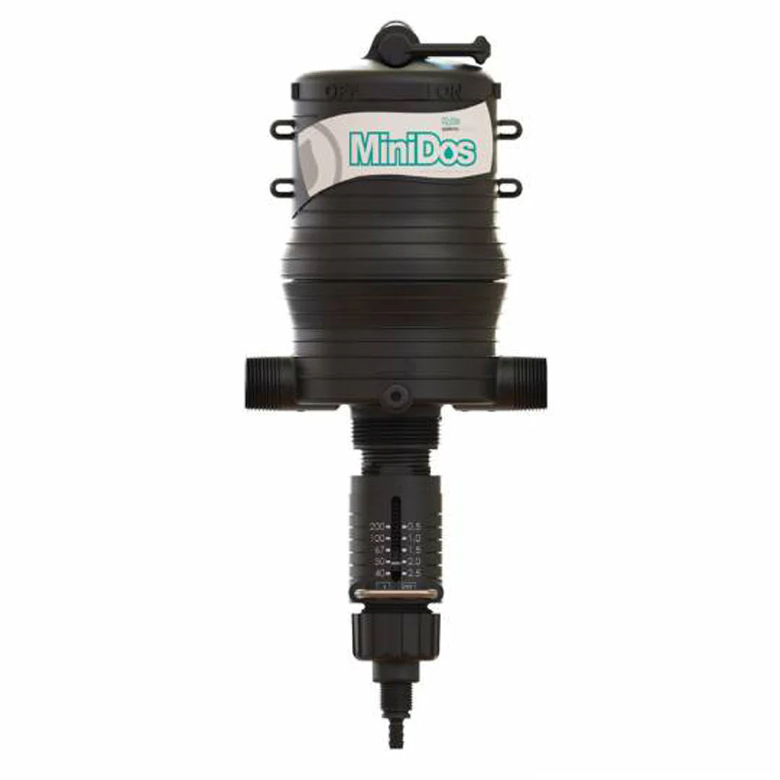
Fertilizer injectors
Fertilizer injectors are used by most growers to apply water-soluble fertilizers to plants. These devices "inject" a small quantity of concentrated fertilizer solution (stock solution) into the irrigation line so that the water leaving the hose (dilute solution) supplies the proper concentration of fertilizer.

Slide 26
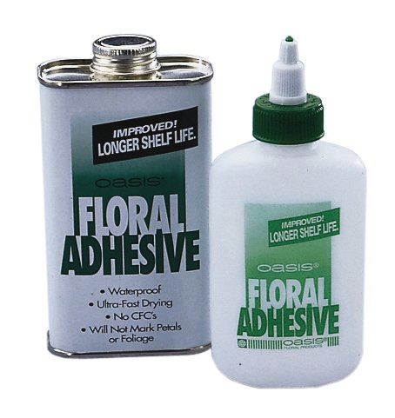
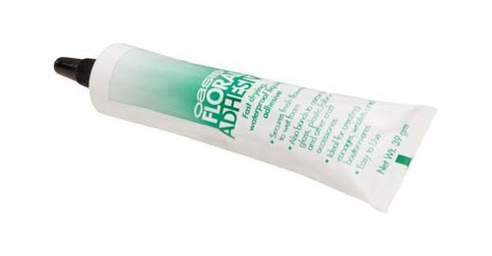
Floral Adhesive
Also known as cold glue
Floral adhesive allows you to glue fresh flowers directly to ribbon or tulle as well as foliage and garland.
http://nebula.wsimg.com/obj/RTRENURGREQzQjM3RUJEMDU2MkQ6MjdhNTY1MzcxMjVhYjFjZjg0YjkwMTcxZmRjYzE3NjE6Ojo6OjA=

Slide 27
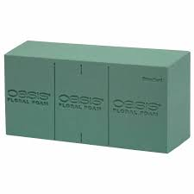
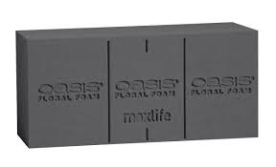
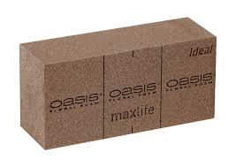
Floral foam
Floral foam stabilizes flowers. Floral foam also holds water (adding flower food is recommended), which increases fresh flower longevity.

Slide 28
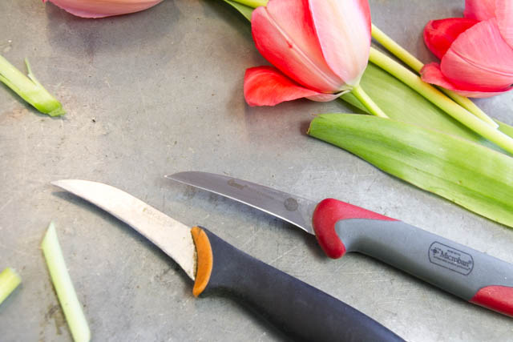
Floral Knife
Most commonly used tool by florists
Looks similar to a kitchen paring knife
Used to cut flowers before they are inserted into a design
http://livingfresh.ca/blog/wp-content/uploads/2014/03/MG_3517.jpg

Slide 29
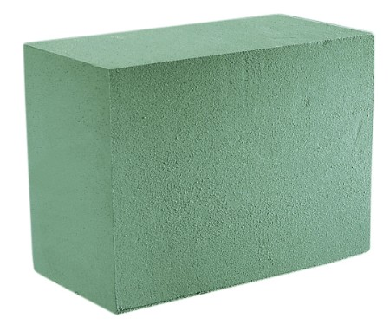
Floral Foam
Used to anchor flowers and foliage in an arrangement
Unlike dry foam, this foam needs to be soaked in water prior to use.
Use with fresh-cut plants
http://www.marshallfloralproducts.com/assets/images/designerblocks.jpg

Slide 30
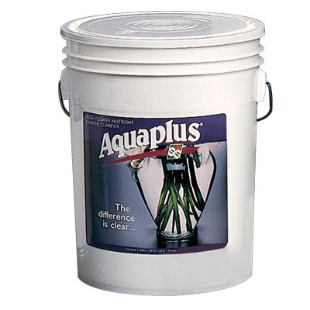
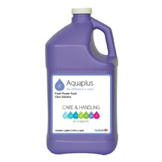
Floral Preservative
Preservatives help extend the life of fresh cut flowers in floral arrangements.
Can be sprayed in a liquid form or sprinkled into water as a powder form
http://www.swflorist.com/categories/floral-preservative.html

Slide 31
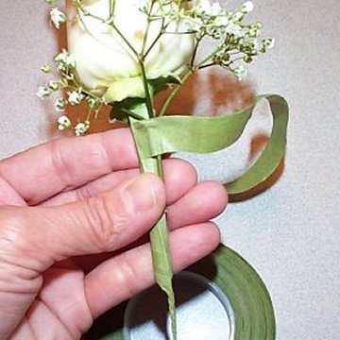
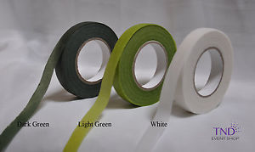
Floral Stem Tape
Paraffin-coated stretchy paper
Used mechanically to help combine wires and multiple stems in a corsages, boutonnieres and hand-held bouquets
Comes in different shades of green and white
http://www.wedding-flowers-and-reception-ideas.com/images/florist-tape-02.jpg
http://i.ebayimg.com/images/g/1kwAAMXQydtTN2zi/s-l300.jpg

Slide 32
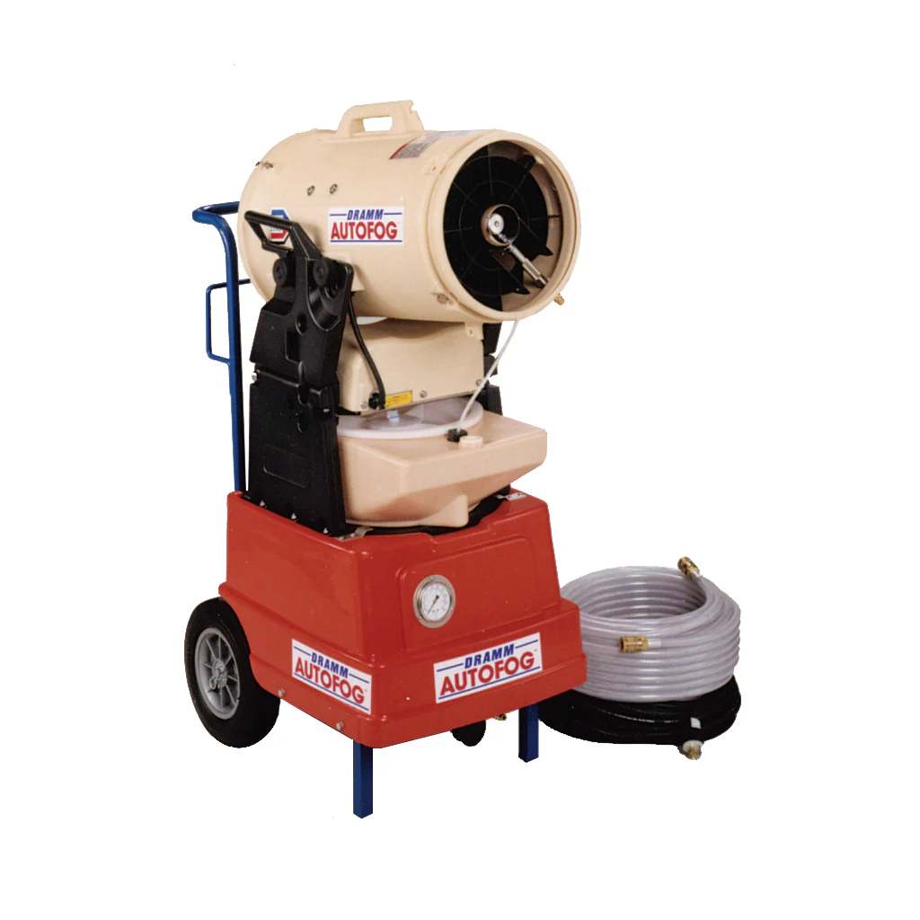
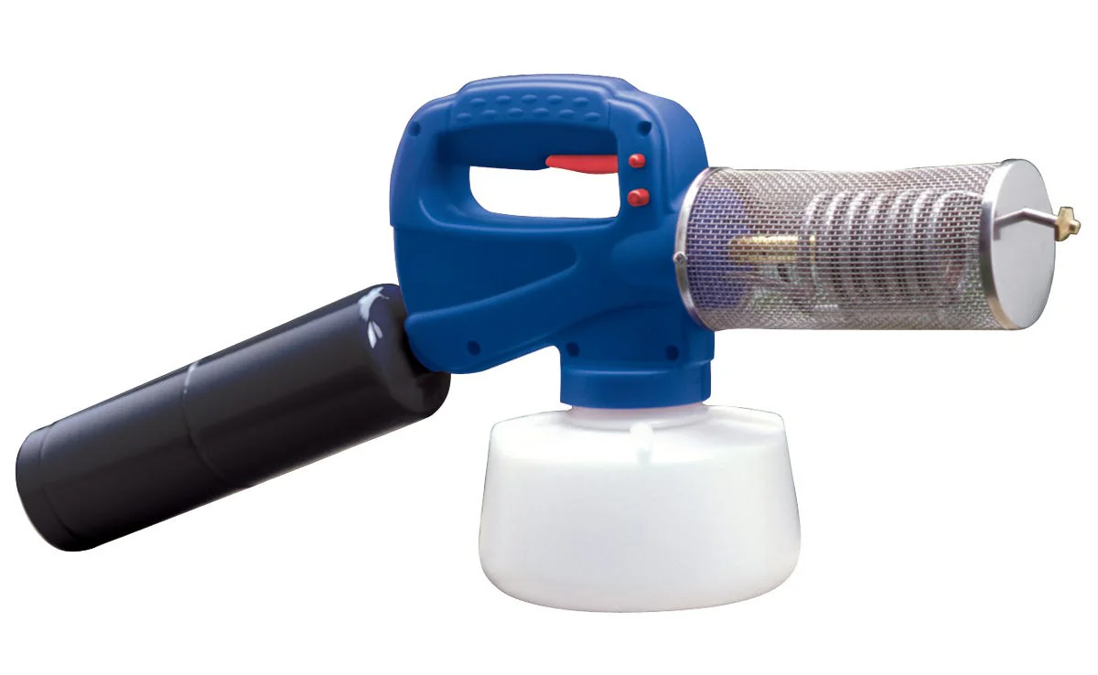
Fogger
Insect foggers are a method of pest control that uses a fine spray of insecticide to kill or repel insects.
https://www.greenhousemegastore.com/products/large-autofog-chemical-applicator
https://growershouse.com/products/propane-fogger

Slide 33
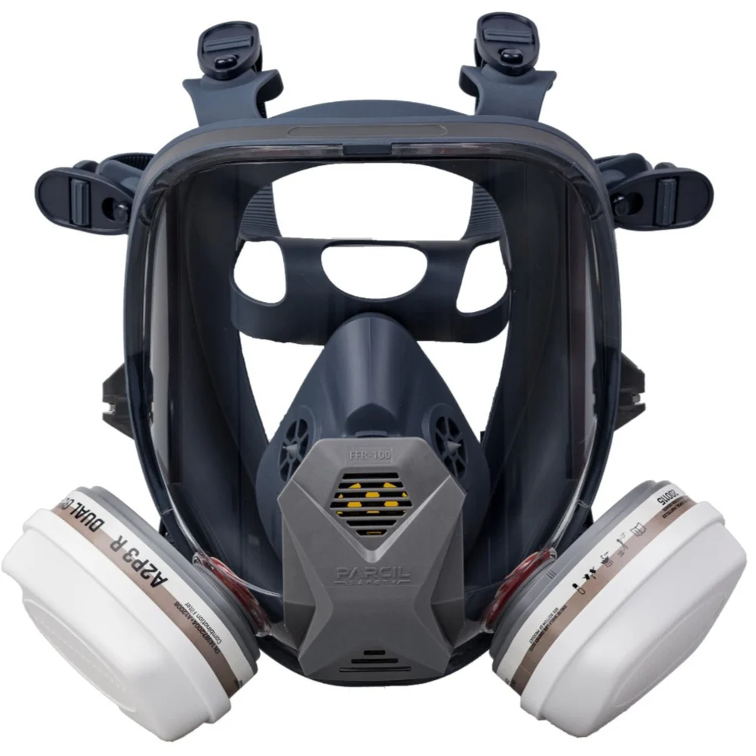
Gas mask
Gas masks provide respiratory protection against pesticides and other toxic airborne materials.

Slide 34
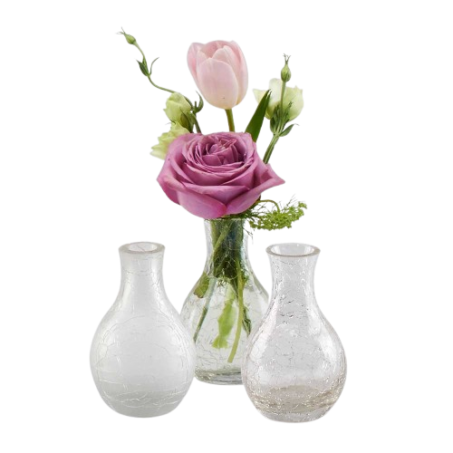
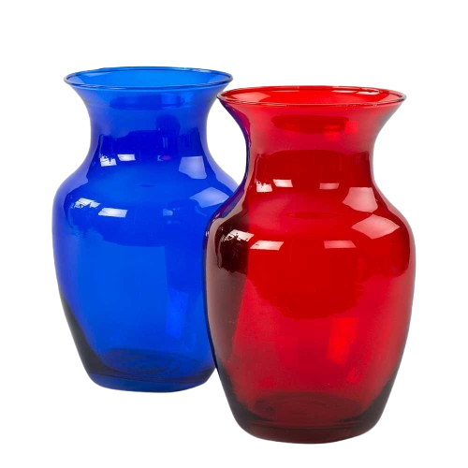
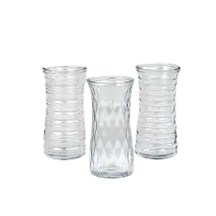
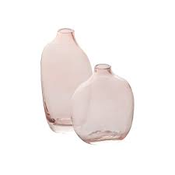
Glass Vase
Glass vases are used to hold single flower or mixed flower arrangements, depending on the size.
Vases can be simple or ornate, big or small, and in various colors and shapes.

Slide 35
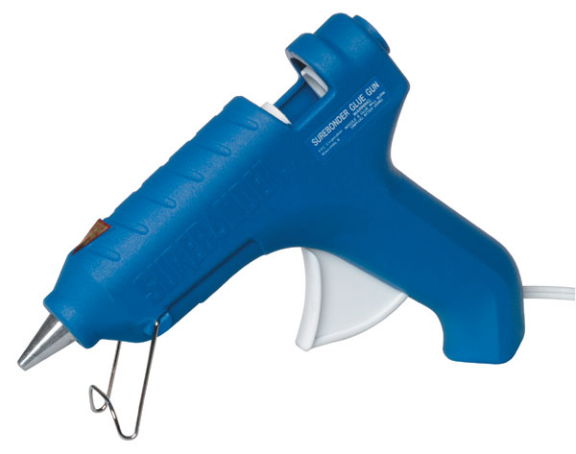
Glue Gun
Used to administer hot glue when working with flower arrangements
When plugged in, the machine heats up the glue sticks and allows it to be applied precisely as a liquid.
http://d28xhcgddm1buq.cloudfront.net/product-images/bevfabriccrafts_2269_775864018_260.jpg

Slide 36
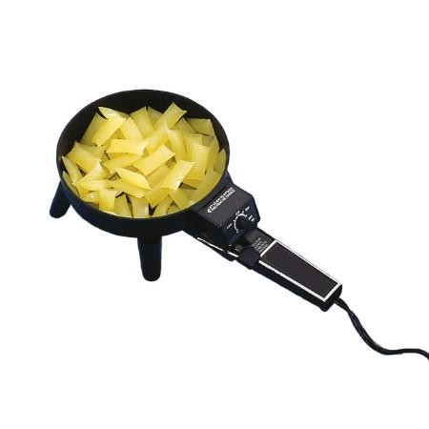
Glue Pan
Melts glue in the pan
Stems and foam can be dipped directly into the glue pan.
http://www.marshallfloralproducts.com/thumbnail.asp?file=assets/images/hotmeltgluepan1.jpg&maxx=500&maxy=0

Slide 37
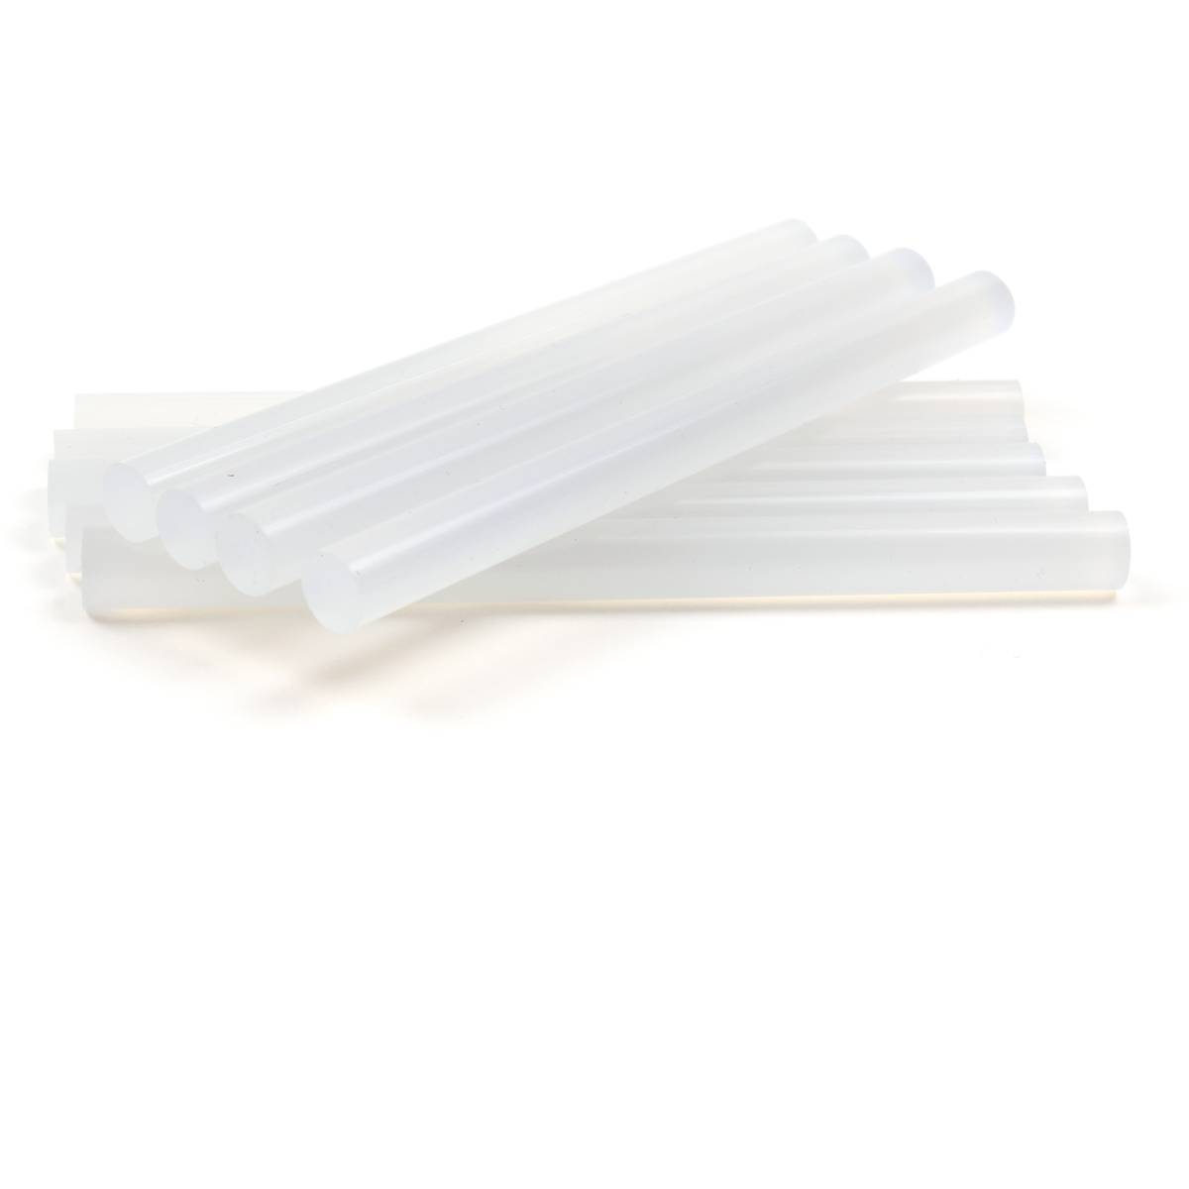
Glue Stick
Starts as solid cylinder sticks of glue
Once inserted into a glue gun, the sticks are heated up and turned into a hot, liquid glue.
http://www.hobbycraft.co.uk/supplyimages/567347_1000_1_800.jpg

Slide 38


Granular fertilizer
Granulated fertilizers can improve soil health by gradually replenishing nutrient levels and promoting microbial activity.

Slide 39



Greenhouse thermostat
A greenhouse thermostat provides the desired temperature so your system knows whether to activate the heater, air conditioner or vents

Slide 40


Hanging basket
A hanging basket is a suspended container used for growing decorative plants.

Slide 41


Hearing protection
To reduce the level of noise to prevent hearing loss.

Slide 42


Hook-and-blade pruners (bypass pruners)
Bypass pruners are suitable for pruning or cutting live branches and stems. Its upper blade is sharpened and lower blade (which we also called hook) is unsharpened and it is going to go very easily through live stems and it is not going to do any damage to the plant.

Slide 43




Hose punch
In horticulture, a hose punch, is used to create precise holes in drip irrigation tubing, allowing for the easy installation of emitters or barbed fittings for water delivery to plants.

Slide 44


Hose repair coupling
Used to reconnect or repair damaged sections of hoses, allowing for quick and easy fixes instead of complete hose replacement
https://www.agriculturesolutions.com/catalogsearch/result/?q=hose+repair

Slide 45



Hose-end repair fitting
Hose-end repair fittings, or hose menders, are horticultural tools used to replace damaged or worn-out ends of garden hoses, allowing for continued use instead of replacement. They come in male and female version
https://www.agriculturesolutions.com/catalogsearch/result/?q=hose+repair

Slide 46

Hose-end sprayer
A hose-end sprayer is a horticultural tool designed for applying liquid products like fertilizers, pesticides, and herbicides to large areas, by mixing the concentrate with water using the water pressure from a garden hose, eliminating the need for pre-mixing

Slide 47

Hose-end washer
The purpose of a hose-end washer in horticulture is to create a watertight seal between the hose and a fitting, preventing leaks and ensuring proper water flow.

Slide 48


Impulse sprinkler
The purpose of an impulse sprinkler, is to efficiently and effectively irrigate (water) large areas, such as lawns, gardens, and agricultural fields, by mimicking natural rainfall with a rotating, circular spray pattern

Slide 49


Drip Irrigation tape
Drip tape ensures water is delivered directly to the roots of the plants, reducing water waste and increasing plant growth
https://www.harrisseeds.com/products/40192-chapin-drip-tape-3000-roll

Slide 50



Irrigation timer
The purpose of an irrigation timer, is to automate and control the watering process, enabling consistent and efficient irrigation, saving time, water, and potentially money, while promoting healthy plant growth

Slide 51

Mist nozzle (mist bed)
Mist nozzles in mist beds (or mist propagation systems) are used to create a controlled, humid environment for rooting cuttings, promoting plant growth and preventing wilting by maintaining a film of water on leaves and preventing excessive moisture loss.

Slide 52


Nosegay Holder
Ornate holders for tuzzie-muzzies or hand-held bouquets
Made popular in European floral design
Can be metal or plastic
https://o.quizlet.com/DR757YvmlND.NssRd341Og_m.png
https://img1.etsystatic.com/129/0/11669397/il_214x170.1049825417_ps1x.jpg

Slide 53

Nursery container
Available in various diameters and volumes and have drainage holes for optimal plant growth.
https://www.greenhousemegastore.com/products/injection-molded-nursery-containers

Slide 54

Oscillating sprinkler
Is designed to efficiently water lawns and gardens by spraying water in a back-and-forth, fan-shaped pattern, covering rectangular areas evenly
https://www.greenhousemegastore.com/products/gardener-select-compact-oscillating-sprinkler

Slide 55

Peat moss
Peatmoss serves as a valuable soil amendment, primarily used to improve soil structure, enhance water retention, and manage soil pH, making it a key component in potting mixes and seed-starting mediums.

Slide 56


Peat pots
Peat pots are biodegradable planting containers, typically made from peat moss, used for starting seeds and seedlings, and then planted directly into the ground, where they decompose and become part of the soil, minimizing transplant shock.

Slide 57


Pest strips
Serve as a method for monitoring and/or reducing pest populations by attracting and trapping insects,
https://www.greenhousemegastore.com/products/yellow-sticky-tape

Slide 58




pH testing meter
pH meters help determine whether the soil is acidic, neutral, or alkaline, allowing farmers and agronomists to adjust soil amendments and fertilization strategies to create an optimal pH environment for the crops being grown.
https://www.greenhousemegastore.com/search?q=pH+testing

Slide 59

Polyethylene film
Polyethylene film serves as a cost-effective and versatile covering, primarily used for creating a controlled environment for plant growth by regulating temperature, light transmission, and humidity, while also offering protection from weather and pests.
https://www.greenhousemegastore.com/products/thermal-ac-greenhouse-film-6-mil

Slide 60

Polyethylene pipe
Are primarily used for irrigation systems, acting as flexible, durable, and lightweight pipes for delivering water to plants.
https://www.homedepot.com/p/Advanced-Drainage-Systems-1-in-x-100-ft-IPS-200-PSI-NSF-Poly-Pipe

Slide 61


Pot Covers
Polyfoil material used to cover containers
Comes in a variety of colors
https://o.quizlet.com/1CaGCDjArxivuVYHkAw4Cw_m.jpg
https://quizlet.com/113856139/floriculture-cde-tool-id-flashcards-flash-cards/

Slide 62

Propagation mat
Provide consistent, gentle warmth to the soil, promoting faster germination and stronger root development in seeds and cuttings

Slide 63


Propagation trays
Are shallow and used to start seeds or propagate plants from cuttings.

Slide 64

PVC (polyvinylchloride) pipe
PVC is a safe material for transporting water for irrigation and hydroponic systems, ensuring water quality remains unaffected. PVC pipes are known for their durability, resistance to weathering, and UV degradation, making them suitable for outdoor gardening applications.

Slide 65


PVC pipe cutter
Is designed to provide clean, precise cuts in PVC and other plastic pipes, offering a more efficient and easier alternative to using a hacksaw or other general-purpose cutting tools.

Slide 66

Resin-coated fertilizer
Resin-coated fertilizer, often referred to as controlled-release fertilizer (CRF), is used in greenhouses to provide a steady and controlled nutrient supply to plants.
https://www.pthorticulture.com/en-us/training-center/pros-and-cons-of-using-controlled-release-fertilizers-in-the-greenhouse

Slide 67


Respirator
Respirators protect workers against insufficient oxygen environments, harmful dusts, fogs, smokes, mists, gases, vapors, and sprays. These hazards may cause cancer, lung impairment, diseases, or death.
https://www.osha.gov/respiratory-protection

Slide 68

Ribbon Shears
Around 8.5 inches in length
Used specifically for cutting ribbon and nothing else
Sharp blade to cut ribbon without causing the ribbon to unravel or fringe

Slide 69

Rice hulls
Rice hulls enhance soil structure by improving aeration and drainage, preventing compaction and waterlogging. They retain moisture, making them beneficial during dry periods. They can be mixed into potting soil or used as a topdressing, improving soil quality. They can also be used as a mulch to suppress weed growth

Slide 70

Rockwool propagation cubes
Used for seed germination, seedling propagation, and cloning, providing a sterile, moisture-retentive, and well-aerated medium for root development.

Slide 71


Rose and Stem Flower Stripper
Strips the leaves and thorns of roses and other flowers
Can be a hand held machine, pad or glove
http://www.fss.com/images/products/T5.jpg
http://www.leevalley.com/us/images/item/gardening/db312s1.jpg

Slide 72

Safety goggles
Safety goggles protect your eyes from flying debris, dust, and potential chemical splashes while using tools or working with plants, minimizing the risk of eye injuries

Slide 73

Sand
Is used to improve soil drainage and aeration, crucial for healthy plant growth, especially in heavy or compacted soils.

Slide 74

Scoop shovel
A scoop shovel, a horticulture tool, is primarily used for lifting and transferring loose materials like soil, mulch, compost, and sand.

Slide 75


Shade fabric
Shade fabric, also known as shade cloth, serves to protect plants from excessive sunlight, heat, and UV radiation, and potentially reducing water usage

Slide 76

Sharpening stone
To maintain and restore the cutting edges of garden tools like pruners, loppers, and shears, ensuring efficient and clean cuts, and preventing damage to plants
https://www.brecksgifts.com/product/garden-tool-sharpening-stone

Slide 77

Sheet Moss
Sheet moss is harvested and kept intact in whole-sheet pieces.
Used to cover foam and soil media in planting containers or cut flower arrangements
https://www.burtonandburton.com/images/catalog/F4141_L.jpg

Slide 78

Siphon injector
A siphon injector, or siphon mixer, is a horticultural tool used to accurately and automatically dilute and apply concentrated liquid fertilizers, fungicides, or insecticides through a garden hose.
https://www.greenhousemegastore.com/products/syphonject

Slide 79



Soil moisture meter
Soil moisture sensors measure or estimate the amount of water in the soil.
https://generaltools.com/soil-moisture-meter
https://dyacon.com/product/smec-5/

Slide 80


Solenoid valve
Solenoid valves are essentially electrically controlled valves that use an electromagnetic coil to open or close a passage, allowing or preventing the flow of fluids.

Slide 81

Spaghetti tubing (1/4” diameter or less)
Microtubing or spaghetti tubing is a very fine plastic tubing used in drip irrigation, typically in gardens and greenhouses.

Slide 82

Spanish Moss
Shredded moss is used to cover soil media in mixed planter and container arrangements.
Also used in some cutting propagation methods
http://img.hobbylobby.com/sys-master/root/h86/h8d/h00/8944380215326/601526[5].jpg

Slide 83

Sphagnum moss
Sphagnum moss is often used as a base or foundation for floral arrangements. It provides stability and support for stems and other elements while also retaining moisture, keeping flowers fresh for longer periods. It can be used to conceal mechanics such as floral foam or wire grids in arrangements. It covers the base of the container or structure, creating a seamless transition between the design and its container. The texture of sphagnum moss adds visual interest and contrast to floral designs. Its fluffy, airy appearance complements the smooth surfaces of flowers and foliage, creating depth and dimension in the arrangement.

Slide 84

Spray suit
Is worn to protect workers from exposure to chemicals when applying pesticides, herbicides, fungicides, or fertilizers in greenhouse and field environments.

Slide 85

Square point (flat) shovel
Used for moving and transferring loose materials like soil, gravel, or mulch, and for scraping or leveling surfaces. The square tip allows it to hold significantly more material than the pointed or rounded spade.

Slide 86

Styrofoam
Styrofoam is more porous than both dry and floral foam.
Typically used in decorative work that does not require flowers.
http://www.floracraft.com/wp-content/themes/floracraft/images/home-styrofoam.jpg

Slide 87

Surestik Cling
Commonly called stickum, floral clay or cling
This material is a sticky, clay-like material used to adhere anchors into floral containers.
For a secure bond between the anchor and the container, roll a small piece of clay between your hands to warm it and create a thin "snake" of clay.
Form the clay into a circle on the bottom of the anchor. Then press the anchor into place with a twisting motion.
https://www.floraldesigninstitute.com

Slide 88


Tulle
Sheer, brittle fabric used to make bows and other decorative accents
6-inch width and comes in a variety of colors
http://www.tutunetoandnotions.com/wp-content/uploads/2013/07/soft-tulle-010-bianco-white.jpg
http://www.fuzzyfabric.com/upload_images/products/3-6-9-12-18-inch-tulle--25-yards-.jpg

Slide 89

Vermiculite
Vermiculite serves to improve soil structure, enhance moisture retention, and promote aeration, making it beneficial for seed germination and rooting cuttings.

Slide 90


Water breaker
Is designed to deliver a gentle, aerated flow of water, preventing damage to delicate plants and seedlings, and disturbing soil when watering.

Slide 91

Water Picks
Water picks are very similar to water tubes except they are typically green in color.
They come with a spike on the end to allow them to be inserted into Styrofoam or dry floral foam or wreaths when using fresh flowers.
http://thumbs3.ebaystatic.com/d/l225/m/mTzSvgFE1BelUjeJej38IUg.jpg

Slide 92

Water soluble fertilizer
Water-soluble fertilizers are those that readily dissolve in water, allowing for efficient and targeted delivery of nutrients to plants through methods like drip irrigation or foliar application.

Slide 93

Water Tubes
Small plastic tubes that holds water to keep flowers fresh
Tube is rounded with a lid that allows a stem to be inserted
http://www.rjcarbone.com/Photos/saqc5497.jpg

Slide 94

Waterproof Container Tape
Also called anchor tape, helps secure wet floral foam to containers
Available in green or white in widths of ¼- or ½-inch
http://www.oasishomeandhobby.co.uk/media/catalog/product/cache/1/small_image/295x295/9df78eab33525d08d6e5fb8d27136e95/6/0/6020-_a_.jpg

Slide 95

Wire Cutter
Used to cut through floral wire
Sharp blades and spring handle allow it to cut through thick gauges with ease
http://www.fss.com/images/products/T487.jpg

Slide 96

Wooden Picks
Wooden picks can be used when working with fresh flowers.
  Example: to cluster grasses together for a single insertion into floral foam
They can also be used when working with heavy or bulky stems to give greater stability.
Wooden picks can be used to secure a bow in an arrangement and are great for securing fruits, vegetables, pine cones and pods in a floral design.
https://o.quizlet.com/NhlQ3kzgNNGzSAYyf0okPg_m.jpg

Slide 97




Wrist Corsage Holder
Used to anchor the corsage arrangement
Fabric wristlet comes in different colors and materials
http://d28xhcgddm1buq.cloudfront.net/product-images/wrist-corsage-holder-white-satin-3.jpg
http://factorydirectcraft.com/pimages/20100911094924-183190/white_satin_corsage_bracelet_1.jpg

Slide 98
Floriculture Crop Identification
Flower crops have blooms that vary in size and color.
Foliage crops are classified as greenery, lacking blooms.
In floral arrangements, flowers and foliage are grouped based on their function:
Line: long and straight, creates height and width.
Form: large and unique in size, usually a focal point.
Mass: draw attention to focal area, add depth.
Filler: small sprays that help fill in space.

Slide 99



Line Flowers
Delphinium consolida (Larkspur)
Gladiolus x hortulanus cv. (Garden Gladiolus)
Liatris spicata (Liatris)
http://whatcomflowers.net/wp-content/uploads/2014/10/Blue-Larkspur-Flowers-in-Garden.jpg
http://mobileimages.lowes.com/product/converted/685229/685229008350.jpg
http://www.eattheweeds.com/wp-content/uploads/2013/02/liatris-spicata-D790-1013091wg.jpg

Slide 100



Line Foliage
Eucalyptus polyanthemos (Silver Dollar Eucalyptus)
Salix matsudana (Curly Willow)
Myrtus (Myrtle)
http://www.flowermuse.com/media/catalog/product/cache/1/image/1200x1200/9df78eab33525d08d6e5fb8d27136e95/s/i/silver-dollar-eucalyptus-2.jpg
http://www.nettletonhollow.com/v/vspfiles/photos/110201-3.jpg
http://images.fiftyflowers.com/site_files/FiftyFlowers/Image/Product/Univ-Myrtle-350.jpg

Slide 101



Form Flowers
Anthurium x andraeanum cv. (Flamingo Plant)
Steriltzia reginae (Bird of Paradise)
Zantedeschia hybrid cv. (Calla Lily)
http://www.healingpeak.com/wp-content/uploads/2014/03/flamingo-lily.jpg
http://img09.deviantart.net/575a/i/2007/214/e/0/blue_bird_of_paradise_by_massano.png
http://typesofflower.com/wp-content/uploads/2015/01/calla-lily-flower-season.jpg

Slide 102



Form Foliage
Caladium x hortulanum cv. (Caladium)
Codiaeum variegatum pictum (Croton)
Monstera deliciosa (Split Leaf Philodendron)
https://s-media-cache-ak0.pinimg.com/736x/08/cf/36/08cf36d649780e320e761ed68446fbc4.jpg
https://badger.uvm.edu/xmlui/bitstream/handle/2051/4869/Croton2.JPG?sequence=1
http://fcit.usf.edu/florida/flassets/content/6200/fa6227/fa6227.jpg

Slide 103



Mass Flowers
Chrysanthemum x morifolium (Florist’s Chrysanthemum)
Dianthus caryophyllus cv. (Carnation)
Rosa hybrid cv. (Hybrid Tea Rose)
http://siteforeverything.com/wp-content/uploads/2015/08/Chrysanthemum.jpg
http://www.buffalo-niagaragardening.com/wp-content/uploads/2012/12/pink-carnations-from-Mischlers-in-Amherst-NY.jpg
http://image.brands-list.com/articleimg/20150609/20150609152100_36210.jpg

Slide 104


Mass Foliage
Rumohra adiantformis (Leatherleaf Fern)
Chamaedorea elegans (Parlor Palm)
http://ep.yimg.com/ca/I/yhst-89672727041557_2250_14899213
http://indoor-air-quality-plants.com/uploads/images/parlor-palm-cleans-air-house-plant.jpg

Slide 105



Filler Flowers
Erica carnea cv. (Spring Heather)
Gypsophila elegans cv. (Baby’s Breath)
Limonium sinuatum (Statice)
http://previews.123rf.com/images/cascoly2/cascoly21106/cascoly2110600315/9746659-Detail-purple-heather-in-bloom-spring-in-Seattle--Stock-Photo.jpg
http://www.miseagrant.umich.edu/wp-content/blogs.dir/1/files/2013/03/Babys-Breath-Gypsophylia-Hubert-Steed.jpg
http://www.thegardenhelper.com/psd/limonium_sinuatum.jpg

Slide 106



Filler Foliage
Asparagus densiflorus (Sperngeri Fern)
Asparagus setaceus (Plumosa Asparagus)
Anethum graveolens (Dill)
http://www.boulevardflst.com/images/PLUMOSA_STEMxg.jpg
http://www.freshfromflorida.com/var/ezdemo_site/storage/images/media/images/marketing-development-images/fern_sprengeri/264492-1-eng-US/fern_sprengeri.jpg
http://previews.123rf.com/images/fablok/fablok1406/fablok140600026/29304608-bunch-of-fresh-dill-on-white-background-Stock-Photo.jpg

Slide 107



Review
Pick an Arrangement
http://shop.flowerno5.com/images/1800_16733.jpg
http://res.cloudinary.com/picasso/image/upload/c_lpad,f_jpg,fl_progressive,h_300,q_95,w_300/l65qafnerzh4t1muq70l.jpg
http://images.costco-static.com/image/media/500-100101172-847__1.jpg
List what kind of equipment and floral crops you would need to recreate the arrangement.

