Slide 1

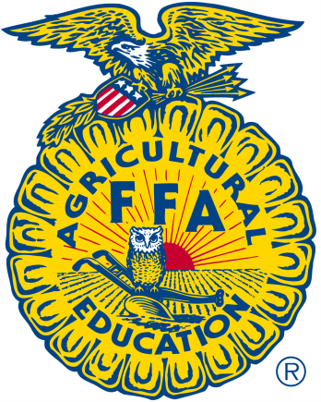


Slide 2

Organizational Structure
National FFA Organization has three significant levels to its structure:
Local
State
National

Slide 3

FFA Mission
“FFA makes a positive difference in the lives of students by developing their potential for premier leadership, personal growth and career success through agricultural education.”

Slide 4
FFA Colors
National Blue – for the blue field of our nation’s flag
Corn Gold – for the golden fields of ripened corn

Slide 5
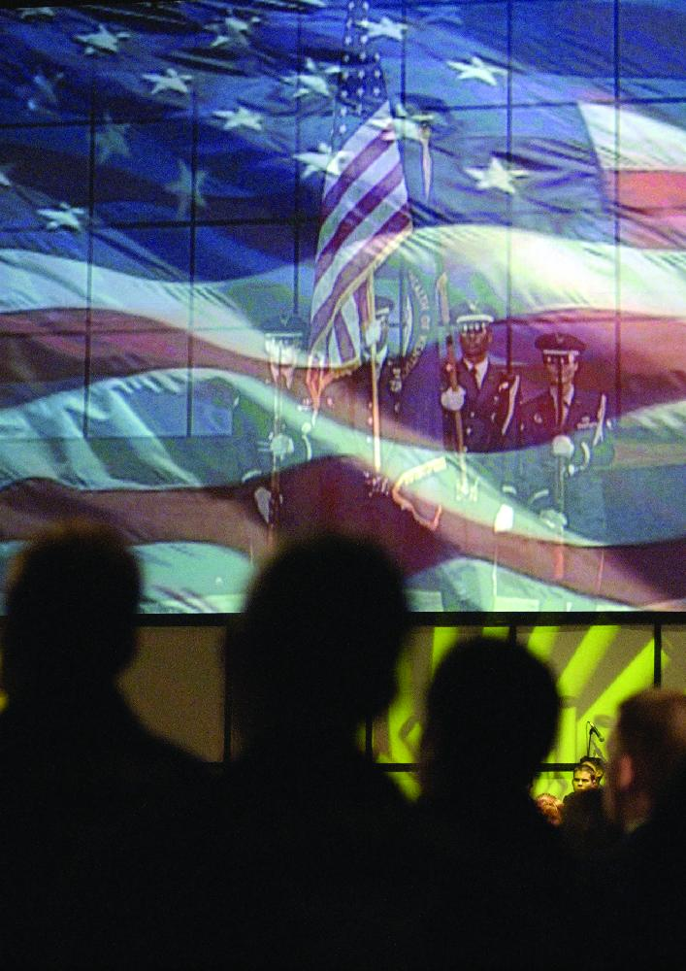
FFA Salute
I pledge allegiance to the flag of the United States of America and to the Republic for which it stands, one nation under God, indivisible, with liberty and justice for all.

Slide 6
FFA Motto
Learning to Do,
Doing to Learn,
Earning to Live,
Living to Serve.
Written by Layton S. Hawkins, a pioneer in vocational education who began teaching in 1904.

Slide 7
The FFA Emblem
Cross section of corn represents ‘Unity’
Whether you live in Alaska, Puerto Rico, Maine, Hawaii or one of the states in between, corn is grown somewhere in your state. This agriculture crop signifies unity, and, from the first Thanksgiving feast on, corn has historically served as the foundation crop of American agriculture. It is appropriate then that the cross section of corn be used as the foundation of the national FFA emblem.
Rising sun signifies ‘Progress’
Just as the industry of agriculture has developed new technologies and evolved to meet the next generation of consumer demands, the National FFA Organization has continued to evolve as well and continually looks to the future to meet each member’s needs. The rising sun signifies progress and holds the promise that tomorrow will bring a new day, shining with opportunity.

Slide 8
The FFA Emblem
Plow signifies ‘Labor and Tillage of the Soil’
The National FFA Organization is an organization founded in agriculture, the backbone of our country. The plow signifies labor and tillage of the soil and the historic foundation of our country’s strength.
Eagle symbolizes ‘Freedom’
The eagle is a national symbol which reminds all FFA members of our freedom and the ability to explore new horizons for the future of agriculture.

Slide 9
The FFA Emblem
Owl represents ‘Knowledge’
Long recognized as a symbol of wisdom and knowledge, the owl symbolizes the knowledge required to be successful in the industry of agriculture.
Agricultural Education and FFA
The words Agricultural Education and FFA are emblazoned in the center of the emblem to signify the combination of learning and leadership necessary for progressive agriculture.

Slide 10
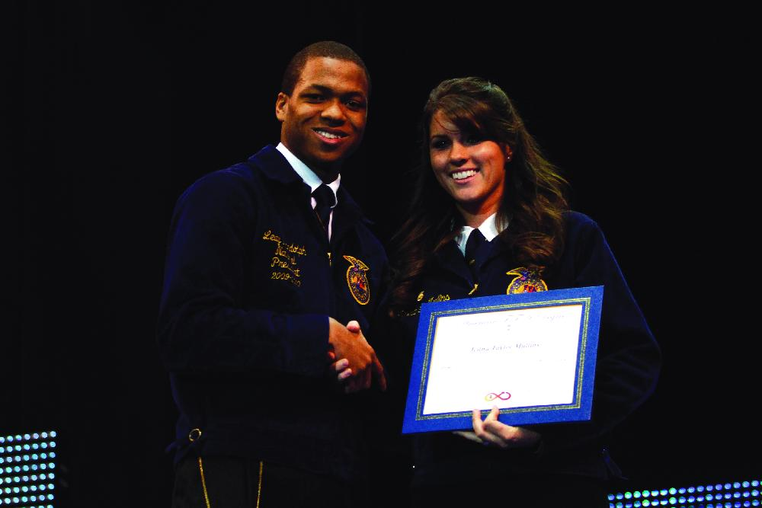
FFA Degrees
Discovery FFA Degree
Greenhand FFA Degree
Chapter FFA Degree
State FFA Degree
American FFA Degree
Visit ffa.org for the latest requirements listing

Slide 11
Types of FFA Membership
Active FFA members – those who are enrolled in an agriculture course and have paid their membership dues.
Collegiate FFA members – also belong to FFA chapters at colleges and universities where they are enrolled in agriculture courses.
Alumni membership – is open to anyone interested in supporting and promoting agricultural education and FFA.
Honorary membership – is given to individuals who have provided outstanding service to FFA and agricultural education.

Slide 12
FFA Code of Ethics
FFA members conduct themselves at all times to be a credit to their organization, chapter, school, community and family.
As an FFA member, I pledge to:
  1. Develop my potential for premier leadership, personal growth and career success.
  2. Make a positive difference in the lives of others.
  3. Dress neatly and appropriately for the occasion.
  4. Respect the rights of others and their property.
  5. Be courteous, honest and fair with others.
  6. Communicate in an appropriate, purposeful and positive manner.
  7. Demonstrate good sportsmanship by being modest in winning and generous in defeat.
  8. Make myself aware of FFA programs and activities and be an active participant.
  9. Conduct and value a supervised agricultural experience (SAE) program.
  10. Strive to establish and enhance my skills through agricultural education in order to enter a successful career.
  11. Appreciate and promote diversity in our organization.
Adopted by the delegates at the 1952 National FFA Convention.
The Code of Ethics was revised by the delegates at the 1995 National FFA Convention.

