Slide 1
FFA Experience Jeopardy!

Slide 2
FFA History
FFA Meeting Room
FFA Creed
FFA Jackets & Pins
Women in FFA
Famous Alumni
100
100
100
100
100
100
200
200
200
200
200
200
300
300
300
300
300
300
400
400
400
400
400
400
500
500
500
500
500
500

Slide 3
FFA History 100
FFA WAS ESTABLISHED IN THIS YEAR.
BACK

Slide 4
FFA History 200
THE NAME CHANGED FROM FUTURE FARMERS OF AMERICA TO THE NATIONAL FFA ORGANIZATION IN THIS YEAR.
BACK

Slide 5
FFA History 300
NEW FARMERS OF AMERICA (NFA) MERGED WITH FFA IN THIS YEAR.
BACK

Slide 6
FFA History 400
THE FFA ALUMNI ASSOCIATION WAS ESTABLISHED IN THIS YEAR.
BACK

Slide 7
FFA History 500
IN THIS YEAR, THE FIRST NATIONAL FFA WEEK WAS CELEBRATED.
BACK

Slide 8

FFA Meeting Room 100
I AM STATIONED BY THE
BACK

Slide 9
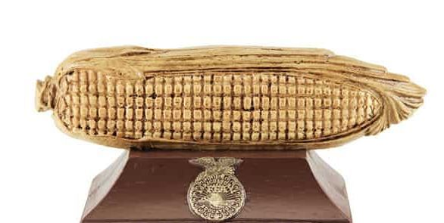
FFA Meeting Room 200
I AM STATIONED BY THE
BACK

Slide 10
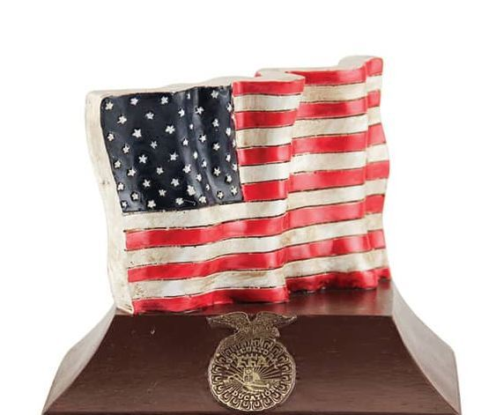
FFA Meeting Room 300
I AM STATIONED BY THE
BACK

Slide 11
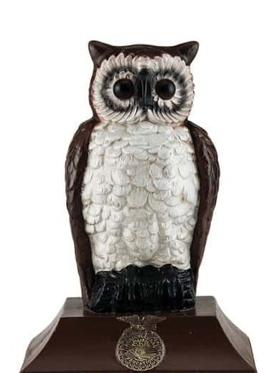
FFA Meeting Room 400
I AM STATIONED BY THE
BACK

Slide 12
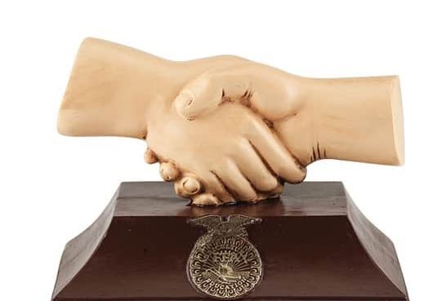
FFA Meeting Room 500
I AM STATIONED BY THE
BACK

Slide 13
FFA Creed 100
I WROTE THE FFA CREED.
BACK

Slide 14
FFA Creed 200
THE FFA CREED WAS FIRST ADOPTED IN THIS YEAR.
BACK

Slide 15
FFA Creed 300
THE FFA CREED WAS REVISED AT THESE TWO CONVENTIONS.
BACK

Slide 16
FFA Creed 400
ALL FIVE PARAGRAPHS OF THE FFA CREED BEGIN WITH THESE WORDS.
BACK

Slide 17
FFA Creed 500
THE NUMBER OF WORDS IN THE FFA CREED.
BACK

Slide 18
FFA Jackets and Pins 100
IN THIS YEAR, THE FFA JACKET WAS ADOPTED AS OFFICIAL DRESS.
BACK

Slide 19
FFA Jackets and Pins 200
THE NUMBER OF PINS THAT CAN BE WORN ON AN FFA JACKET.
BACK

Slide 20
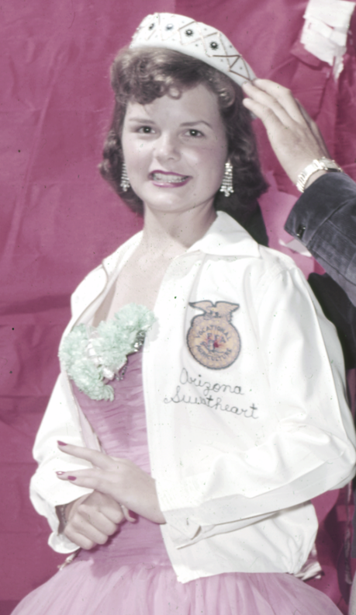
FFA Jackets and Pins 300
TYPE OF JACKET SHOWN HERE.
BACK

Slide 21
FFA Jackets and Pins 400
THIS COMPANY EMBROIDERS ALL FFA JACKETS.
BACK

Slide 22
FFA Jackets and Pins 500
THE FIRST FFA JACKET WAS WORN BY THIS CHAPTER AT THE 1933 CONVENTION.
BACK

Slide 23
Women in FFA 100
WOMEN WERE FIRST ALLOWED MEMBERSHIP IN THIS YEAR.
BACK

Slide 24
Women in FFA 200
THE FIRST FEMALE NATIONAL PRESIDENT WAS ELECTED IN THIS YEAR.
BACK

Slide 25
Women in FFA 300
IN 2002, SHE BECAME THE FIRST FEMALE STAR FARMER.
BACK

Slide 26
Women in FFA 400
IN THIS YEAR, THE FIRST AMERICAN DEGREES WERE AWARDED TO WOMEN.
BACK

Slide 27
Women in FFA 500
ANITA DECKER WAS ONE OF THE FIRST FEMALE DELEGATES IN 1970, REPRESENTING THIS STATE.
BACK

Slide 28
Famous Alumni 100
SHE WAS THE FIRST FEMALE AFRICAN AMERICAN NATIONAL FFA PRESIDENT.
BACK

Slide 29
Famous Alumni 200
THIS FORMER MEMBER IS A MUSICIAN AND ENTERTAINER FROM THE HENDERSONVILLE FFA CHAPTER IN TENNESSEE.
BACK

Slide 30
Famous Alumni 300
HE WAS THE FIRST AFRICAN AMERICAN NATIONAL OFFICER AND A FORMER AIDE TO PRESIDENTS FORD, REAGAN AND BUSH.
BACK

Slide 31
Famous Alumni 400
HE IS A FORMER U.S. PRESIDENT AND NOBEL PRIZE WINNER.
BACK

Slide 32
Famous Alumni 500
THIS FORMER FFA MEMBER WAS A FOOTBALL PLAYER WITH THE GREEN BAY PACKERS.
BACK

