Slide 1



FFA History

Slide 2
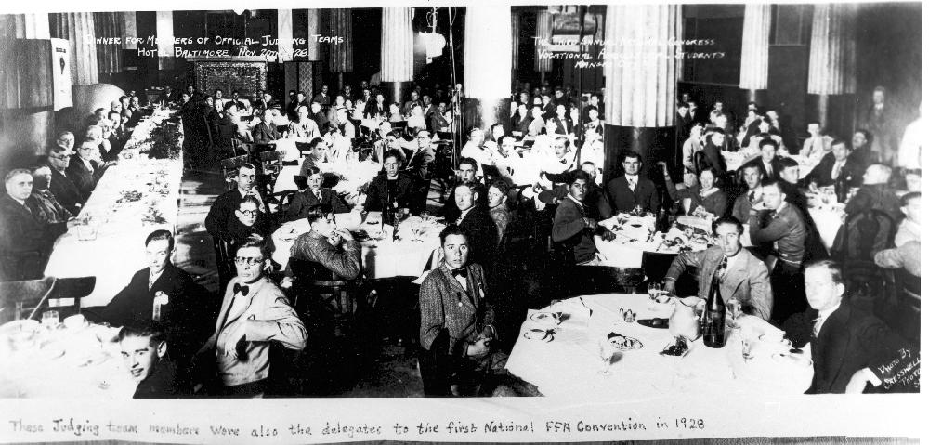

Milestones
1917 - Smith-Hughes Vocational Education Act
1928 – National Organization of the Future Farmers of America was formed

Slide 3
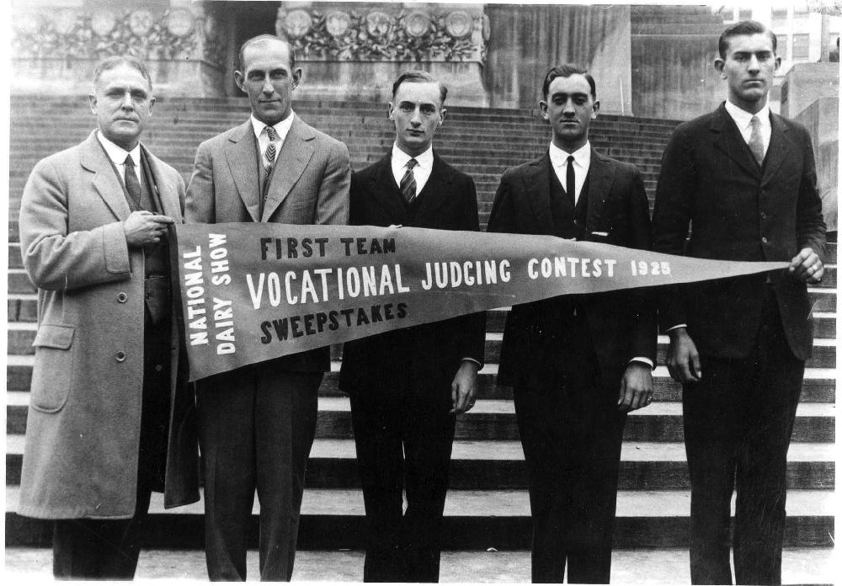
First Leaders
Dr. Charles Homer Lane, First National FFA Advisor
Henry C. Groseclose, First National FFA Executive Secretary and Treasurer
Harry Oscar Sampson, Founder of the Young Farmers Organization of New Jersey
Harvey Owen Sargent, Co-Founder of New Farmers of America
G.W. Owens, Co-Founder of New Farmers of America
J.R. Thomas, National NFA Advisor
David Simmons, First National NFA President

Slide 4
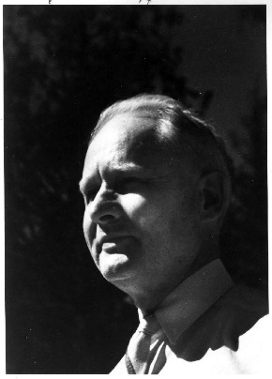
FFA CREED
By Erwin Milton “E.M.” Tiffany
I believe in the future of agriculture, with a faith born not of words but of deeds - achievements won by the present and past generations of agriculturists; in the promise of better days through better ways, even as the better things we now enjoy have come to us from the struggles of former years.
I believe that to live and work on a good farm, or to be engaged in other agricultural pursuits, is pleasant as well as challenging; for I know the joys and discomforts of agricultural life and hold an inborn fondness for those associations which, even in hours of discouragement, I cannot deny.
I believe in leadership from ourselves and respect from others. I believe in my own ability to work efficiently and think clearly, with such knowledge and skill as I can secure, and in the ability of progressive agriculturists to serve our own and the public interest in producing and marketing the product of our toil.
I believe in less dependence on begging and more power in bargaining; in the life abundant and enough honest wealth to help make it so--for others as well as myself; in less need for charity and more of it when needed; in being happy myself and playing square with those whose happiness depends upon me.
I believe that American agriculture can and will hold true to the best traditions of our national life and that I can exert an influence in my home and community which will stand solid for my part in that inspiring task.

Slide 5
FFA Creed
Paragraphs 1 and 2
I believe in the future of agriculture, with a faith born not of words but of deeds - achievements won by the present and past generations of agriculturists; in the promise of better days through better ways, even as the better things we now enjoy have come to us from the struggles of former years.
I believe that to live and work on a good farm, or to be engaged in other agricultural pursuits, is pleasant as well as challenging; for I know the joys and discomforts of agricultural life and hold an inborn fondness for those associations which, even in hours of discouragement, I cannot deny.

Slide 6
FFA Creed
Paragraphs 3, 4 and 5
I believe in leadership from ourselves and respect from others. I believe in my own ability to work efficiently and think clearly, with such knowledge and skill as I can secure, and in the ability of progressive agriculturists to serve our own and the public interest in producing and marketing the product of our toil.
I believe in less dependence on begging and more power in bargaining; in the life abundant and enough honest wealth to help make it so--for others as well as myself; in less need for charity and more of it when needed; in being happy myself and playing square with those whose happiness depends upon me.
I believe that American agriculture can and will hold true to the best traditions of our national life and that I can exert an influence in my home and community which will stand solid for my part in that inspiring task.

Slide 7
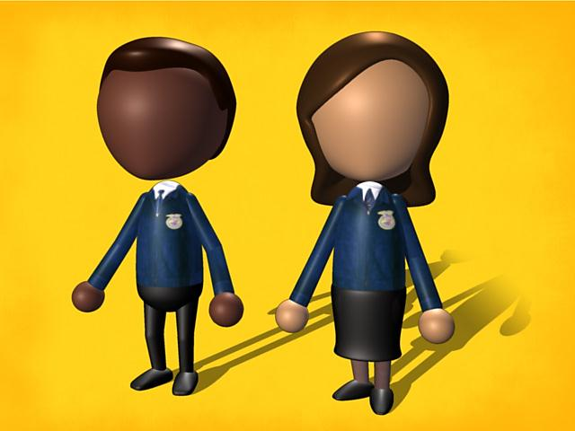
Only Blue Will Do
Significance of the Blue Corduroy Jacket:
The most recognizable symbol of the FFA Organization
Allows members to be on an even playing field when participating in various FFA events.
Legacy began in Fredericktown, Ohio
Today more than 66,000 blue corduroy jackets are sold to FFA members each year.

Slide 8
Official Dress for
Female Members
Official FFA jacket, zipped to the top
Black skirt: Skirt is to be at least knee length, hemmed evenly across the bottom, with a slit no higher than two inches above the knee, excluding the kick pleat.
White collared shirt
Official FFA blue scarf
Black closed heel and toe dress shoes (no boots, sandals, open-toed shoes or tennis shoes), worn with black nylon hosiery

Slide 9
Official Dress for
Male Members
Official FFA jacket, zipped to the top
Black slacks (no jeans)
White collared shirt
Official FFA tie
Black dress shoes (no boots, sandals, open-toed shoes or tennis shoes) worn with black socks

Slide 10
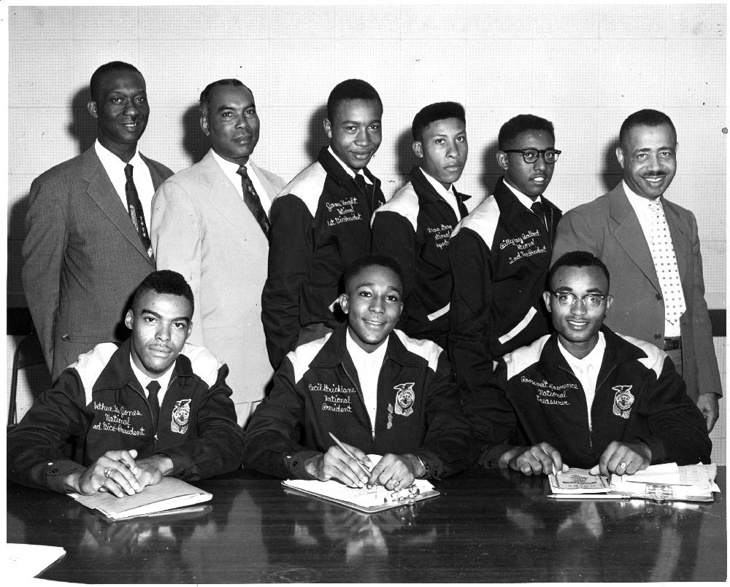
New Farmers of America
Started in Virginia in 1927
Official colors were black and gold
Eblem was similar to the FFA emblem, featuring a boll of cotton instead of a cross section of corn

Slide 11
New Farmers of America
1965 - New Farmers of America merged with Future Farmers of America

Slide 12
New Farmers of America Creed
I believe in the dignity of farm work and that I shall prosper in proportion as I learn to put knowledge and skill into the occupation of farming.
I believe that the farm boy who learns to produce better crops and better livestock; who learns to improve and beautify his home surroundings will find joy and success in meeting the challenging situations as they arise in his daily living.
I believe that rural organizations should develop their leaders from within; that the boys in the rural communities should look forward to positions of leadership in the civic, social and public life surrounding them.
I believe that the life of service is the life that counts; that happiness endures to mankind when it comes from having helped lift the burdens of others.
I believe in the practice of cooperation in agriculture; that it will aid in bringing to the man lowest down a wealth of giving as well as receiving.
I believe that each farm boy bears the responsibility for finding and developing his talents to the end that the life of his people may thereby be enriched so that happiness and contentment will come to all.

Slide 13
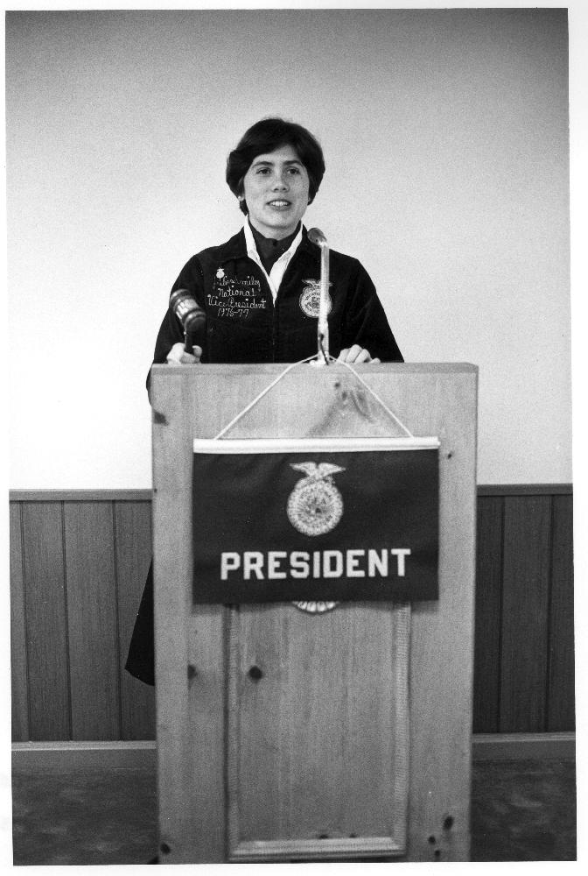
Women Join FFA
In 1969 FFA opened membership to females
1976 first female to hold a national office, Julie Smiley from Washington

Slide 14
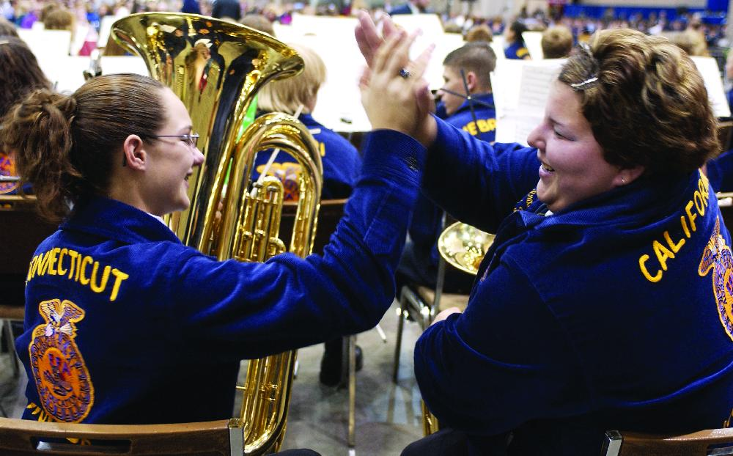
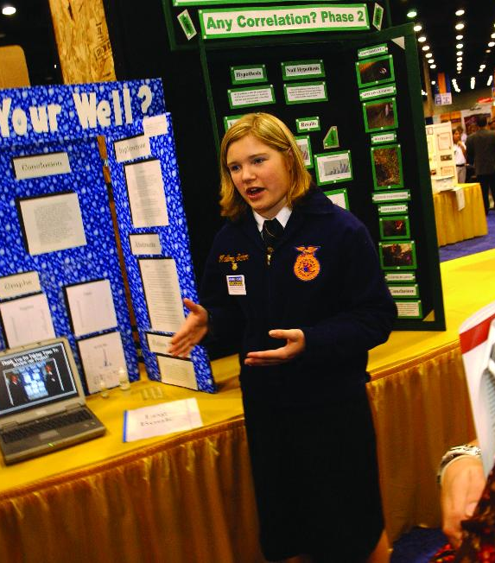
Women Join FFA
Now females hold more than half of the leadership positions with in FFA chapters.

Slide 15

Name Change
As members’ needs changed and evolved with time, the Future Farmers of America adopted many new programs and activities to meet those needs.
By the early 1980s, the Future Farmers of America was recognized as more than an organization for rural farm students.
In 1988, the delegates at the 60th National FFA Convention voted to change the official name of the organization from Future Farmers of America to the National FFA Organization to reflect the changing demographics of its membership.
  These changes illustrated an increased emphasis in the business, science and technology of agriculture in addition to production farming and ranching.

Slide 16
Convention Locations
The first national FFA convention was held in 1928 in Kansas City, Mo.
After 71 years in Kansas City, the national FFA convention moved to Louisville, Ky., in 1999 for the 72nd annual convention. The national convention remained in Louisville until 2005.
In 2006, the 79th National FFA Convention was held in Indianapolis.
In 2013 the convention will being to rotate between Louisville and Indianapolis every 3 years.

Slide 17
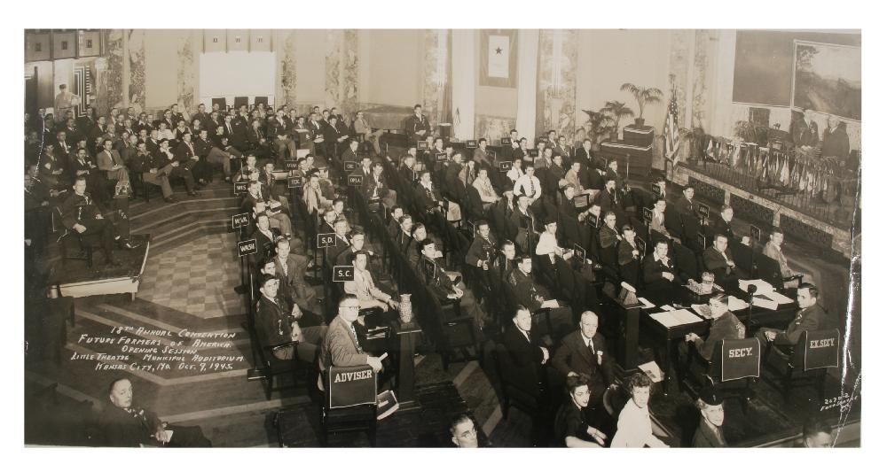
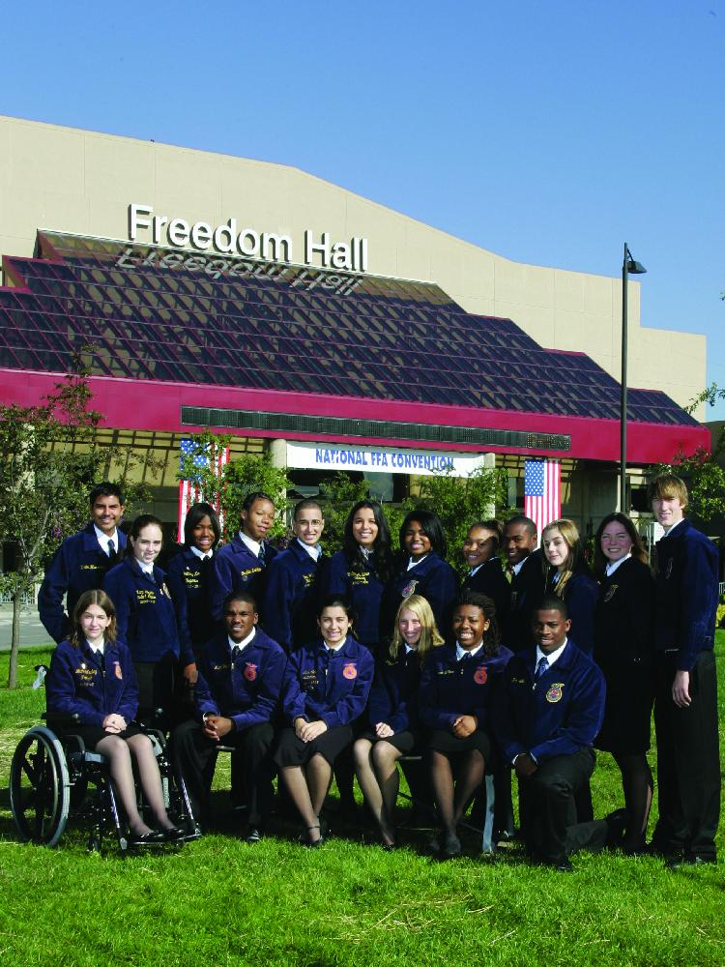
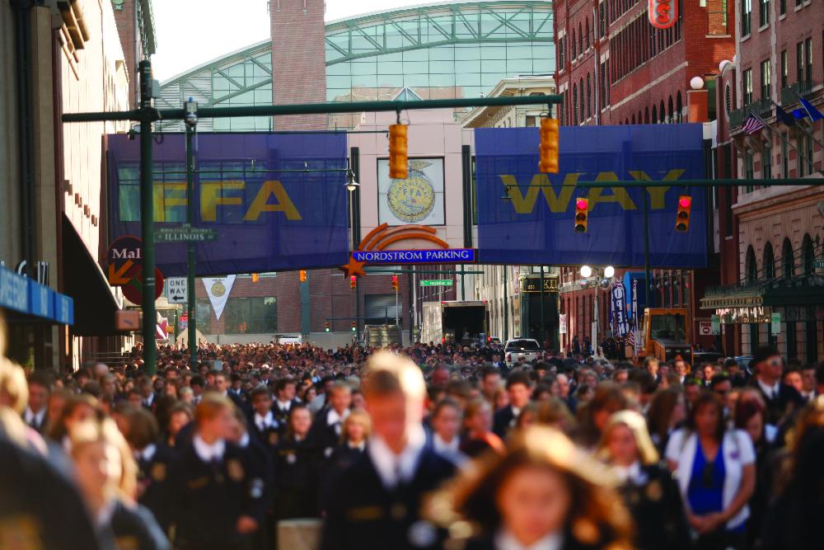
Convention Locations
1928 - 1998 Kansas City, Mo.
1999 – 2005 Louisville, Ky.
2006 – 2013 Indianapolis

