Slide 1
Minecraft in Agricultural Education
Fallon Jackson

Slide 2
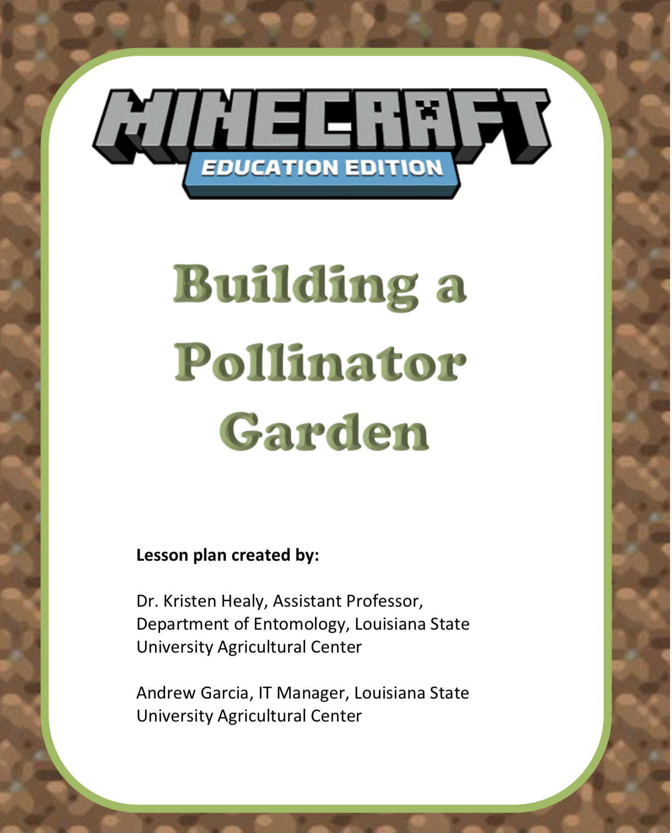
Background Info
Not an expert
Not a gamer
  I played around with the game a little
Students helped troubleshoot a lot
  They will know a lot more than you do

Slide 3
Where Do I Start?
Find a Lesson
  https://education.minecraft.net/
Get Started
  Will tell you if your school has Microsoft capabilities
Class Resources
  Find a lesson
  THERE ARE A TON!
Building a Pollinator Garden
  https://education.minecraft.net/lessons/building-a-pollinator-garden
National FFA has your back
  https://m.box.com/shared_item/https%3A%2F%2Fffa.box.com%2Fv%2FMinecraftEducation
  Listed by Pathway
  Middle School Lessons Too

Slide 4

How to Set it Up
Host a World
  Couldn’t get this to work
  Have to leave open
  Doesn’t require students to already have Minecraft
    Sign in with school email
Students Use Own Account
  PS4, computer, Xbox, Nintendo Switch, phone, etc.
  Take screenshots of the gardens they built
  Send them to you
    Upload pictures to the Google Classroom
    Whatever method you prefer

Slide 5
Classes
Greenhouse
Covered pollinators heavily
Didn’t have them do the questions at the end
  Next time I will
Floral Design
Briefly went over pollinators in February
  Students did a “profile”
  Shared with group mates
Students answered questions at end
  Made the “why does this matter” connection to a lot
  Several had no idea how important pollinators are

Slide 6
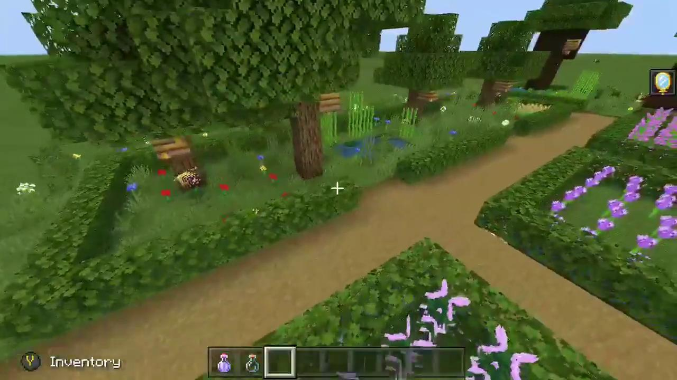
Owen (Greenhouse)
Developed tics first semester of his senior year
Wasn’t a traditional Ag student
  I had him in mind when I came across this lesson
He loved working in the greenhouse
  Preferred to do so by himself or with one other person

Slide 7
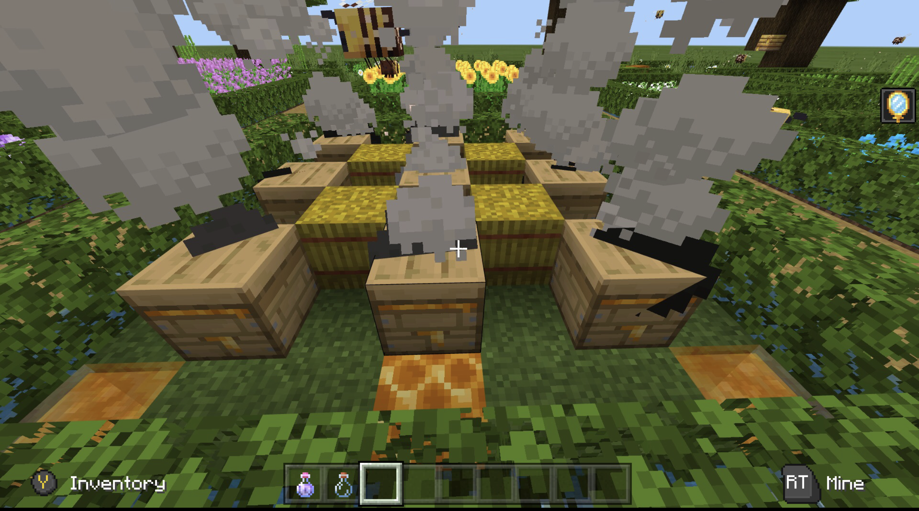
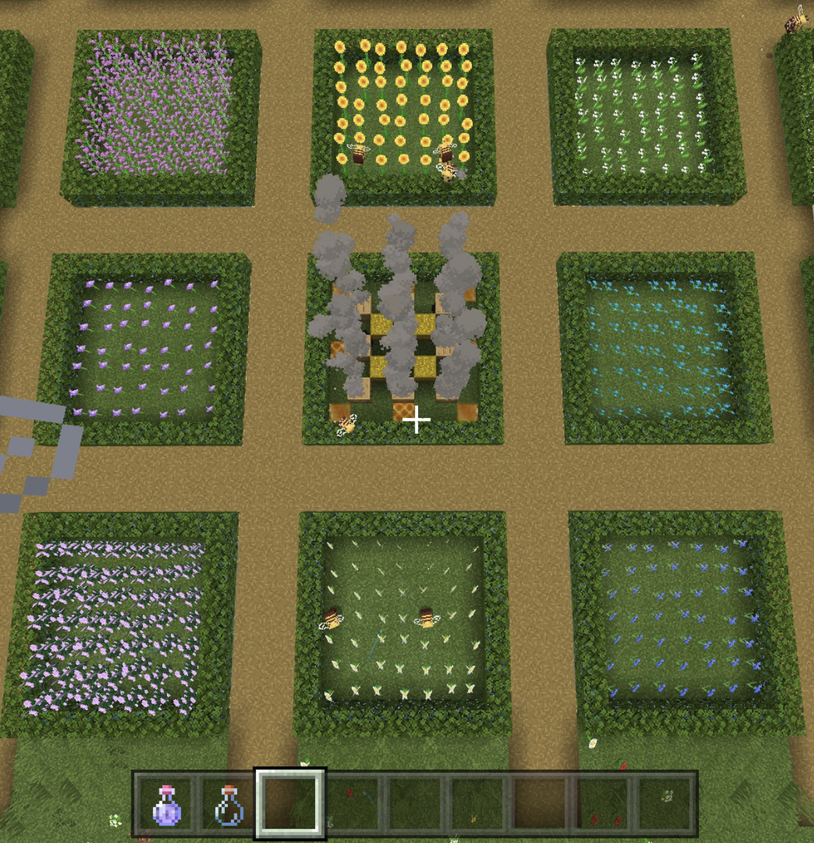
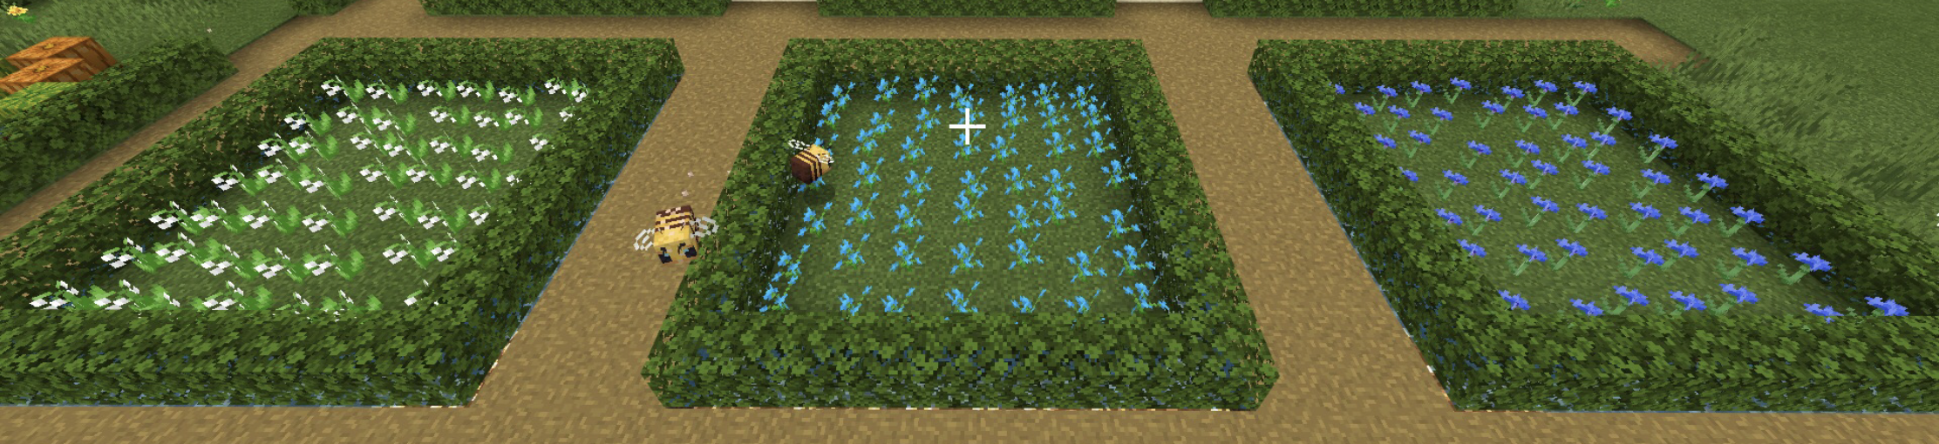
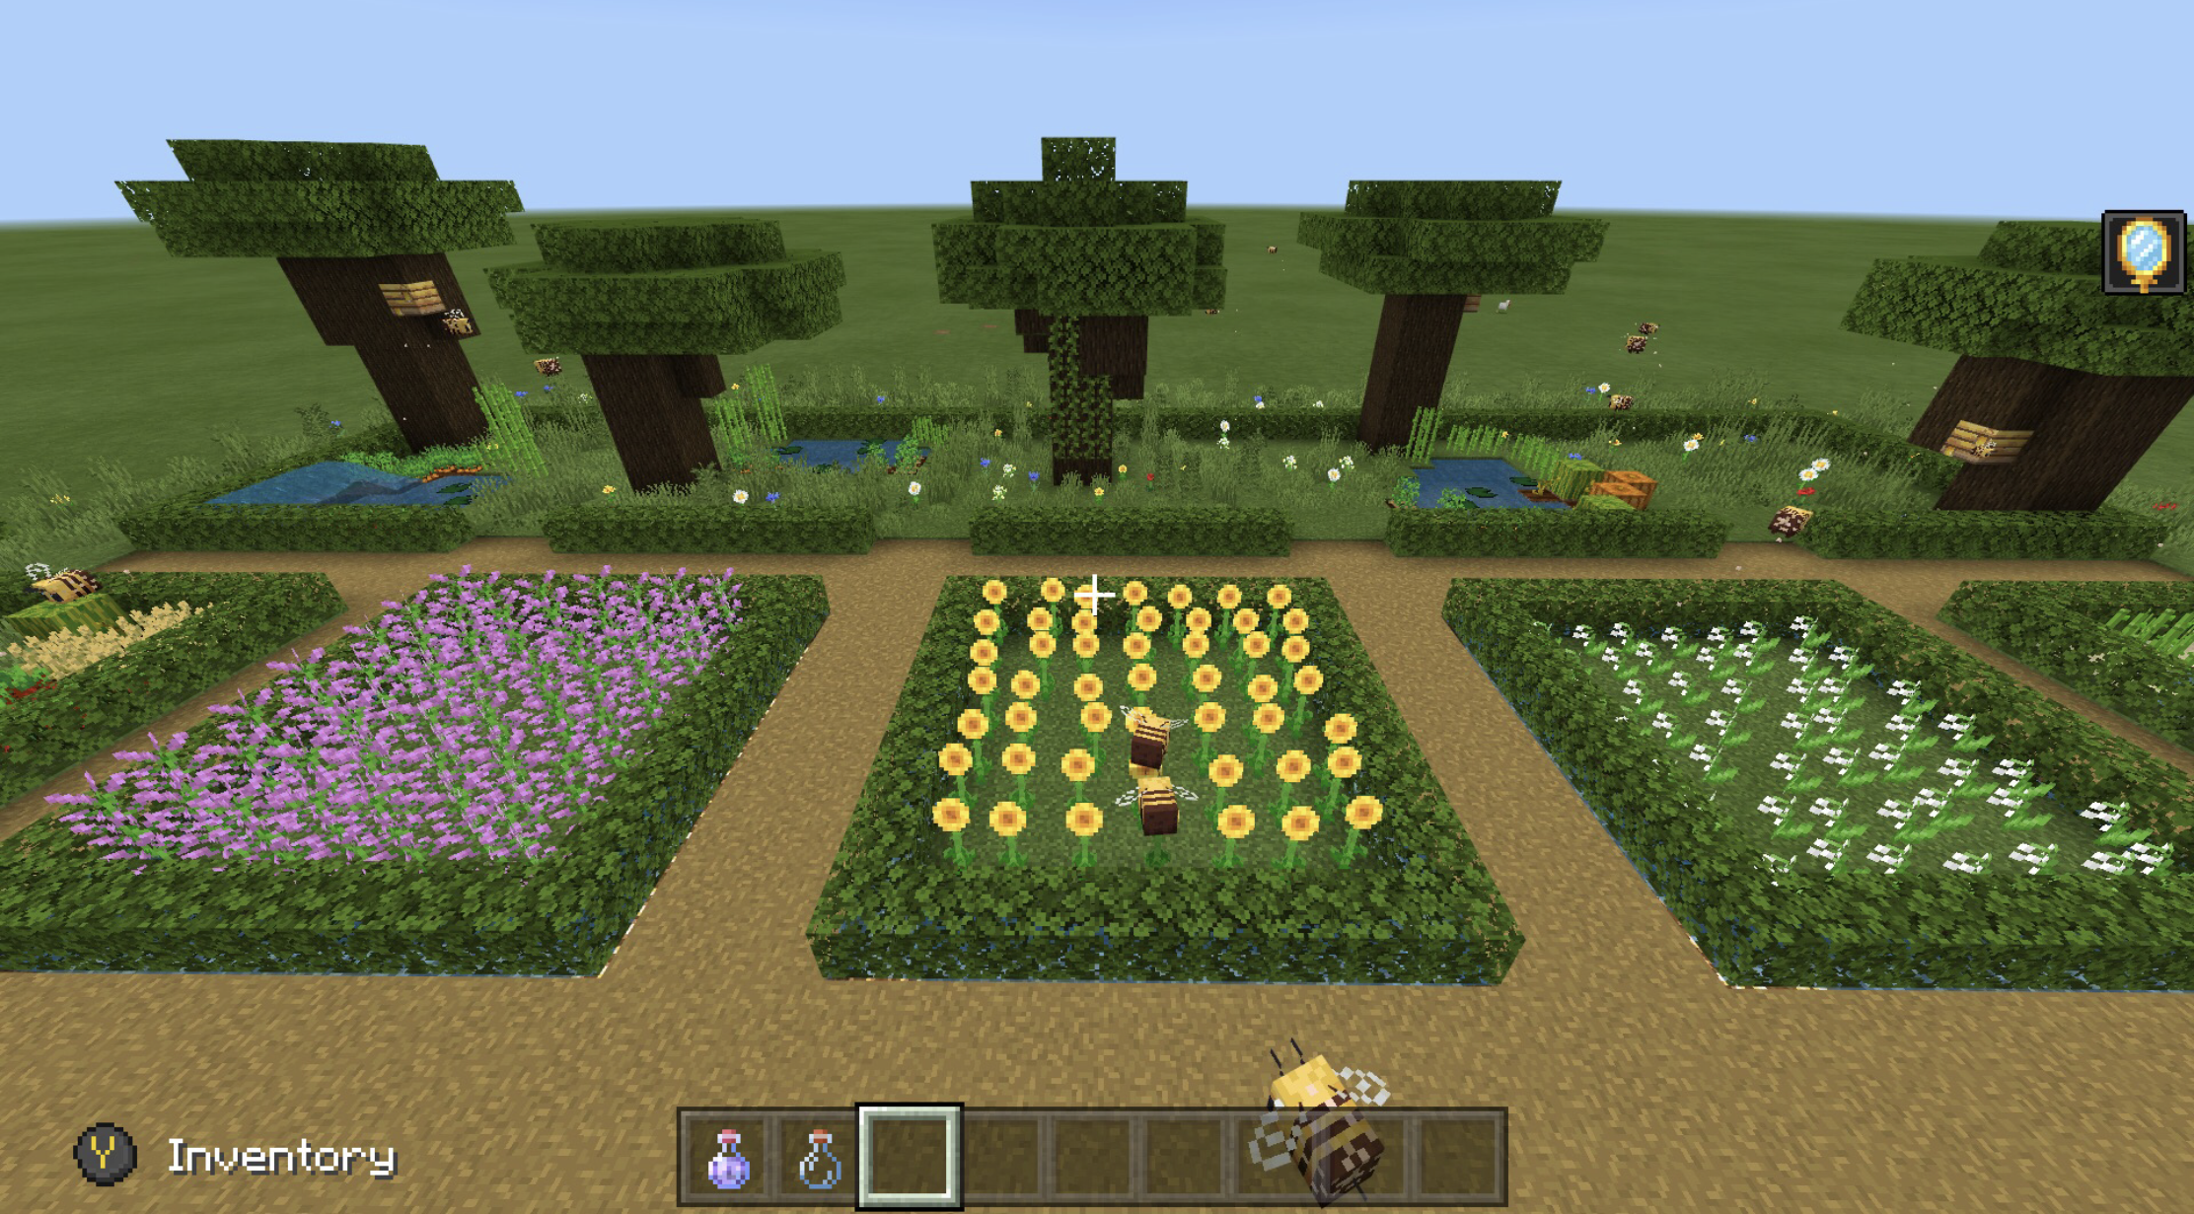
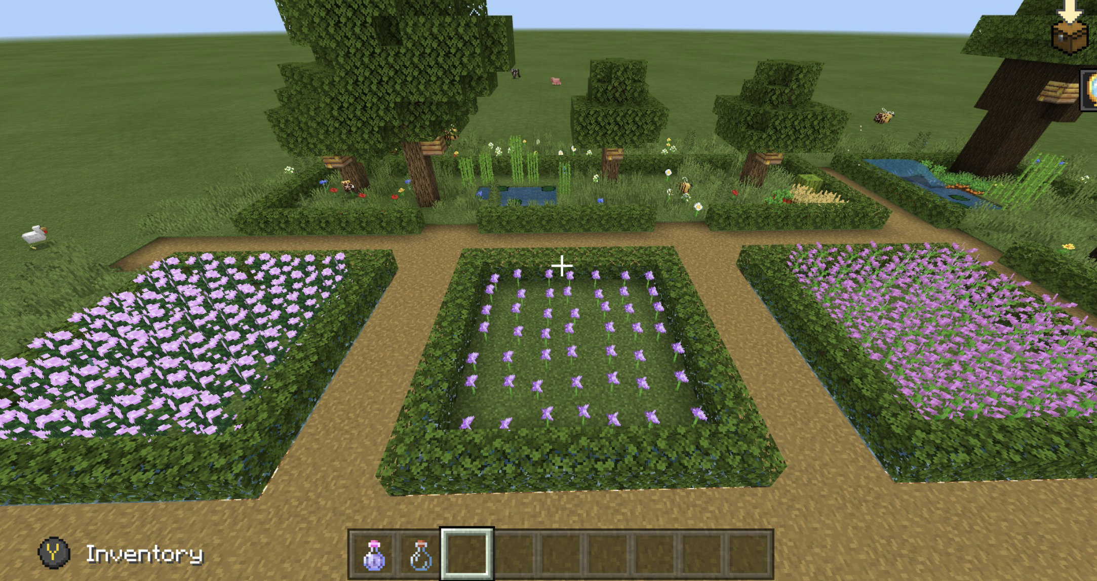
Owen (Greenhouse)

Slide 8
Kim (Floral Design)
English was her second language
  Spoke very good English, but needed help sometimes
Very outgoing
  All virtual was really hard on her

Slide 9
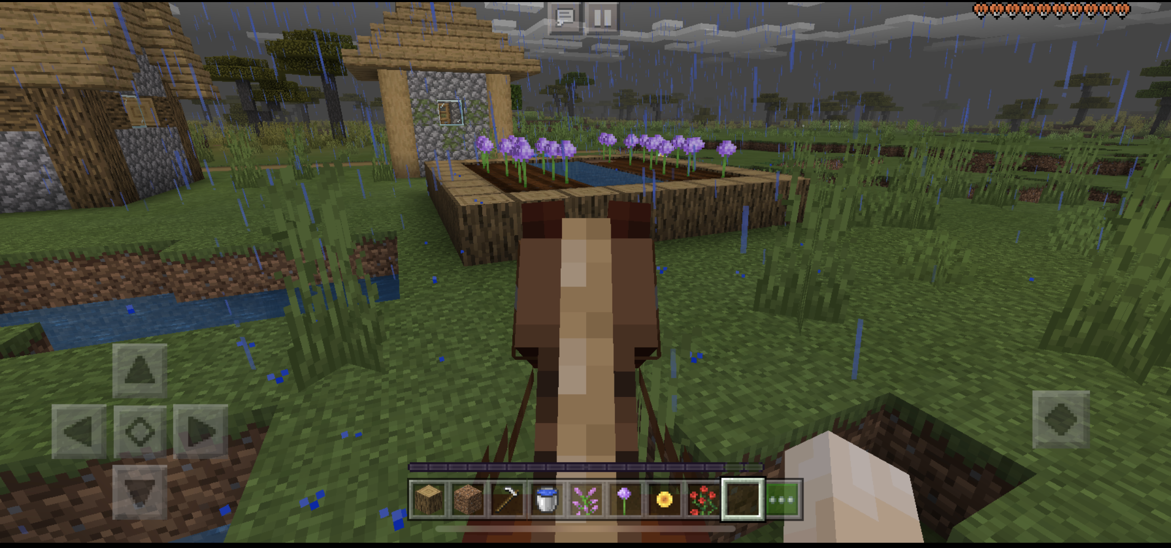
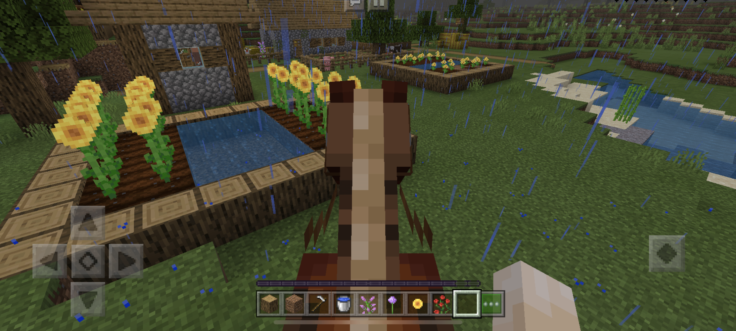
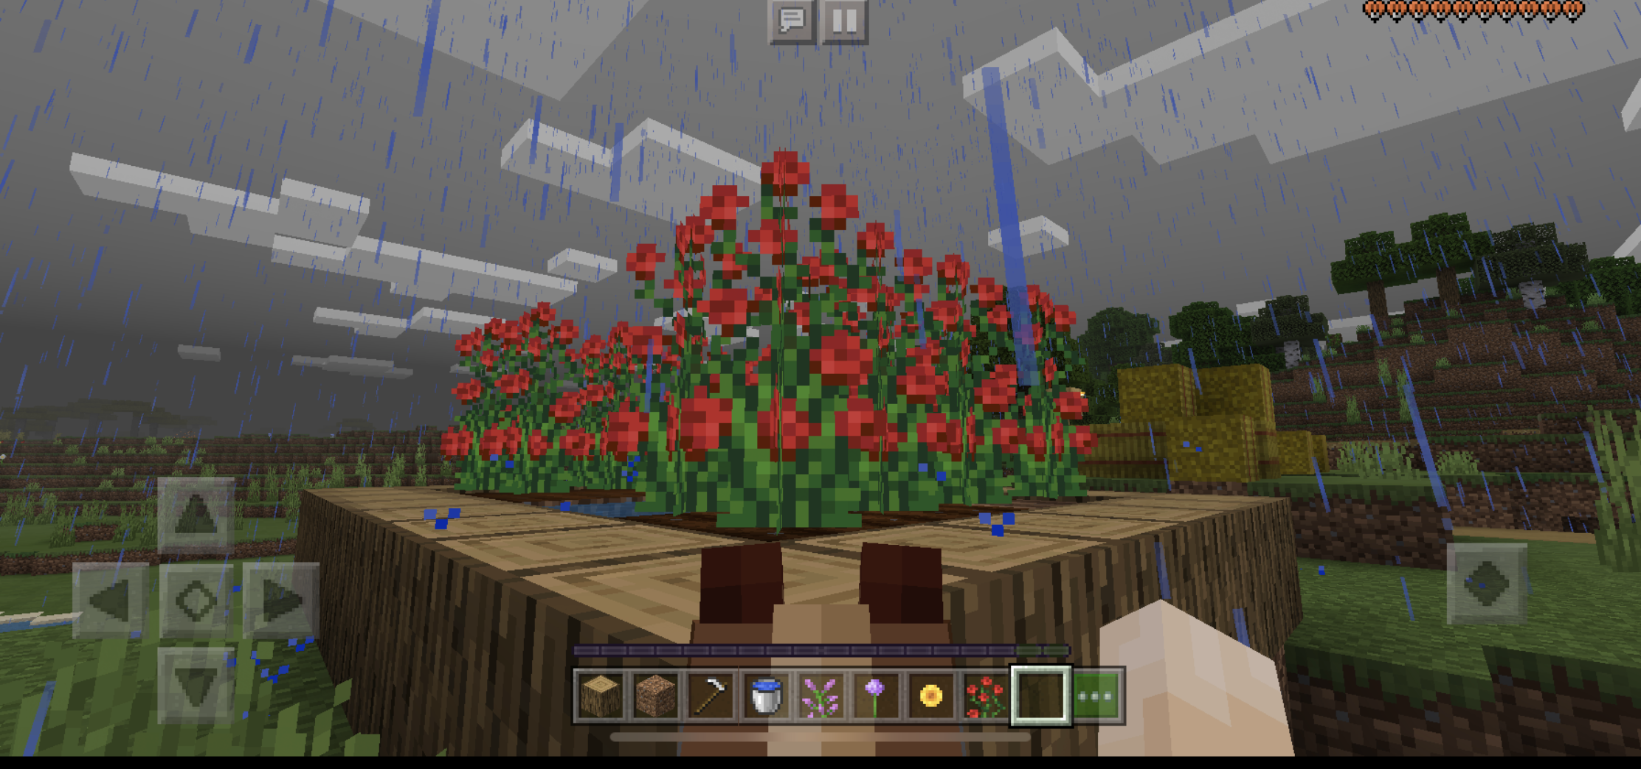
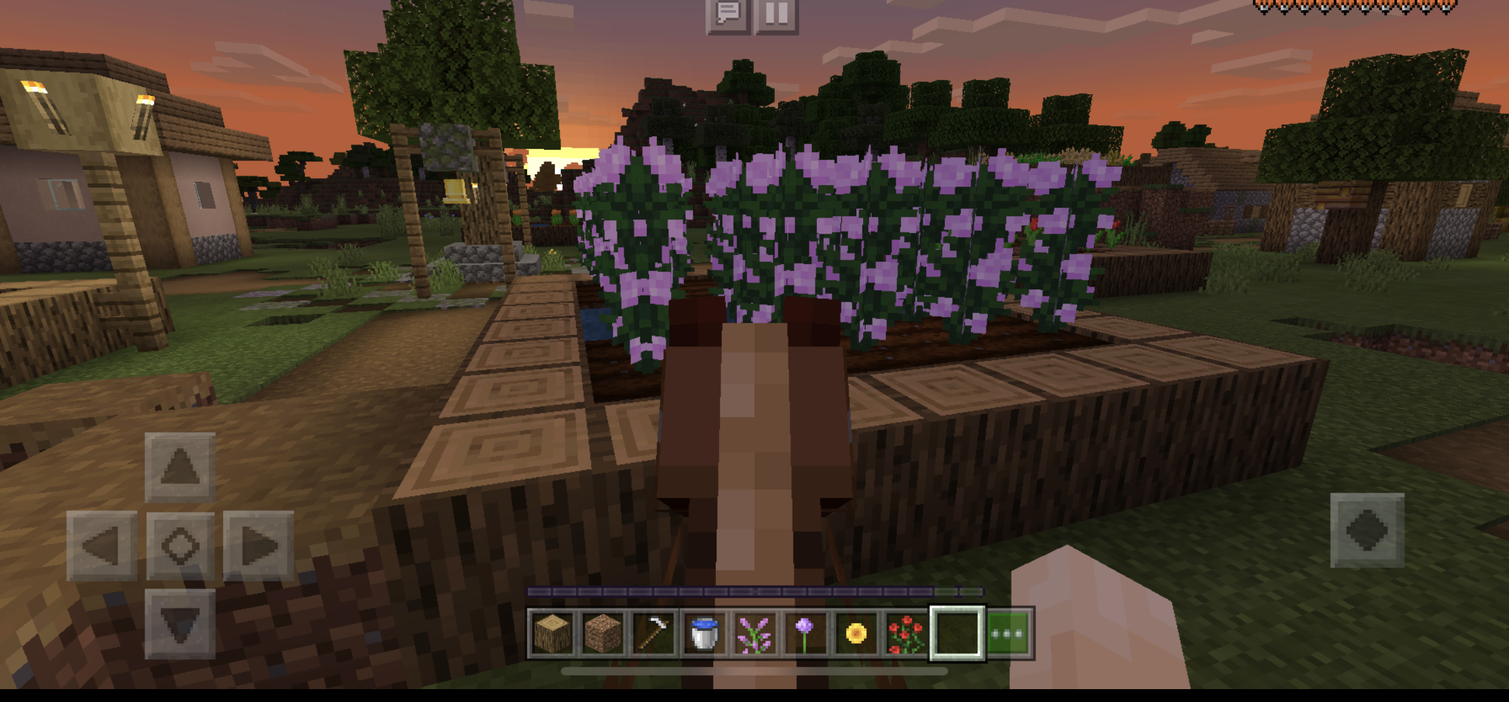
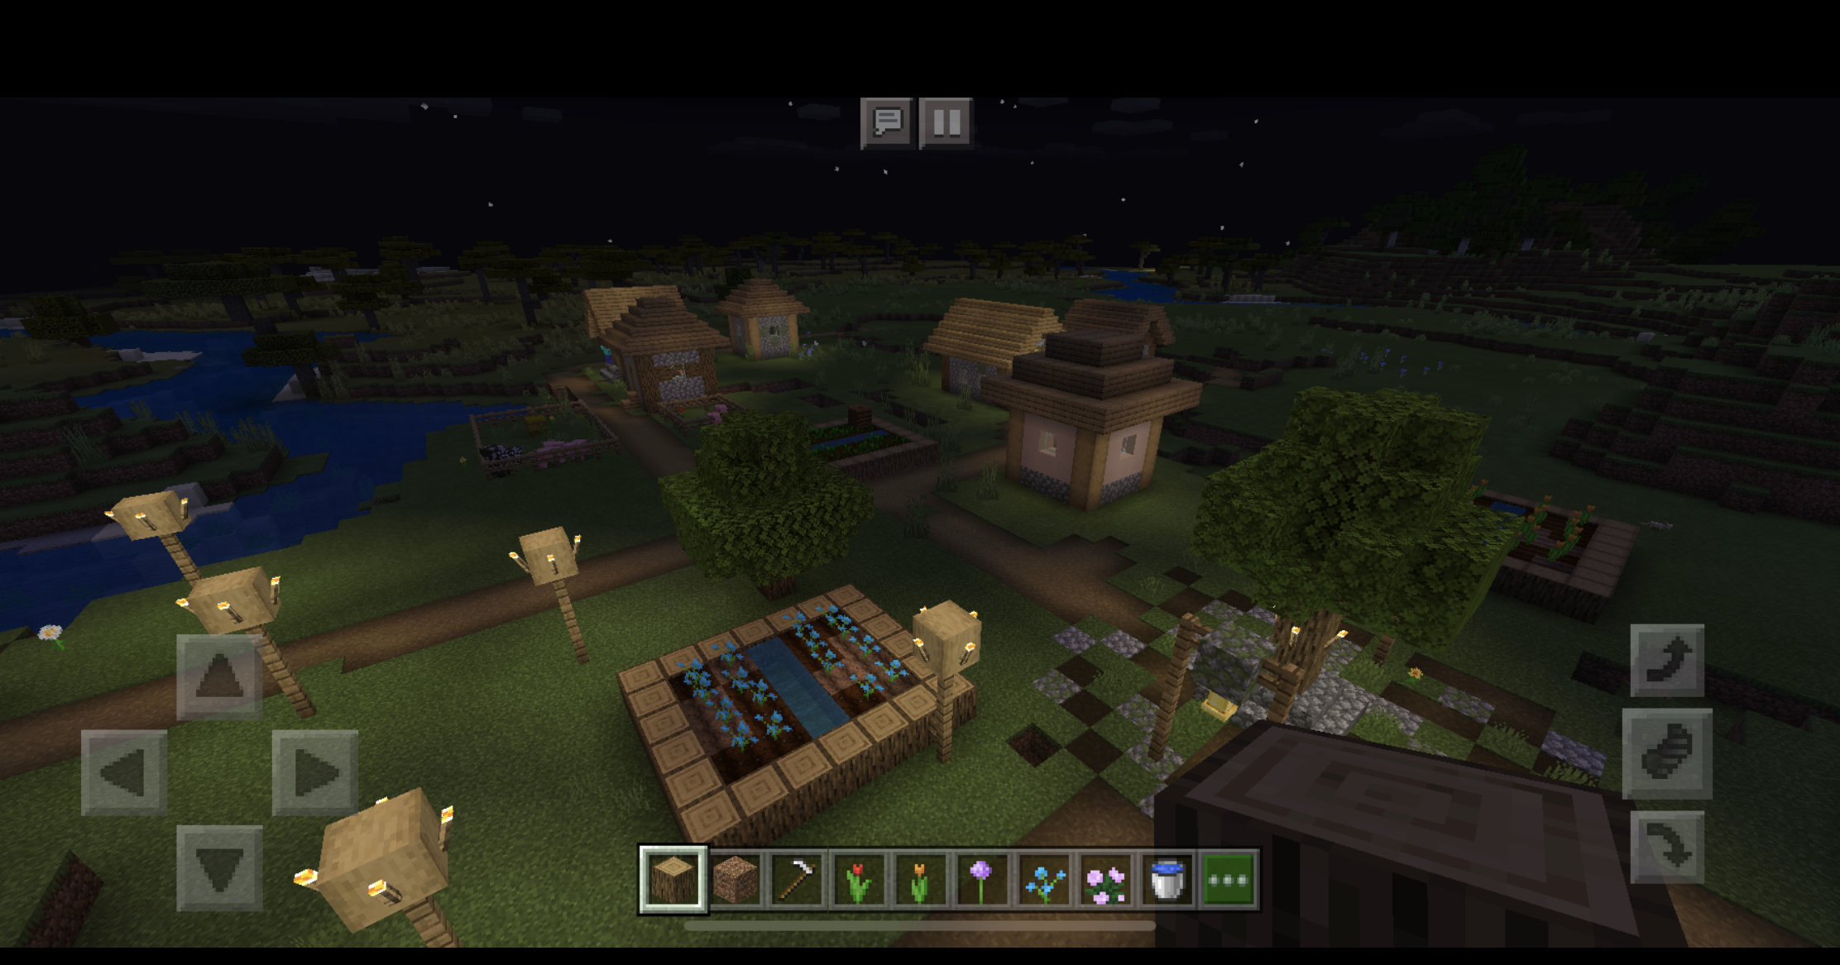
Kim (Floral Design)

Slide 10
Ok, So What?
Both were very different students to have in class
  Both really excelled at this assignment
This assignment had the highest turn in rate for all of my classes
Students were excited to share their work with me
  They had fun with this!

Slide 11
Main Takeaways
1
Students loved being able to create something from scratch that shows their creativity
3
If we go back in person I will do this in my classroom, otherwise I’ll have it be the final for our pollinator unit during e-learning
2
The pre-made lesson is great and takes a lot of work off your shoulders
I didn’t do everything exactly how it said, but I followed it pretty closely
4
I plan on finding other lessons that we can use Minecraft for
Animal Handling Facility

Slide 12
Questions?

