Slide 1
General Fencing Info

Slide 2
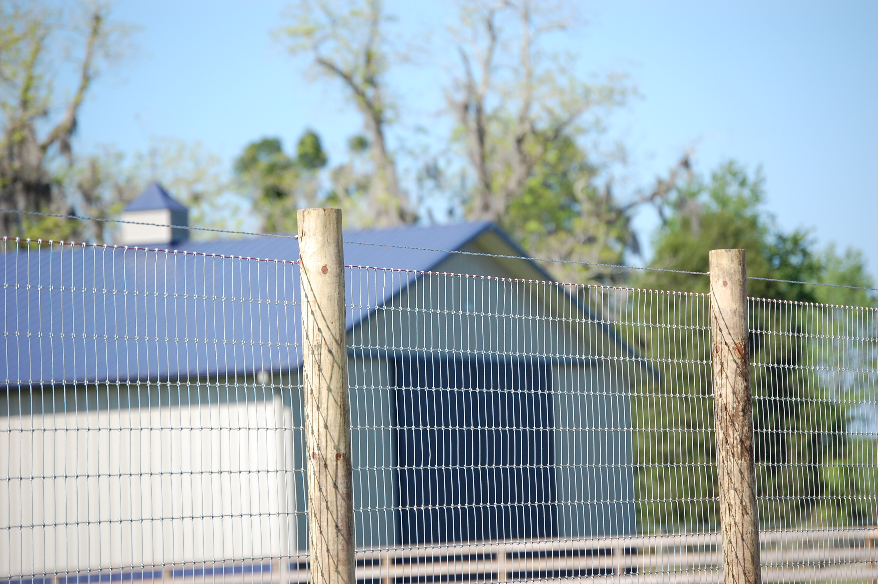
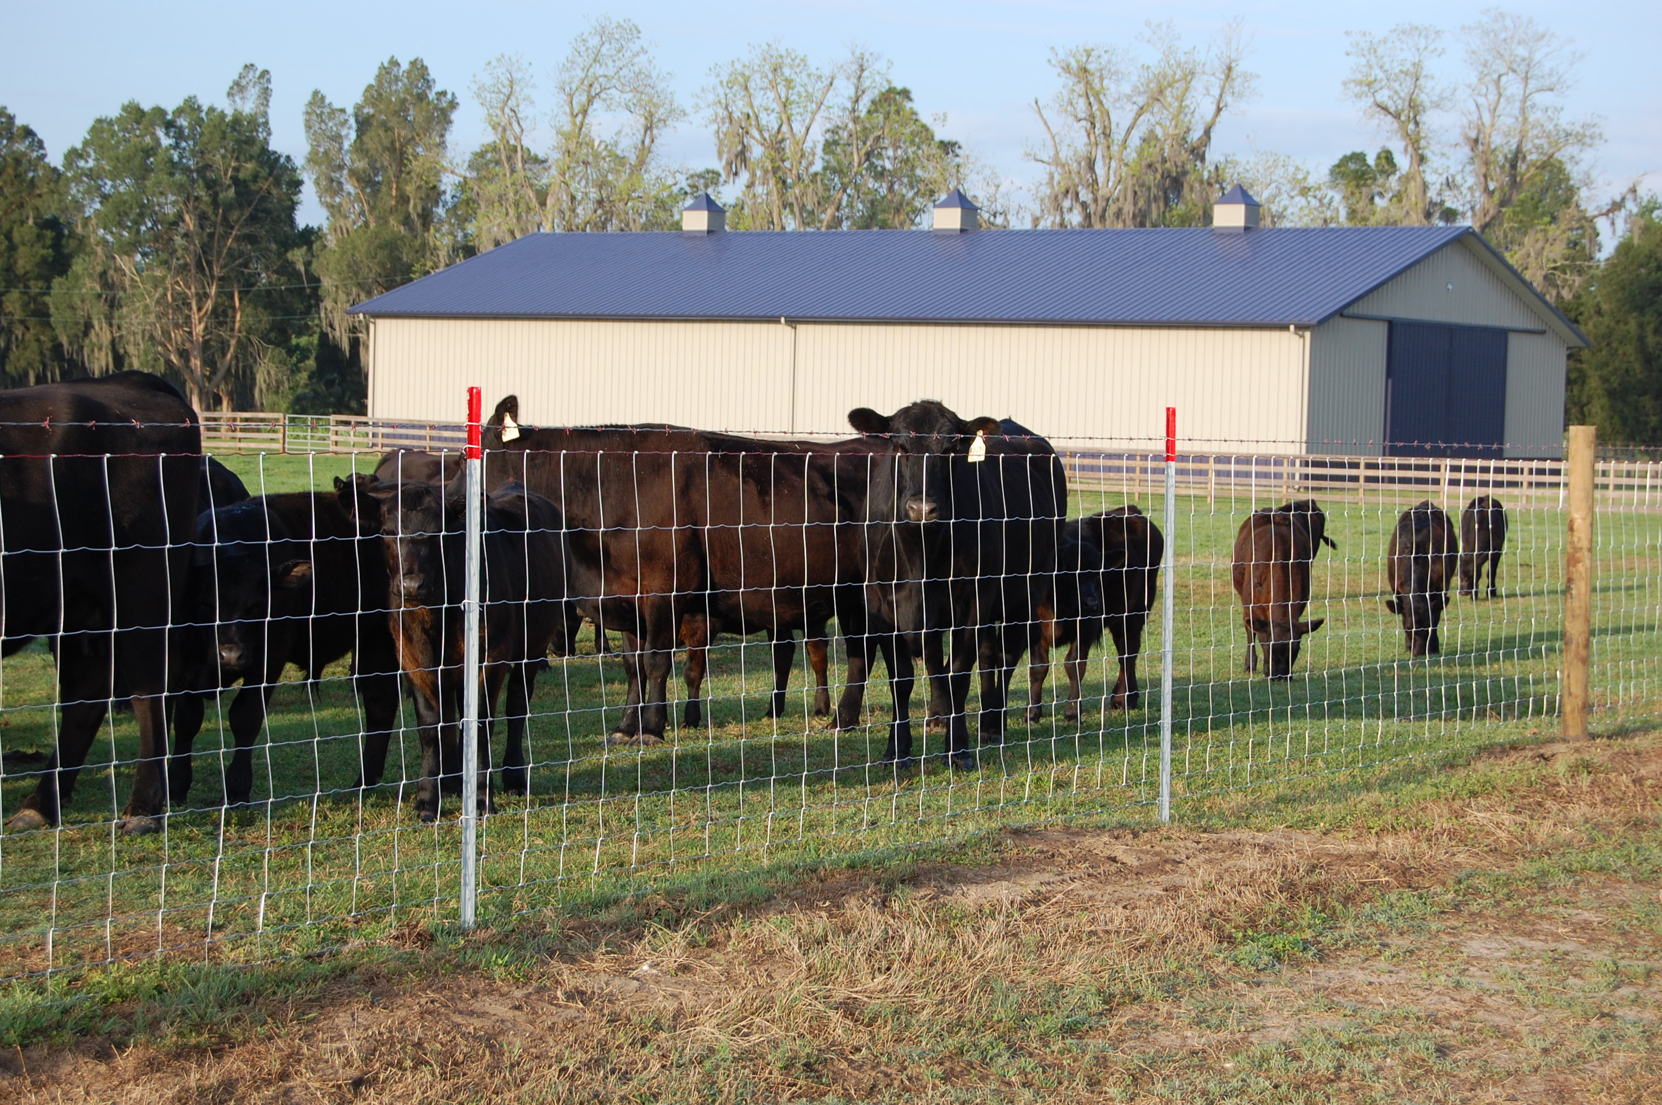
GENERAL FENCING INFO
Fence Value
Addition to Property
• Keep livestock in
and predators out
• Provide safety
and security
• Direct movement of
animals and machinery
• Reduce trespassing
• Enhance property
appearance
• Define property lines

Slide 3
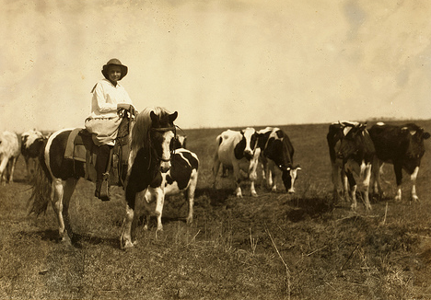
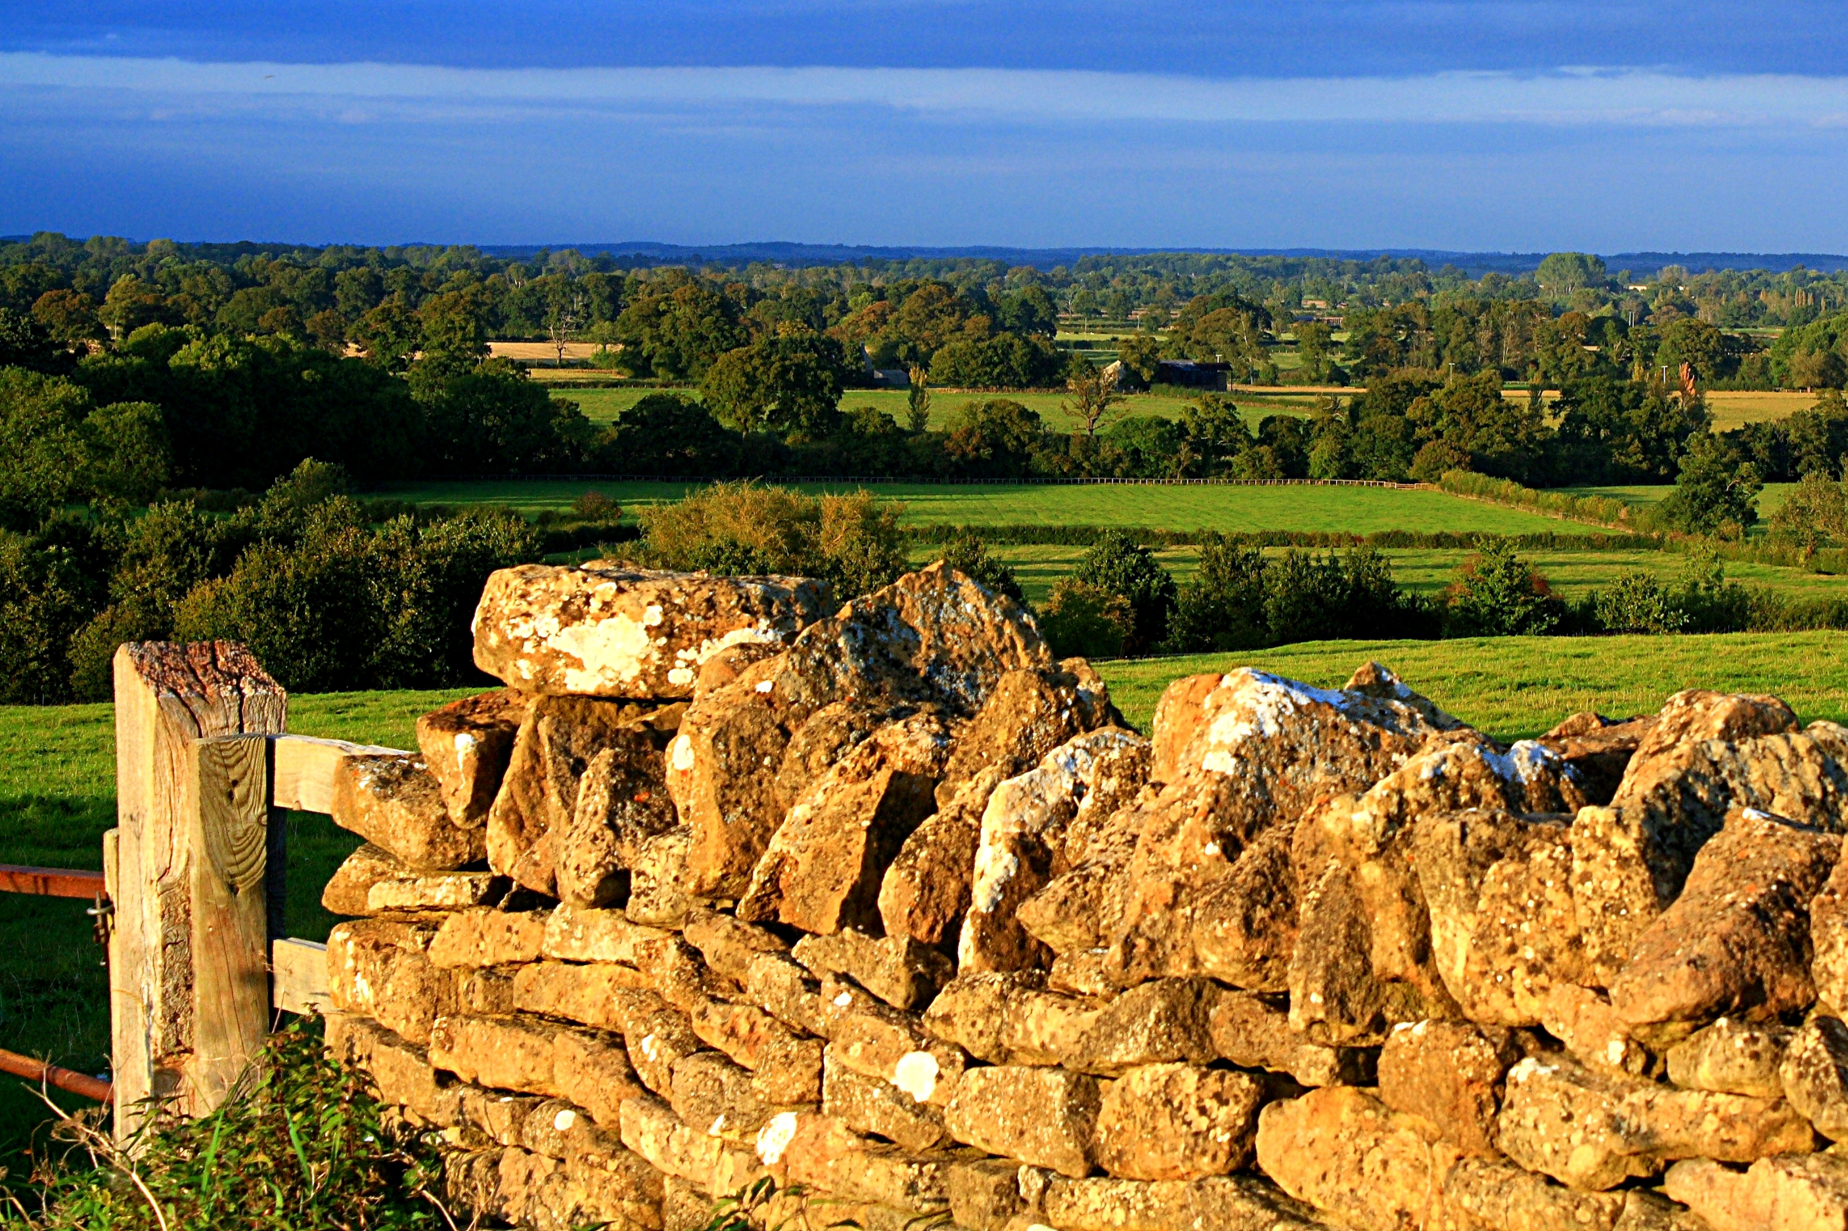
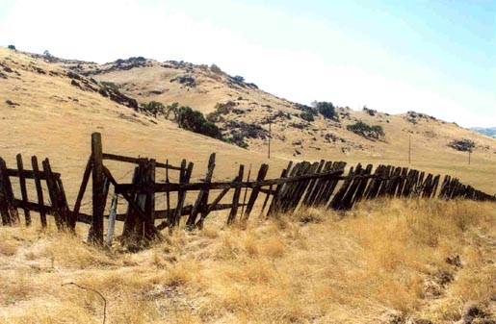
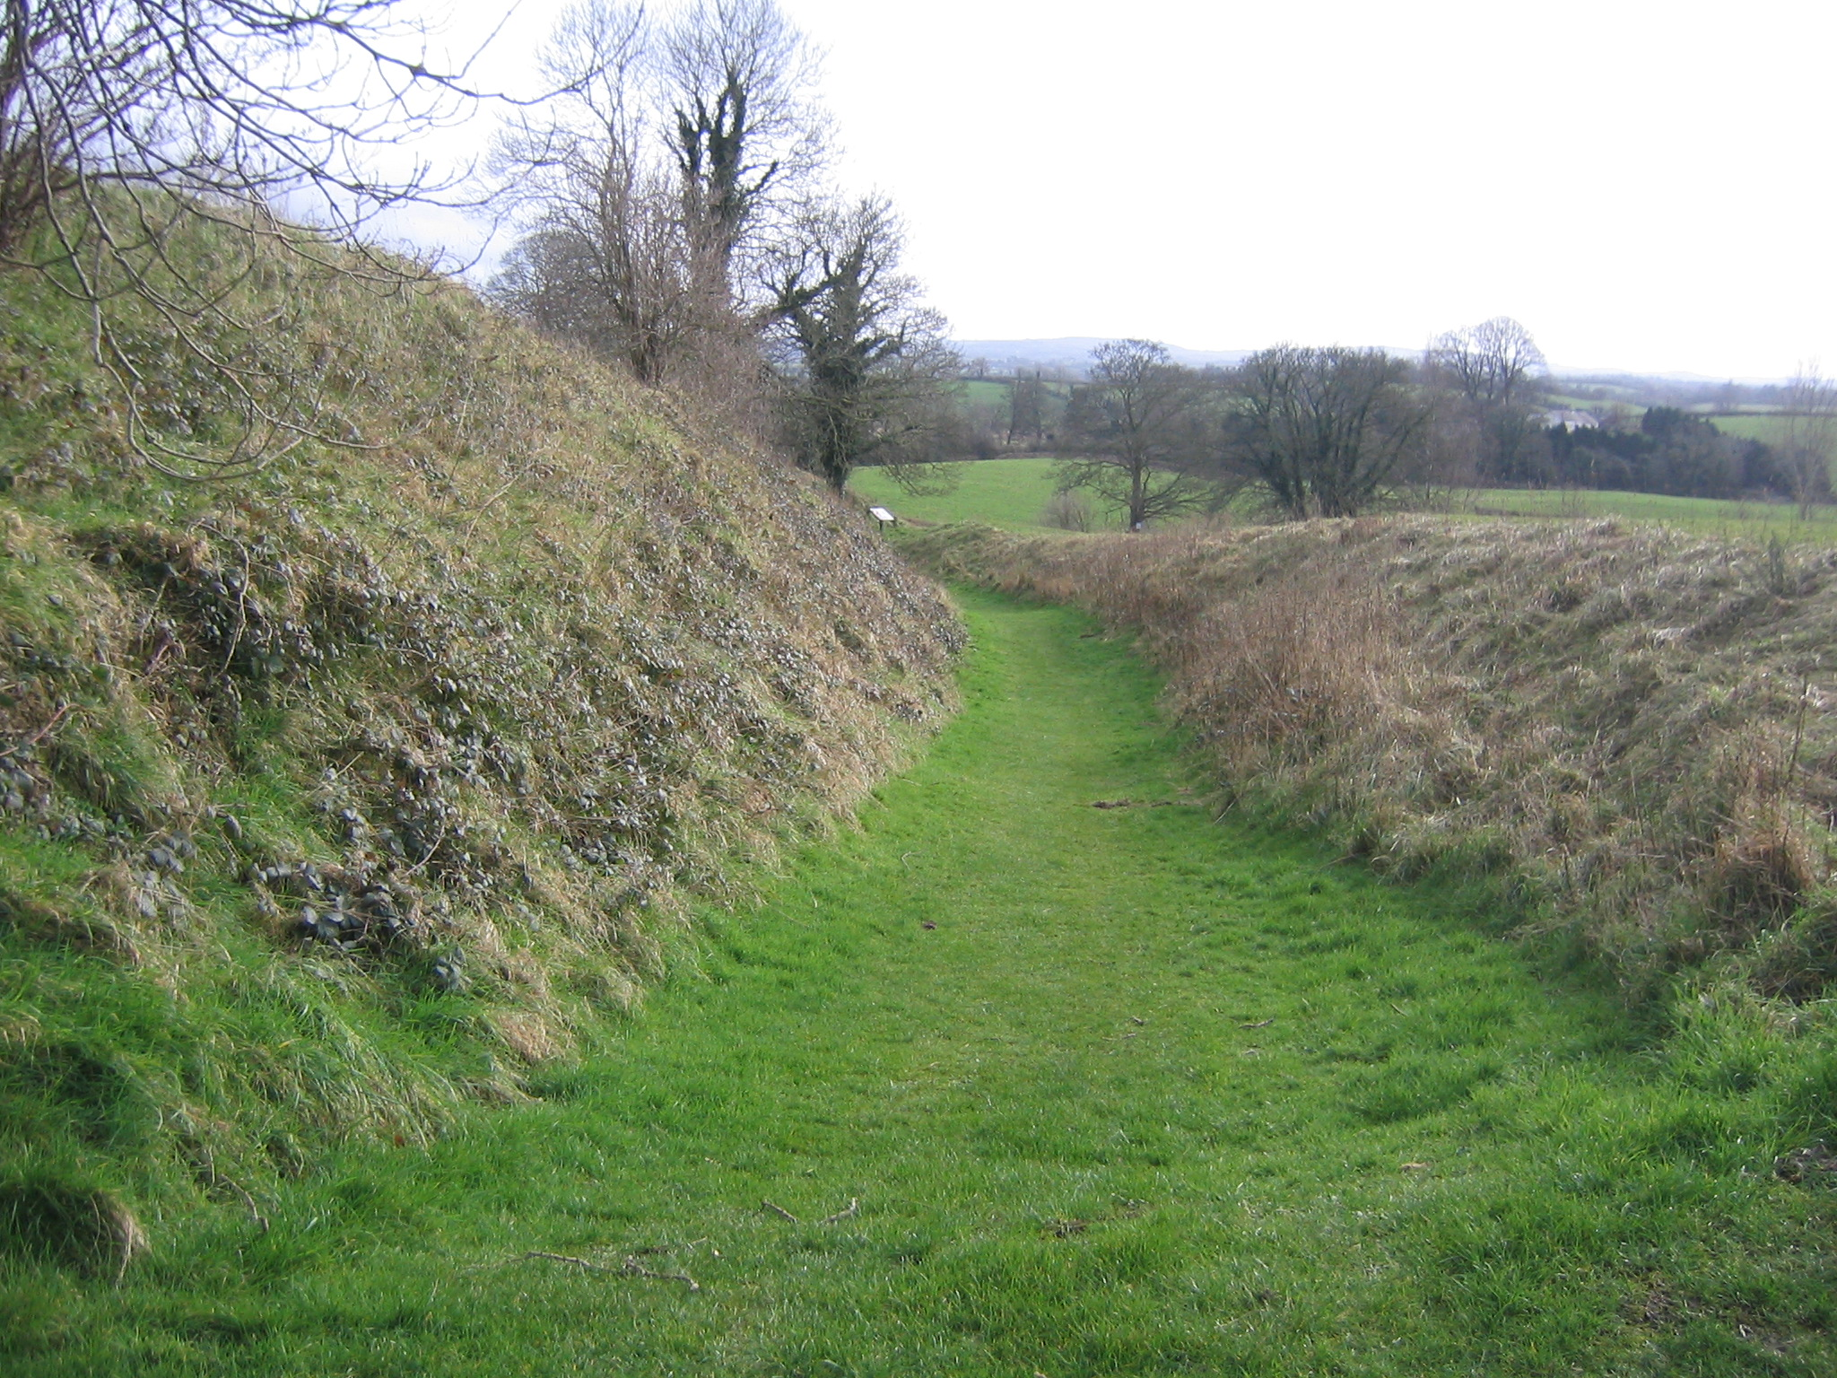
GENERAL FENCING INFO
History of
Agricultural Fence
Free Roam
Stone Fence
Wood Fence
Sunken Fence

Slide 4
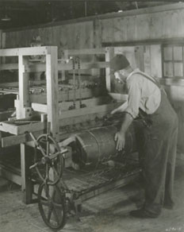
GENERAL FENCING INFO
First Woven Wire
Fence Machine
• 1889 – Peter Sommer invented the first wire fence machine
• It took 16 hours to produce 200’ of fence
• Keystone Steel & Wire founded in 1889 creating Red Brand

Slide 5
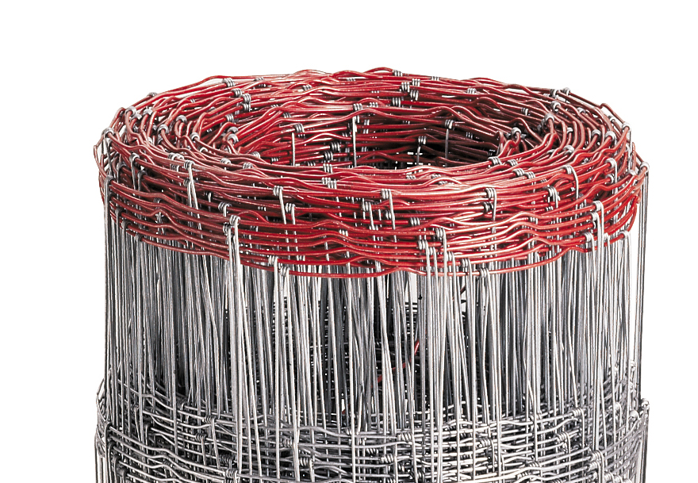
GENERAL FENCING INFO
About Red Brand
• Today can produce
100’ of fence in minutes
• Produce enough barbed wire in 1 year to wrap the earth’s
circumference 6 times
• Distinctive red top line wire
• Still American-made

Slide 6
Wire Gauge

Slide 7
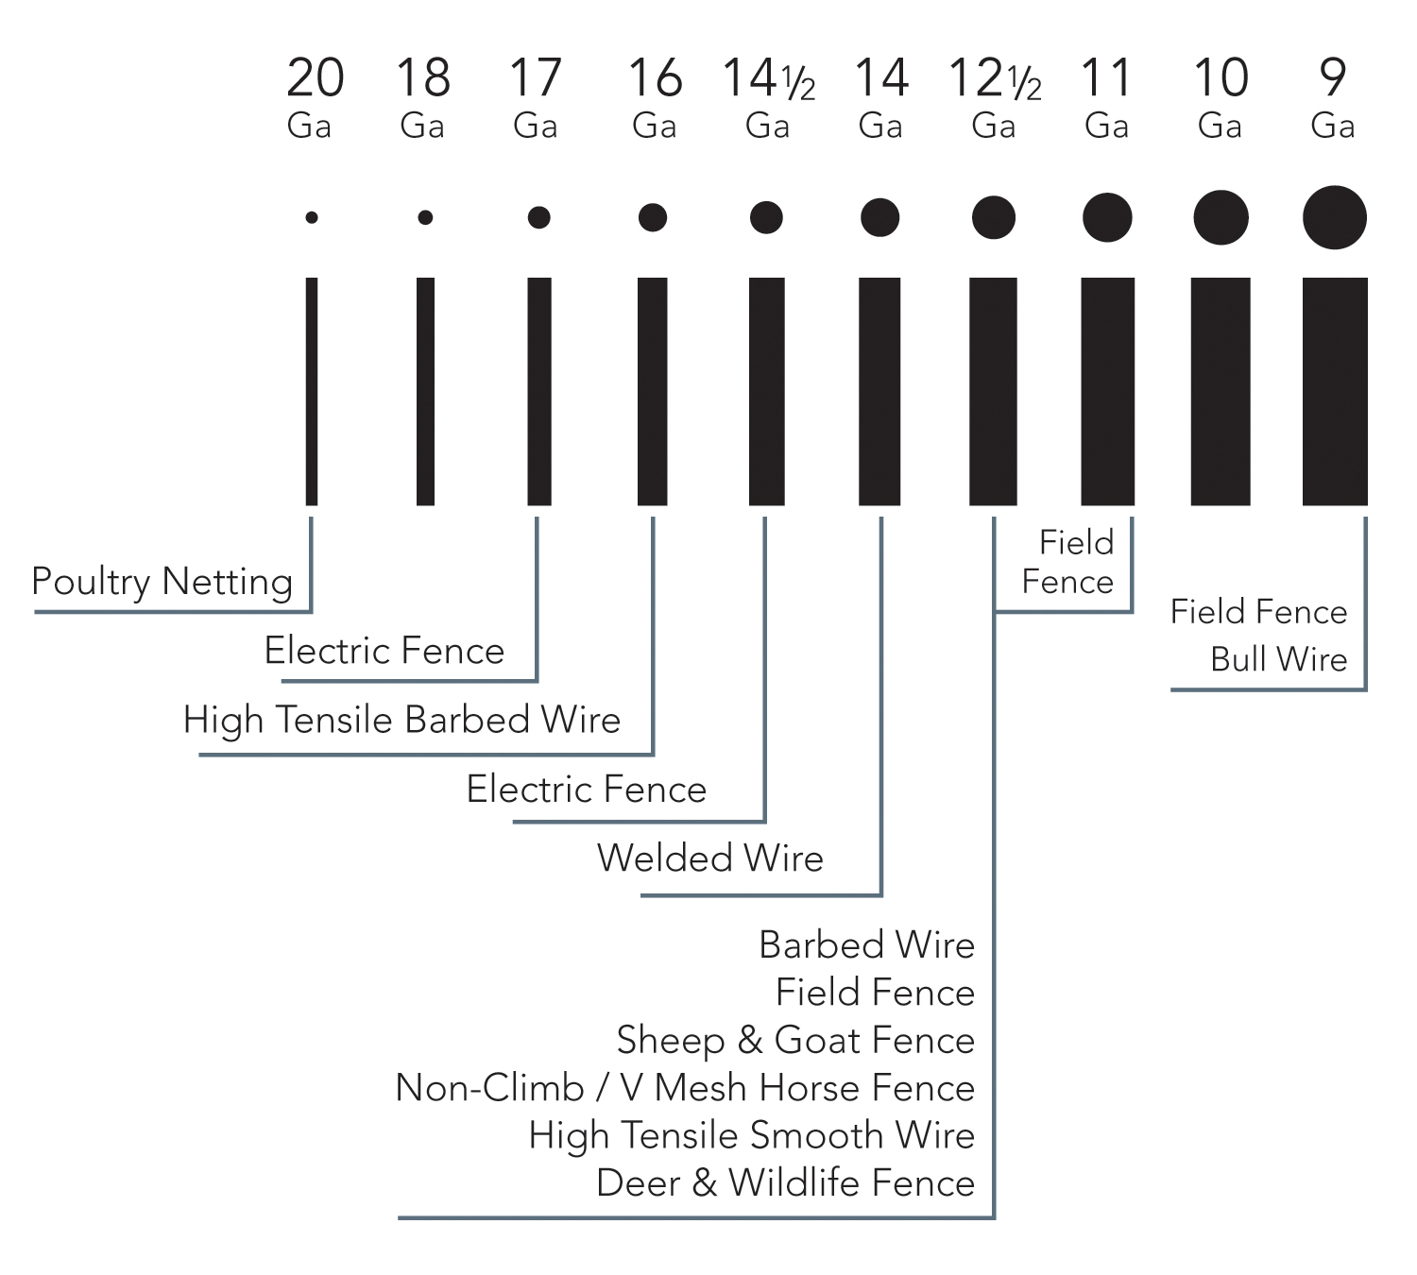
WIRE GAUGE
• Gauge describes the weight and size of wire
• The larger the number
the smaller the wire
9 gauge wire =
3mm = 3/32”

Slide 8
Galvanized Zinc Coating

Slide 9
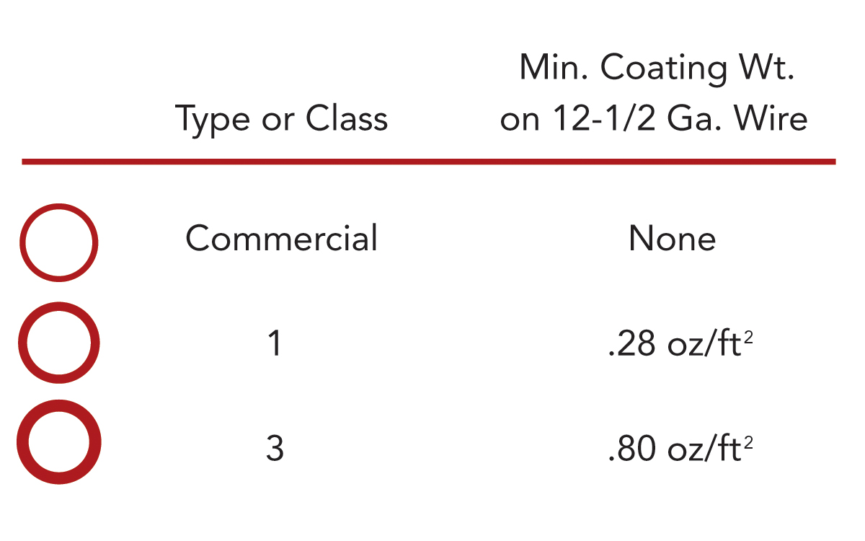
GALVANIZED
ZINC COATING
• Steel is coated with zinc
to protect it from rusting
• 3 Coating Types
  - Class 3
  - Class 1
  - Commercial
• Class 3 will last 2½ times longer than Class 1

Slide 10
Types of Wire

Slide 11
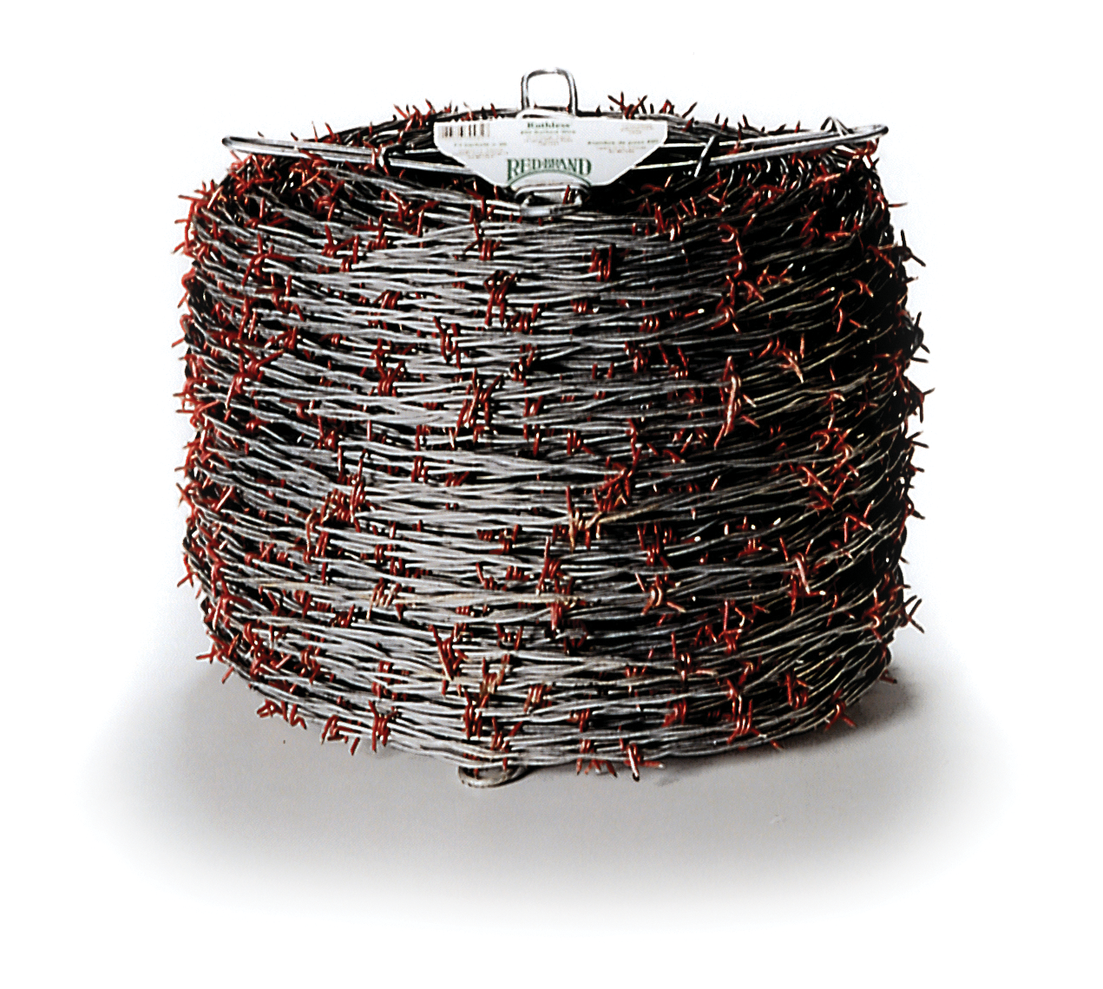
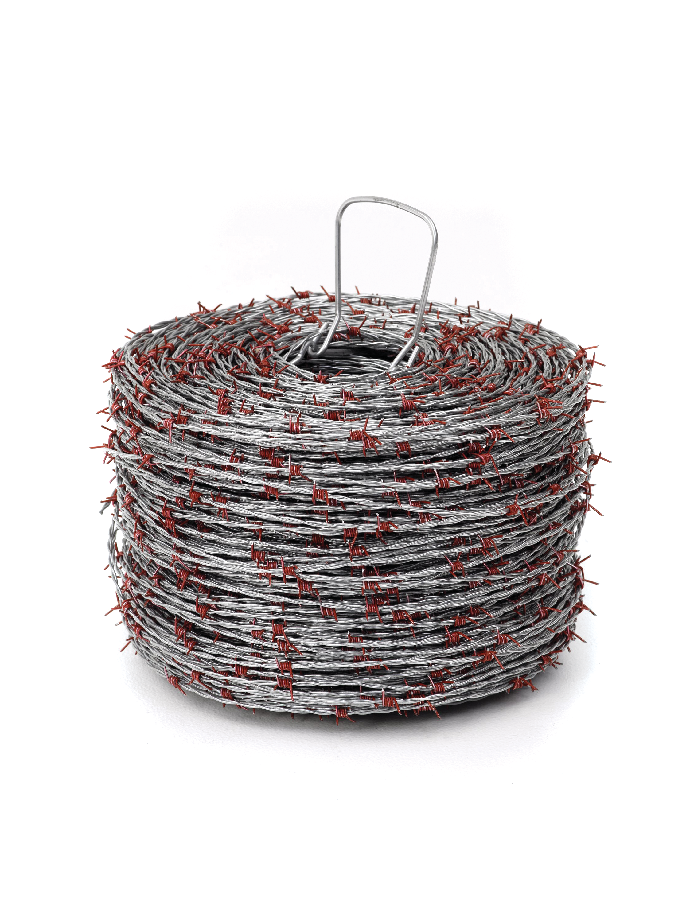
TYPES OF WIRE
Low Carbon
• Contains approx 0.05 – 0.15 carbon content
• Very malleable (bends easy)
• 8-11% elongation
• 85% of ag fencing made today is from low carbon
High Tensile
• High tensile contains approx
0.6–0.99% carbon content
• 1-3% elongation
• Lighter weight, thinner wire, same break strength
Both rolls are 1,320’ long

Slide 12
Fence Knots

Slide 13



FENCE KNOTS
Monarch Knot
• Acts as a hinge that gives under pressure
• Allows the fence to spring back into shape
Square Deal
• Prevents Red Brand fence from buckling or sagging
• Provides extra strength and rigidity with flexibility for ideal installation over hilly terrain
Cross Lock
• Firmly affixes the fence wires together
• Provides superior resistance to movement
from animal penetration or severe snowstorms

Slide 14
Reading Fence Style Numbers

Slide 15
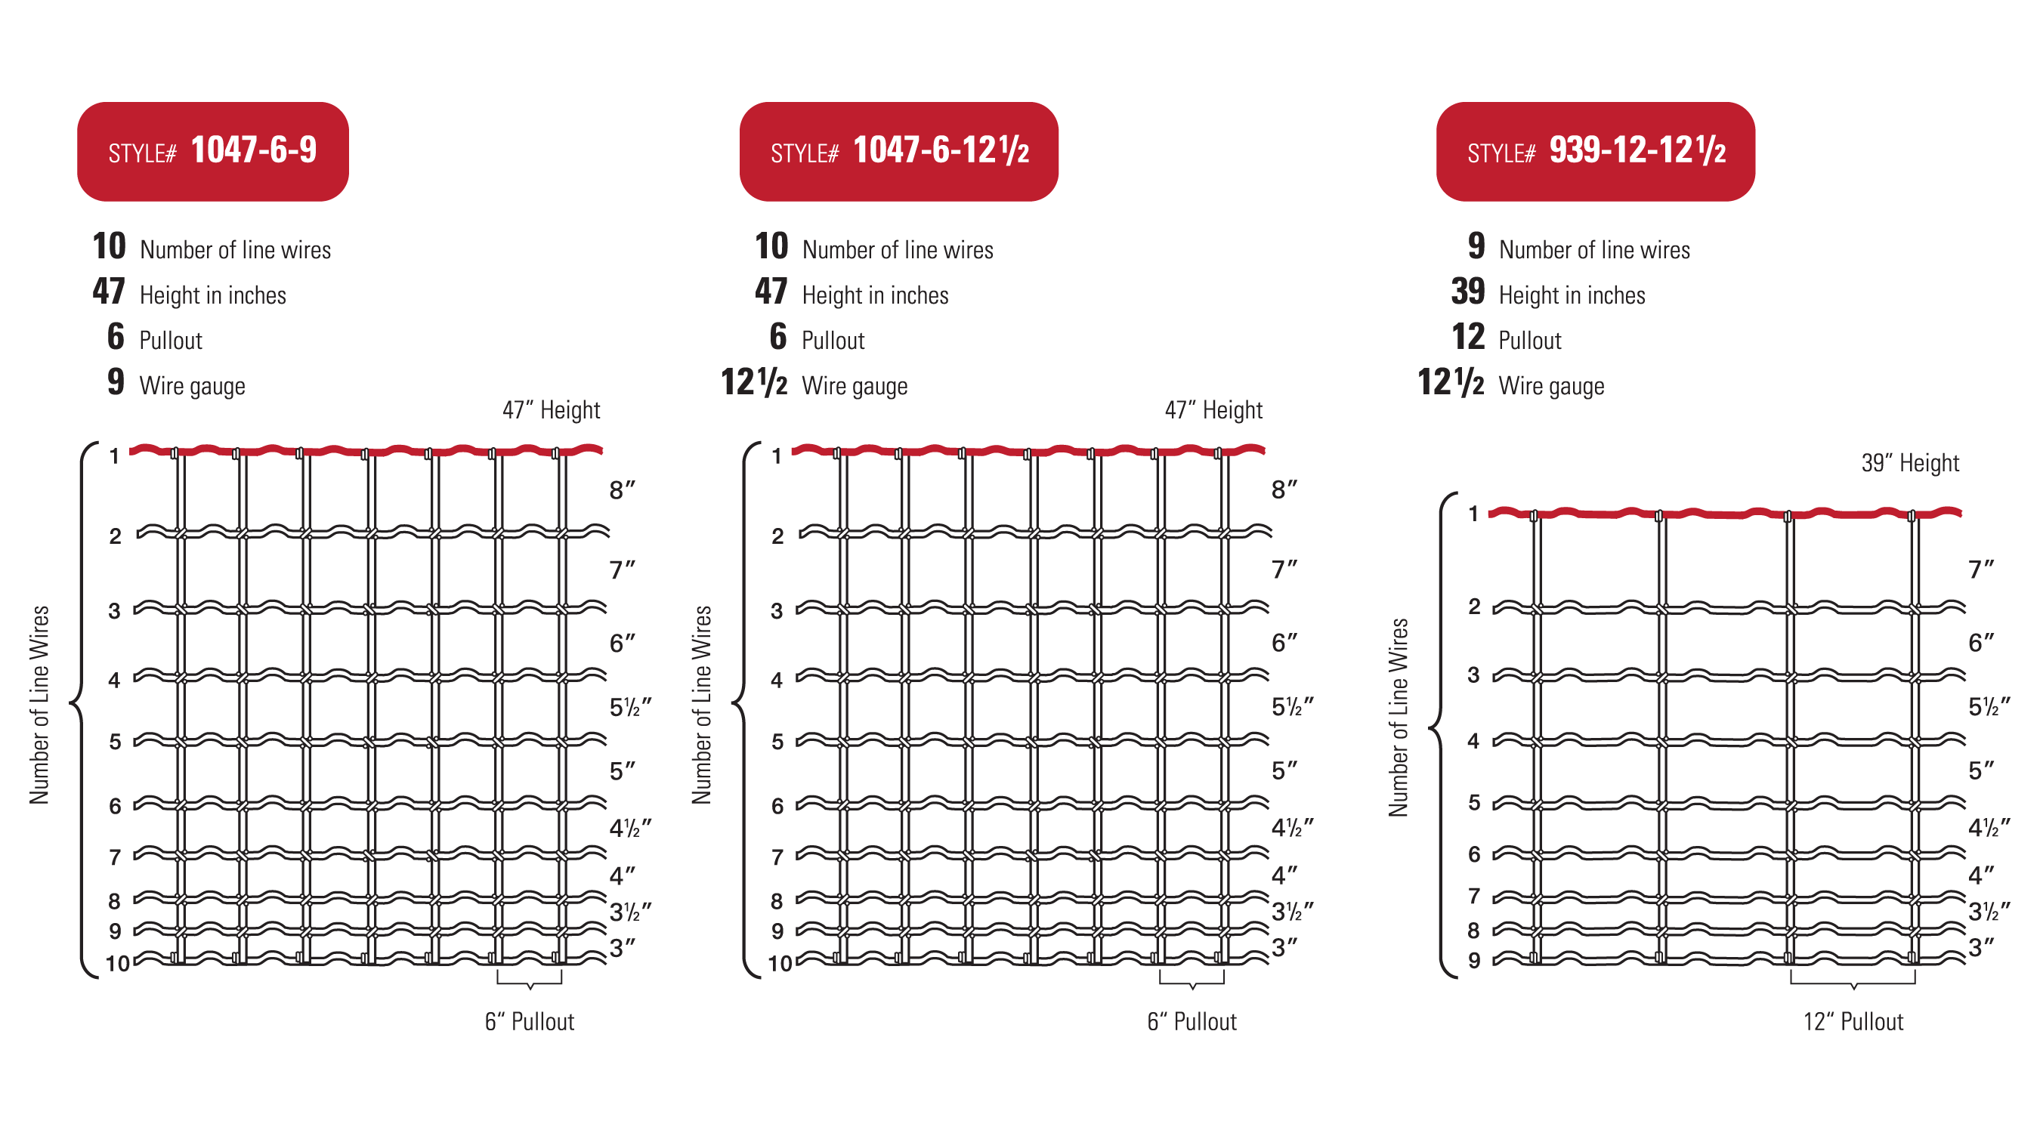
READING FENCE STYLE NUMBERS
Example 1
Example 2
Example 3

Slide 16
Types of Fence

Slide 17
TYPES OF FENCE
• Multi-Use Woven Field Fence
• Non-Climb Horse Fence
• Keepsafe® V-Mesh Horse Fence
• Sheep & Goat Fence
• Deer & Orchard Fence
• Deer & Wildlife Fence
• Barbed Wire
• Stockade Panels
• Welded Wire
• Poultry Netting
• Apron Fence
• Yard, Garden, and Kennel

Slide 18
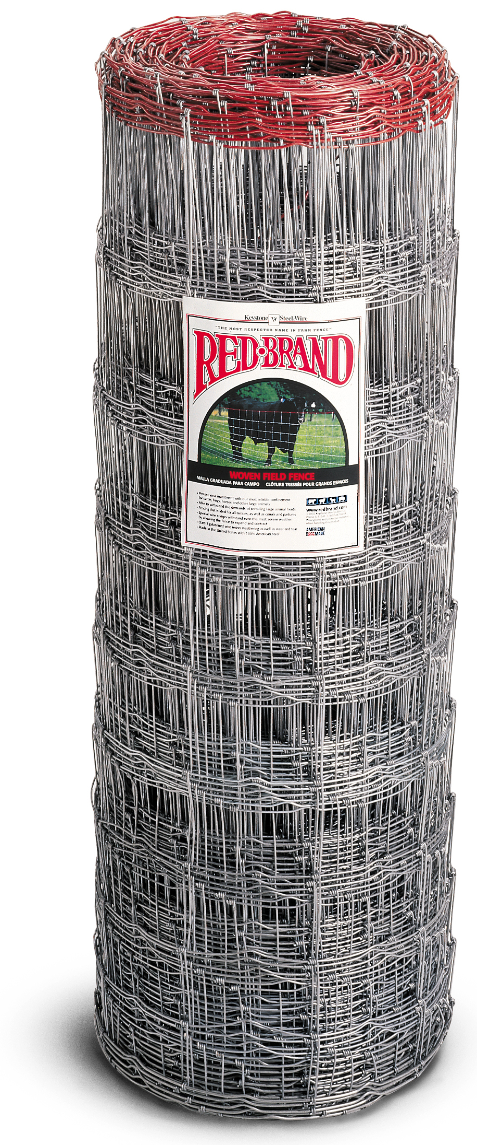
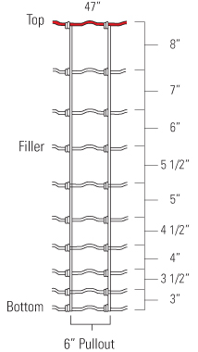
TYPES OF FENCE
Show Field Fence Swatches
Multi-Use Woven Field Fence
Features | Benefits
Available in multi-use and heavy duty styles | Versatile
Sturdy construction | Provides reliable containment for livestock
Ideal for all terrain, including corrals and pastures | Easy of installation
Zinc coating | Longevity
Monarch® Knot | Acts like a hinge under pressure
Square Deal® Knot | Doesn’t slip, prevents buckling and sagging
Cross Lock® Knot | Resists movement from animals and severe snowstorms
High Tensile | Light weight, thinner alternative with same break strength

Slide 19
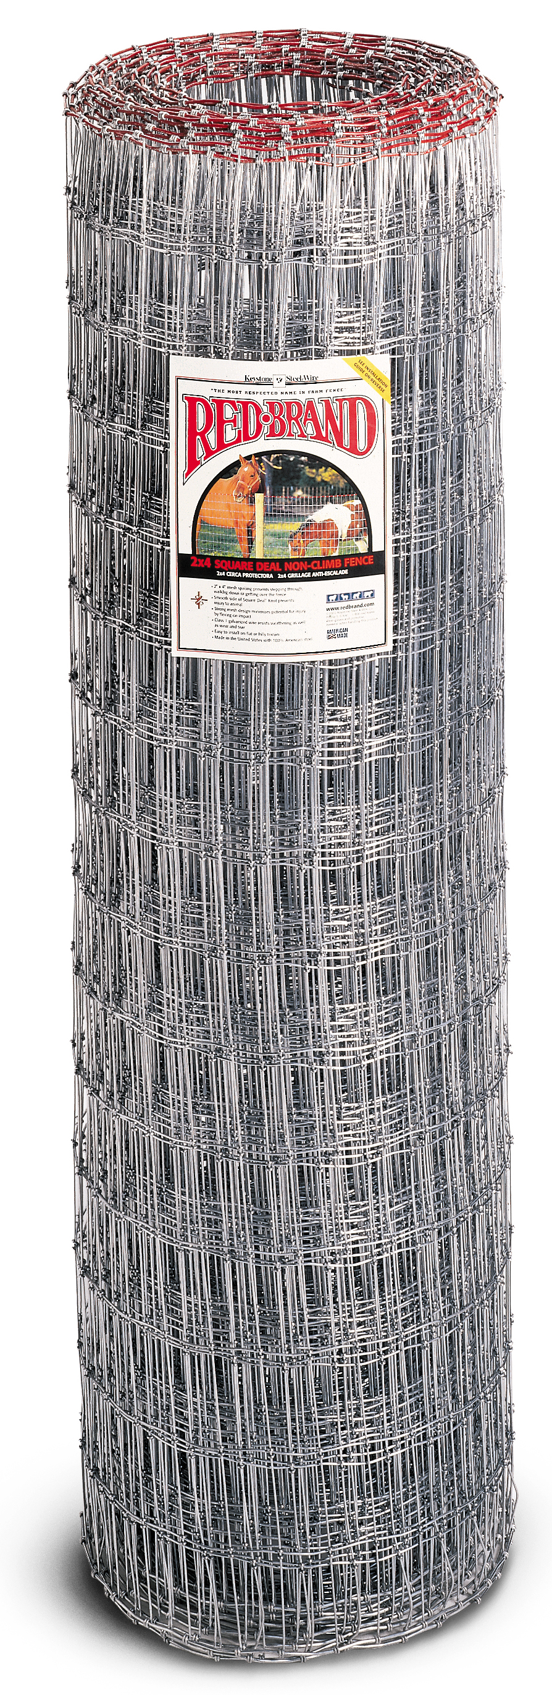
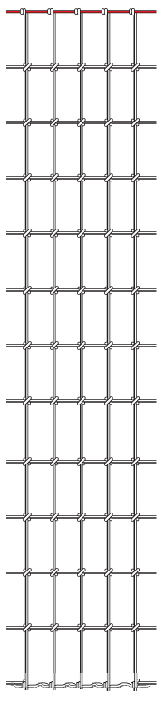
TYPES OF FENCE
Show Non-Climb Swatch
Non-Climb Horse Fence
Features | Benefits
Unique 2” x 4” spacing | Prevents stepping through
Smooth Square Deal® Knot | Protects hides from injury
Strong mesh design | Keeps unwanted animals out, provides safety
Zinc coating | Longevity
4”
2”

Slide 20
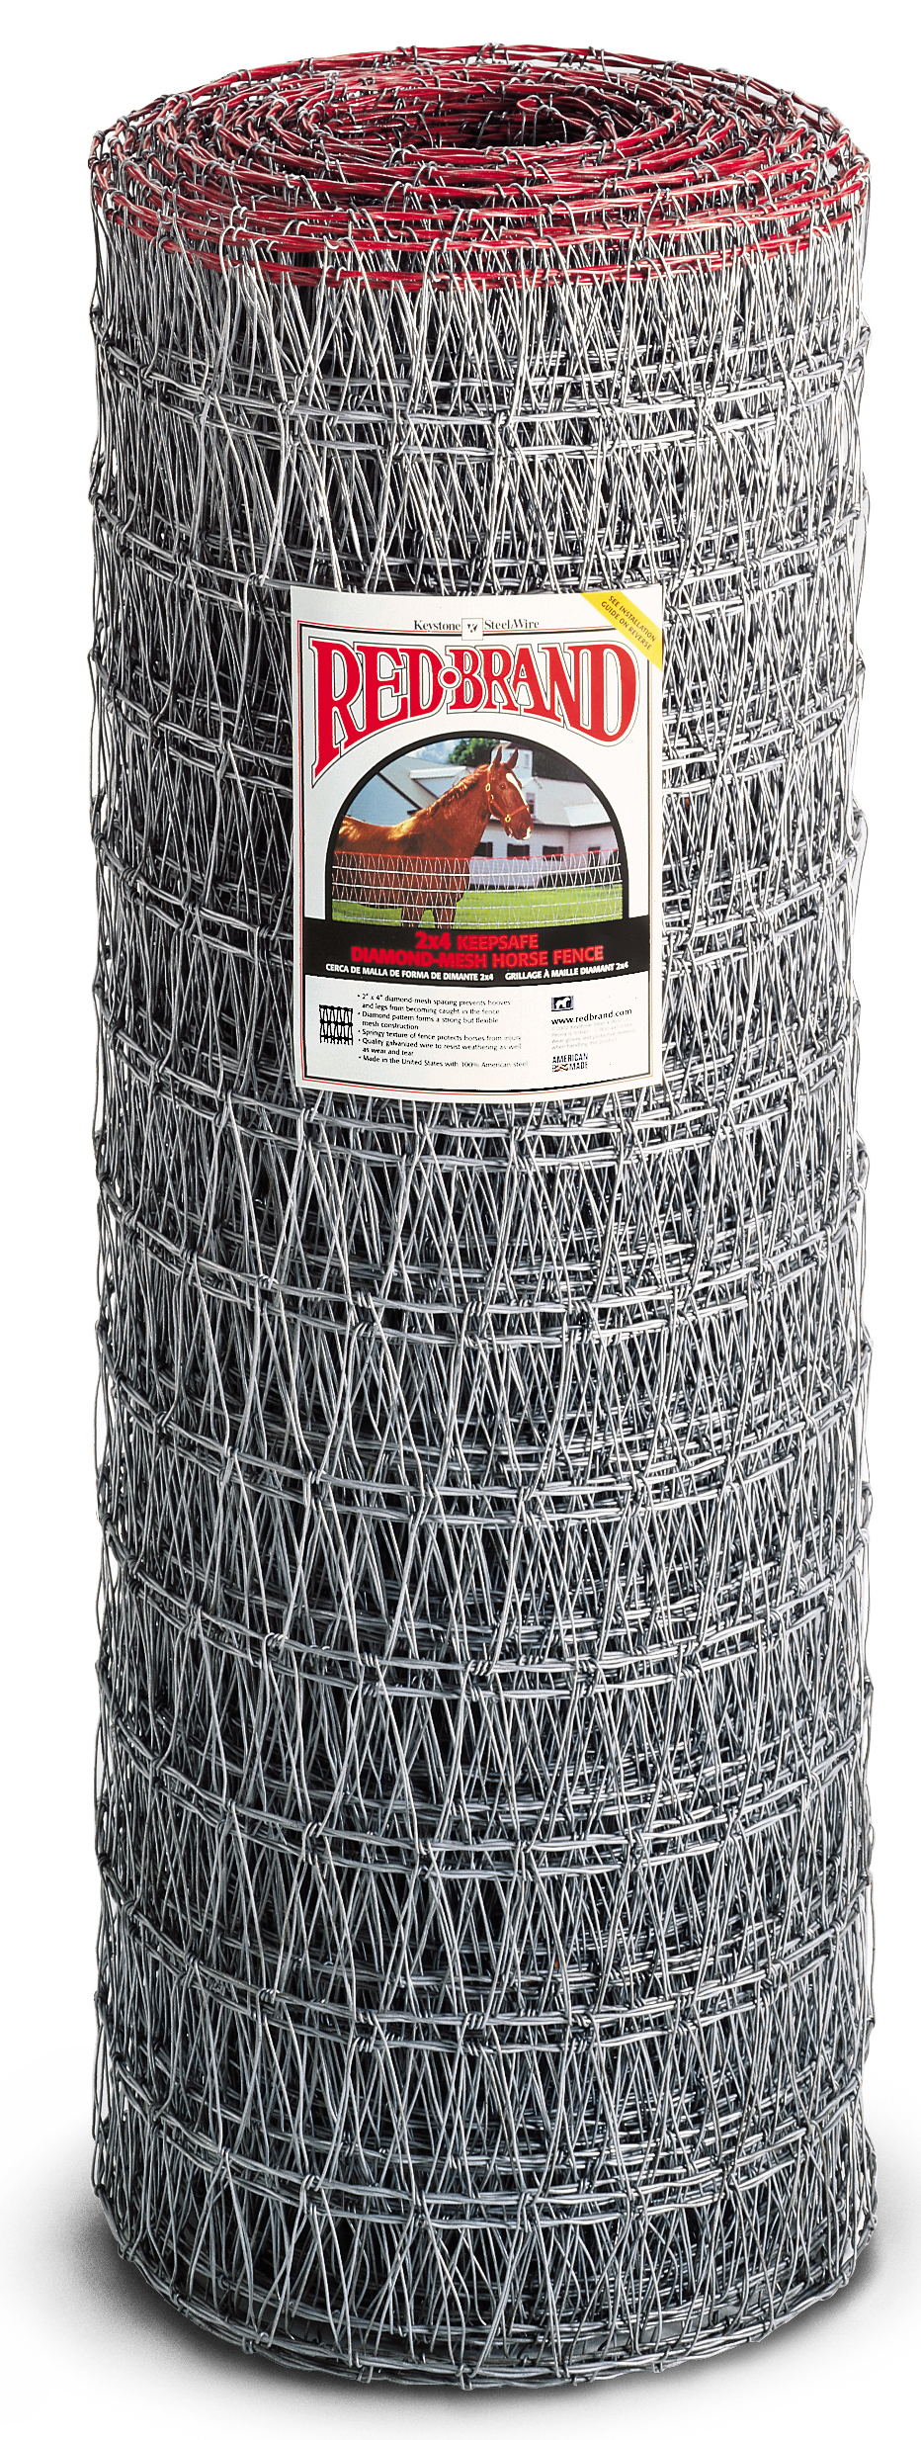
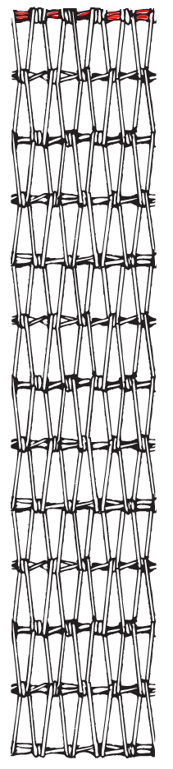
TYPES OF FENCE
Show Keepsafe® V-Mesh Horse Fence Swatch
Keepsafe® V-Mesh Horse Fence
Features | Benefits
Unique 2” x 4” v-mesh spacing | Prevents hooves from getting caught, keeps unwanted animals out
Continuous v shape pattern weave | Strength and flexibility, minimizes potential for injury
Zinc coating | Longevity
4”
2”

Slide 21
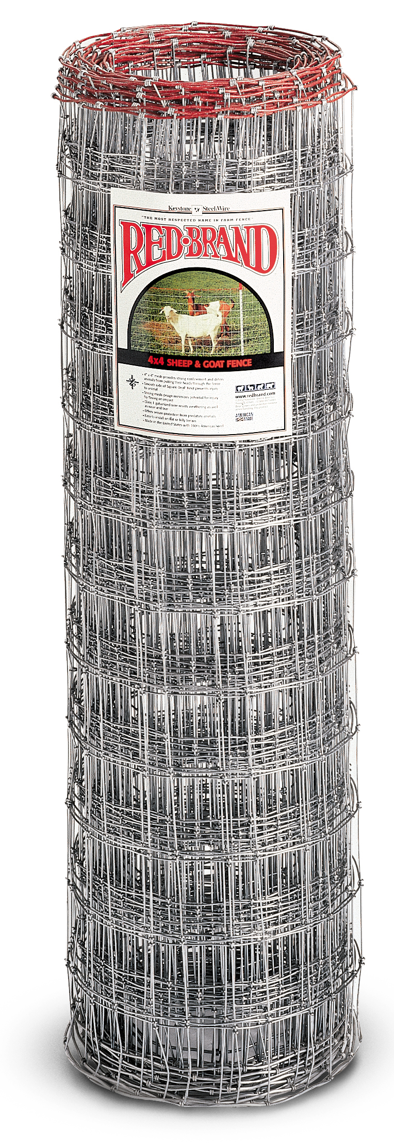
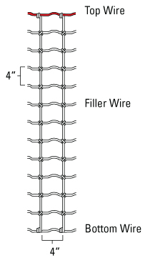
TYPES OF FENCE
Show Sheep & Goat Swatch
Sheep and Goat Fence
Features | Benefits
4” x 4” mesh spacing | Prevents goats from getting their heads stuck
Smooth Square Deal® Knot | Protects hides from injury
Strong mesh design | Flexes on impact
Zinc coating | Longevity

Slide 22
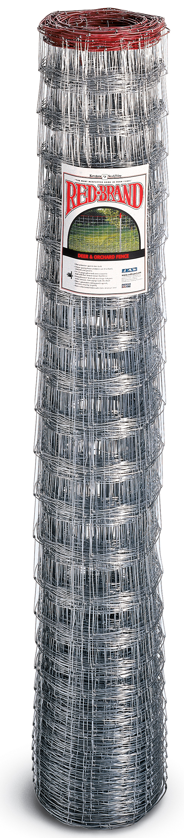
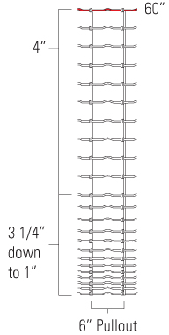
TYPES OF FENCE
Show Deer and Orchard Swatch
Deer and
Orchard Fence
Features | Benefits
Close spacing at bottom | Keeps small vermin from entering enclosure
Monarch® Knot | Acts like a hinge under pressure
Ideal for all terrain, including corrals and pastures | Ease of installation
Zinc coating | Longevity

Slide 23
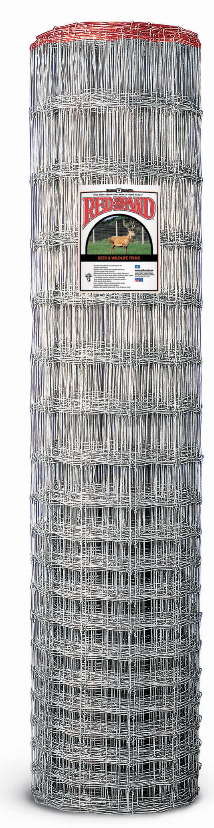
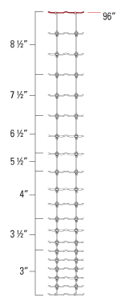
TYPES OF FENCE
Show Deer and Wildlife Swatch
Deer and Wildlife Fence
Features | Benefits
Close spacing at bottom | Prevents small animals from getting their heads stuck
CrossLock® Knot | Provides superior resistance to movement
96 inch tall fence | Prevents deer from jumping over
Zinc coating | Longevity

Slide 24
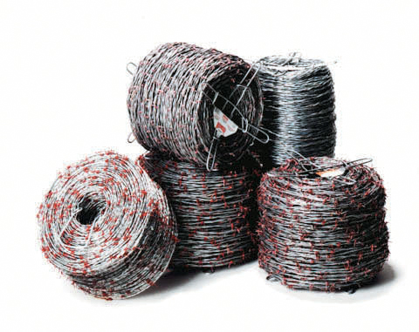
TYPES OF FENCE
Show Barbed Wire Swatches
Barbed Wire
Features | Benefits
Sharp points | Presents hurt factor to animals
Strong barbs | Resists bending
Twisted cable | Provides strength to the fence
Zinc coating | Longevity
High Tensile Barbed Wire | Light weight, thinner alternative, same break strength

Slide 25
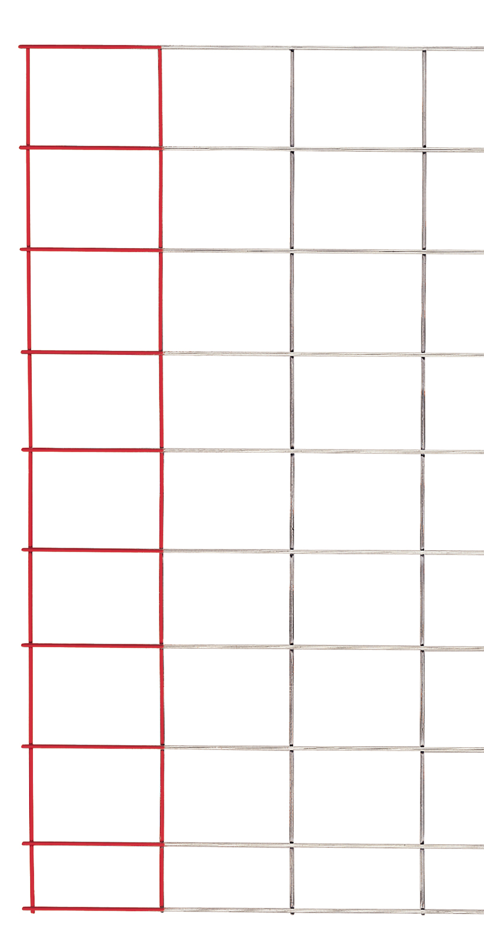
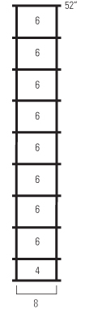
TYPES OF FENCE
Show Panel Swatch
Stockade Panels
Features | Benefits
Solid rigid construction | Easy to install, provides strength and durability
Sturdy welded construction | Will not fail under animal pressure
Several gauges and heights available | Match specific animal confinement need
Zinc coating | Longevity

Slide 26
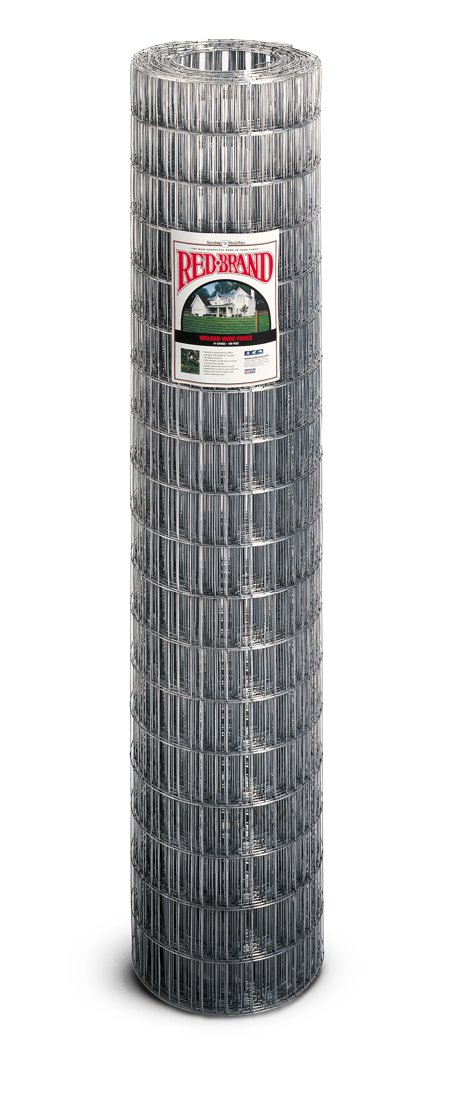
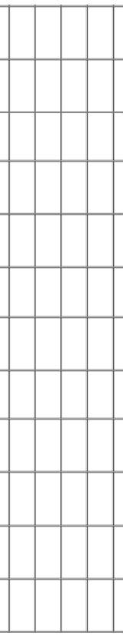
TYPES OF FENCE
Show Welded Wire Swatch
Welded Wire Fence
Features | Benefits
General purpose fence | Variety of outdoor projects
Varying mesh sizes, heights and lengths | Matches specific fencing criteria
Sturdy Welds | Uniform mesh pattern
Zinc coating | Longevity
4”
2”

Slide 27
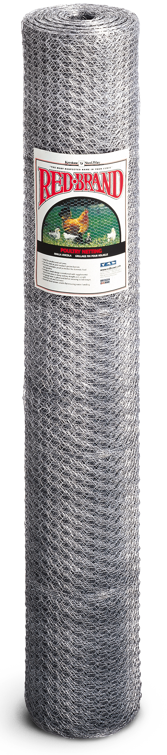
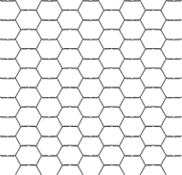
TYPES OF FENCE
Show Poultry Netting Swatch
Poultry Netting
Features | Benefits
Close hexagonal spacing | Ideal for poultry and pet pens
Additional horizontal line wire | Add strength
Reverse twist weave | Resists unraveling
Zinc coating | Longevity
1”

Slide 28
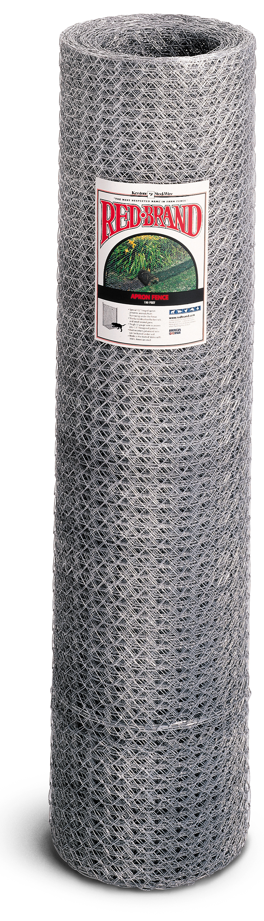
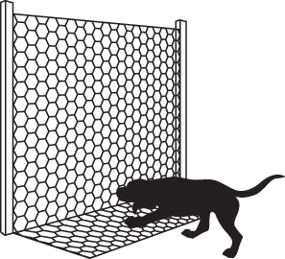
TYPES OF FENCE
Show Apron Fence Swatch
Apron Netting
Features | Benefits
Close hexagonal spacing | Ideal for poultry and pet pens
12” hinge apron | Prevents animals from burrowing
Constructed from 17 gauge wire | Strength and rigidity for a secure pen
Zinc coating | Longevity
60”

Slide 29
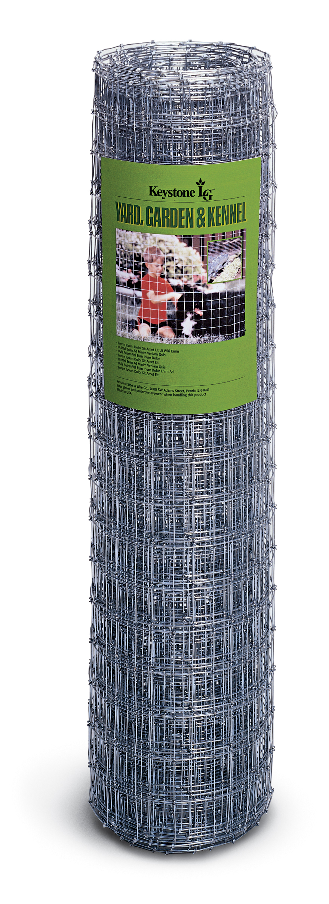
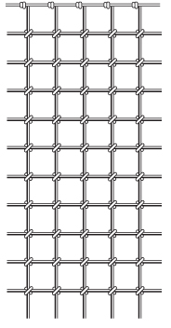
TYPES OF FENCE
Show YG&K Swatch
Yard, Garden,
and Kennel Fence
2”
Features | Benefits
2” x 2” mesh spacing | Keepsafe yards, gardens, toddlers and pets
Smooth Square Deal® Knot | Protects hides from injury
Knotted not welded | Easy to install and strong
Zinc coating | Longevity
2”

Slide 30
Acreage Concepts

Slide 31
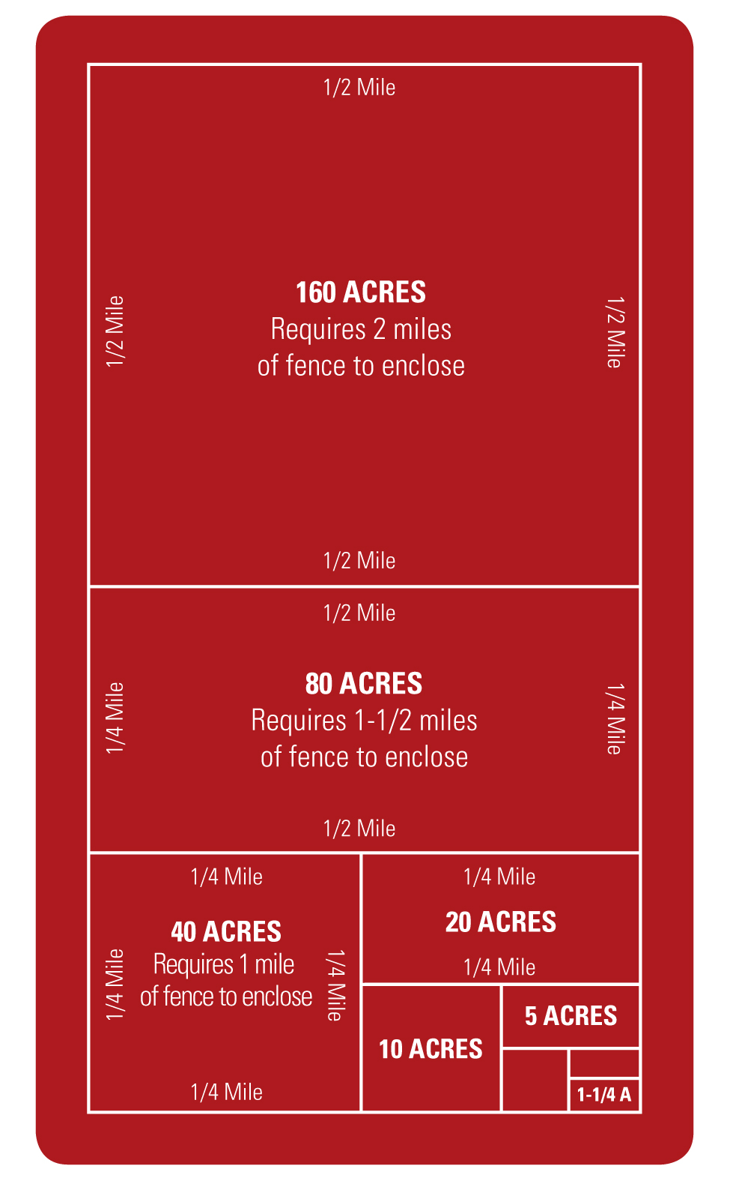
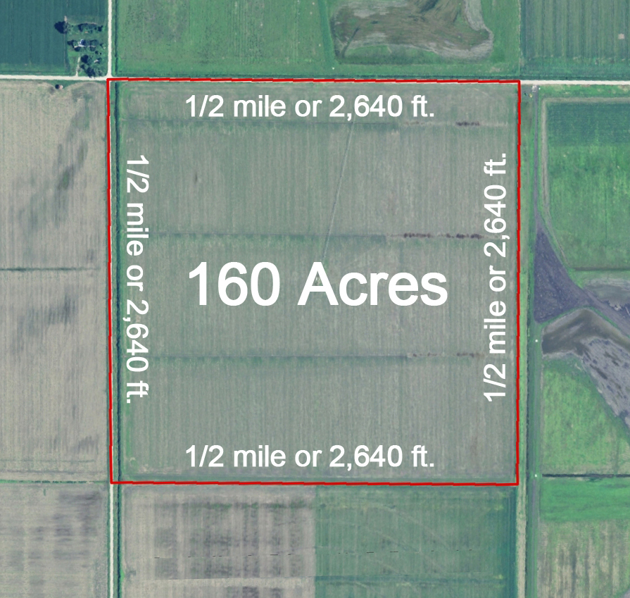
ACREAGE CONCEPTS
• Acre means “open field”
• Amount tillable by one man
behind one ox in one day
• 1 acre is almost the size of a football field or 208’ x 208’
• 160 acres was the most that
1 family could expect to farm
• Homestead Act of 1862
gave 160 acre partials
to 1.6 million families
1 mile = 5,280 feet
¹/₄ mile = 1,320 feet = 1 roll Barbed Wire
¹/₁₆ mile = 330 feet = 1 roll Field Fence

