Slide 1



Slide 2
90th Annual FFA Convention and Expo, October 25, 2017
Floral Design
Theory & Mechanics
David Kesler AIFD PFCI FDI
Leanne Kesler AIFD PFCI FDI
Floral Design is Easy……..
Teaching Floral Design Can Be Challenging

Slide 3


Slide 4
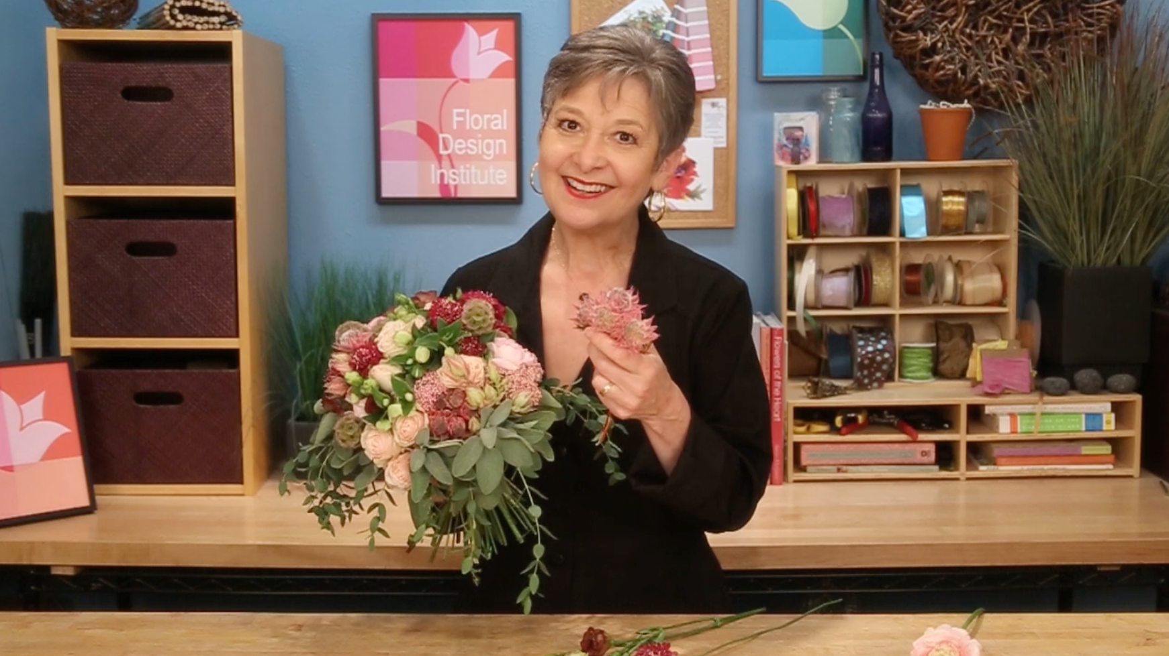

Slide 5


Slide 6


Slide 7

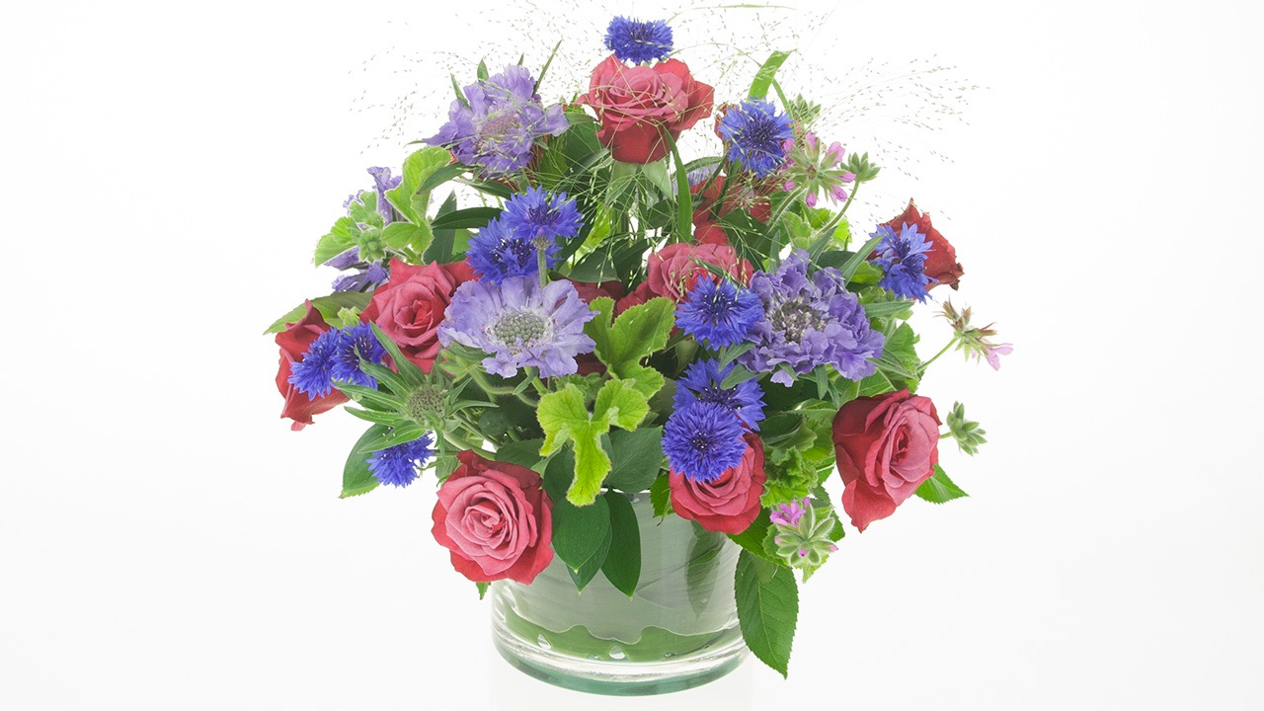
Basic Round Arrangement

Slide 8


Tools and Supplies

Slide 9


Care & Handling

Slide 10



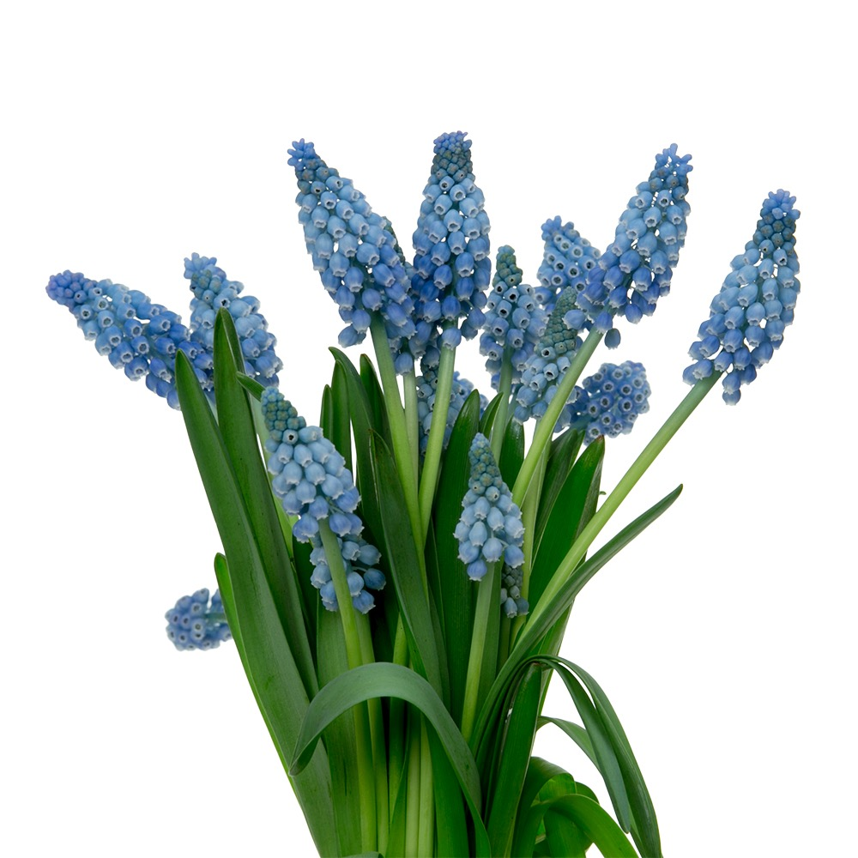


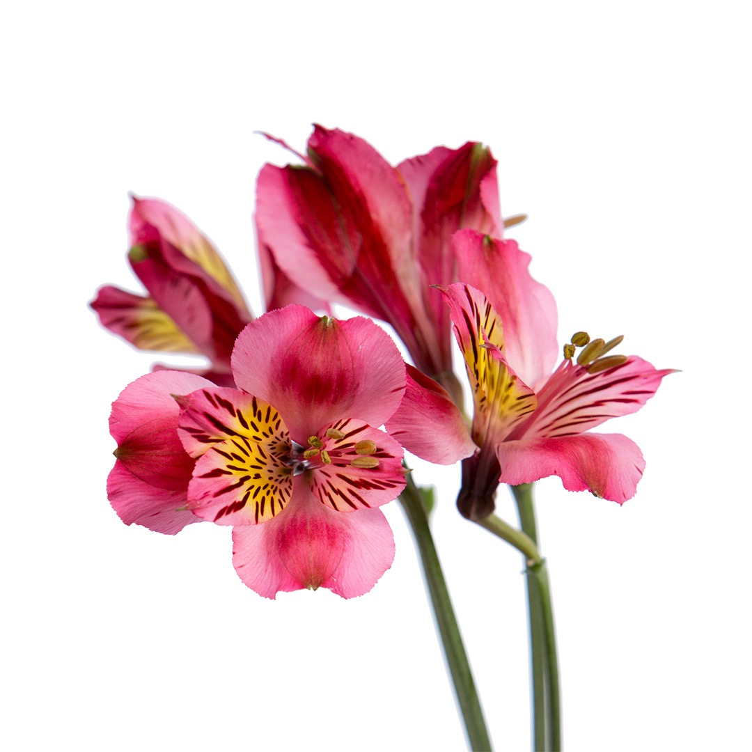
Identification

Slide 11


Floral Orb

Slide 12

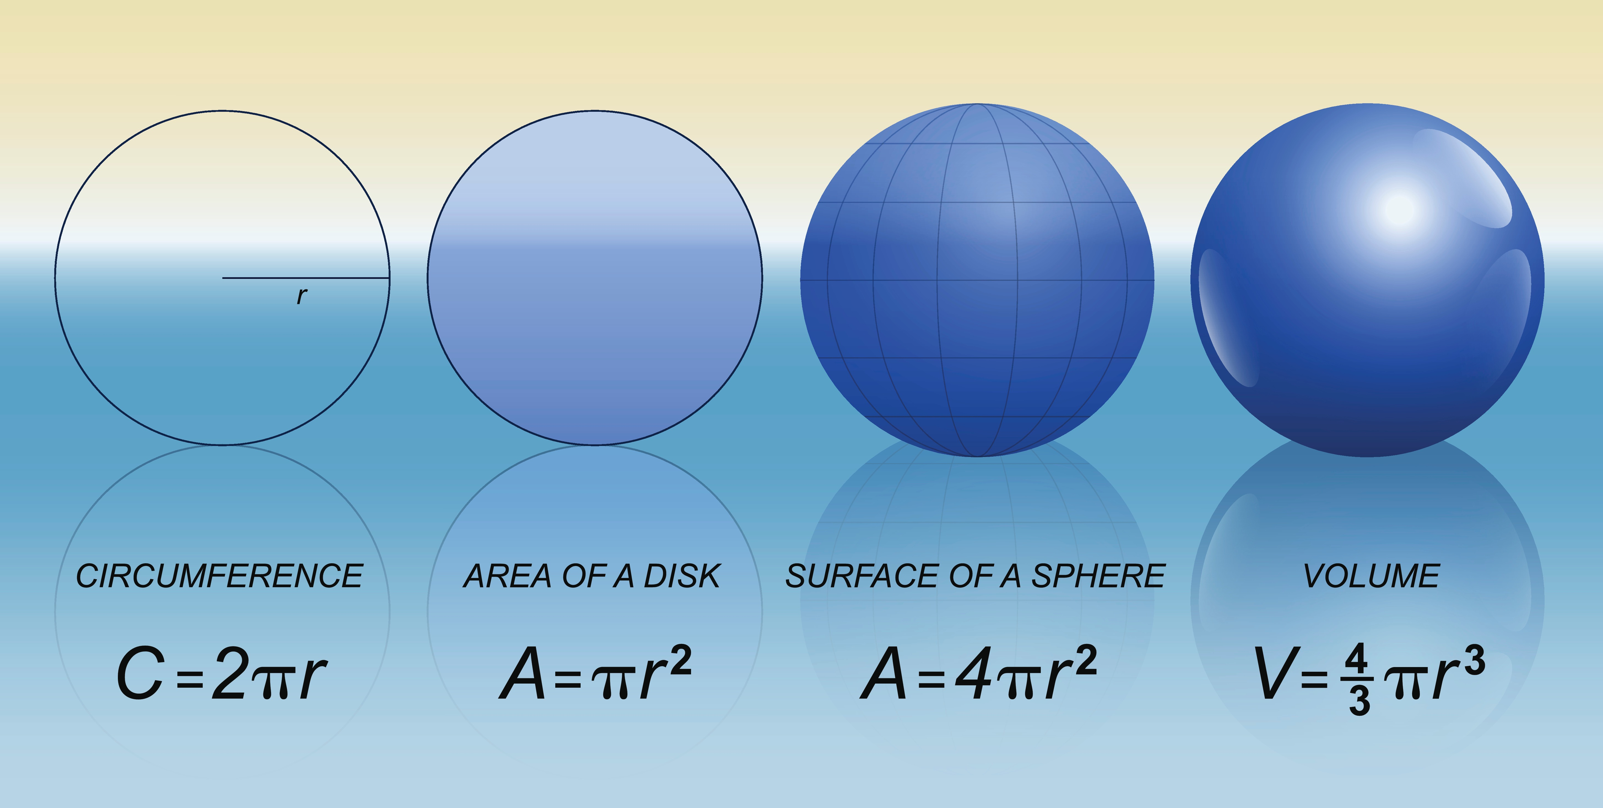
How Many Roses?

Slide 13

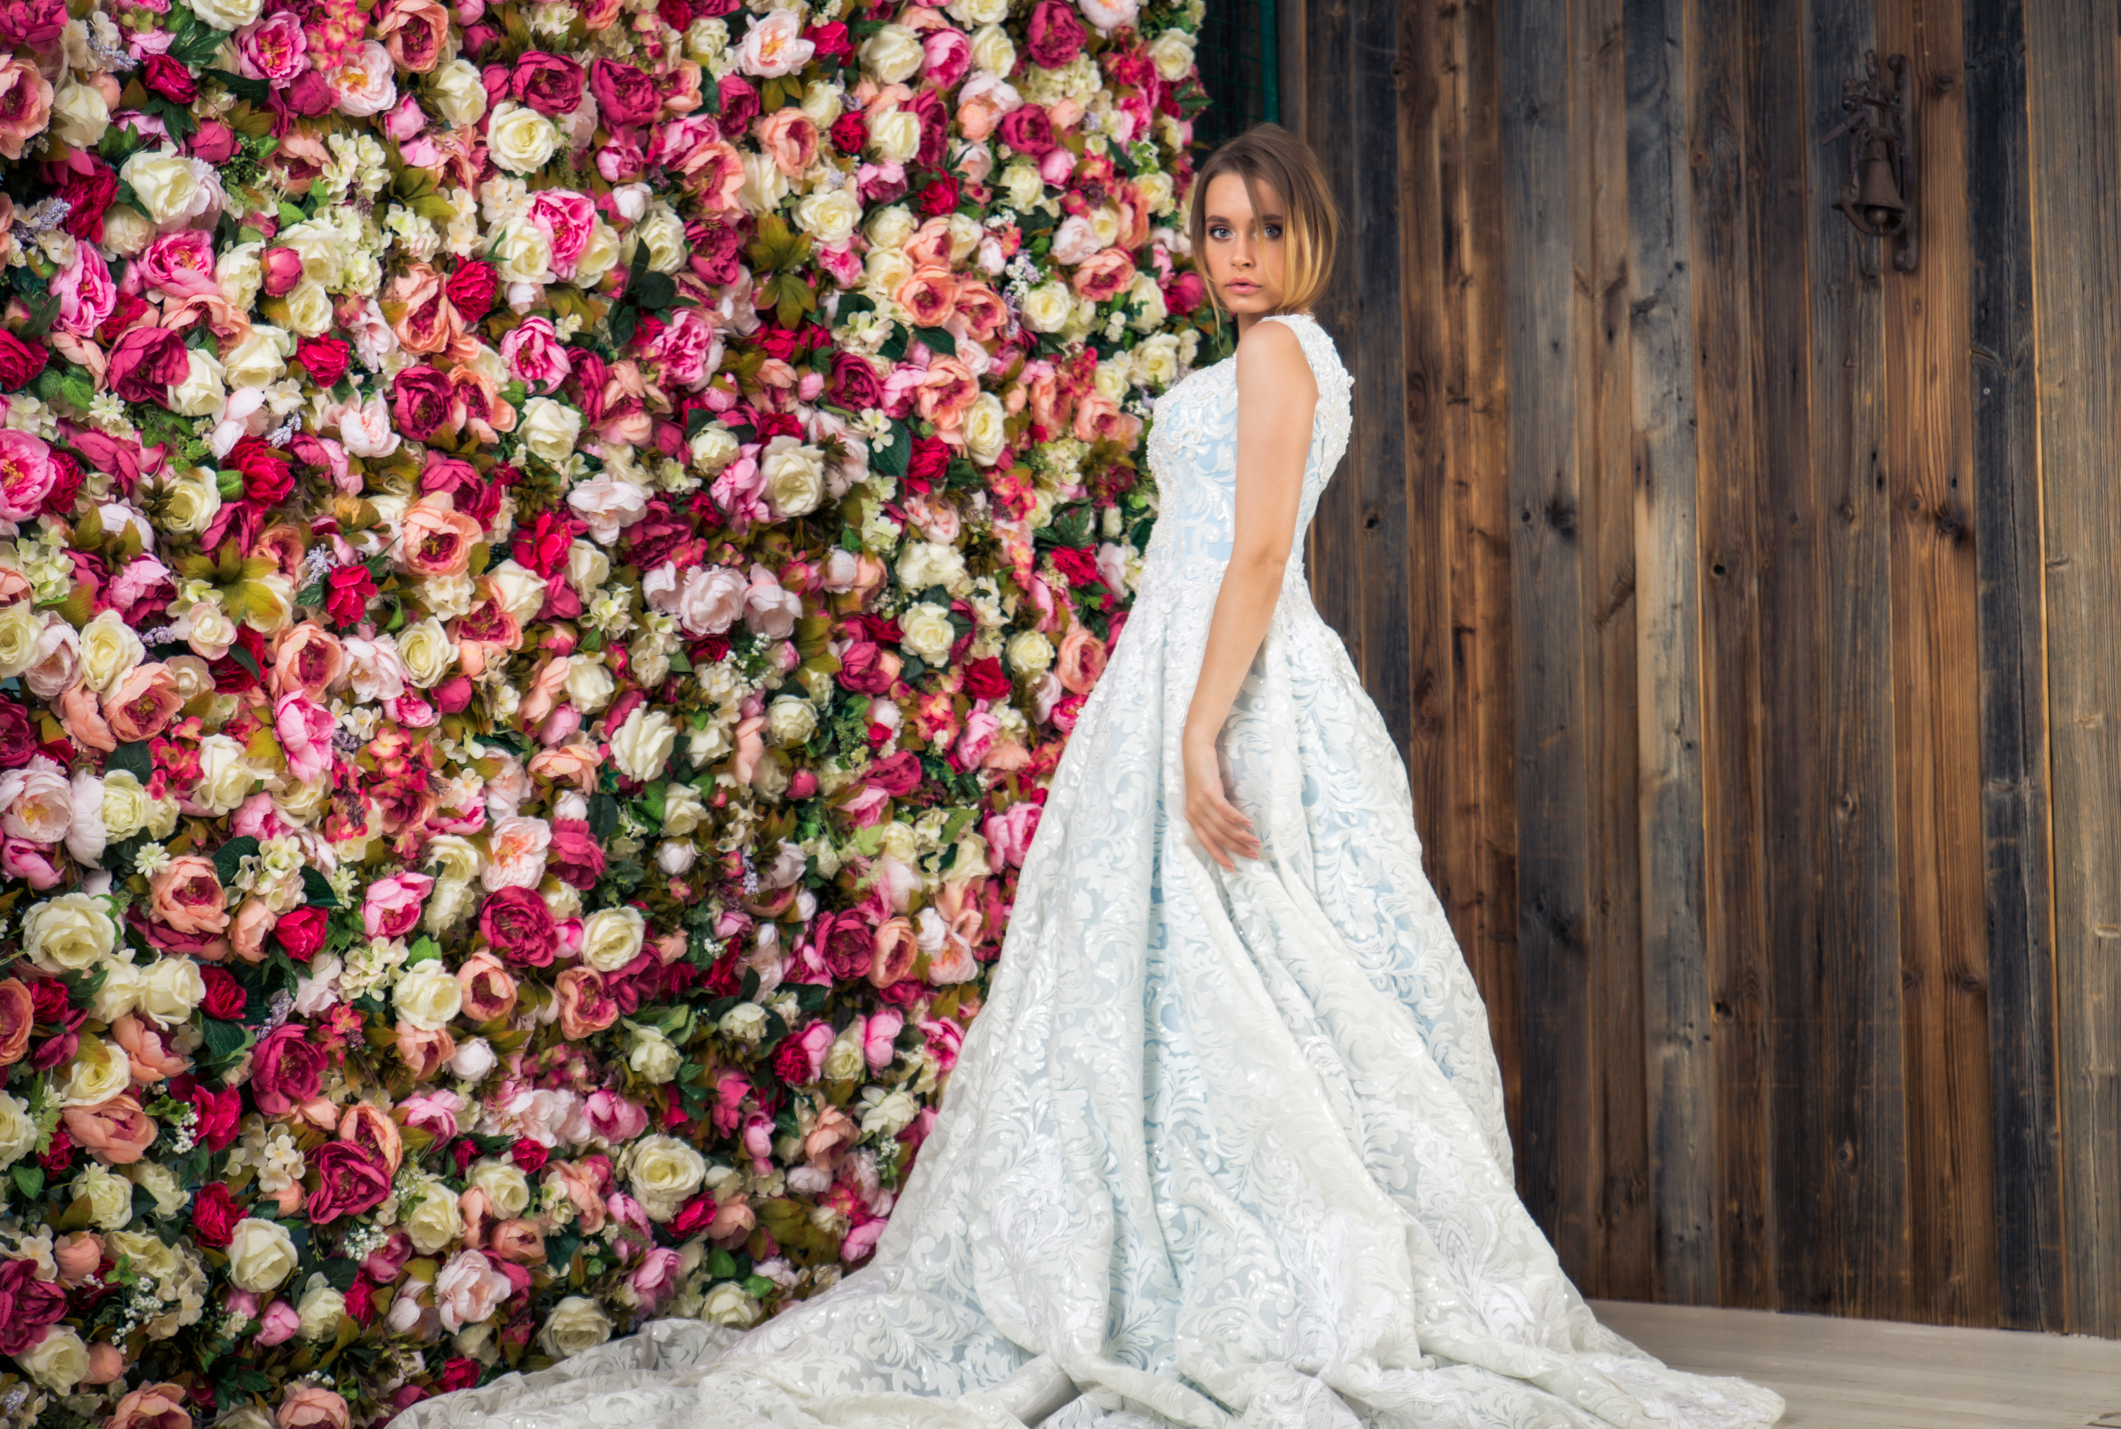


Flower Walls and Chandeliers

Slide 14

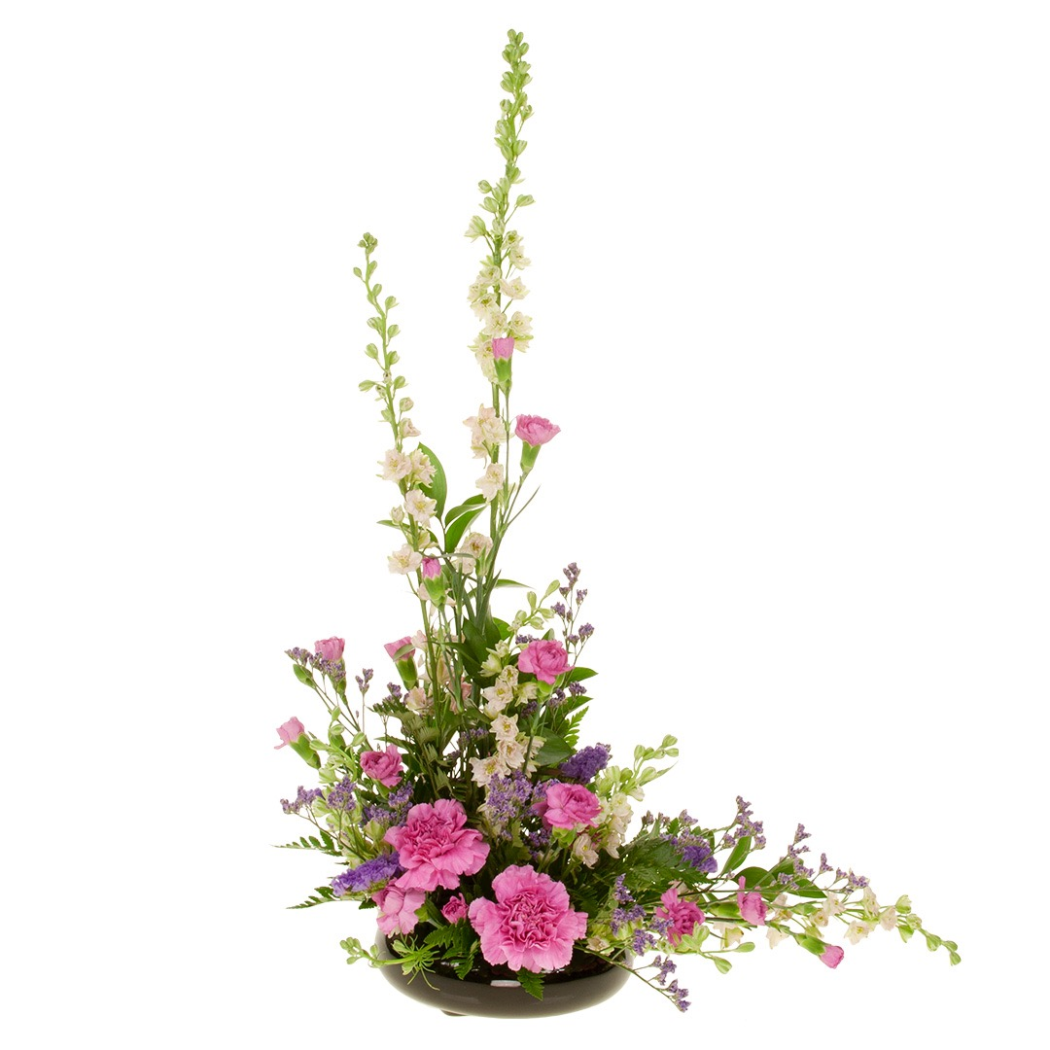
Basic Triangle

Slide 15
The Elements and Principles of Design
Elements
Principles
Form
Space
Texture
Line
Color
Accent
Scale
Harmony
Rhythm
Unity
Balance

Slide 16




Fibonacci Numbers

Slide 17


Pricing and Selling Flowers

Slide 18




On Trend Bespoke Garden Style

Slide 19



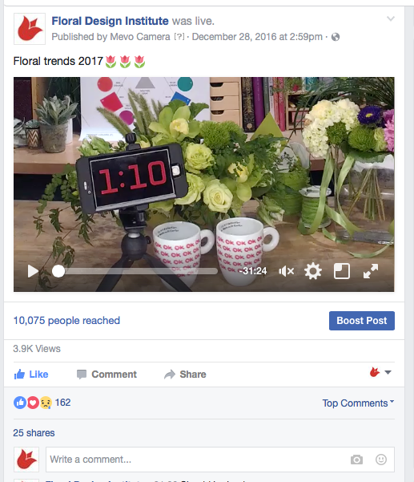


Dream-Create-Share
90th Annual FFA Convention and Expo, October 25, 2017
The Goal in Life is to
Find Your Gift
The Meaning of Life is to
Give Your Gift Away

