Slide 1
Food Safety and Defense Issues
An Introduction to Food Contamination

Slide 2
Goals
Contrast the differences in food safety and food defense issues
Identify important labeling components
Explain intentional and unintentional threats to our food system
Explain the three types of contamination hazards in foods

Slide 3
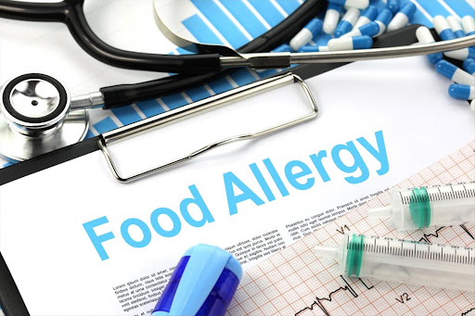
http://www.youtube.com/watch?feature=endscreen&NR=1&v=hPeRYJoWzZE

Slide 4
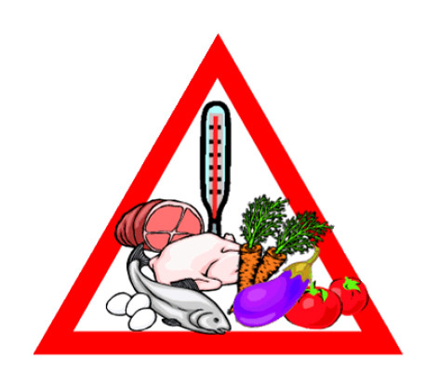
Food Concerns Must Be Placed into 1 of the 2:
Food Quality Concern
Food Safety Concern

Slide 5
Food Safety Concerns
A system to ensure that illness or harm will not result from eating food
Everyone along the farm-to-table continuum — farm (production), processing, transportation, retail and table(home) — plays a role in keeping our nation’s food safe.
In the food science CDE, food safety concerns are anything that could cause illness or harm if ingested. Examples: pathogens, bacteria, foreign material in foods, allergens, etc.
Keep the four Cs in mind: cook, clean, chill, don’t cross-contaminate

Slide 6
Food Quality Concerns
Characteristics of food that is considered acceptable for human consumption
Size, shape, color, appearance, consistency, flavor, texture, etc.
A food quality concern will not typically make someone sick as it is not “dangerous” to consume, but the food item may not be desirable to eat based on the above characteristics.

Slide 7
Food Defense
The protection of food products from intentional contamination by biological, chemical, physical or radiological agents that are not reasonably likely to occur in the food supply

Slide 8
Food Defense
  Food defense plans are divided into four areas to protect food:
    outside security
    inside security
    personnel security
    incident response

Slide 9
Pathogens, Spoilage and Good Bacteria
Pathogens cause death and illness.
Spoilage organisms cause color, aroma and flavor changes.
Spoilage detracts from food quality.
Pathogens are not as competitive as bacteria.
Good bacteria are used in foods to help fermentation and age the food (e.g., cheese) to produce a different flavor.

Slide 10
Biological Hazards
Are normally very small and cannot be seen by the naked eye
Sometimes biological hazards are known as microbiological hazards because they are so small.
Biological hazards are disease-causing microorganisms or toxins that are found in some plants and animals.
  Includes bacteria, viruses, parasites, protozoa and fungi

Slide 11
Spoilage Bacteria
Bacteria that cause changes to the taste, texture and/or odor of a food
  They will not likely pose a risk of making someone sick.
Bacteria that lead to foodborne illnesses
  A few of the common bacteria in this class are E. coli, listeria, salmonella, clostridium botulinum and staphylococcus aureus
  Pathogenic bacteria are bacteria that lead to foodborne illnesses. A few of the common bacteria in this class are E.coli, listeria, salmonella, clostridium botulinum and staphylococcus aureus
  Zoonotic agents are biological hazards that cause disease in animals and can be transmitted to and cause disease in humans.

Slide 12
Pathogenic Bacteria
Biological hazards, which are mainly bacterial, can cause either foodborne infections or intoxications.
A foodborne infection is caused by a person ingesting a number of pathogenic microorganisms sufficient to cause infection as a result of their multiplication, e.g., salmonellosi.
A foodborne intoxication is caused by the ingestion of already formed toxins produced by some bacteria when they multiply in food, e.g., staphylococcal enterotoxin.
When assessing bacterial hazards to human health in meat and poultry products, 9 pathogenic bacteria must be considered:
  Bacillus cereus
  Campylocter jejuni
  Clostridium botulinum
  Clostridium perfringens
  Escherichia coli O157:H7
  Listerua monocytogens
  Salmonella spp
  Staphylococcus aureus
  Yersinia entercolitica

Slide 13
Chemical Hazard
A chemical that is not allowed in food such as pesticide residue and cleaning solution that can cause illness
Chemical hazards can originate from five sources:
  Agriculture chemicals: pesticides, herbicides, animal drugs, fertilizers, etc.
  Production plant chemicals: cleaners, sanitizers, oils, lubricants, paints, pesticides, etc.
  Naturally occurring toxicants: products of plant, animal or microbial metabolisms such as aflatoxins, etc.
  Food chemicals: preservatives, acids, food additives, sulfating agents, processing aids, etc.
  Environmental contaminants: lead, cadmium mercury, arsenic, PCBs

Slide 14
Chemical Hazards
  Added
    Pesticides, fertilizers, antibiotics, plant chemicals (cleaners, lubricants, sanitizers, adhesives, inks) and food additives (when they exceed legal levels)
  Naturally Occurring
    Proteins associated with allergens
    Major allergens, which account for 90% of all food allergic reactions, are milk, egg, fish, crustacean shellfish, tree nuts, wheat, peanuts and soybeans.
    Aflotoxins are found in nuts and grains.
    Gluten (if consumer is allergic)

Slide 15
Physical Hazard
Material that is neither biological nor chemical, such as extraneous matter or a foreign object, that might get into a food product
Hazard | Source or cause
Glass | Bottles, jars, light fixtures, utensils, gauge covers, thermometers
Metal | Nuts, bolts, screws, steel wool, wire, meat hooks
Stones | Raw materials
Plastics | Packaging materials, raw materials
Bone | Raw material, improper plant processing
Bullet/BB Shot/ Needles | Animals shot in field, hypodermic needles used for infections
Jewelry | Pens/pencils, buttons, careless employee practices

Slide 16
Radiological Hazard
The uncontrolled release of radioactive material that can harm people or damage the environment (some foods may be irradiated during processing, which should not result in harmful levels of radiation)

Slide 17
Unintentional Contamination
Accidental, which means that there was nothing purposely added by anyone to taint the food product

Slide 18
Intentional Contamination
When harmful substances are purposely used to contaminate food to scare, injure or kill people.

Slide 19
Scope/Impact
Food safety may involve many illnesses but usually few deaths.
Food defense has the potential to result in many deaths.

