Slide 1
Food Science:
Food Product Development

Slide 2
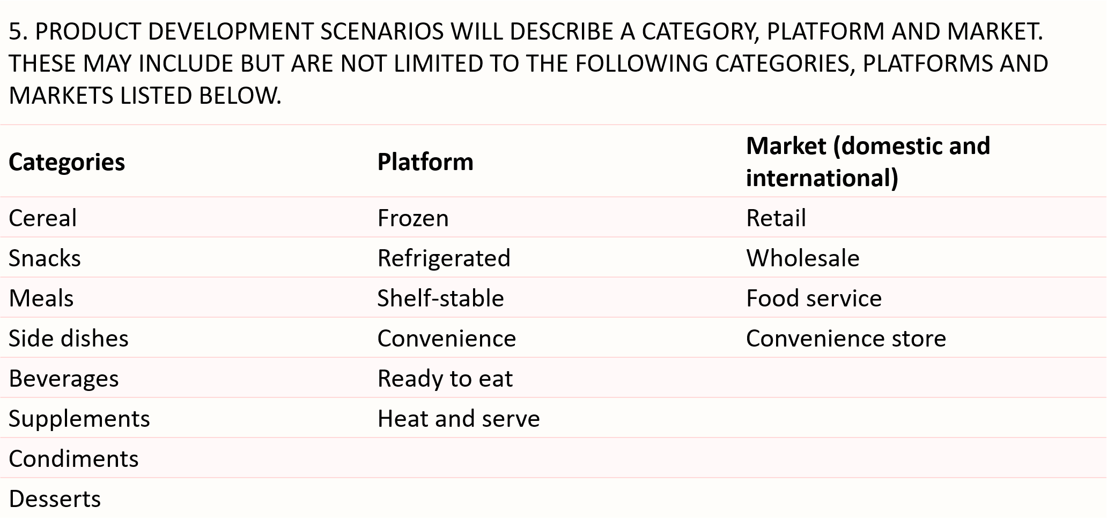
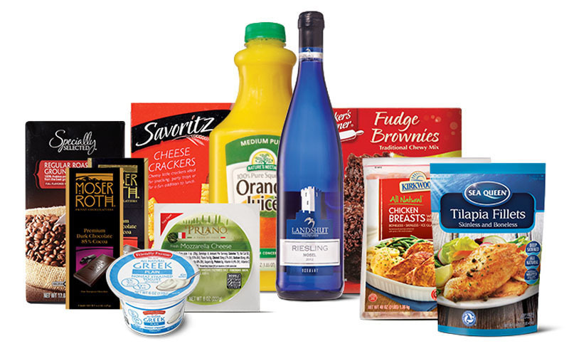
TEAM PRODUCT DEVELOPMENT

Slide 3
    Comparison of Nutrition Facts Labels
        Learn the changes of the New Format of the Nutrition Facts Label on this website from the FDA: https://www.fda.gov/food/nutrition-education-resources-materials/new-nutrition-facts-label
Image Source: Food and Drug Administration, https://www.fda.gov/food/new-nutrition-facts-label/whats-new-nutrition-facts-label.
Notes:
This is the beginning of one way to calculate Nutritionals.

Slide 4
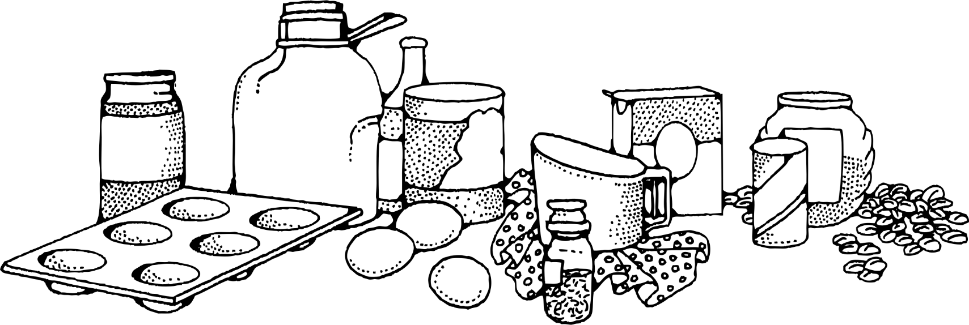
PRODUCT DEVELOPMENT
Decide ingredients and amounts
  Do certain ingredients need to make up most of the product?
  Does a certain ingredient need to be replaced?
  Determine amounts in easy-to-calculate percentages

Slide 5
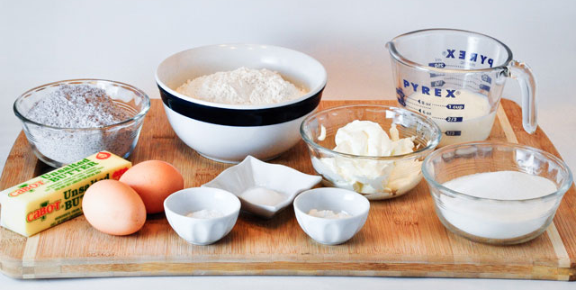
PRODUCT DEVELOPMENT
Nutrition Facts Panel (NFP) Example
  Step 1: Choose Ingredients
    Reformulate cookie dough mix to be “natural and gluten-free”
      Replace ingredients in Starting Formula using those in provided spreadsheet, as necessary
      Only need to replace ingredients that are not “natural” or that contain gluten

Slide 6
    Step 1: Choose Ingredients
    Starting Formula:
Ingredient
Unsalted Butter
Peanut Butter
White Sugar
Brown Sugar
Eggs
All-purpose Flour
Baking Powder
Salt
Baking Soda

Slide 7
    Ingredient Nutrient Spreadsheet
Food Science CDE Contest 2015 - Product Development Portion
Nutritional Information (per 100g)
 |  | Total | Sat. | Trans | Chol | Sodium | Carbs | Fiber | Sugars | Protein
Ingredients | Calories | Fat (g) | Fat (g) | Fat (g) | (mg) | (mg) | (g) | (g) | (g) | (g)
Flour Sources
All Natural Pastry Flour | 364.0 | 1 | 0 | 0 | 0 | 2 | 78 | 3 | 0 | 9
Barley Flour | 395.0 | 7 | 2 | 0 | 0 | 12 | 64 | 31 | 0 | 20
Cassava Flour | 377.0 | 1 | 0 | 0 | 0 | 0 | 93 | 7 | 1 | 1
Rice Flour, Brown | 363.0 | 3 | 1 | 0 | 0 | 8 | 76 | 5 | 1 | 7
Rice Flour, White | 366.0 | 1 | 0 | 0 | 0 | 0 | 80 | 2 | 0 | 6
Rye Flour | 357.0 | 1 | 0 | 0 | 0 | 2 | 77 | 8 | 1 | 10
Sorghum Flour | 361.0 | 3 | 0 | 0 | 0 | 4 | 77 | 7 | 2 | 8
Tapioca Flour | 333.0 | 0 | 0 | 0 | 0 | 4 | 87 | 0 | 0 | 1
Other Ingredients
Baking Powder | 51.0 | 0 | 0 | 0 | 0 | 7893 | 24 | 0 | 0 | 0
Baking Soda | 0.0 | 0 | 0 | 0 | 0 | 27360 | 0 | 0 | 0 | 0
Whole Eggs | 143.0 | 10 | 3 | 0 | 372 | 142 | 1 | 0 | 0 | 13
Peanut Butter A | 594.0 | 50 | 9 | 0 | 0 | 469 | 22 | 6 | 9 | 25
Peanut Butter B | 554.0 | 51 | 11 | 0 | 0 | 474 | 20 | 7 | 9 | 23
Salt | 0.0 | 0 | 0 | 0 | 0 | 38758 | 0 | 0 | 0 | 0
Sugar, Brown | 380.0 | 0 | 0 | 0 | 0 | 28 | 98 | 0 | 97 | 0
Sugar, White | 387.0 | 0 | 0 | 0 | 0 | 1 | 100 | 0 | 100 | 0
Unsalted Butter | 714.0 | 79 | 50 | 0 | 214 | 0 | 0 | 0 | 0 | 0
Ingredient Statements:
All Natural Pastry Flour: Wheat Flour
Baking Powder: Calcium Acid Phosphate, Bicarbonate of soda, Corn Starch.
Peanut Butter A: Roasted Peanuts and Sugar, Contains 2% of Less of: Molasses, Fully Hydrogenated Vegetable Oil
(Rapeseed and Soybean), Mono Diglycerides, Salt.
Peanut Butter B: Roasted Peanuts, Sugar, Palm Oil, Salt.

Slide 8
    Step 1: Choose Ingredients
    Starting Formula:
Peanut Butter Options:
Version A – includes hydrogenated oils and stabilizers
Version B – contains simpler ingredients
Ingredient
Unsalted Butter
Peanut Butter Peanut Butter B
White Sugar (to simplify formula)
Brown Sugar
Eggs
All-purpose Flour Rice Flour, Brown
Baking Powder (to simplify formula)
Salt
Baking Soda
Tapioca Flour
Gluten can be found in Wheat (All-purpose Flour), Rye and sometimes Barley.
It generally takes a combination of starches to replace wheat in baked goods.
Notes:
Unless the product is required to have certain ingredients or a certain number of ingredients, remove as many extra ingredients to simplify the process. In the above example, white sugar and baking powder were removed. The tapioca flour could have been left out as well, but the food scientist in us just couldn’t do that. Points would be deducted if the participants removed Peanut Butter altogether (it is part of the identity of the product, Peanut Butter Cookie Dough Balls) or if the participants didn’t choose a gluten-free starch.

Slide 9
    Step 2: Determine amounts (hint: keep it simple)
    New Formula
Ingredient | %
Unsalted Butter | 10
Peanut Butter B | 20
Brown Sugar | 30
Eggs | 10
Rice Flour, Brown | 20
Salt | 1
Baking Soda | 1
Tapioca Flour | 8
Make sure the percentages add up to 100%!
Notes:
These are Theoretical, not necessarily realistic

Slide 10
    Step 3: Calculate each Ingredients’ nutrients based on % used in formula
      Find nutrition info on Ingredient Nutrient spreadsheet
      Nutrition Information provided on 100 grams of each ingredient
      Calculate ingredient nutrients based on same percentage used in ingredient formulation
YEAH ALGEBRA!
        Standard reporting for all food nutrient content by USDA Food Composition Database is based on 100 grams (https://ndb.nal.usda.gov/ndb/search/list)
Notes:
This is the beginning of one way to calculate Nutritionals.

Slide 11
    Ingredient Nutrient Spreadsheet
Food Science CDE Contest 2015 - Product Development Portion
Nutritional Information (per 100g)
 |  | Total | Sat. | Trans | Chol | Sodium | Carbs | Fiber | Sugars | Protein
Ingredients | Calories | Fat (g) | Fat (g) | Fat (g) | (mg) | (mg) | (g) | (g) | (g) | (g)
Flour Sources
All Natural Pastry Flour | 364.0 | 1 | 0 | 0 | 0 | 2 | 78 | 3 | 0 | 9
Barley Flour | 395.0 | 7 | 2 | 0 | 0 | 12 | 64 | 31 | 0 | 20
Cassava Flour | 377.0 | 1 | 0 | 0 | 0 | 0 | 93 | 7 | 1 | 1
Rice Flour, Brown | 363.0 | 3 | 1 | 0 | 0 | 8 | 76 | 5 | 1 | 7
Rice Flour, White | 366.0 | 1 | 0 | 0 | 0 | 0 | 80 | 2 | 0 | 6
Rye Flour | 357.0 | 1 | 0 | 0 | 0 | 2 | 77 | 8 | 1 | 10
Sorghum Flour | 361.0 | 3 | 0 | 0 | 0 | 4 | 77 | 7 | 2 | 8
Tapioca Flour | 333.0 | 0 | 0 | 0 | 0 | 4 | 87 | 0 | 0 | 1
Other Ingredients
Baking Powder | 51.0 | 0 | 0 | 0 | 0 | 7893 | 24 | 0 | 0 | 0
Baking Soda | 0.0 | 0 | 0 | 0 | 0 | 27360 | 0 | 0 | 0 | 0
Whole Eggs | 143.0 | 10 | 3 | 0 | 372 | 142 | 1 | 0 | 0 | 13
Peanut Butter A | 594.0 | 50 | 9 | 0 | 0 | 469 | 22 | 6 | 9 | 25
Peanut Butter B | 554.0 | 51 | 11 | 0 | 0 | 474 | 20 | 7 | 9 | 23
Salt | 0.0 | 0 | 0 | 0 | 0 | 38758 | 0 | 0 | 0 | 0
Sugar, Brown | 380.0 | 0 | 0 | 0 | 0 | 28 | 98 | 0 | 97 | 0
Sugar, White | 387.0 | 0 | 0 | 0 | 0 | 1 | 100 | 0 | 100 | 0
Unsalted Butter | 714.0 | 79 | 50 | 0 | 214 | 0 | 0 | 0 | 0 | 0
Ingredient Statements:
All Natural Pastry Flour: Wheat Flour
Baking Powder: Calcium Acid Phosphate, Bicarbonate of soda, Corn Starch.
Peanut Butter A: Roasted Peanuts and Sugar, Contains 2% of Less of: Molasses, Fully Hydrogenated Vegetable Oil
(Rapeseed and Soybean), Mono Diglycerides, Salt.
Peanut Butter B: Raosted Peanuts, Sugar, Palm Oil, Salt.

Slide 12
    Step 3: Calculate each Ingredients’ Nutrients based on % in formula
      Calculate nutritionals for 10% Unsalted Butter using information from Ingredient Nutrient spreadsheet
Example:
100 grams of Unsalted Butter has 714 calories
Our formula contains 10% Unsalted Butter
  Calculation: 714 x 0.10 = 71.4
  So, in 100grams of cookie dough, Unsalted Butter contributes 71.4 calories
  Need to calculate 10% of each nutrient in Unsalted Butter

Slide 13
    Step 3: Calculate each Ingredients’ Nutrients based on % in formula
    Enter information for 10 grams Unsalted Butter into Worksheet
Item Name | Quantity | Calories | Fat | Sat Fat | Trans Fat | Cholesterol | Sodium | Carbs | Fiber | Sugar | Protein
 | (grams) | (kcal) | (g) | (g) | (g) | (mg) | (mg) | (g) | (g) | (g) | (g)
Unsalted Butter | 10 | 71.4 | 7.9 | 5.0 | 0.0 | 21.4 | 0.0 | 0.0 | 0.0 | 0.0 | 0.0

Slide 14
    Step 3: Calculate each Ingredients’ Nutrients
    Calculate nutritionals for 20% (20 grams) Peanut Butter using information from Ingredient Nutrients spreadsheet
Example:
100 grams of Peanut Butter B has 554 calories
Our cookie dough formula contains 20% of Peanut Butter B
    Calculation: 554 x 0.20 = 110.8
So, in 100 grams of cookie dough, Peanut Butter B contributes 110.8 calories
Item Name | Quantity | Calories | Fat | Sat Fat | Trans Fat | Cholesterol | Sodium | Carbs | Fiber | Sugar | Protein
 | (grams) | (kcal) | (g) | (g) | (g) | (mg) | (mg) | (g) | (g) | (g) | (g)
Unsalted Butter | 10 | 71.4 | 7.9 | 5 | 0 | 21 | 0 | 0 | 0 | 0 | 0
Peanut Butter B | 20 | 110.8 | 10.2 | 2.2 | 0.0 | 0.0 | 94.8 | 4.0 | 1.4 | 1.8 | 4.6
Brown Sugar | 30
Eggs | 10
Rice Flour, Brown | 20
Salt | 1
Baking Soda | 1
Tapioca Flour | 8

Slide 15
    Step 4: Calculate Nutritionals
    Calculate remaining ingredients and enter numbers in the worksheet provided
    Avoid rounding numbers more than 1 decimal place on individual ingredients
Item Name | Amount | Calories | Fat | Sat Fat | Trans Fat | Cholesterol | Sodium | Carbs | Fiber | Sugar | Protein
 | Grams | (kcal) | (g) | (g) | (g) | (mg) | (mg) | (g) | (g) | (g) | (g)
Unsalted Butter | 10 | 71.4 | 7.9 | 5 | 0 | 21 | 0 | 0 | 0 | 0 | 0
Peanut Butter B | 20 | 110.8 | 10.2 | 2.2 | 0.0 | 0.0 | 94.8 | 4.0 | 1.4 | 1.8 | 4.6
Brown Sugar | 30 | 114 | 0 | 0 | 0 | 0 | 8.4 | 29 | 0 | 29 | 0
Eggs | 10 | 14.3 | 1.0 | 0.3 | 0.0 | 37.2 | 14.2 | 0.1 | 0.0 | 0.0 | 1.3
Rice Flour, Brown | 20 | 72.6 | 0.6 | 0.2 | 0 | 0 | 1.6 | 15 | 1 | 0.2 | 1.4
Salt | 1 | 0.0 | 0.0 | 0.0 | 0.0 | 0.0 | 387.6 | 0.0 | 0.0 | 0.0 | 0.0
Baking Soda | 1 | 0 | 0 | 0 | 0 | 0 | 274 | 0 | 0 | 0 | 0
Tapioca Flour | 8 | 26.6 | 0.0 | 0.0 | 0.0 | 0.0 | 0.3 | 7.0 | 0.0 | 0.0 | 0.1

Slide 16
    Step 4: Calculate Nutritionals
    Add up totals for each column
Item Name | Amount | Calories | Fat | Sat Fat | Trans Fat | Cholesterol | Sodium | Carbs | Fiber | Sugar | Protein
 | Grams | (kcal) | (g) | (g) | (g) | (mg) | (mg) | (g) | (g) | (g) | (g)
Unsalted Butter | 10 | 71.4 | 7.9 | 5 | 0 | 21 | 0 | 0 | 0 | 0 | 0
Peanut Butter B | 20 | 110.8 | 10.2 | 2.2 | 0.0 | 0.0 | 94.8 | 4.0 | 1.4 | 1.8 | 4.6
Brown Sugar | 30 | 114 | 0 | 0 | 0 | 0 | 8.4 | 29 | 0 | 29 | 0
Eggs | 10 | 14.3 | 1.0 | 0.3 | 0.0 | 37.2 | 14.2 | 0.1 | 0.0 | 0.0 | 1.3
Rice Flour, Brown | 20 | 72.6 | 0.6 | 0.2 | 0 | 0 | 1.6 | 15 | 1 | 0.2 | 1.4
Salt | 1 | 0.0 | 0.0 | 0.0 | 0.0 | 0.0 | 387.6 | 0.0 | 0.0 | 0.0 | 0.0
Baking Soda | 1 | 0 | 0 | 0 | 0 | 0 | 274 | 0 | 0 | 0 | 0
Tapioca Flour | 8 | 26.6 | 0.0 | 0.0 | 0.0 | 0.0 | 0.3 | 7.0 | 0.0 | 0.0 | 0.1
Totals (100g basis) | 100 | 410 | 20 | 7.7 | 0 | 59 | 781 | 56 | 2.4 | 31 | 7.4

Slide 17
    Step 4: Calculate Nutritionals
    Calculate Amount Per Serving based on serving size (given serving size for this product is 50 grams)
    Round numbers to nearest whole number
Item Name | Amount | Calories | Fat | Sat Fat | Trans Fat | Cholesterol | Sodium | Carbs | Fiber | Sugar | Protein
 | Grams | (kcal) | (g) | (g) | (g) | (mg) | (mg) | (g) | (g) | (g) | (g)
Unsalted Butter | 10 | 71.4 | 7.9 | 5.0 | 0 | 21.4 | 0 | 0.00 | 0.0 | 0 | 0
Peanut Butter B | 20 | 110.8 | 10.2 | 2.2 | 0.0 | 0.0 | 94.8 | 4.00 | 1.4 | 1.8 | 4.6
Brown Sugar | 30 | 114 | 0 | 0.0 | 0 | 0 | 8.4 | 29.40 | 0.0 | 29 | 0
Eggs | 10 | 14.3 | 1.0 | 0.3 | 0.0 | 37.2 | 14.2 | 0.10 | 0.0 | 0.0 | 1.3
Rice Flour, Brown | 20 | 72.6 | 0.6 | 0.2 | 0 | 0 | 1.6 | 15.20 | 1.0 | 0.2 | 1.4
Salt | 1 | 0.0 | 0.0 | 0.0 | 0.0 | 0.0 | 387.6 | 0.00 | 0.0 | 0.0 | 0.0
Baking Soda | 1 | 0 | 0 | 0.0 | 0 | 0 | 274 | 0.00 | 0.0 | 0 | 0
Tapioca Flour | 8 | 26.6 | 0.0 | 0.0 | 0.0 | 0.0 | 0.3 | 6.96 | 0.0 | 0.0 | 0.1
Totals (100g basis) | 100 | 410 | 19.7 | 7.7 | 0 | 58.6 | 781 | 55.7 | 2.4 | 31 | 7.4
Amount per serving | 50 | 205 | 10 | 4 | 0 | 29 | 390 | 28 | 1 | 16 | 4

Slide 18
    Step 5: Determine %Daily Value …Did I hear the word Algebra?
Nutrient | DV
Total Fat | 65 g
Saturated Fat | 20 g
Sodium | 2400 mg
Total Carbohydrate | 300 g
Dietary Fiber | 25 g
Cholesterol | 300 mg
% Daily Values are used to guide consumers on the level that each nutrient in the product contributes to their daily diet.
Example:
Daily Value (DV) for Total Fat is 65 grams
One serving of our cookie dough ball has 9.9 grams of Total Fat
Calculation: 10 ÷ 65 = 0.15
  To make a percentage, multiply by 100 → 0.15 x 100 = 15%
Answer: one serving of cookie dough ball contains 15% DV of Total Fat
Notes:
%DV can be calculated from either the unrounded total nutrient contents or the final rounded numbers that are used on the Nutrition Facts Panel.

Slide 19
    Step 5: Determine %DV
    Use chart provided on worksheet
Item Name | Amount | Calories | Fat | Sat Fat | Trans Fat | Cholesterol | Sodium | Carbs | Fiber | Sugar | Protein
 | Grams | (kcal) | (g) | (g) | (g) | (mg) | (mg) | (g) | (g) | (g) | (g)
Unsalted Butter | 10 | 71.4 | 7.9 | 5.0 | 0 | 21.4 | 0 | 0.00 | 0.0 | 0 | 0
Peanut Butter B | 20 | 110.8 | 10.2 | 2.2 | 0.0 | 0.0 | 94.8 | 4.00 | 1.4 | 1.8 | 4.6
Brown Sugar | 30 | 114 | 0 | 0.0 | 0 | 0 | 8.4 | 29.40 | 0.0 | 29 | 0
Eggs | 10 | 14.3 | 1.0 | 0.3 | 0.0 | 37.2 | 14.2 | 0.10 | 0.0 | 0.0 | 1.3
Rice Flour, Brown | 20 | 72.6 | 0.6 | 0.2 | 0 | 0 | 1.6 | 15.20 | 1.0 | 0.2 | 1.4
Salt | 1 | 0.0 | 0.0 | 0.0 | 0.0 | 0.0 | 387.6 | 0.00 | 0.0 | 0.0 | 0.0
Baking Soda | 1 | 0 | 0 | 0.0 | 0 | 0 | 274 | 0.00 | 0.0 | 0 | 0
Tapioca Flour | 8 | 26.6 | 0.0 | 0.0 | 0.0 | 0.0 | 0.3 | 6.96 | 0.0 | 0.0 | 0.1
Totals (100g basis) | 100 | 410 | 19.7 | 7.7 | 0 | 58.6 | 781 | 55.7 | 2.4 | 31 | 7.4
Amount per serving | 50 | 205 | 10 | 4 | 0 | 29 | 390 | 28 | 1 | 16 | 4
%DV |  |  | 15% | 20% |  | 10% | 16% | 9% | 4%
Notes:
Round to the nearest whole number for the %DV values.

Slide 20
    Step 6: Enter Values into Nutrition Facts Panel
    Round to nearest whole number unless following FDA rounding rules (FDA guidelines 21 CFR 101.9)
      Calories = 205
      Fat (g) = 10
      Sat Fat (g) = 4
      Trans Fat (g) = 0
      Cholesterol (mg) = 30
      Sodium(mg) = 390
      Carbs (g) = 28
      Fiber (g) = 1
      Sugar (g) = 16
      Protein (g) = 4
      Fat = 15%
      Sat Fat = 20%
      Cholesterol = 10%
      Sodium = 16%
      Carbs = 9%
      Fiber = 4%
      Sugar = 32%
Notes:
Round to the nearest whole number for the %DV values. Do not need to figure the Vitamin/Mineral content.

Slide 21
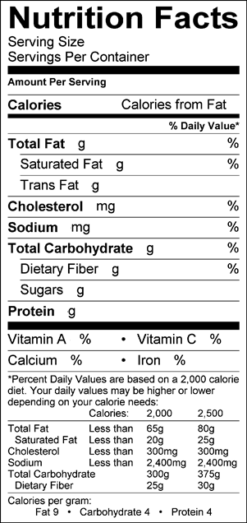
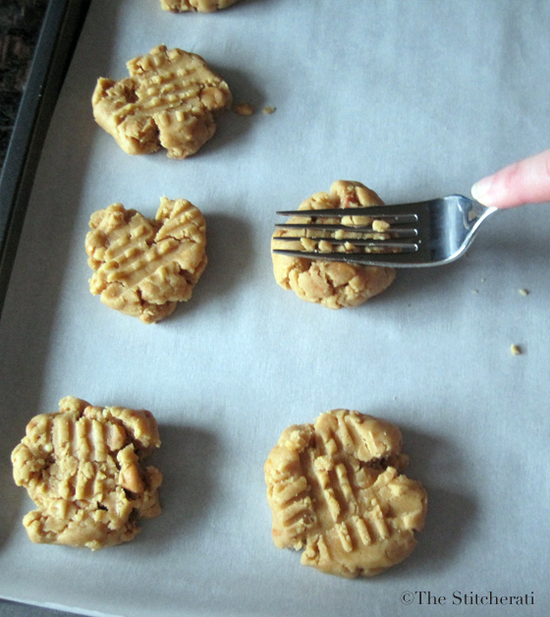
    Step 7: Enter Information into Nutrition Facts Panel
    Enter Serving Size
      1 cookie dough ball
        Include piece or measurement of serving (1 cookie dough ball)
        Include weight of serving (50 grams)
      Enter Servings Per Container
        May not be given, can make up any number
        In this scenario, we are told that there are 24 balls of dough.

Slide 22
    Organize Ingredient List for the Ingredient Statement
Ingredient | %
Brown Sugar | 30
Peanut Butter B | 20
Rice Flour, Brown | 20
Unsalted Butter | 10
Eggs | 10
Tapioca Flour | 8
Salt | 1
Baking Soda | 1
Ingredients with the same amount can be listed interchangeably
List Ingredients from most to least
Notes:
This chart was organized to provide a visual of the ingredient listing. Participants do not need to reorganize their chart.

Slide 23
PRODUCT DEVELOPMENT
  Write out Ingredients Statement:
  Ingredients: Brown Sugar, Peanut Butter (Roasted Peanuts, Sugar, Palm Oil, Salt), Brown Rice Flour, Butter (milk, cream), Eggs, Tapioca Flour, Salt, Baking Soda.
  Reminder: Order of ingredients must match percentages in formula.

Slide 24
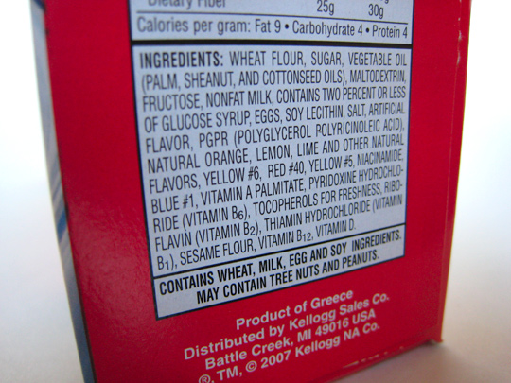
PRODUCT DEVELOPMENT
Information Panel (IP)
  Nutrition Facts Panel
  Ingredients
  Manufacturer Information
    Company name
    Full mailing address
    Items must be listed in proper order
    No intervening materials allowed on IP per FDA regulations

Slide 25
PRODUCT DEVELOPMENT
Principle Display Panel (PDP) includes:
Net Weight Statement
  Must put down total weight of product
  Must include weight in ounces and grams
    Example: (calculate: 24 balls at 50 grams = 1200 grams
        1200 grams / 28 grams/ounce = 42.8 oz.)
    NET WT. 42.8 oz. (1200 g) or
      NET WT. 2 lb., 10.8 oz. (1.2 kg)

Slide 26
PRODUCT DEVELOPMENT
Net Weight Conversions:
28 grams* = 1oz
454 grams** = 16oz = 1 lb
*Technically, 28.35 grams = 1oz, but for this contest we will round to 28 grams.
**Based on actual grams-to-ounce conversation, 454 grams is more accurate number to use for grams/pound

Slide 27

Product Development
  QUESTIONS?
Thank you to the University of Nebraska – Lincoln Food Science Supervisors Sara Roberts, Food Science & Technology Department and Julie Reiling, the Food Processing Center, at University of Nebraska-Lincoln

