Slide 1
Foodborne Illnesses
What they are & how to prevent them!

Slide 2
Objectives
Describe the scope of foodborne illness
Explain factors related to food pathogens and spoilage
Discuss microorganisms and their roles in food
Identify the 12 most undesirable pathogens
Explain how beneficial bacteria are used in food processing
Identify 8 major food allergens

Slide 3
Foodborne Illness
A disease that is carried or transmitted to humans by food containing harmful substances
Examples are the disease salmonellosis, which is caused by Salmonella bacteria, and the disease botulism, which is caused by the toxin produced by the bacteria Clostridium botulinum.

Slide 4
Foodborne Illness
CDC estimates that each year roughly 1 in 6 Americans (or 48 million people) get sick from, 128,000 are hospitalized because of and 3,000 die from foodborne diseases
Foodborne illness costs Americans billions of dollars each year and serves as a constant challenge for consumers, researchers, government and industry.
Have you ever had a foodborne illness?

Slide 5
Pathogenic bacteria cause illnesses.
They grow rapidly in the “danger zone” — when food temperatures are between 40°F and 140°F — and don’t generally affect the taste, smell or appearance of food.
Food that is left too long or stored at unsafe temperatures could be dangerous to eat but could look and smell just fine.
E. Coli 0157:H7, Campylobacter and Salmonella are examples of pathogenic bacteria.

Slide 6
Top 5 Pathogens
(contributing to domestically acquired foodborne illnesses)
Pathogen | Estimated number of illnesses | %
Norovirus | 5,461,731 | 58
Salmonella, nontyphoidal | 1,027,561 | 11
Clostridium perfringens | 965,958 | 10
Campylobacter spp. | 845,024 | 9
Staphylococcus aureus | 241,148 | 3
Subtotal | 8,541,422 | 91

Slide 7
Top 5 Pathogens
(contributing to domestically acquired foodborne illnesses resulting in hospitalization)
Pathogen | Estimated number of hospitalizations | %
Salmonella, nontyphoidal | 19,336 | 35
Norovirus | 14,663 | 26
Campylobacter spp. | 8,463 | 15
Toxoplasma gondii | 4,428 | 8
E.coli (STEC) O157 | 2,138 | 4
Subtotal | 49,028 | 88

Slide 8
Top 5 Pathogens
(contributing to domestically acquired foodborne illnesses resulting in death)
Pathogen | Estimated number of deaths | %
Salmonella, nontyphoidal | 378 | 28
Toxoplasma gondii | 327 | 24
Listeria monocytogenes | 255 | 19
Norovirus | 149 | 11
Campylobacter spp. | 76 | 6
Subtotal | 1,185 | 88

Slide 9
Pathogens
Any microorganism that is infectious or toxigenic and causes disease
Pathogens include parasites, viruses, and some fungi, yeast and bacteria.

Slide 10
What Is Spoilage Bacteria?
They cause food to deteriorate (i.e., decompose) and textures to change.
  These one-celled microorganisms are what causes fruits and vegetables to get mushy or slimy or meat to develop a bad odor and discolor.

Slide 11
Can Spoilage Bacteria Make People Sick?
  Most people wouldn’t choose to eat spoiled food.
  If they did, they might not get sick.
  Although, they may experience upset stomach and/or diarrhea.

Slide 12
How Do Bacteria Spoil Food?
Under the right conditions, spoilage bacteria can grow rapidly, and in some cases, they can double their numbers in as little as 20 minutes.
  A large number of microorganisms and their waste products cause the undesirable changes in odor, taste and texture that we associate with spoiled food.

Slide 13
What Would Happen If We Did Not Have Bacteria to Decompose Food?
Some bacteria use dead organisms’ molecules as food, but the rest of the molecules get mixed into the soil for plants to use for their growth.
Without bacteria, animals and plants could not obtain the nutrients they require.

Slide 14
What do you know about microorganisms?
What do you think you should know about microorganisms?
What don’t you know about microorganisms?

Slide 15
Microorganisms
A microscopic life form that cannot be seen with the naked eye
Types of microorganisms include bacteria, viruses, protozoa, fungi, yeasts, and some parasites and algae.

Slide 16
Least-Wanted Pathogens
Salmonella
Staphylococcus aureus
Shigella
Toxoplasma gondii
Vibrio vulnificus
Campylobacter
Clostridium botulinum
E. coli O157:H7
Listeria monocytogenes
Norovirus

Slide 17

Campylobacter
  Second most common bacterial cause of diarrhea in the United States
Sources: raw and undercooked poultry and other meat, raw milk and untreated water
http://www.fightbac.org/about-foodborne-illness/least-wanted-pathogens

Slide 18

Clostridium botulinum
This organism produces a toxin that causes botulism, a life-threatening illness that can prevent the breathing muscles from moving air in and out of the lungs.
Sources: improperly prepared home-canned foods; honey should not be fed to children less than 12 months old
http://www.fightbac.org/about-foodborne-illness/least-wanted-pathogens

Slide 19

E. coli O157:H7
A bacterium that can produce a deadly toxin and causes approximately 73,000 cases of foodborne illness each year in the US
Sources: beef, especially undercooked or raw hamburger; produce; raw milk; and unpasteurized juices and ciders
http://www.fightbac.org/about-foodborne-illness/least-wanted-pathogens

Slide 20

Listeria monocytogenes
Is everywhere in our environment
The problem is when it gets on a product (dirty air, gloves, equipment, etc.) that has been cooked but would not be cooked before being eaten.
Sources: unpasteurized dairy products, including soft cheeses; sliced deli meats; smoked fish; hot dogs; pate; and deli-prepared salads (i.e., egg, ham, seafood and chicken salads)
http://www.fightbac.org/about-foodborne-illness/least-wanted-pathogens

Slide 21

Norovirus
The leading viral cause of diarrhea in the United States
Poor hygiene causes Norovirus to be easily passed from person to person and from infected individuals to food items.
Sources: any food contaminated by someone who is infected with this virus; also caused by food service workers not properly washing hands
http://www.fightbac.org/about-foodborne-illness/least-wanted-pathogens

Slide 22

Salmonella
Most common bacterial cause of diarrhea in the United States and the most common cause of foodborne death
Responsible for 1.4 million cases of foodborne illness a year
Sources: raw and undercooked eggs; undercooked poultry and meat; fresh fruits and vegetables; and unpasteurized dairy products
  Salmonellosis is a problem when foods are not kept cold enough.
http://www.fightbac.org/about-foodborne-illness/least-wanted-pathogens

Slide 23

Staphylococcus aureus
This bacterium produces a toxin that causes vomiting shortly after being ingested.
Sources: cooked foods high in protein (e.g., cooked ham, salads, bakery products, dairy products) that are held too long at room temperature
  Human skin and noses are also a source for staph.
http://www.fightbac.org/about-foodborne-illness/least-wanted-pathogens

Slide 24

Shigella
Causes an estimated 448,000 cases of diarrhea illnesses per year
Poor hygiene causes Shigella to be easily passed from person to person and from infected individuals to food items.
Sources: salads, unclean water and any food handled by someone who is infected with the bacterium
http://www.fightbac.org/about-foodborne-illness/least-wanted-pathogens

Slide 25

Toxoplasma gondii
A parasite that causes toxoplasmosis, a very severe disease that can produce central nervous system disorders particularly mental retardation and visual impairment in children
Sources: raw or undercooked pork
  Also associated with handling cats and cat feces
http://www.fightbac.org/about-foodborne-illness/least-wanted-pathogens

Slide 26

Vibrio vulnificus
Causes gastroenteritis, wound infection and severe bloodstream infections
People with liver diseases are especially at high risk.
Sources: raw or undercooked seafood, particularly shellfish
http://www.fightbac.org/about-foodborne-illness/least-wanted-pathogens

Slide 27
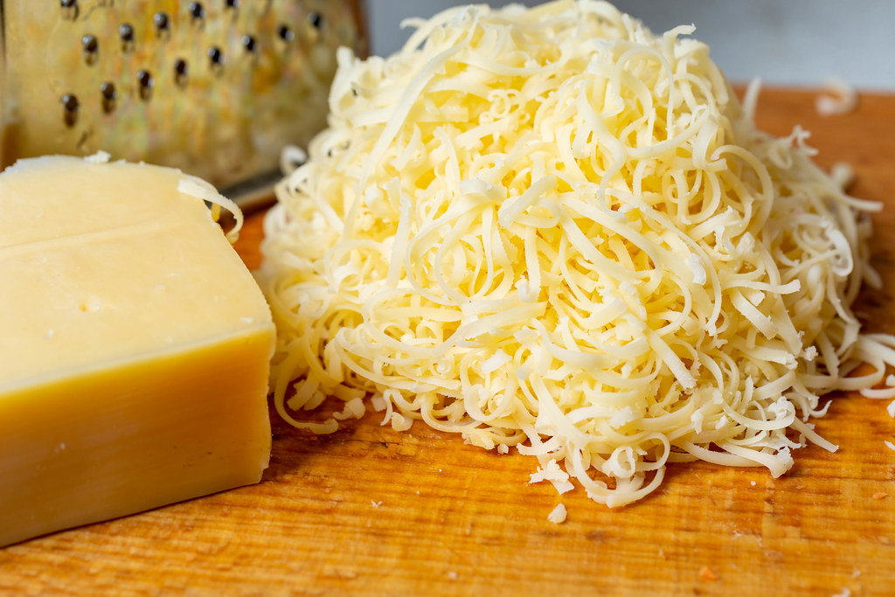
Good Bacteria
Beer
Wine
Cheese
Yogurt

Slide 28
Good Bacteria
The most common yeast that is used in the preparation of beer is Saccharomyces cerevisiae, commonly known as “baker’s yeast” or “brewer’s yeast.”
Beer is made from barley, wheat or rye grain that is germinated to convert starch to sugar such as maltose. The grain is dried and crushed before hot water and yeast are added to initiate fermentation.

Slide 29
Fermentation
The chemical conversion of carbohydrates into alcohols or acids
It occurs when oxygen supplies are limited and, therefore, is a type of anaerobic respiration.
In the fermentation process, sugars in the mixture are converted to alcohol and carbon dioxide. After 2 to 5 days the beer is separated from the yeast, matured and filtered before packaging.

Slide 30
Fermentation
Wine is also produced through fermentation. Grapes or other fruits are crushed to release the sugars, and yeast is then added for fermentation and conversion of the sugars into alcohol.
For sparkling wines, the carbon dioxide produced by the fermentation process is trapped to create bubbles.

Slide 31
Probiotic
Probiotic (for life) bacteria can protect the host and prevent disease.
They are live microorganisms that provide a health benefit to the host.
For example, antibiotics can kill off normal intestinal flora and the administration of probiotic bacteria can replenish the flora to normal levels.

Slide 32
Yogurt
  Bacterial strains such as Lactobacillus bulgaricus convert lactose sugar into lactic acid. This reaction lowers the pH (e.g., acidity) and causes the milk to clot, creating the characteristic texture and taste of yogurt.
  Live bacteria in probiotic yogurts can help restore the natural microbe population of the gut (stomach), which can be depleted by using antibiotics.

Slide 33
Food Allergens
160 foods can cause allergic reactions (and even death) in people with food allergies.
The law identifies the 8 most common allergenic foods; 90% of food allergic reactions come from these 8 foods.
These 8 foods are also the sources from which many other ingredients are derived.

Slide 34
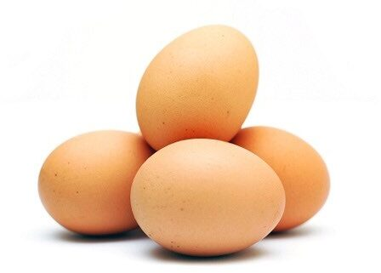
Top 8 Food Allergens
  Milk
  Eggs
  Fish (e.g., bass, flounder, cod)
  Crustacean shellfish (e.g., crab, lobster, shrimp)
  Tree nuts (e.g., almonds, walnuts, pecans)
  Peanuts
  Wheat
  Soybeans

Slide 35
Food Allergens
The law requires that food labels identify the food source names of all major food allergens used to make the food.
This requirement is met if the common or usual name (e.g., buttermilk) of an ingredient that is a major food allergen already identifies that allergen's food source name (i.e., milk).

Slide 36
Food Allergens
Otherwise, the allergen's food source name must be declared at least once on the food label in one of two ways:
  In parentheses following the name of the ingredient.
  Examples: “lecithin (soy),” “flour (wheat)” and “whey (milk)”
    – OR –
  Immediately after or next to the list of ingredients in a “contains” statement.
  Example: “Contains Wheat, Milk and Soy”

