Slide 1
Four Cuts of
Farm-to-Table Marketing

Slide 2
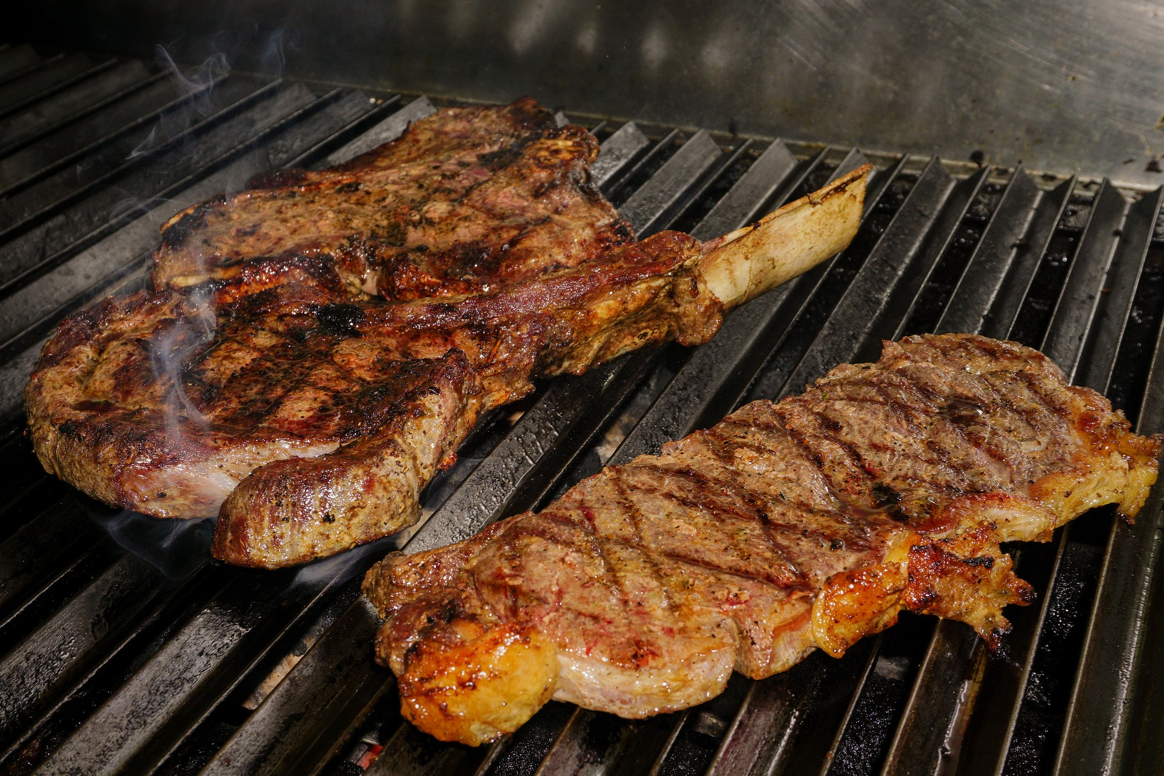
Product
What are we selling and why would someone want it?

Slide 3
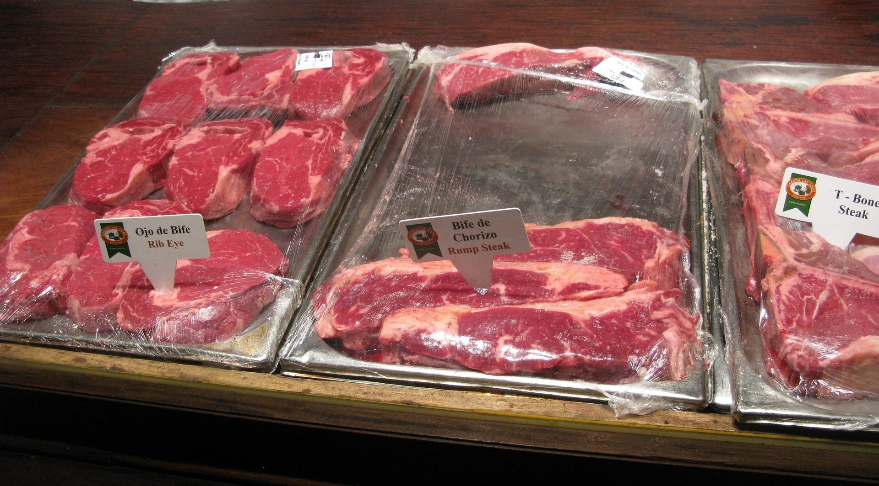
Price
How much is it worth to the customer?

Slide 4
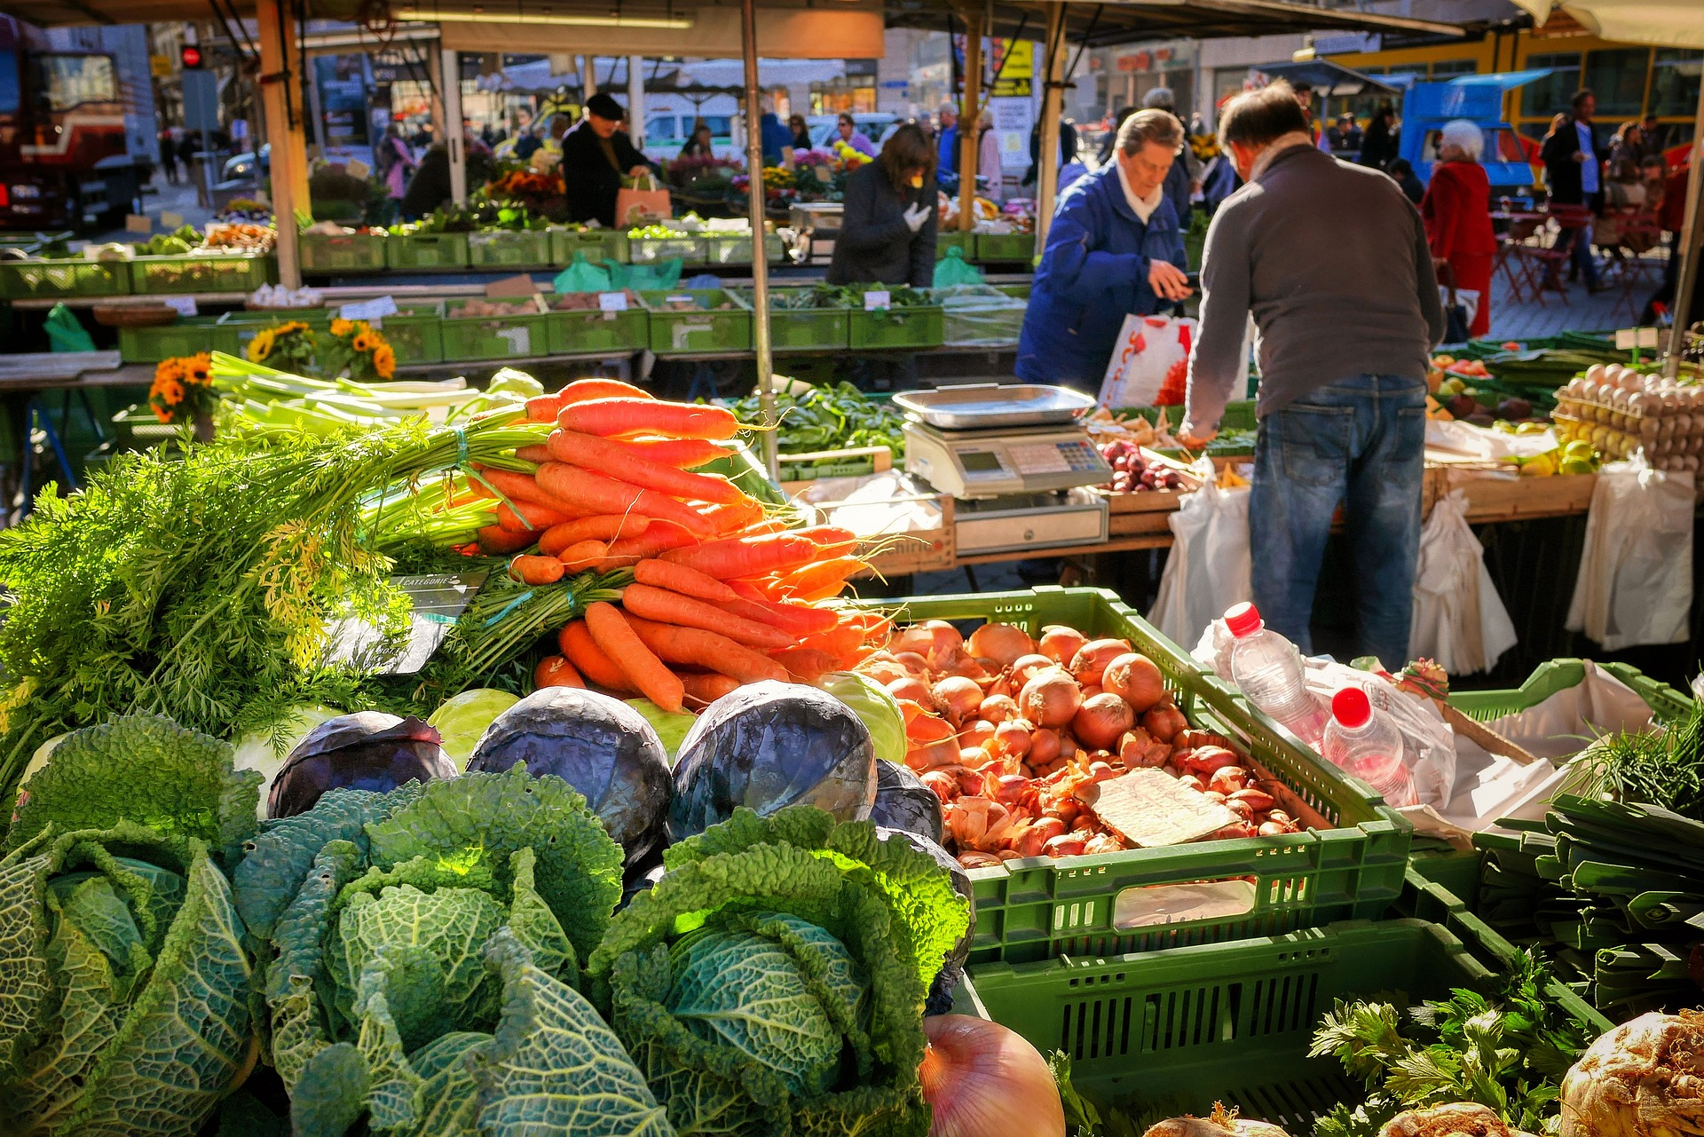
Place
Where can customers buy it?

Slide 5
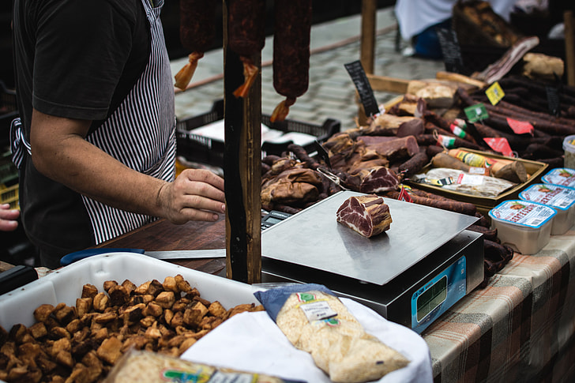
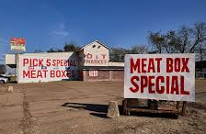

Promotion
How do we encourage customers to purchase?

