Slide 1
How Organizations are Structured–Components of a Local Program
What are the components of a successful organization?
HS 114
FFA: An Integral Component of Agricultural Education

Slide 2
The ASK Challenge
7. Ks will walk over to the A of their group in the middle of the room and show them their figure.
8. The As will study the figure, then walk over to the S of their group and explain how to draw it.
9. Only the As can speak during this challenge. Ks and Ss cannot speak. If you do, you will disqualified.
10. As cannot touch the Ss pencil, paper, nor the S. They can only talk.
11. As are allowed to go back and refer to K’s drawing as many times as they need to, but cannot show K’s drawing to S.
Receive only verbal instructions from A and draw it on their papers. Drawing most similar to the original wins.
In groups of three, assign one of three letters to each person: A, S, or K.
Ss go to the back of the room; As to the middle of the room; Ks to the front of the room. Once there, bring your attention back to the teacher.
The object of the challenge is to recreate a figure that will only be shown to the Ks at the front of the room. The group who recreates the diagram closest to the original in the fastest time will win the first part of the challenge.
When you hear the words DRAW IT! the challenge will begin.
Teacher will show Ks the master figure and give them instructions.
Ks will recreate the figure they just saw on a blank sheet of paper.
Objective 1
HS 114TM A

Slide 3
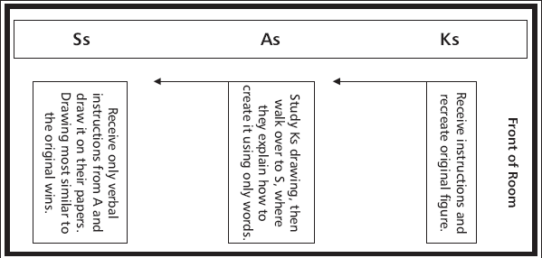
The ASK Challenge
Objective 1
HS 114TM A

Slide 4
3 Components of the FFA
Agriculture Education Classroom
1. Acquisition of Knowledge
Supervised Agriculture Experience
1. Develop Skills
National FFA Organization
1. Develops Attitude
Objective 1
HS 114TM A

Slide 5
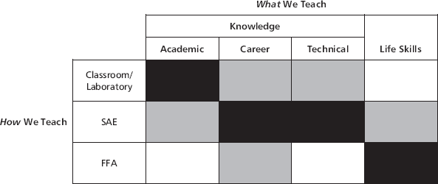
A Model of Agricultural Education
HS 114TM B

Slide 6
Extracurricular is…
- An activity that is outside of the classroom experience
Objective 2

Slide 7
Intercurricular is…
- An activity that is within and/ or essential to the classroom experience.
Objective 2

