Slide 1
How Leaders Influence Others Through Vision
What vision do I have for influence?
HS 17
Stage One of Development
ME

Slide 2
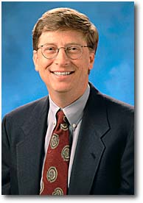
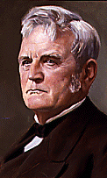
Leaders
Bill Gates
John Deere
Interest Approach
HS 17 TM A1

Slide 3
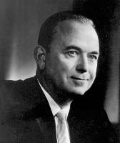
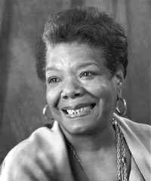
Leaders
Ray Kroc
Maya Angelou
Interest Approach
HS 17 TM A2

Slide 4
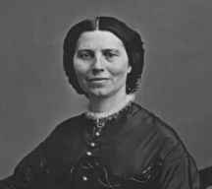
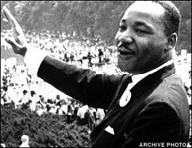
Leaders
Clara Barton
Martin Luther King, Jr.
Interest Approach
HS 17 TM A3

Slide 5
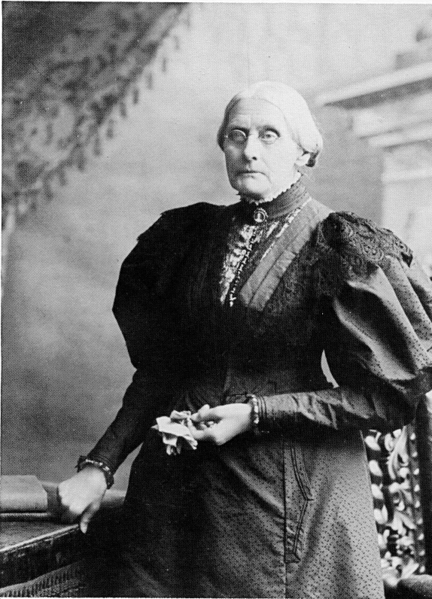
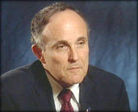
Leaders
Susan B. Anthony
Mayor
Rudy Giuliani
Interest Approach
HS 17 TM A4

Slide 6
An Articulate Vision of Influence
Vision is a mental picture of the future for a specific project or idea.
Influence is the power or act of gaining a desired end result without obvious use of force or direct command.
Articulate mean expressing one’s message or thoughts clearly.
Interest Approach
HS 17 TM B1

Slide 7
Components of a
Visionary Leader
Visionary leaders have the ability to create and support a vision that will:
    Set an image for change.
    Impact others beyond themselves.
    Challenge their ability to accomplish the task.
    Create a vision others can believe.
Objective 1
HS 17 TM B2

Slide 8
How to Gain Buy-in
For people to make a vision a reality, each person must:
  Define each person’s role in the vision
  Appeal to the core values of each person involved.
  Encourage individual process for completion of the vision
  Celebrate the path towards the vision
Objective 3
HS 17 TM B3

