Slide 1

Understanding Career Clusters
How do I begin to grow?
HS 31
Stage One of Development
ME

Slide 2
What are career clusters?
Career clusters represent
a grouping of occupations and broad industries based on commonalities.
Objective 1
HS 31 TM A1

Slide 3
Why career clusters?
Tomorrow’s jobs require:
  more knowledge
  more understanding of technology
  more flexible workers.
Tomorrow’s workers need to be prepared to change jobs, update knowledge, adapt, and understand the big picture.
Objective 1
HS 31 TM A2

Slide 4
Career Pathways:
Food Products and Processing Systems
Agricultural
Communications
Specialists
Business-Educators
Food Scientists
Meat Processors
Biochemists
Food Brokers-Inspectors
Meat Researchers
Food Meal Supervisors
Cheese Makers
Food and Fiber
Engineers
Bioengineers
Food Processors
Quality Control Specialist
Objective 2
HS 31 TM B

Slide 5
Career Pathways: Plant Systems
Plant Breeders and
Genetics
Biotechnology Lab Technology
Soil and Water Specialist
Crop Farm Manger
Agricultural Educators
Plant Pathologist
Sales Representative
Tree Surgeons
Commodity Marketing Specialist
Forest Genetics
Growers/Farmers/
Greenhouse Managers
Golf Course Superintendents
Objective 2
HS 31 TM C

Slide 6
Career Pathways: Animal Systems
Agricultural Educators
Livestock Producers
A.I. Technicians
Animal Caretakers/
Poultry Managers
Veterinarians
Embryo Technologist
Livestock Buyers
Wildlife Biologist
Animal and Dairy
Inspectors
Animal Health
Salesperson
Livestock Geneticists
Reproductive
Physiologists
Pet Shop Operators
Objective 2
HS 31 TM D

Slide 7
Career Pathways:
Power, Structural and Technical Systems
Machine Operators
Electronics System Technicians
Agricultural Engineers
Heavy Equipment Maintenance
Wastewater Treatment Plant Operators
Welders
Machinist
Communication
Technicians
Software Developer/
Programmer
Computer
Technicians
Objective 2
HS 31 TM E

Slide 8
Career Pathways:
Natural Resource Systems
Wildlife Managers
Ecologists
Park Managers
Fish and
Game Officers
Loggers
Forest
Technicians
Geologist
Hydrologists
Fish Hatchery
Manager
Commercial
Fisherman
Objective 2
HS 31 TM F

Slide 9
Career Pathways:
Environmental Service Systems
Pollution Prevention
and Control Mangers
Environmental Sampling
and Analysis Scientists
Health and Safety
Sanitarians
Hazardous Materials Handlers
Hazardous Materials Technician
Water Environment Managers
Water Quality
Managers
Toxicologists
Recyclers
Solid Waste
Specialists
Objective 2
HS 31 TM G

Slide 10
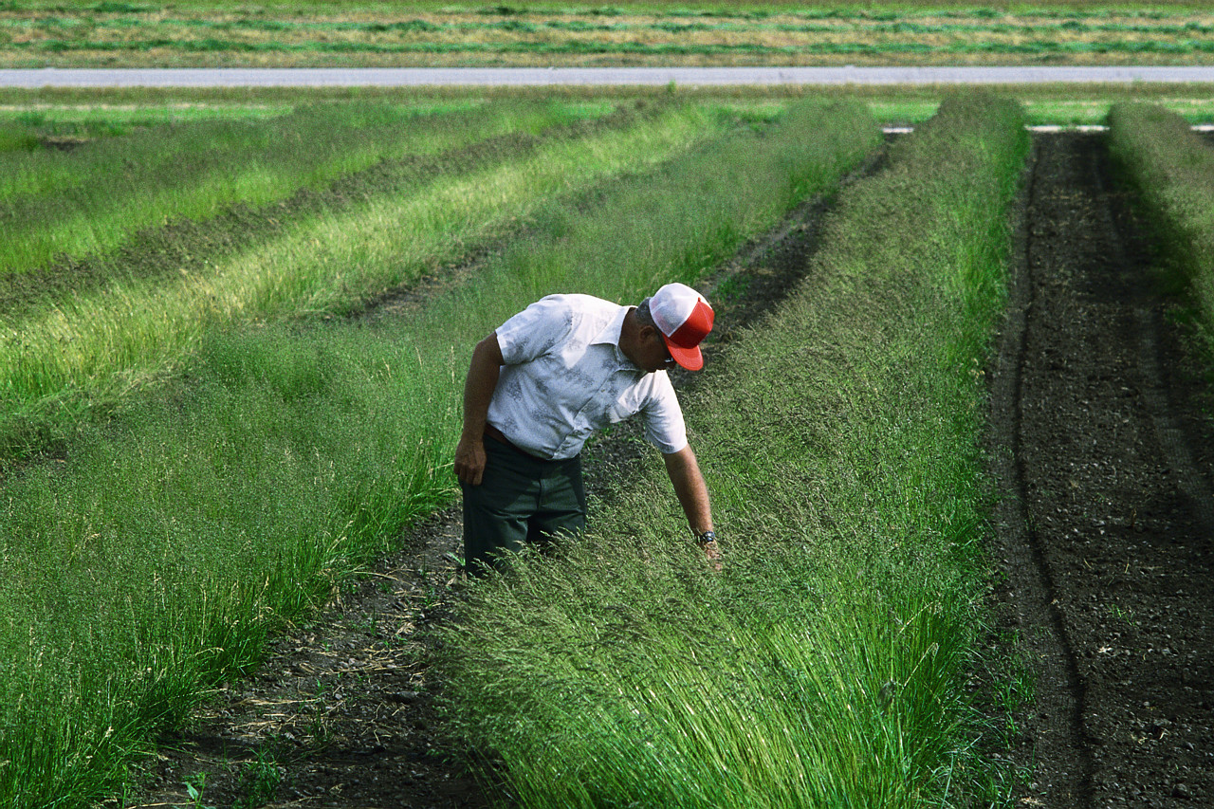
Career Pathways:
Agribusiness Systems
Agricultural Commodity Broker
Agricultural Economist
Farmer/Rancher/
Feedlot Owner
Agricultural
Products Buyer
Animal Health
Products Distributor
Salesperson
Sales Manager
Banker/Loan Officer
Field Representative
for Bank
Farm Investment
Manager
Objective 2
HS 31 TM H

