Slide 1
Building a Relationship with a Mentor
How do I begin to grow?
HS 49
Stage One of Development
ME

Slide 2
Benefits of your mentor/protégé relationship
Mentor/Protégé Relationship:
A dynamic process whereby each participant respects and trusts the other’s advice, counsel and guidance across a significant period of time.
Objective 1
HS 49 TM A

Slide 3
Benefits of your mentor/protégé relationship
  Companion
  Role Model
  Resource Person
  Advice from a different perspective
  Think of other benefits of the mentor/protégé relationship to add to this list
Objective 1
HS 49 TM A

Slide 4
Mentor/Protégé Relationship Parameters
Meet regularly with the mentor to review and discuss goals.
Be available for assistance, advice, and support to accomplish the common goals.
Recognize the ethical responsibilities of the mentor/protégé relationship.
Objective 2
HS 49 TM B

Slide 5
Mentor/Protégé Relationship Parameters
Listen to the mentor/protégé's questions and concerns.
Accept the feedback and suggestions given by the mentor/protégé.
Meet in a regular location at a regular time.
Objective 2
HS 49 TM B

Slide 6
So you have a mentor…Now What!?
Guidelines for the mentor/protégé relationship:
Arrange your first meeting date, time, and place.
Discuss and outline a list of short-term, intermediate, and long-term goals for you and your mentor.
Objective 3
HS 49 TM C

Slide 7
So you have a mentor…Now What!?
Guidelines for the mentor/protégé relationship:
Select at least one goal in each area and create an action plan with deadlines.
Set your next meeting date, time, and place.
Objective 3
HS 49 TM C

Slide 8
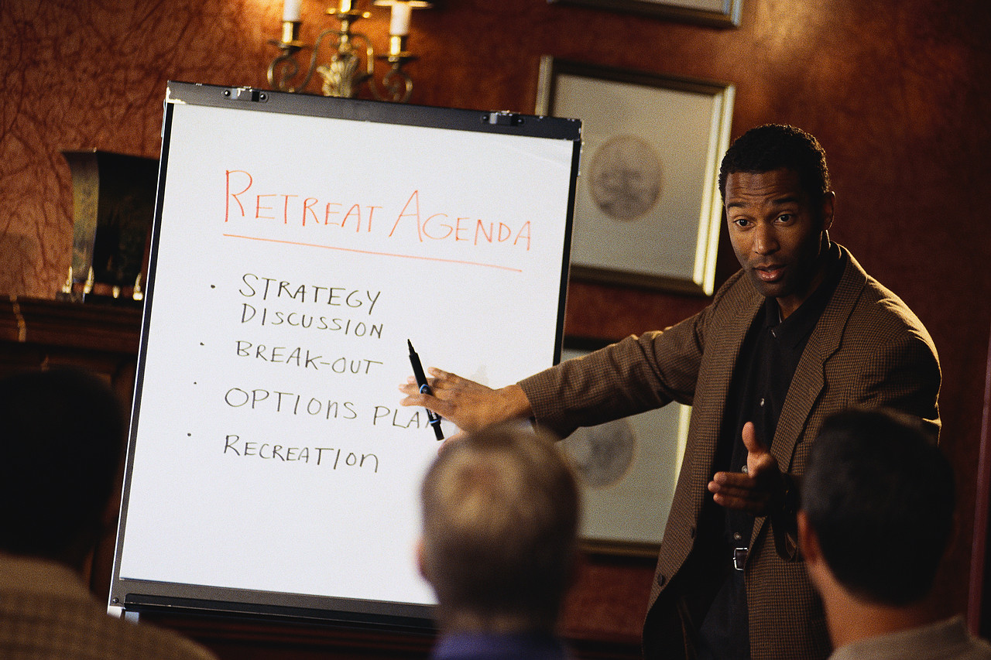
So you have a mentor…Now What!?
Guidelines for the mentor/protégé relationship:
Identify an agenda for the next meeting including the following:
  discuss progress and get suggestions from your mentor
  evaluate progress and goals
  set new timelines and deadlines as accomplishments are made
Objective 3
HS 49 TM C

