Slide 1

Meeting New People
How do I build relationships with others?
HS 52
Stage Two of Development
WE

Slide 2
Benefits of meeting new people
  Ability to gain new contacts or resources
  Gain skills or knowledge
  Develop friendships or business associates
Objective 1
HS 52 TM A

Slide 3
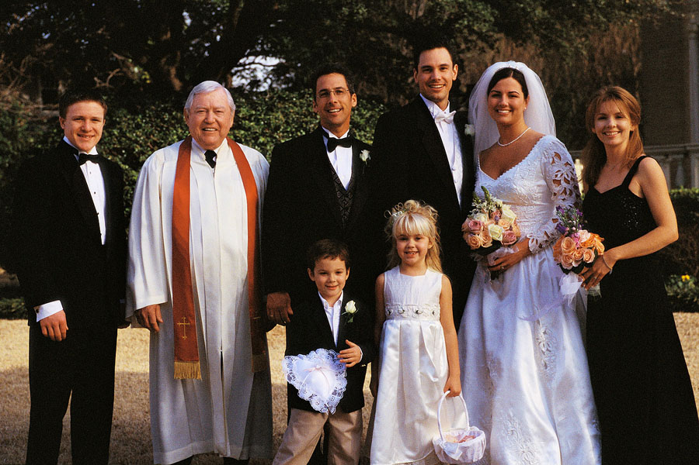
Formal or Informal?
Objective 2
HS 52 TM B

Slide 4
Formal or Informal?
Objective 2
HS 52 TM C

Slide 5
Formal Setting:
An environment where you are expected to be on your best behavior and show others respect, within a social context.
Objective 2
HS 52 TM D1

Slide 6
Informal Setting:
An environment where you are allowed to have a casual atmosphere when meeting others. In most cases, you will know some people in the setting.
Objective 2
HS 52 TM D2

Slide 7
Elements of informal and formal settings:
  Dress -casual or formal
  Language -formal or slang
  Manners
  Body language
  Personalities of people in the room
Objective 2
HS 52 TM D3

Slide 8
Challenges in meeting people:
  Fear -risking rejection
  Language -formal or slang
  Diversity -different backgrounds, interests
  Biases -people in a different economic bracket, different upbringing-
Objective 3
HS 52 TM E

