Slide 1

Appreciating Differences in People
How do I build relationships with others?
HS 56
Stage Two of Development
WE

Slide 2

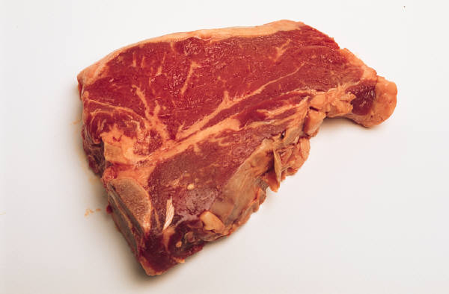
The Favorite Meal
What is your favorite meal of all time?
What is it that you like about this meal?
Could you eat the same meal everyday for the rest of your life?
Why or why not?
Interest Approach
HS 56 TM A1

Slide 3
Body Types: Slender
Disability: Deaf
Ethnicity: German
Gender: Male
Living Communities: Rural
Race: White/Anglo-American
Religion: Baptist
Sexual Orientation: Heterosexual
Social Economic Status: Middle Class
Spiritual Faith: Christianity
Objective 1
HS 56 TM A2

Slide 4
Monday Gender/Sexual Orientations
Tuesday Living Communities/Social Economic Status
Wednesday Ethnicities/Races
Thursday Religions/Spiritual Faiths
Friday Disabilities/Body Types
Objective 1
HS 56 TM A3

Slide 5
Bias
action or judgment placed against someone without grounds for the opinion or assumption.
Objective 2
HS 56 TM A4

Slide 6
Sensitive
paying attention and awareness to others’ views, feelings and experiences.
Objective 3
HS 56 TM A5

Slide 7
Stereotypes
Believing a certain pattern of thought about a group that represents an oversimplified opinion or an unfair judgment to describe a group as a whole.
Objective 3
HS 56 TM A6

Slide 8
Three Steps Towards Acceptance
Question Your Own Views
Where do you believe your personal views or beliefs about different groups come from?
Objective 3
HS 56 TM B1

Slide 9
Three Steps Towards Acceptance
2. Question the Views of Others Around
What individuals in your life have influenced your opinions on other groups?
Objective 3
HS 56 TM B2

Slide 10
Three Steps Towards Acceptance
3. Challenge Yourself Beyond Your Comfort Zone
What are some projects you can do to go beyond your comfort zone?
Objective 3
HS 56 TM B3

