Slide 1

Defining Teamwork
How do we play as teams?
HS 65
Stage Two of Development
WE

Slide 2
Situation 1 | Situation 2
Interest
Approach
HS 65 TM A

Slide 3

How to tell the difference between a group and a team:
Group:
  Strong leader
  Individual accountability
  Purpose is the same as the organization’s
  Individual work
  Meetings are quick and efficient
Objective 1
HS 65 TM B1

Slide 4
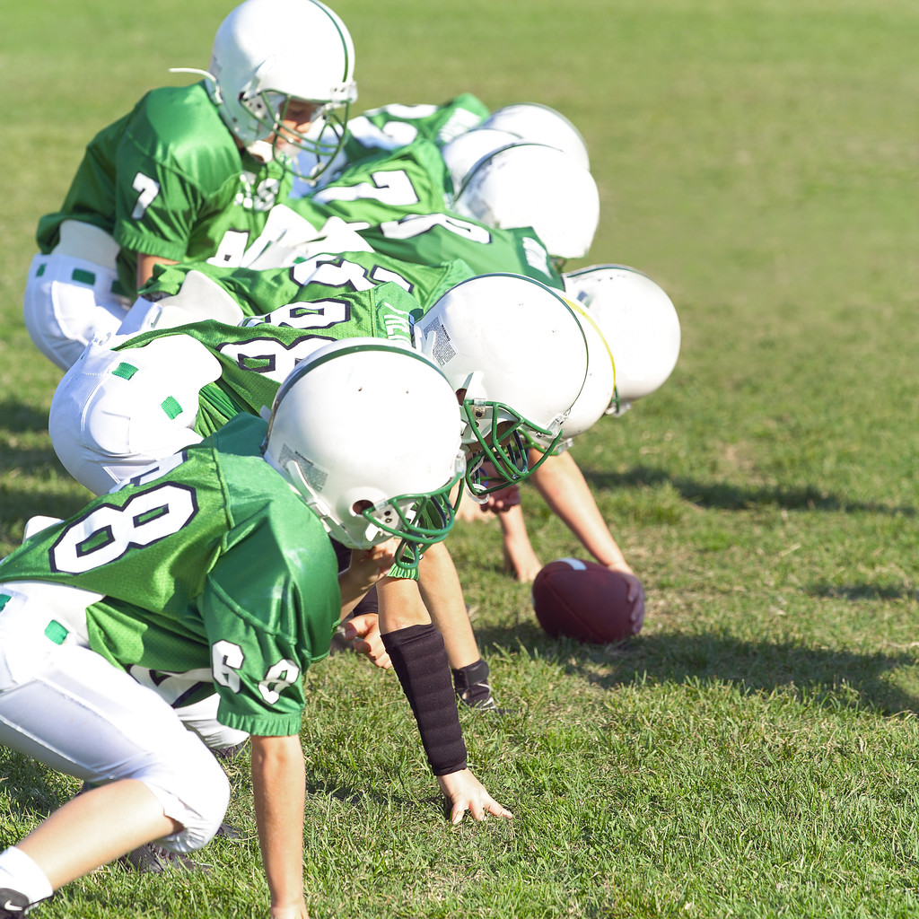
How to tell the difference between a group and a team:
Team :
  Shared leadership
  Individual and shared accountability
  Specific team purpose
  Collective work
  Meetings are often open-ended
Objective 1
HS 65 TM B2

Slide 5
Benefits of Teamwork
Fosters a sense of togetherness
Heightens productivity
Diversity of Talents
Shares Workload
Balances and Shares Roles
Encourages risk-taking
Objective 2
HS 65 TM C

Slide 6
Is it a Group or Team?
_______1. Small number of people whose skills complement each other, and who share parameters of how they will equally commit to work together.
_______2. Meetings run efficiently, quickly.
_______3. Performance comes from what members do individually.
HS 65 Assess

Slide 7
Is it a Group or Team?
_______4. Performance includes results from both individuals and two or more individuals working together.
_______5. Small number of people working on the same thing.
_______6. Often have open-ended meetings.
_______7. A __________ performance is better than the sum of all the individual bests.
HS 65 Assess

Slide 8
Is it a Group or Team?
_______8. Individual and team accountability.
_______9. Members know their performance will affect their teammates.
______10. Members hold each other accountable, don’t rely on external pres sure.
______11. Leader is strong, clearly focused.
HS 65 Assess

Slide 9
Is it a Group or Team?
______12. Members buy into common purpose; it isn’t forced on them.
______13. Common and effective in large organizations where individual accountability is important.
______14. Specific, measurable goals are derived from their purpose.
HS 65 Assess

Slide 10
Is it a Group or Team?
______15. Leadership roles are shared.
______16. Members take responsibility only for themselves and no one else in the group.
______17. Purpose comes from out side the group, usually top—down.
HS 65 Assess

