Slide 1
Making Business Management Engaging & Profitable!
Hannah Everetts, Edon-Northwest HS

Slide 2
What do we love and hate about teaching Ag Bus?
What do you love/look forward to about teaching ag business?
What do you dread/hate about teaching ag business?

Slide 3
What if...
...we could get students excited about ag business?
...we could be excited to teach it?
...students could gain CDE skills and have better SAE’s?
...students could earn money IN CLASS?

Slide 4
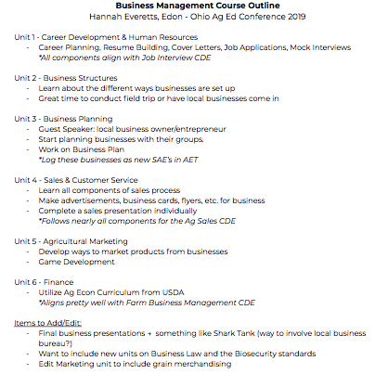

Slide 5
Unit 1 - Career Development & HR
Career Planning, Resume Building, Cover Letters, Job Applications, Mock Interviews
    *All components align with Job Interview CDE

Slide 6
Unit 2 - Business Structures
Learn about the different ways businesses are set up
Great time to conduct field trip or have local businesses come in

Slide 7
Unit 3 - Business Planning
Guest Speaker: local business owner/entrepreneur
Start planning businesses with their groups.
Work on Business Plan
*Log these businesses as new SAE’s in AET

Slide 8
Business Plan Template
https://docs.google.com/document/d/1ssz6IGtibkrgvVAFgNdXLq6OeAlOdS_Myk_hmnONyH4/edit

Slide 9
Student Example:
https://docs.google.com/document/d/1AcU1txJAWGhAfvjiB2U4DJD8UzYkmNenbDHBJeieSGQ/edit

Slide 10
Unit 4 - Sales & Customer Service
Learn all components of sales process
Make advertisements, business cards, flyers, etc. for business
Complete a sales presentation individually
*Follows nearly all components for the Ag Sales CDE

Slide 11
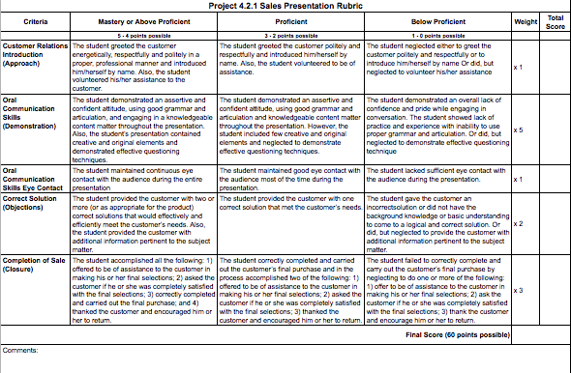
Sales Presentation:

Slide 12
Unit 5 - Marketing
Develop ways to market products from businesses
Game Development

Slide 13
Unit 6 - Finance
Utilize Ag Econ Curriculum from USDA
*Aligns pretty well with Farm Business Management CDE

Slide 14
Items to Add/Edit:
Final business presentations → something like Shark Tank (way to involve local business bureau?)
Want to include new units on Business Law and the Biosecurity standards
Edit Marketing unit to include grain merchandising

Slide 16
Fillers/Differentiators:
Can simplify or add components to business plan
Find entrepreneur videos and share
Peer Business Eval - Have students evaluate other groups’ businesses
National FFA Resources - www.ffa.org/teacherresources

Slide 17
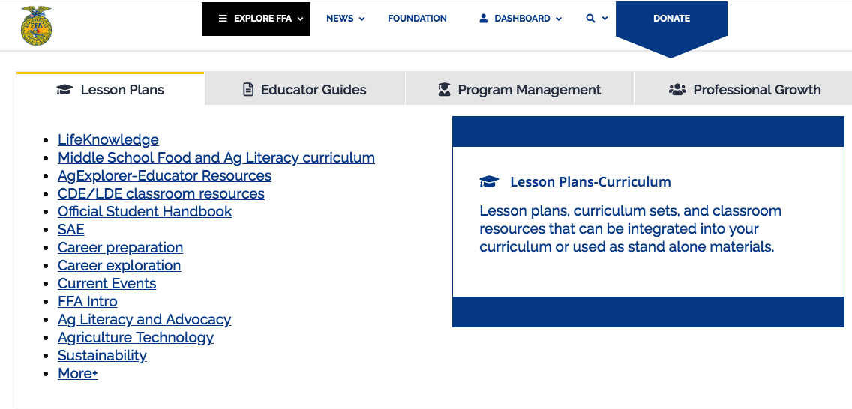

Slide 18
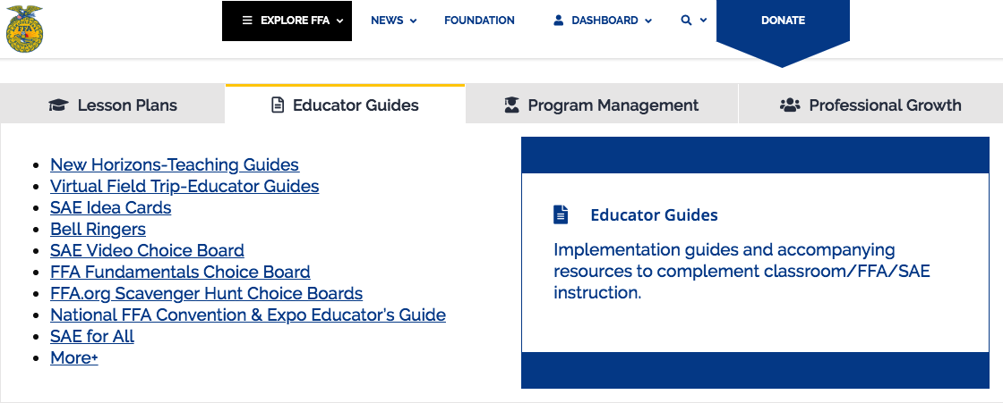

Slide 19
Thoughts?

Slide 20
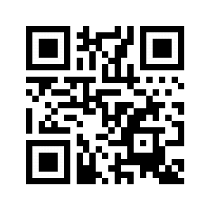
http://bit.ly/h_everetts

