Slide 1
Hazard Analysis and Critical Control Points (HACCP)

Slide 2
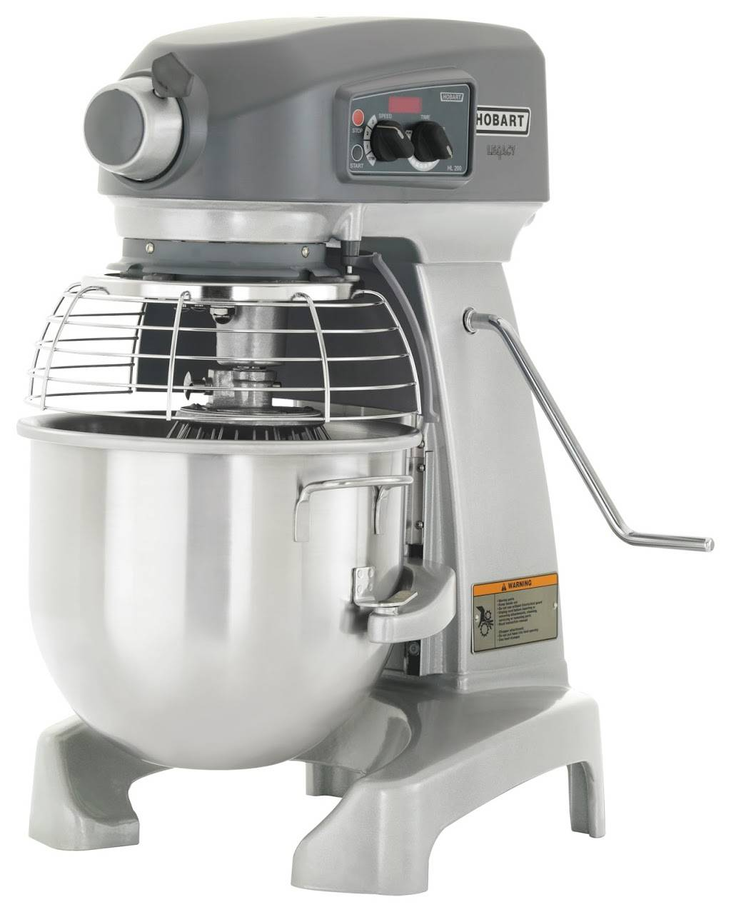
Objectives
Identify product and ingredient hazard analysis
Introduce the seven principles of HACCP

Slide 3
What Is HACCP?
HACCP (Hazard Analysis and Critical Control Point) is a process control system that identifies where hazards are likely to occur in the food production process and puts into place stringent actions to take to prevent the hazards from occurring.
By strictly monitoring and controlling each critical step (critical control points) of the process, there is less chance for hazards to occur.

Slide 4
Why Is HACCP Important?
HACCP is important because it prioritizes and controls potential hazards in food production. By controlling major food risks, such as microbiological, chemical and physical contaminants, the industry can better assure consumers that its products are as safe as good science and technology allow.
By reducing foodborne hazards, public health protection is strengthened.

Slide 5
Is HACCP New?
HACCP is not new. It was first used in the 1960s by the Pillsbury Company to produce the safest and highest quality food possible for astronauts in the space program.
The National Academy of Sciences, National Advisory Committee for Microbiological Criteria for Foods and the Codex Alimentarius have endorsed HACCP as the best process control system available today.

Slide 6

Foodborne Infection
Caused by a person ingesting a number of pathogenic microorganisms sufficient to cause infection as a result of their multiplication, e.g., salmonellosis

Slide 7

Foodborne Intoxication
Caused by the ingestion of already formed toxins produced by some bacteria when they multiply in food, e.g., staphylococcal enterotoxin
Toxins are typically not destroyed by normal cooking temperatures.

Slide 8
7 Principles of HACCP
Conduct a hazard analysis.
Identify the critical control points.
Establish critical limits.
Establish CCP monitoring requirements.
Establish corrective actions.
Establish effective recordkeeping procedures.
Establish procedures for verifying.

Slide 9
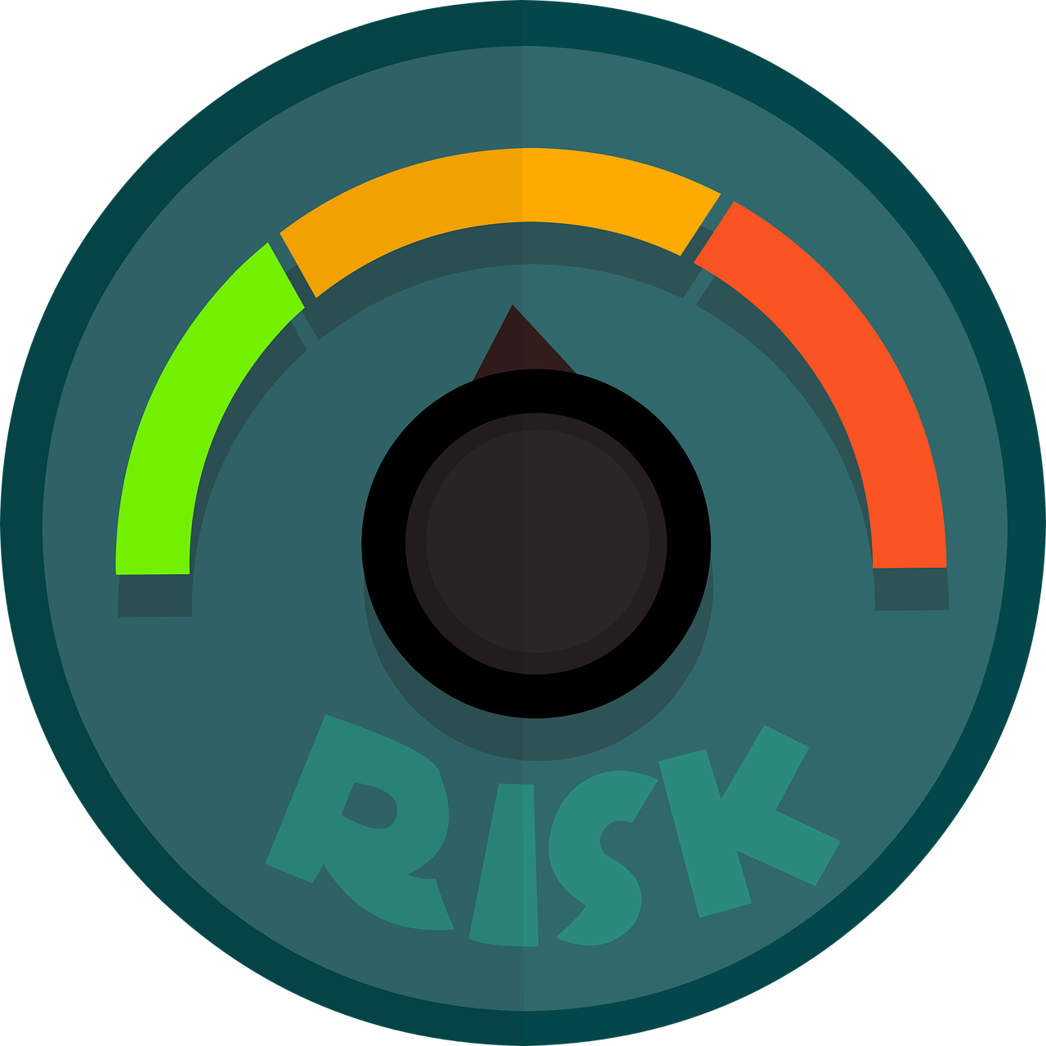
Conduct a Hazard Analysis
To identify potential hazards that are likely to occur during food processing

Slide 10
Identify the Critical Control Points (CCPs)
Those points in the process where hazards are likely to occur and can be prevented, reduced or eliminated

Slide 11
Establish Critical Limits
For preventive measures associated with each identified CCP
A critical limit is a criterion that must be met for each CCP, such as final internal temperature when cooking.
Where appropriate, critical limits may reflect relevant FSIS regulations and FDA tolerances.

Slide 12
Establish CCP Monitoring Requirements
To determine if a CCP is under control
  For example, if you claim that your product is safe when cooked to 160°F, methods must be established to prove that your product has been cooked to 160°F.
Monitoring may require materials or devices to measure or otherwise evaluate the process at CCPs.

Slide 13
Establish Corrective Actions
If monitoring determines a CCP is not within the established limits
In case a problem occurs, corrective actions must be in place to ensure no public health hazard occurs.

Slide 14
Establish Effective Record-Keeping Procedures
Document the HACCP system is working properly
Records should document CCP monitoring, verification activities and deviation records.

Slide 15
Establish Procedures for Verifying
Must verify that the HACCP system is working properly
Verification procedures may include reviewing the HACCP plan, CCP records and critical limits as well as conducting microbial sampling.
Both plant personnel and FSIS inspectors will conduct verification activities

