Slide 2

What is Ethanol?
Clean burning biofuel
Produced from agricultural products such as corn kernels
Used in internal combustion engines
Notes:
This Photo by Unknown Author is licensed under CC BY-SA

Slide 3
How is Ethanol Produced?
Field corn processed into flour
Flour is mixed with recycled water, enzymes and yeast.
  Enzymes breakdown break up corn starch into sugars
  Yeast eat sugars and produce ethanol
Ethanol is distilled from mixture
Coproducts separated from mixture
How is ethanol made?
Ethanol Process Graphic
Notes:
Use the video, How is ethanol made?, and graphic link on the slide to show students how ethanol and coproducts are produced.

Slide 4
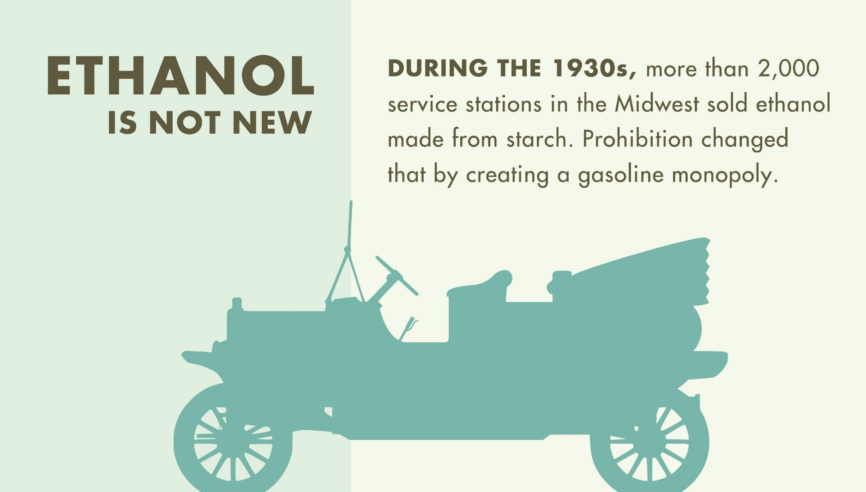
Ethanol History
Notes:
Ethanol has been used since the start of automobile transportation.

Slide 5
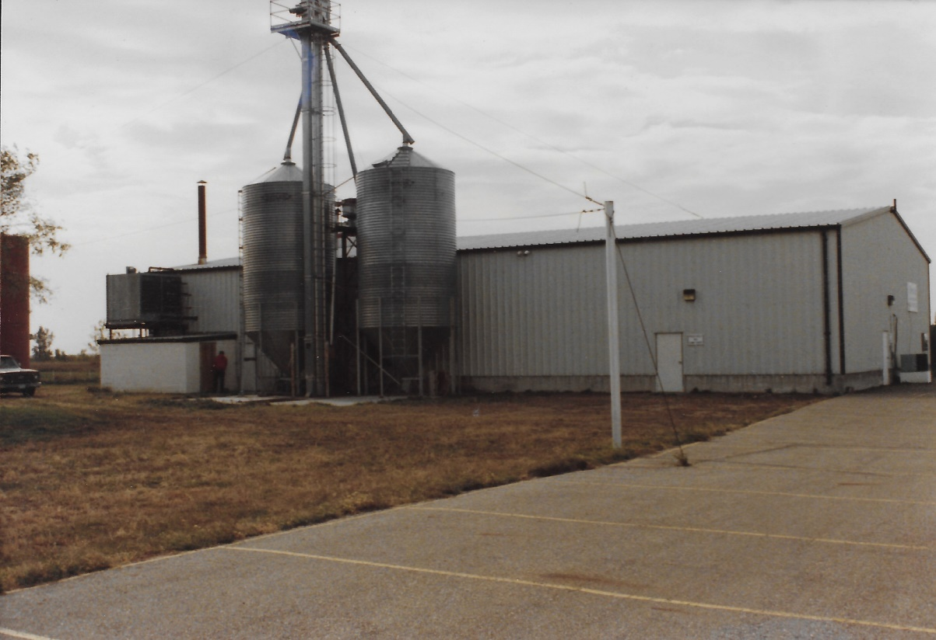
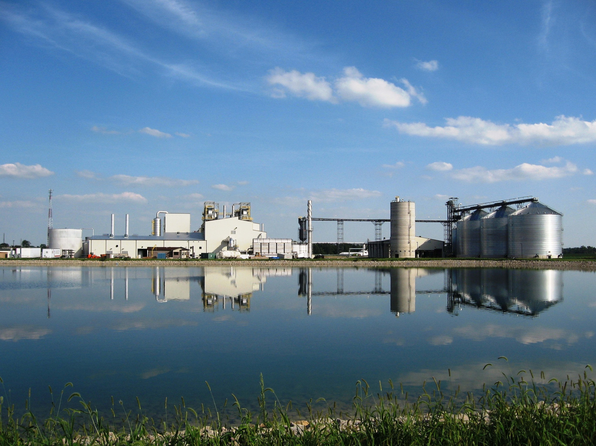
Ethanol Production Growth
Notes:
Early on, many ethanol plants started small as seen in the picture to the left. Over time, the demand for ethanol has grown, as have the production plants, as seen in the picture to the right. The plants seen here show the growth of the industry. Some ethanol businesses grew from small family farms to a large ethanol corporations supporting many family farms across the Midwest. Local corn producers across the Midwest benefit from ethanol production. These local producers have an effect on the global economy.

Slide 6
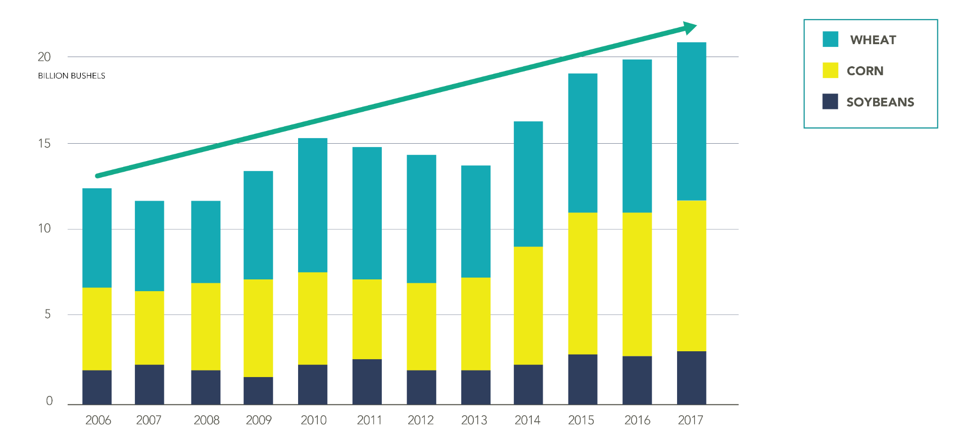
Ag Production Continues to Increase
Grain inventories are at record highs and growing
Notes:
Grain production has increased continuously due to new agricultural technologies and efficiencies.

Slide 7
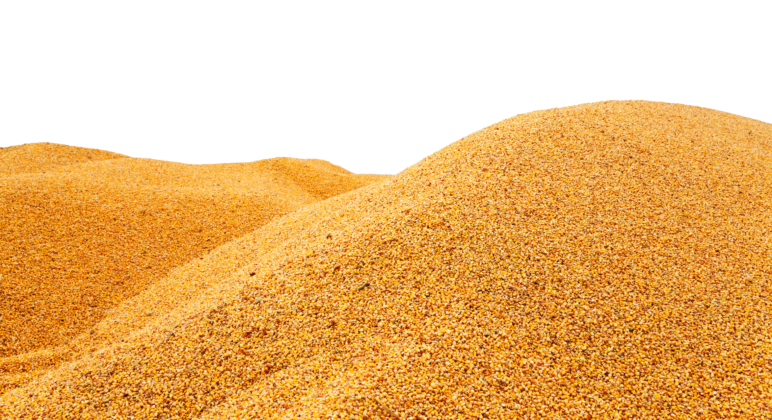
Grain Surplus
World corn, wheat and
soybean surplus hits
record 20 billion bushels

Slide 8
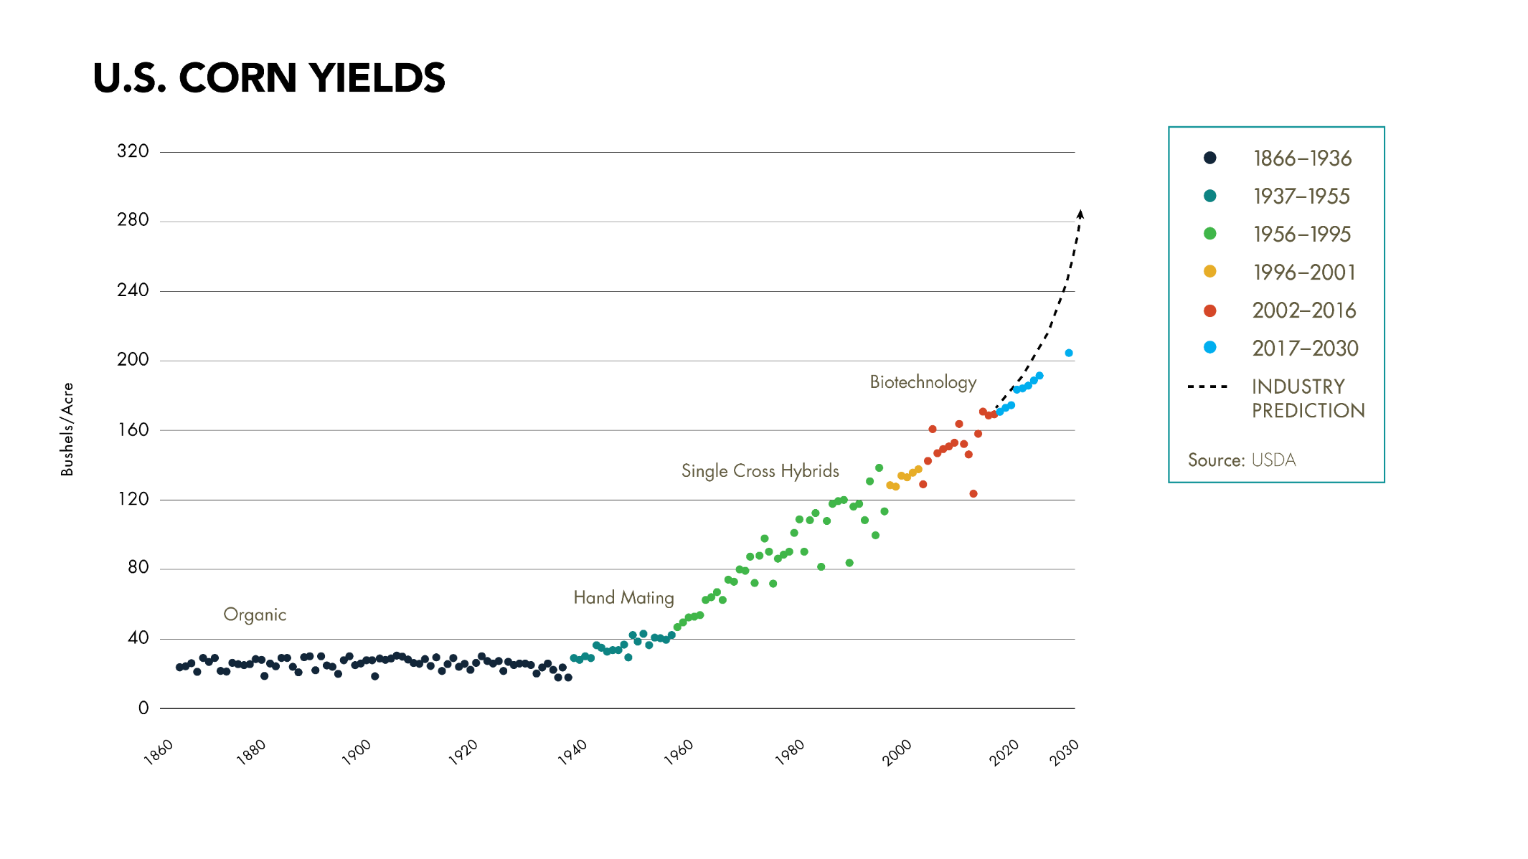
Corn Production
Corn yields continue to grow rapidly
Notes:
How can society utilize the increase of corn production?

Slide 9
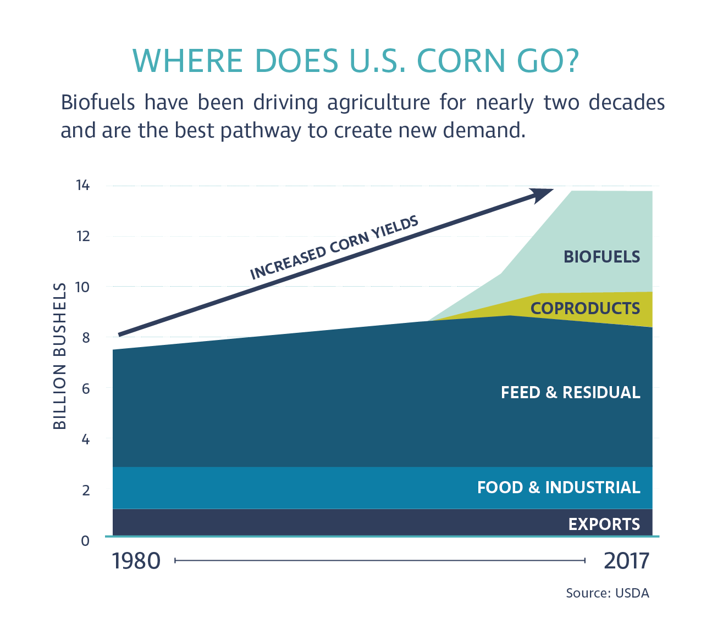
Corn Processing
Notes:
Corn has traditional been used for food and feed. Over the past 30 years, fuel has been an added product due to increase corn yields.

Slide 10
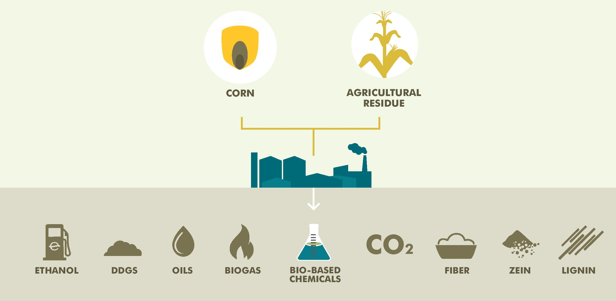
Ethanol and Coproduct Production
Notes:
Ethanol plants, produce ethanol, oils, biogas, distillers grains, and many other coproducts that can be utilized by industry.

Slide 11
Presentation Review
Mark or highlight three key points
List two ideas or concepts related to previous knowledge.
List questions you have about this topic.
Keep notes organized and available for use throughout the course.

Slide 12
References
Berven, D., (2018). [POET presentation]. Biofuels past, present and future. Sioux Falls, SD.
POET. (2018). Products and solutions. Retrieved from https://poet.com/products

