Slide 2
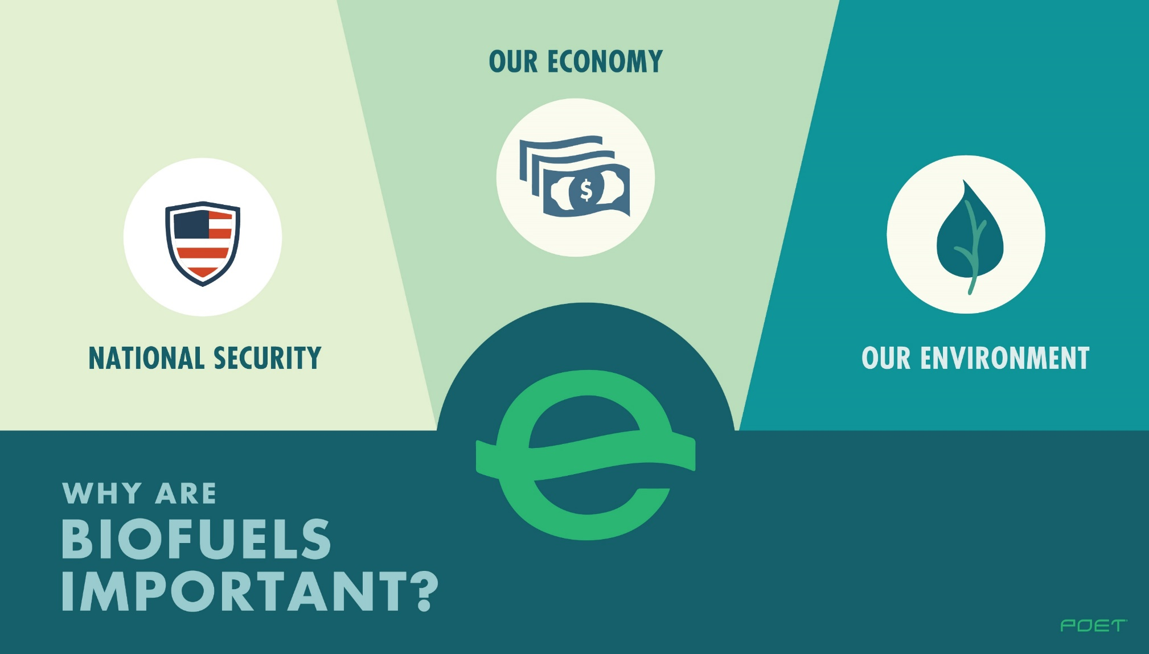
Importance of Biofuels
Notes:
Ethanol benefits our economy while protecting our environment and increasing our national security.

Slide 3
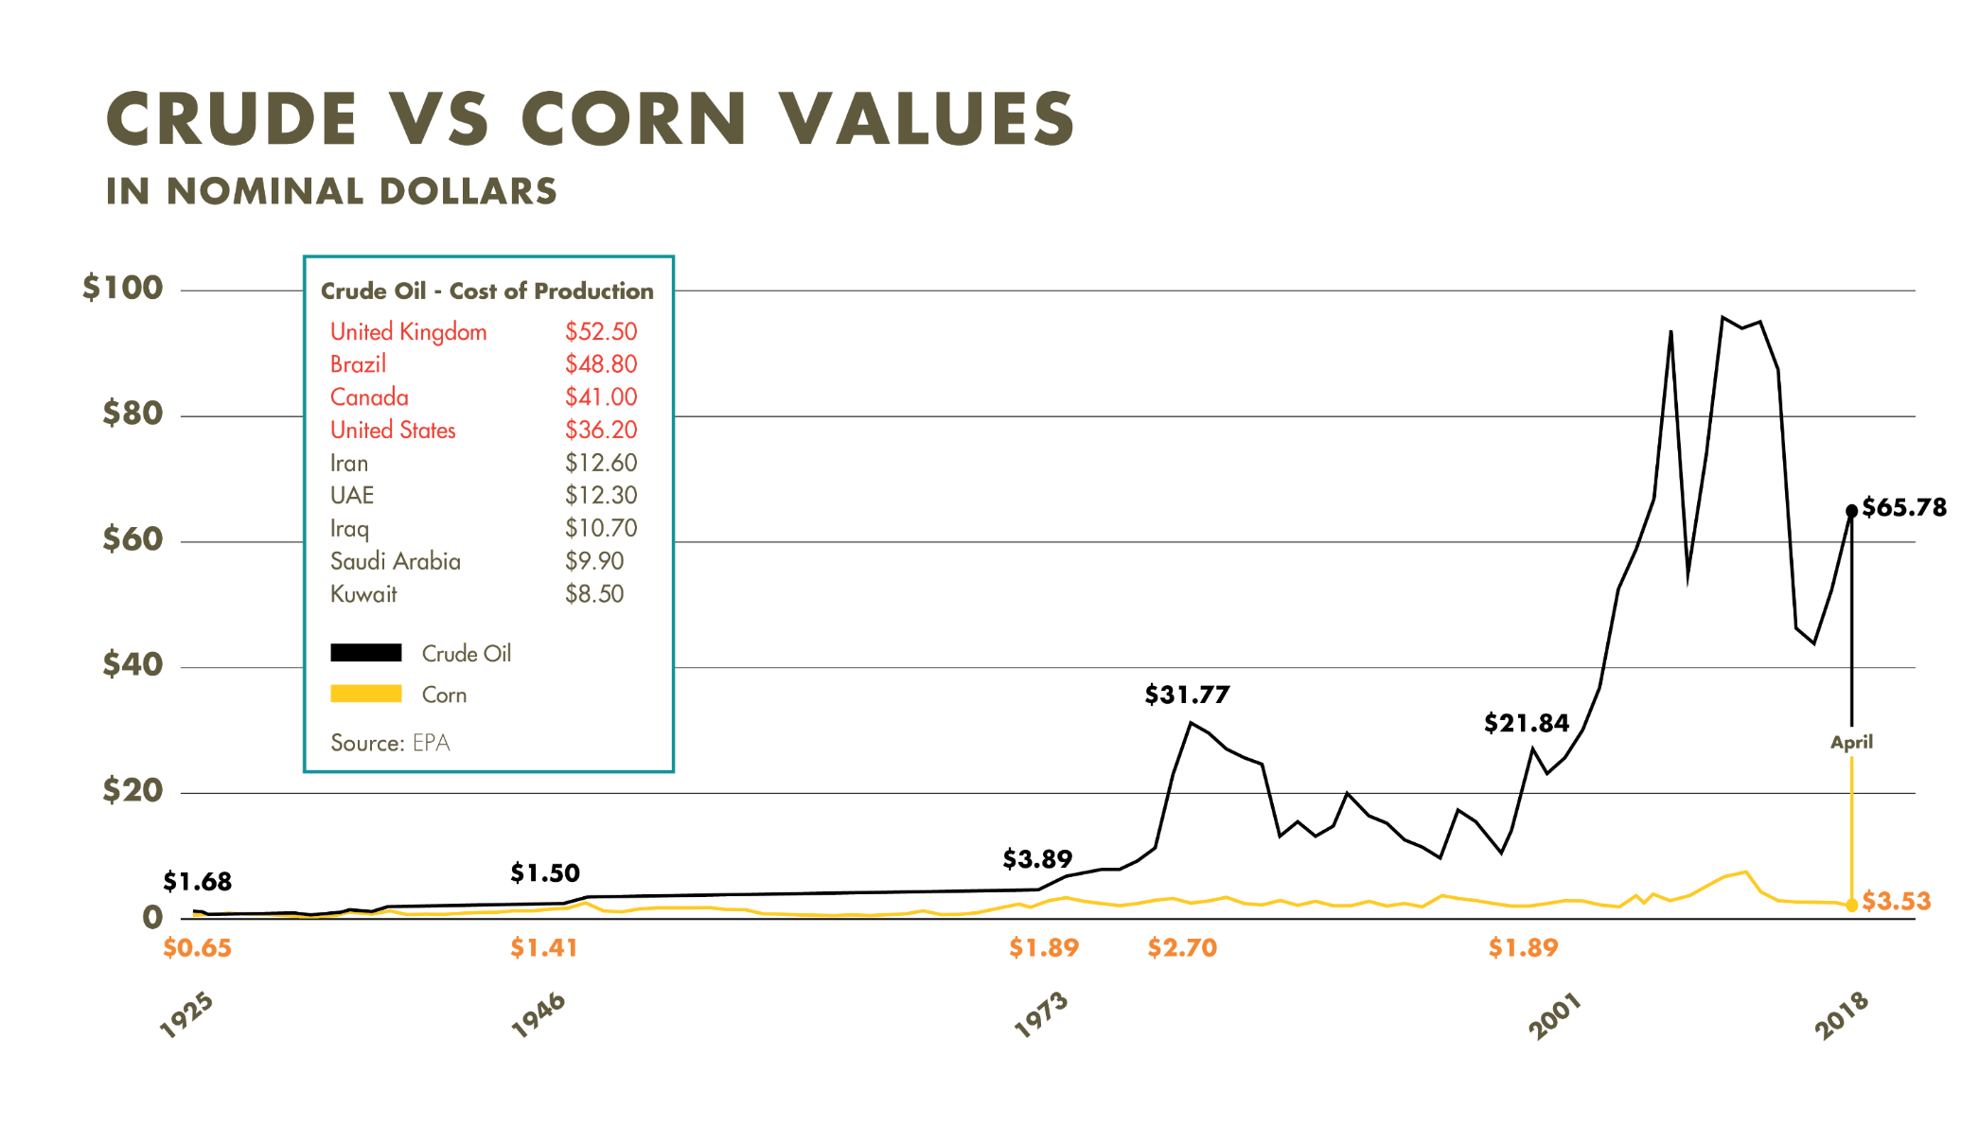
Economic
Notes:
Crude oil prices have increased much more over time than corn. How can we add value to corn in the future?

Slide 4
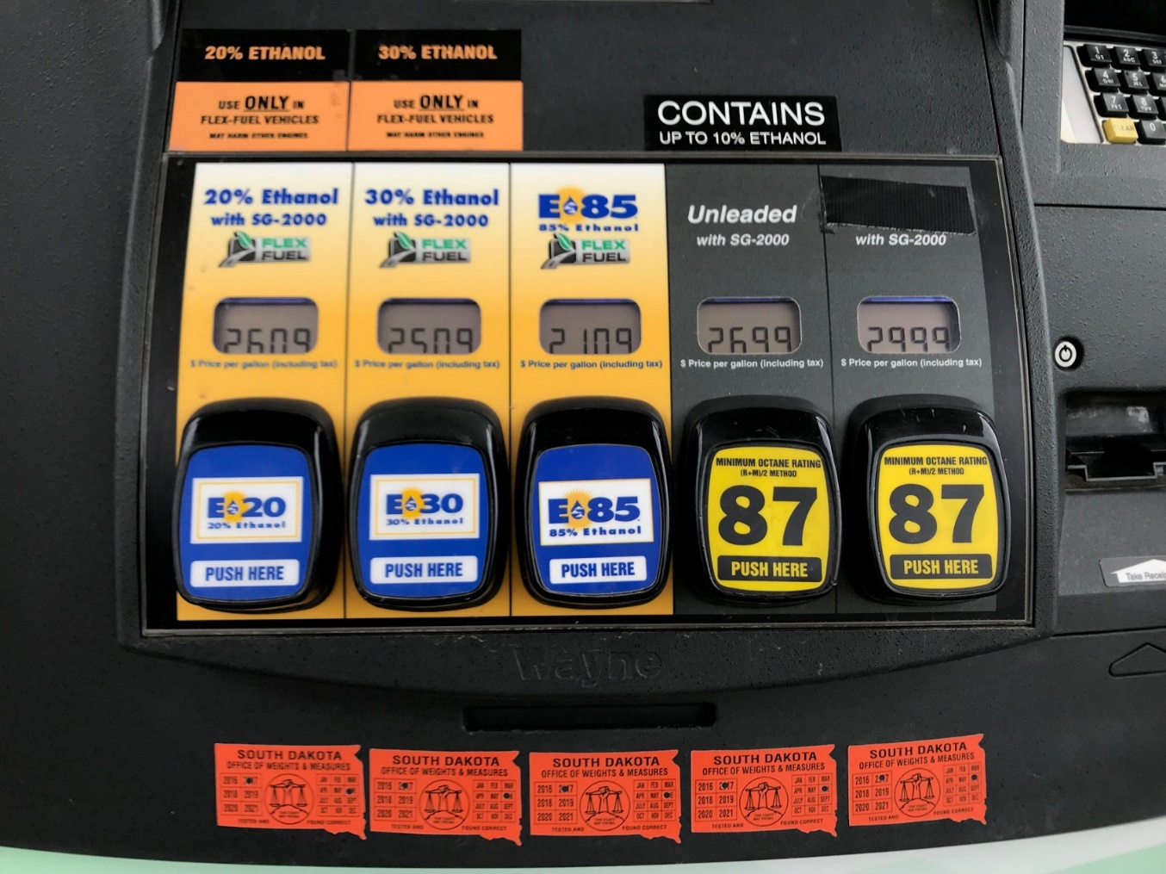
Economic
Consumer Savings
Ethanol replaces some of the most expensive chemicals in the gasoline pool
Ethanol does not have to be less expensive than wholesale gasoline
Notes:
Ethanol is less expensive at the pump for the consumer, but does not have be less expensive than wholesale gasoline.

Slide 5

Economic Impact
$184.5 Billon of Economic Output
$14.5 Billion in Taxes
$46.2 Billion in Wages
360,000 Jobs
Notes:
Ethanol has had a positive impact on our Nation’s economy.

Slide 6
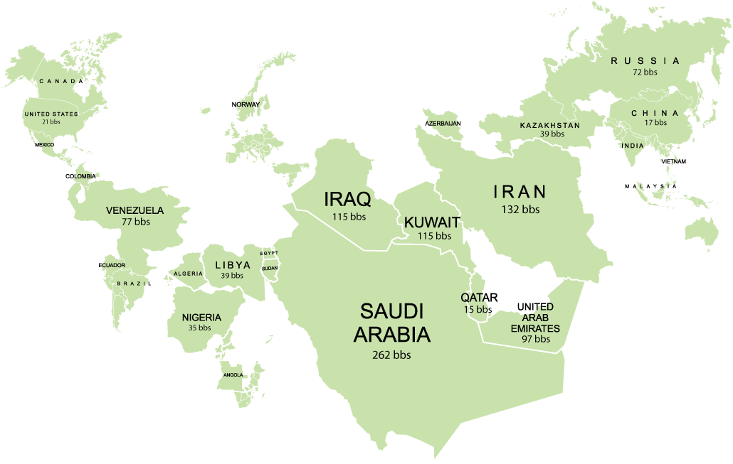
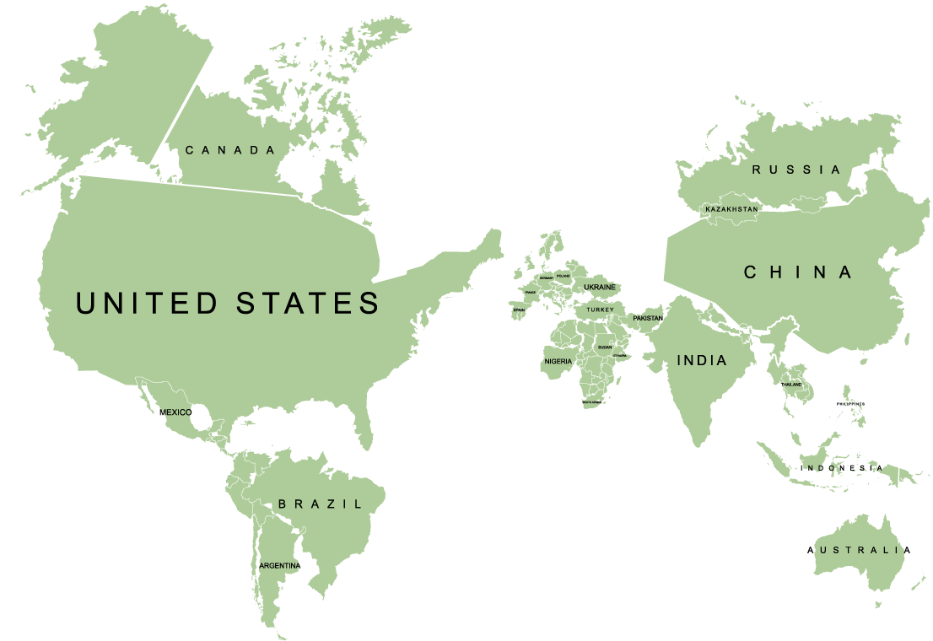
World According to Oil vs Ag
World Oil Influence
World Agriculture Influence
Notes:
World oil production is much higher in other parts of the world than in the United States. The United States has a strong agricultural economy. Ethanol is an answer to reducing our fuel dependence on foreign countries while supporting our agricultural economy.

Slide 7
Renewable Fuel Standard
Decrease Oil Imports
Increase Air Quality
Decrease Gas Prices
Notes:
The Renewable Fuel Standard was enacted to reduce our dependence on foreign oil.

Slide 8
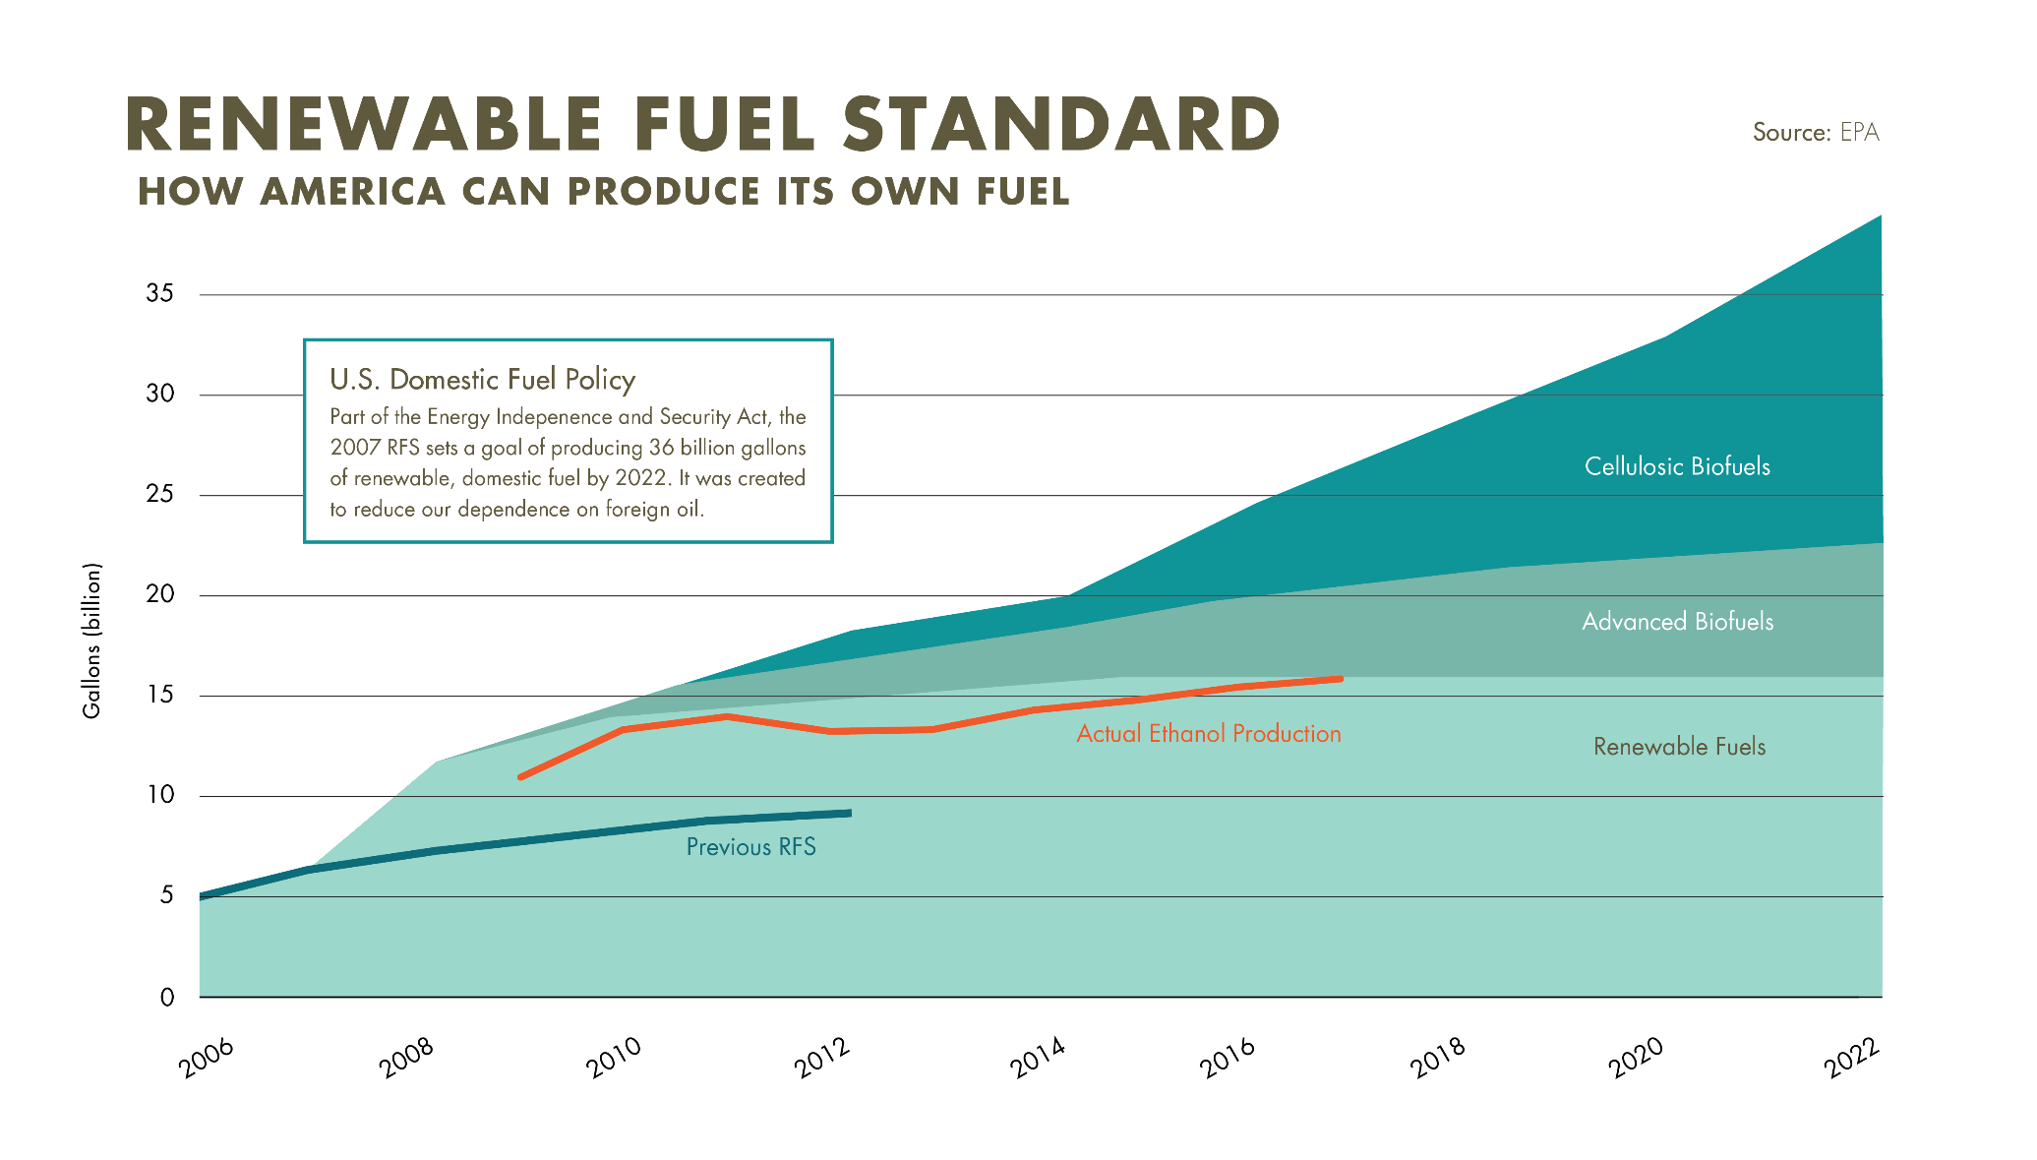
Renewable Fuel Standard
Notes:
Ethanol production will need to increase to meet the future goals of the Renewable Fuel Standard. Additional ethanol will need to be used to meet this goal.

Slide 9

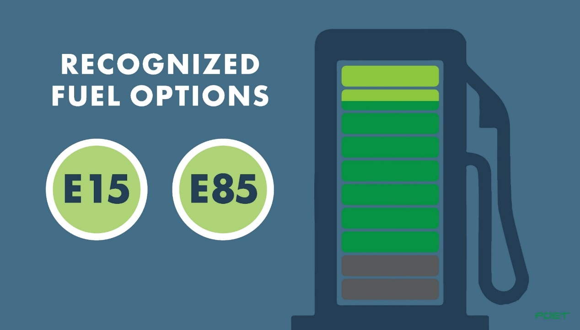
Ethanol Blends
Notes:
Currently all engines are designed for gasoline with a 10% ethanol blend. Increase use of other recognized ethanol percentages and increased choices at the gasoline pump can help achieve the Renewable Fuel Standard.

Slide 10
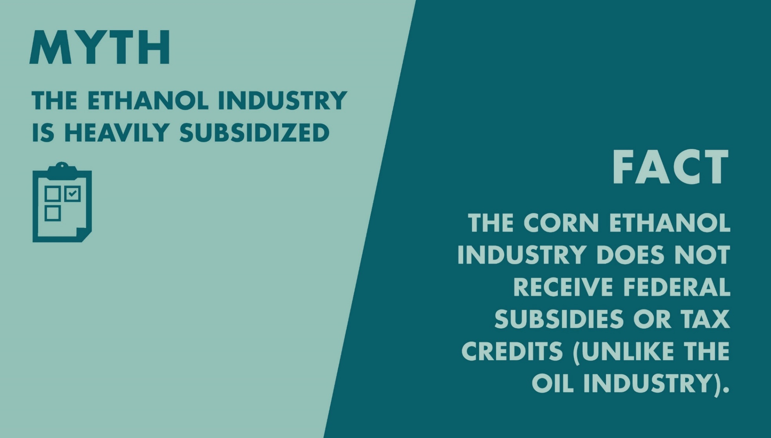
Myths and Facts
Notes:
Many do not understand the facts about ethanol.

Slide 11
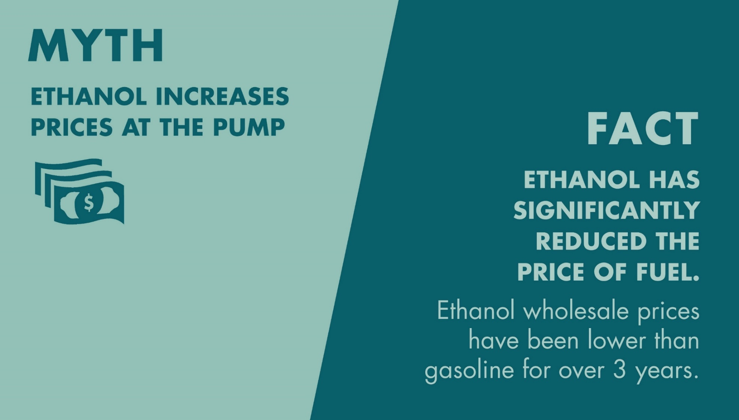
Myths and Facts

Slide 12
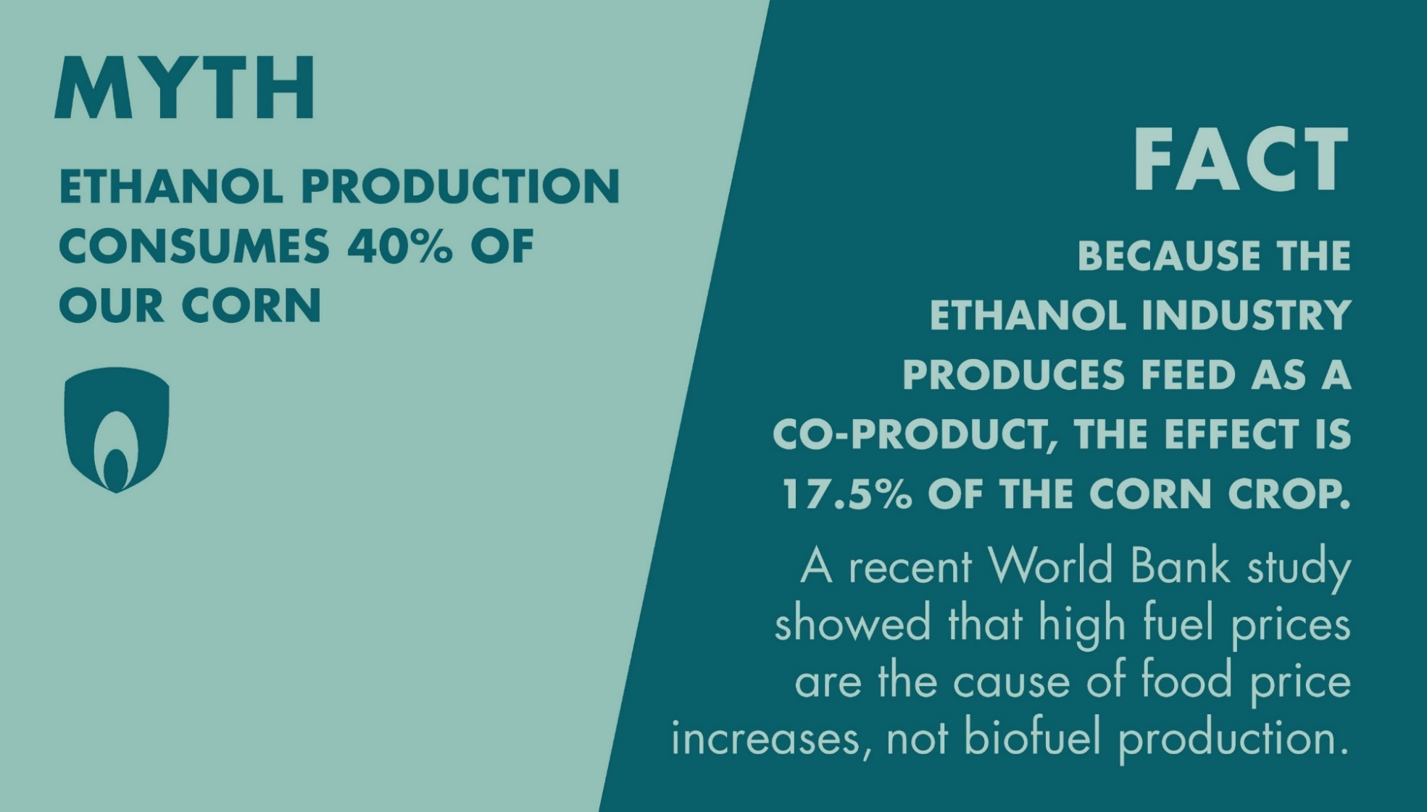
Myths and Facts

Slide 13
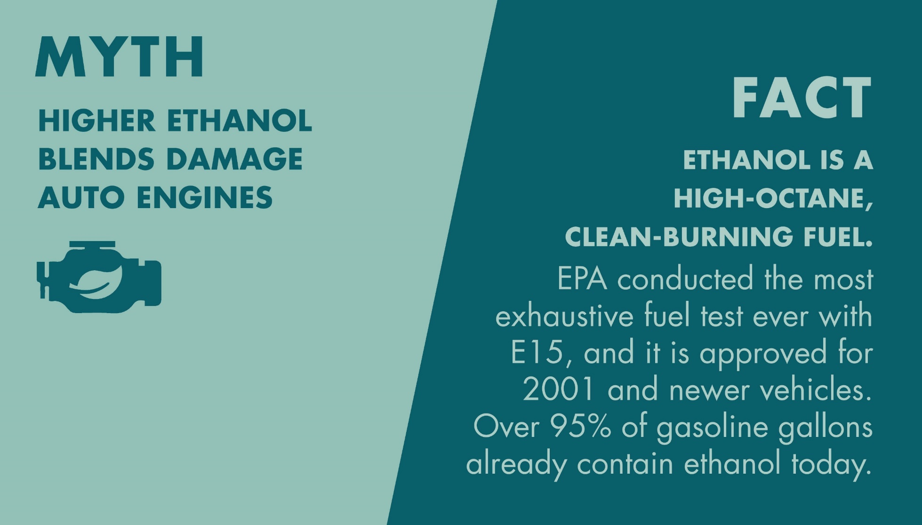
Myths and Facts

Slide 14
Presentation Review
Mark or highlight three key points
List two ideas or concepts related to previous knowledge.
List questions you have about this topic.
Keep notes organized and available for use throughout the course.

Slide 15
References
Berven, D., (2018). [POET presentation]. Biofuels past, present and future. Sioux Falls, SD.

