Slide 1
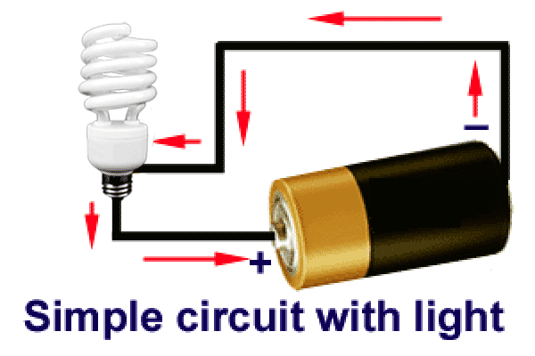
Introduction to
Electrical Circuit Notes

Slide 2
Circuit Terms
Simple Circuit: A simple circuit is a complete circle of current flow. It consists of a source of electricity, one wire to carry the current from the source to where it will be used and another wire to carry it back, plus an object of rated resistance (for example, a lamp) to use the voltage.
Branch circuit: Branch circuits are circuits beginning from the service entrance panel and branching out into a variety of places for a variety of purposes.
Open circuit: An open circuit refers to a break in the circuit circle so that the current cannot flow through it.
Short circuit: A short circuit is a current flow around the circuit resistance and back to the source so rapidly that fuses blow, wire insulation burns and batteries drain.
Grounding: Grounding is the practice of providing an additional connection between a piece of electrical equipment and the earth with a conductor called a ground wire in case the current gets out of the circuit.

Slide 3
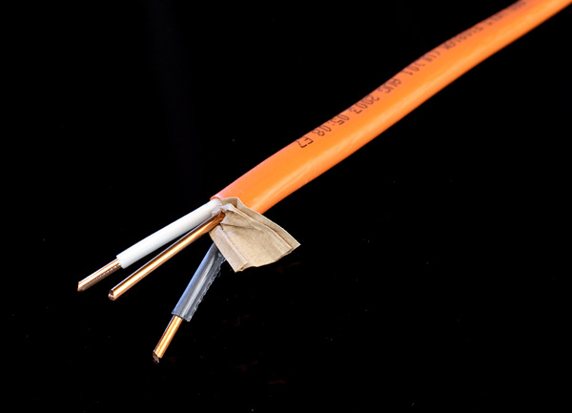
Circuit Components
Components of a Simple Two-Wire Circuit
Wires: A simple circuit has a white wire and a black wire.
The white wire is known as the neutral or grounded wire because it is always connected to an underground water pipe or a ground rod through the service-entrance panel.
  It must always run direct to every 120-volt outlet.
  It must always be connected to a neutral terminal (silver-colored).
  It never has a fuse or breaker.
  It never has a switch.
  It must be electrically continuous.

Slide 4
Circuit Components
The black wire is referred to as the "hot" wire.
One black wire and one white wire must run to every outlet.
Electrical potential always exists between the black wire and the white wire.

Slide 5
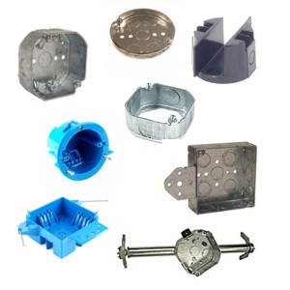
Circuit Components
Electrical Boxes: These are boxes made of either metal or plastic, rectangular or octagonal in shape, which have the following functions:
  They anchor the cable or conduit so stress cannot be placed on wire connections.
  They are nailed, screwed or clamped to the building in order to support outlets, switches or fixtures.
  They contain all wire connections made outside of fixtures.

Slide 6
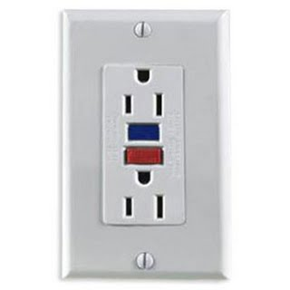
Circuit Components
Outlets: The most common outlet is the duplex receptacle wired so that both of its outlets are on the same circuit.
Outlets are wired across the black wire and the white wire.
The current enters the outlet on the black wire, flows from one screw through a metal strap to the other screw and continues on to the next electrical box.
One outlet in a duplex receptacle may be switched by breaking the metal strap between the two screws, but they must be on the same circuit breaker.

Slide 7
Circuit Components
Fixtures: They are bases or housings for light bulbs, fan motors and other such electrical devices.
Switches: They are electrical devices which provide a means to open a circuit to stop electron flow to outlets or lights and to close it again to allow current flow.
The wire is usually black except in a switch loop.
Their amperage and voltage ratings must match those of the circuit.
Their number of poles indicates how many hot wires feed through the switch.
Their number of throws indicates from how many locations a switch can be operated.

Slide 8
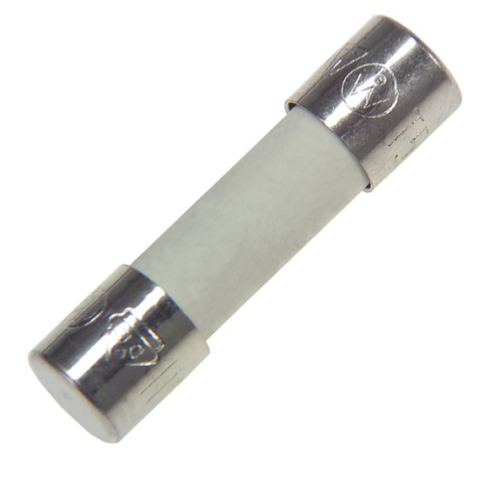
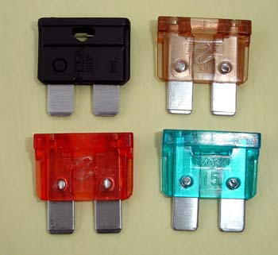
Circuit Components
Overcurrent Protection Devices: Fuses and breakers are always wired to the black (hot) wire.
Entrance Switch: It is a switch placed ahead of the fuse in the hot wire where electricity enters the building.

Slide 9
Wire Colors
Colors of Wires and Terminals in Structural Wiring
  Colors of Wires
    White (sometimes natural gray) colored wire must be used only for the ground wire.
    Additional grounding conductors may be green, green with one or more yellow stripes or a bare wire.
    Wiring for the "hot" wires may be any other color, but it is most frequently black or red.
    The color schemes most often used for structural wiring are:
      Two-wire circuit: white and black
      Three-wire circuit: white, black and red
      Four-wire circuit: white, black, red and blue
      Five-wire circuit: white, black, red, blue and yellow

Slide 10
Wire Colors
B. Colors of Terminals on Electrical Equipment
  Natural copper or brass terminals are for "hot" wires only.
  Terminals of a whitish color (such as nickel, tin or zinc- plated) are for grounded wires only.
  Terminals of a green color are for grounding wires only.
  Grounding wires are those connected to the surface or shell of an appliance or tool to supply a continuous low-resistance path to ground should the surface of the tool or appliance accidentally become energized.

