Slide 1
Introduction to Soil Health
National FFA Organization

Slide 2
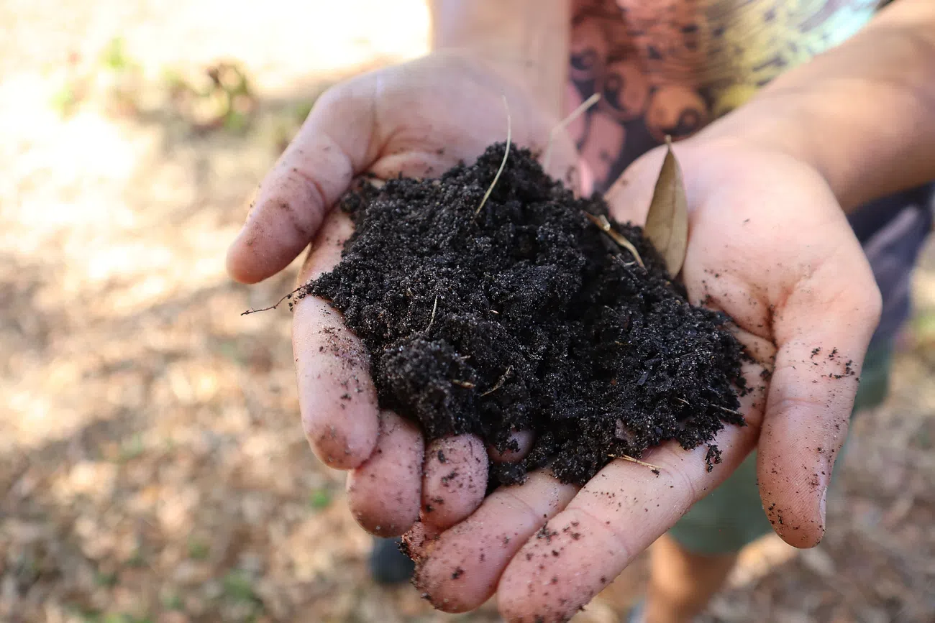
Soil Health
Soil health is defined as the continued capacity of soil to function as a vital living ecosystem that sustains plants, animals and humans.
  Healthy soil gives us clean air and water, bountiful crops and forests, productive grazing lands, diverse wildlife and beautiful landscapes.
Source: United States Department of Agriculture, Natural Resources Conservation Service
https://www.nrcs.usda.gov/conservation-basics/natural-resource-concerns/soils/soil-health

Slide 3
Five Essential Functions of Soil
Regulating water
Sustaining plant and animal life
Filtering and buffering potential pollutants
Cycling nutrients
Providing physical stability and support
Source: United States Department of Agriculture, Natural Resources Conservation Service
https://www.nrcs.usda.gov/conservation-basics/natural-resource-concerns/soils/soil-health

Slide 4
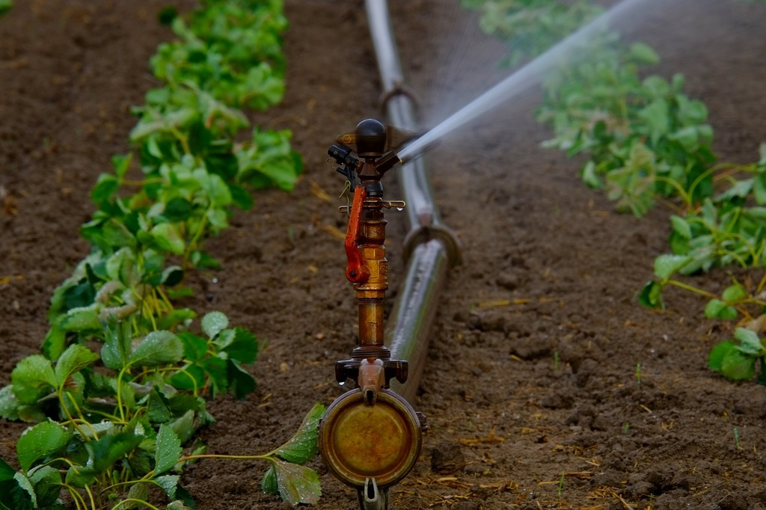
Regulating water
Soil helps control where rain, snowmelt and irrigation water goes.
Water flows over the land or into and through the soil.
Source: United States Department of Agriculture, Natural Resources Conservation Service
https://www.nrcs.usda.gov/conservation-basics/natural-resource-concerns/soils/soil-health

Slide 5
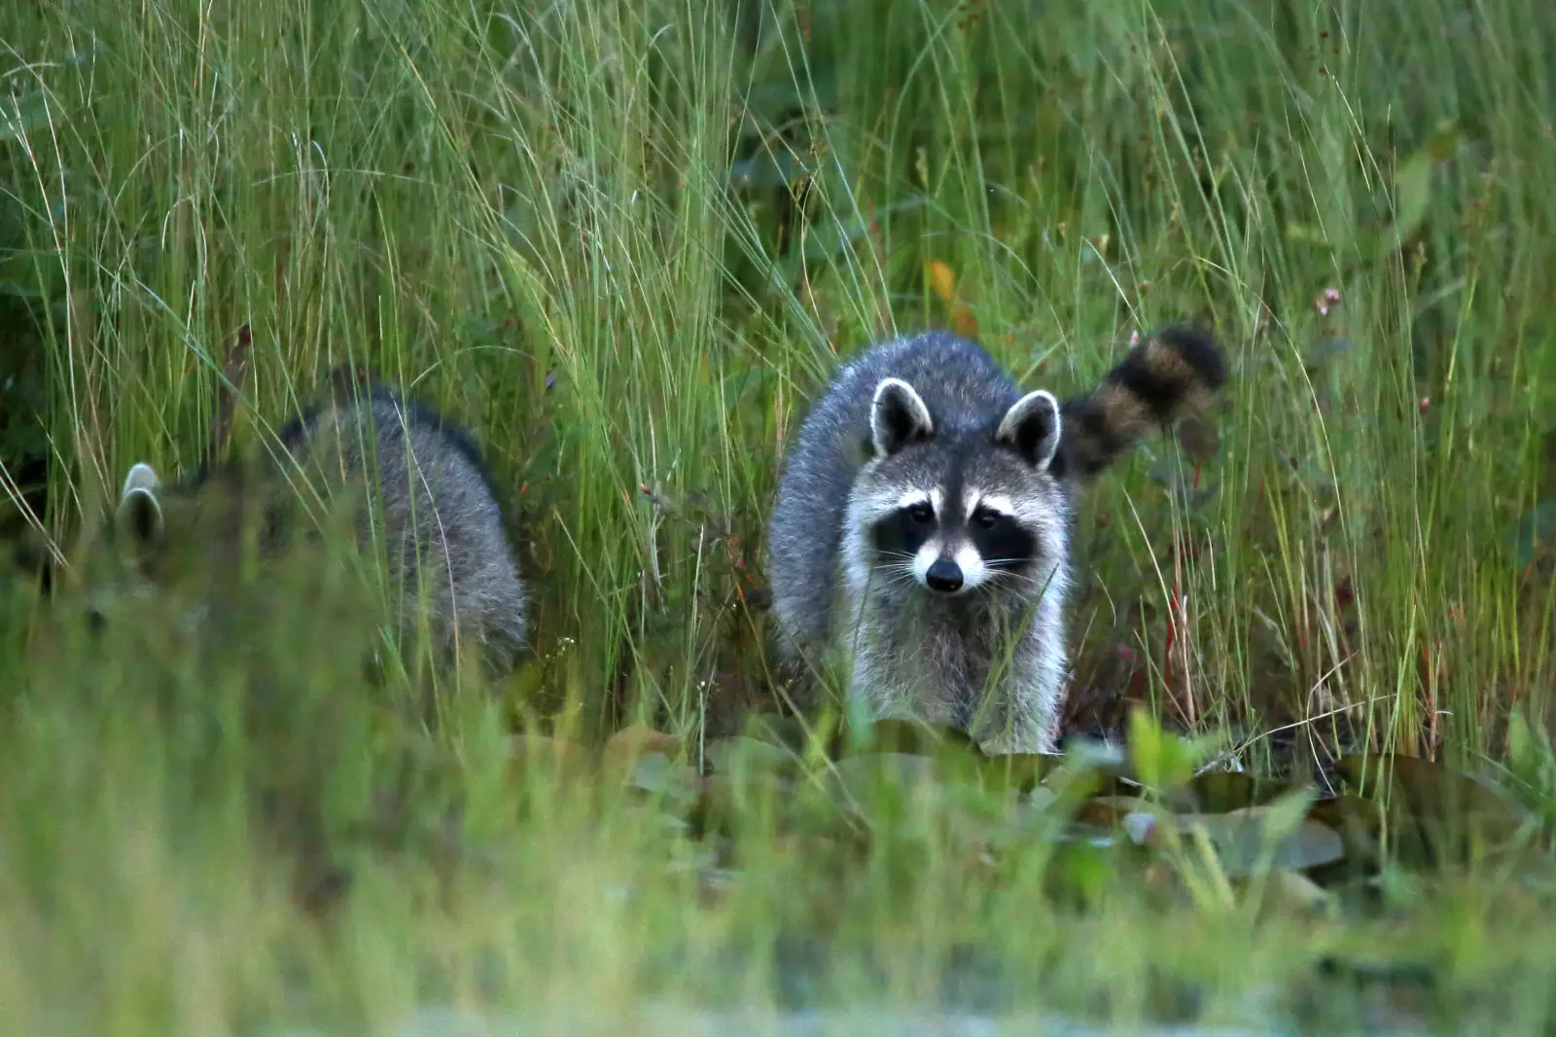
Sustaining plant and animal life
Soil is the foundation of all life.
Plants, animals, bacteria and fungi all rely on healthy soil to live and receive the nutrition they need to survive.
Source: United States Department of Agriculture, Natural Resources Conservation Service
https://www.nrcs.usda.gov/conservation-basics/natural-resource-concerns/soils/soil-health

Slide 6
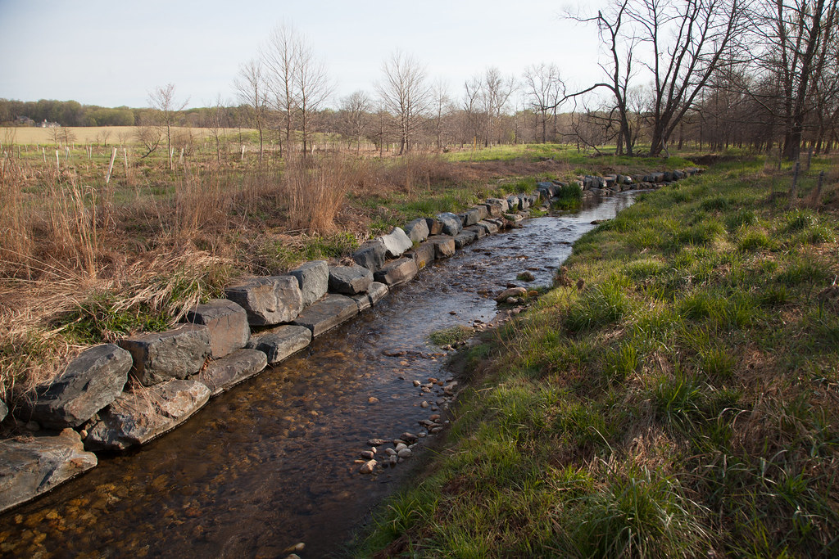
Filtering and buffering potential pollutants
The minerals and microbes in soil are responsible for filtering, buffering, degrading, immobilizing and detoxifying organic and inorganic materials, including industrial and municipal byproducts and atmospheric deposits.
Source: United States Department of Agriculture, Natural Resources Conservation Service
https://www.nrcs.usda.gov/conservation-basics/natural-resource-concerns/soils/soil-health

Slide 7
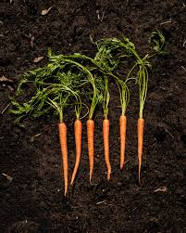
Cycling nutrients
Carbon, nitrogen, phosphorus and many other nutrients are stored, transformed and cycled in the soil.
Source: United States Department of Agriculture, Natural Resources Conservation Service
https://www.nrcs.usda.gov/conservation-basics/natural-resource-concerns/soils/soil-health

Slide 8
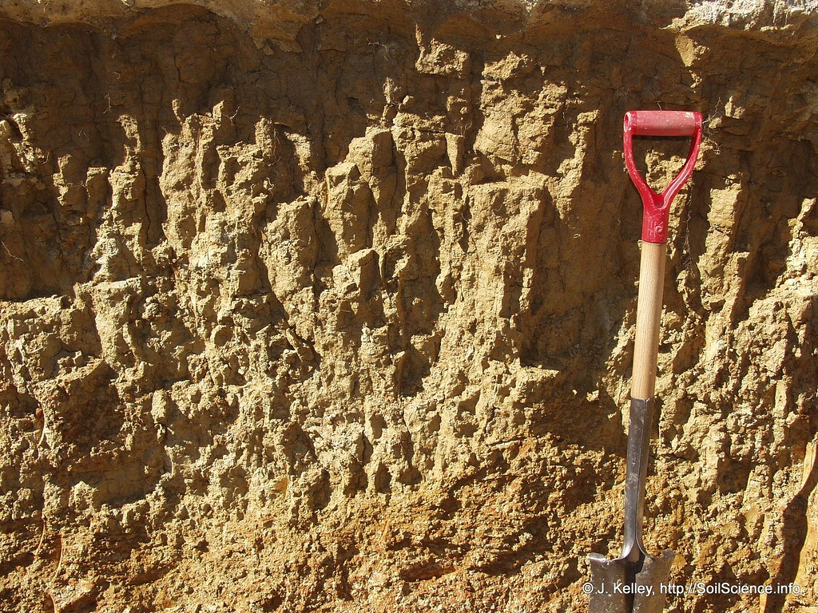
Providing physical stability and support
Soil structure provides a medium for plant roots.
Soils also provide support for human structures and protection for archeological treasures.
Source: United States Department of Agriculture, Natural Resources Conservation Service
https://www.nrcs.usda.gov/conservation-basics/natural-resource-concerns/soils/soil-health

