Slide 1
It’s All in a Label
Interpreting and Designing Food Labels

Slide 2
Interpreting a Food Label
A food label is comprised of 7 parts:
Serving Size
Calories
Total Fat
Cholesterol
Sodium
Total Carbohydrates
Protein
Sourced: https://www.fda.gov/files/food/published/Food-Labeling-Guide-%28PDF%29.pdf
*Can easily be found on labels because they are required to be in BOLD

Slide 3
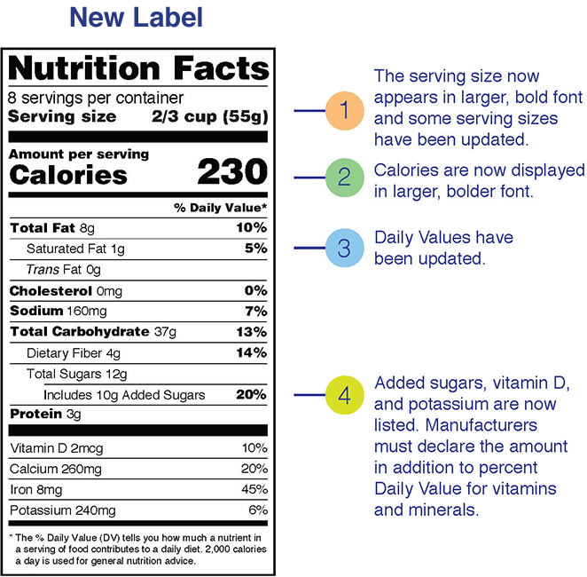
NOTE:
Areas in BOLD are required.
Also added:
Sugars, vitamin D, potassium
Manufacturers must declare amount in addition to % daily value for vitamins and minerals.

Slide 4
Serving size standardizes food portions and allows consumers to compare foods through similar units of measure.
  The size of servings in the packaging influences the number of calories in the food. Pay close attention to serving size because you may accidentally consume too many calories by consuming multiple servings.
Calories (and Calories from fat) are a measure of energy in each serving of the packaged food.
Calories from fat are added to detail how many of the total calories are derived from fat.
  Many Americans consume too many calories, and this portion of the label helps consumers manage their caloric intake.
  General Calorie Guide: 40 calories is low, 100 calories is moderate and 400+ calories is high.
  Typically based on a 2,000 calorie/day diet

Slide 5
Total Fat indicates how many grams of fat are in 1 serving of the item.
Cholesterol indicates how much cholesterol can be found in 1 serving of the food item.
  The body naturally makes cholesterol; therefore, humans do not need to consume additional amounts to meet dietary needs. (It is produced primarily by the liver.)
Sodium indicates how much salt is in 1 serving of the food item.
Total Carbohydrates indicates how much sugar, starch and fiber are in 1 serving of a food item. The amount of carbohydrates we consume can impact blood sugar in the body. Pasta products, sugary cereals, chips and baked products are high in carbohydrates.
Protein indicates the amount of protein in a 100-gram sample of food. Protein grams are measured on the total essential amino acid content and other tests involving bioavailability.

