Slide 1
National FFA Organization
Infusing Ag Business professionals into your program to enhance program planning and instruction
Jacob Ball, National FFA Teacher Ambassador
Carter G. Woodson Academy
Lexington, KY
jacob.ball@fayette.kyschools.us

Slide 2
Topics to be covered:
Advisory Committee
Guest Speakers or Guest Teachers
Project-Based Learning Entry Events and Life Skills Education
Virtual Options

Slide 3
Advisory Committee
Questions to Ask
Who is on my advisory committee?
Do members reflect the local industry including the agribusiness sector?
How is my advisory committee helping my students and me?
Am I truly using these University and Industry experts to their fullest potential?
Suggestions
Invite new members! Sometimes getting new perspective on a program is great for growth!
Reach out to non-traditional industry reps that are embedded in ag sector (banking, marketing, law, HR, etc.)
Add members with a purpose!

Slide 4
Guest Speakers and
Guest Teachers!
Utilize agribusiness industry reps and advisory committee members to engage students in learning.
Establishes strong connections between local industry and students
May lead to co-op/internship placements or job opportunities in the future.
Opens lines of communication.
Promotes your program to local community and school administration.

Slide 5
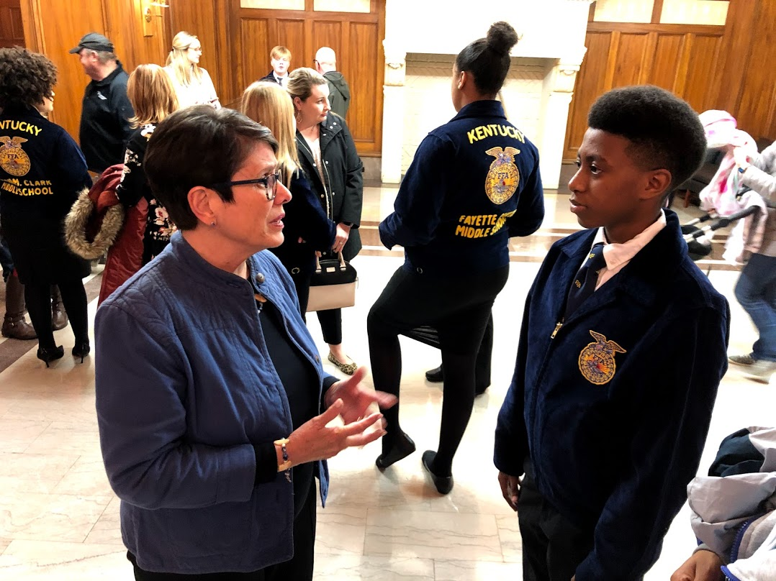
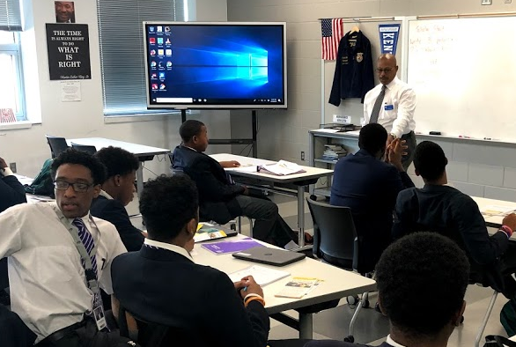
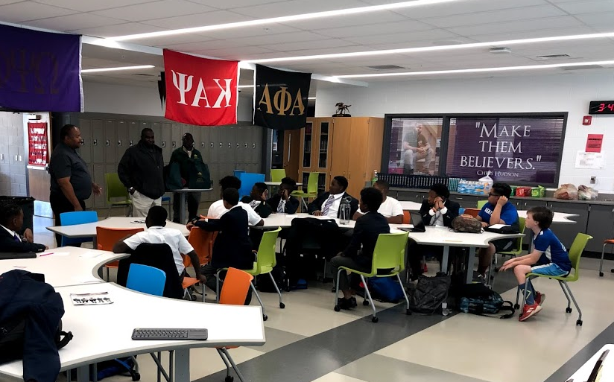
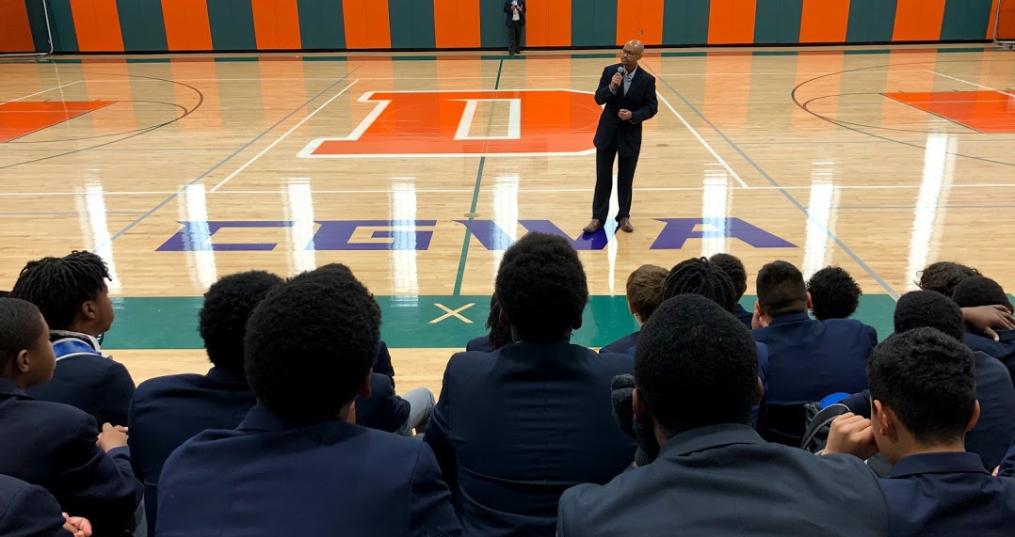
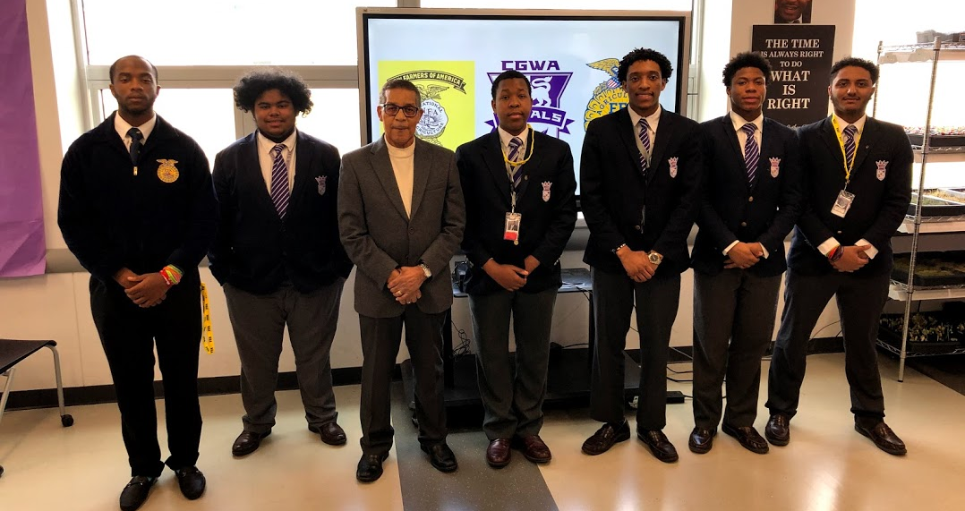
Guest Speakers and
Guest Teachers!

Slide 6
Project-Based Learning Entry Events and Life Skills Education
PBL Entry Event: Have a local agribusiness professional introduce upcoming unit or project to solve a problem for them. Could be a letter, video, zoom, visit, etc.
Financial/Life Skills Education: Bring in business owners, lenders, accountants, etc to provide financial skills.
Can also serve as great FFA events under Personal Growth or Career Success Division

Slide 7


Virtual Options!
We are now all experts at video chats, why not use that to your benefit (even when in-person instruction has resumed)?!
Zoom in speakers from across the country, AgExplorer Virtual Field Trips, partner with local businesses, ask for students to be included on public board meetings, etc.

Slide 8
Questions or other suggestions?
Jacob Ball, National FFA Teacher Ambassador
Carter G. Woodson Academy
Lexington, KY
jacob.ball@fayette.kyschools.us

