Slide 1
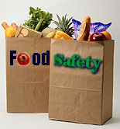
Handling and Preparing Food

Slide 2
Contamination
Contamination: when an unwanted substance or factor comes in contact with another substance or object
Food contamination occurs when an unwanted substance comes in contact with foods during processing.
Microbial contamination occurs when uncontaminated foods come in contact with microorganisms.

Slide 3
Sources of Contamination
Wastewater is water that has been used for processing foods or in cleaning the processing equipment or facilities.
People come into contact with foods during food processing and can introduce microorganisms and other contaminants on their bodies or clothing into food.
Food processing equipment must be constantly cleaned and sanitized.
Food processing plant: The actual facilities must also be clean to prevent contamination.

Slide 4
The Importance of Sanitation
Food sanitation is the maintenance and overall cleanliness and hygiene in the food processing environment (home or factory).
The risk of food contamination is greater if everything is not clean.

Slide 5
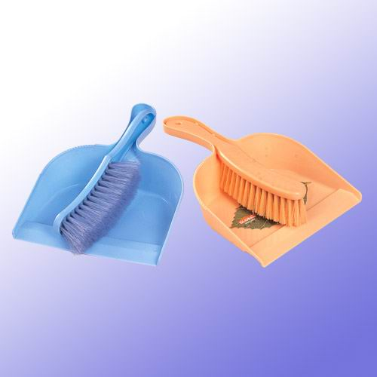
Cleaning and Sanitizing
Cleaning is the removal of all visible dirt and grime. Proper cleaning is required to prevent contamination with microorganisms. Cleaning is undertaken before sanitizing.
Sanitizing is the process of placing an antimicrobial barrier on the surfaces of food processing equipment to kill microorganisms and to prevent other microorganisms from moving on to the equipment. Sanitizing is often accomplished by using chemicals or heat.

Slide 6
HACCP
(HAACP) Hazard Analysis and Critical Control Point
Program designed to evaluate every part of a food processing system to identify potential points for food contamination. Every food processing facility in the country must abide by HACCP regulations.

Slide 7
Personal Hygiene
Personal hygiene is the preservation of personal health. Without good personal hygiene, workers in food processing plants increase the potential for food contamination.
Several factors must be considered!

Slide 8
4 Factors To Consider!
Clothing
Hands
Hair
Footwear

Slide 9
Clothing
Clothing can be a tremendous source of contamination.
Reduce Risk:
  Employees wear uniforms into which they change after arriving at work.
  Wear smocks that cover street clothes
A smock is a long outer coat similar to a lab coat.

Slide 10
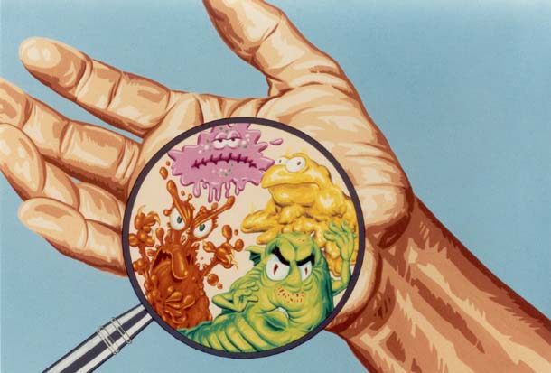
Hands
Hands can be the biggest source of contamination in a food processing plant.
Cleanliness of hands is critical in preventing contamination.
Reduce Risk:
  Wash hands routinely
  Wear gloves

Slide 11
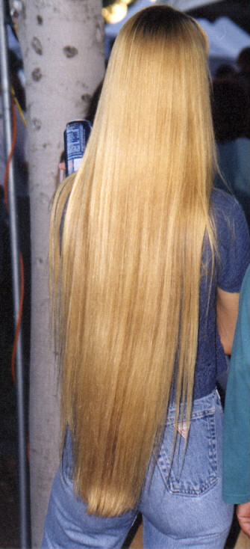
Hair
It can harbor microorganisms, or it can fall out into the food being prepared.
Reduce Risk:
  Wear hairnets
  Pull hair back
  Wear a hat

Slide 12
Footwear
Shoes that employees wear to work from home may contain microorganisms or other contaminates.
Reduce Risk:
  Employers provide shoes or boots for their employees to wear.
  Disinfect shoes before entering work area

Slide 13
When to Wash Your Hands
After using the restroom — only 68% of us do!
Before/during cooking
After handling money
After handling raw meat
After use of handkerchief or tissue
After touching ears, nose, mouth, hair
When hands look or “feel” dirty

Slide 14

Proper Hand Washing Procedure
Wet: Wet hands with warm water.
Soap: Use antibacterial soap.
Soap/Lather: Lather well beyond wrist.
Wash: Work all surfaces, including wrists, back of hands, fingers and fingernails. Wash for at least 15 to 20 seconds.
Rinse: Rinse with warm water. Be sure not to touch side of sink.
Dry: Paper towel is best. Use towel to turn off sink and open doors.

Slide 15
Food Safety at Home
Good Habits!
Wash hands frequently. Paper towels are best for drying.
Keep food processing equipment and utensils clean.
Separate raw meat items from fresh foods.
Store foods at proper temperatures.
Use your senses.

Slide 16
Handling and Preparing Foods at Home
Proper food handling and preparation in the home is critical to eliminate food poisoning.
Food poisoning causes 9,000 deaths/year.
76 million cases/year
Cross contamination occurs when foods are placed on unclean surfaces or when an unclean utensil is used to handle the food.

Slide 17
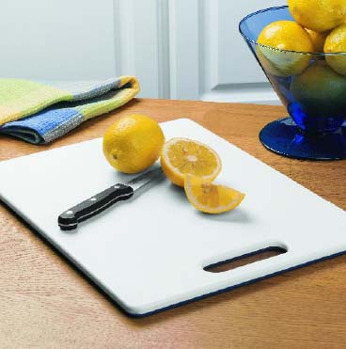
Reduce Risk
Utensils and cutting boards should be thoroughly cleaned between handling each food item.
Plastic cutting boards are safer and easier to clean.
Great care should be taken after handling raw meats.

Slide 18
Proper Temperature Storage
A general rule is “keep hot foods hot and cold foods cold.”
Rapid bacteria growth can occur between 40°F and 140°F.
Cold foods should be stored below 40°F and hot foods above 140°F.
This includes foods during serving.

Slide 19
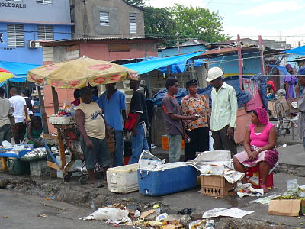
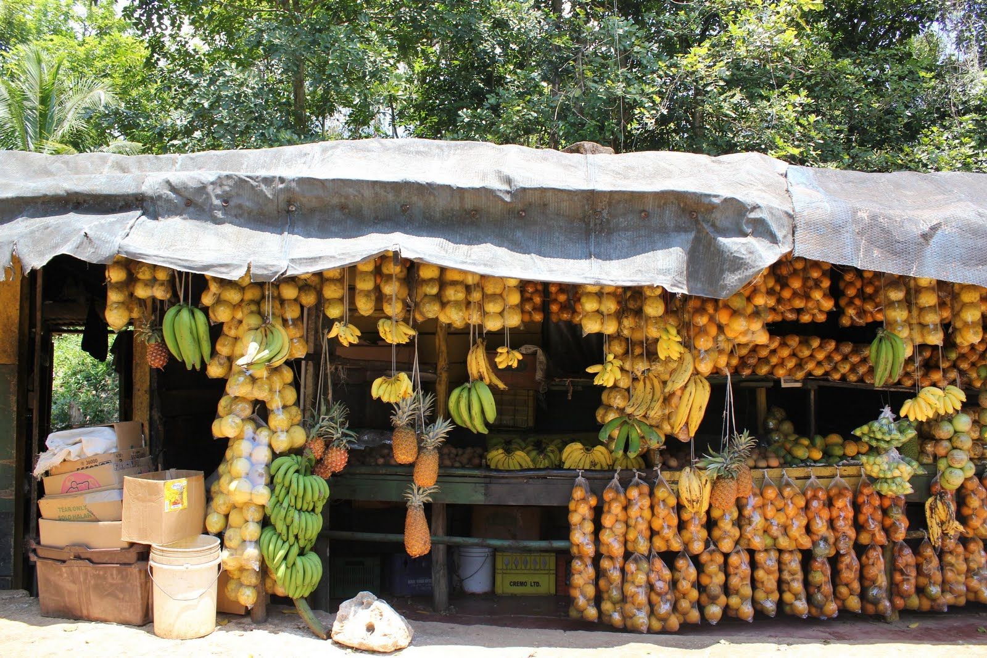

Slide 20
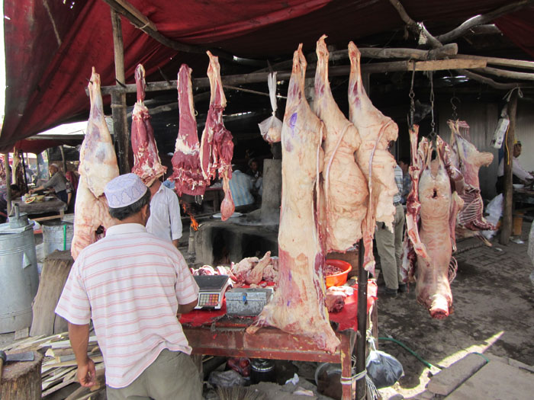

Slide 21
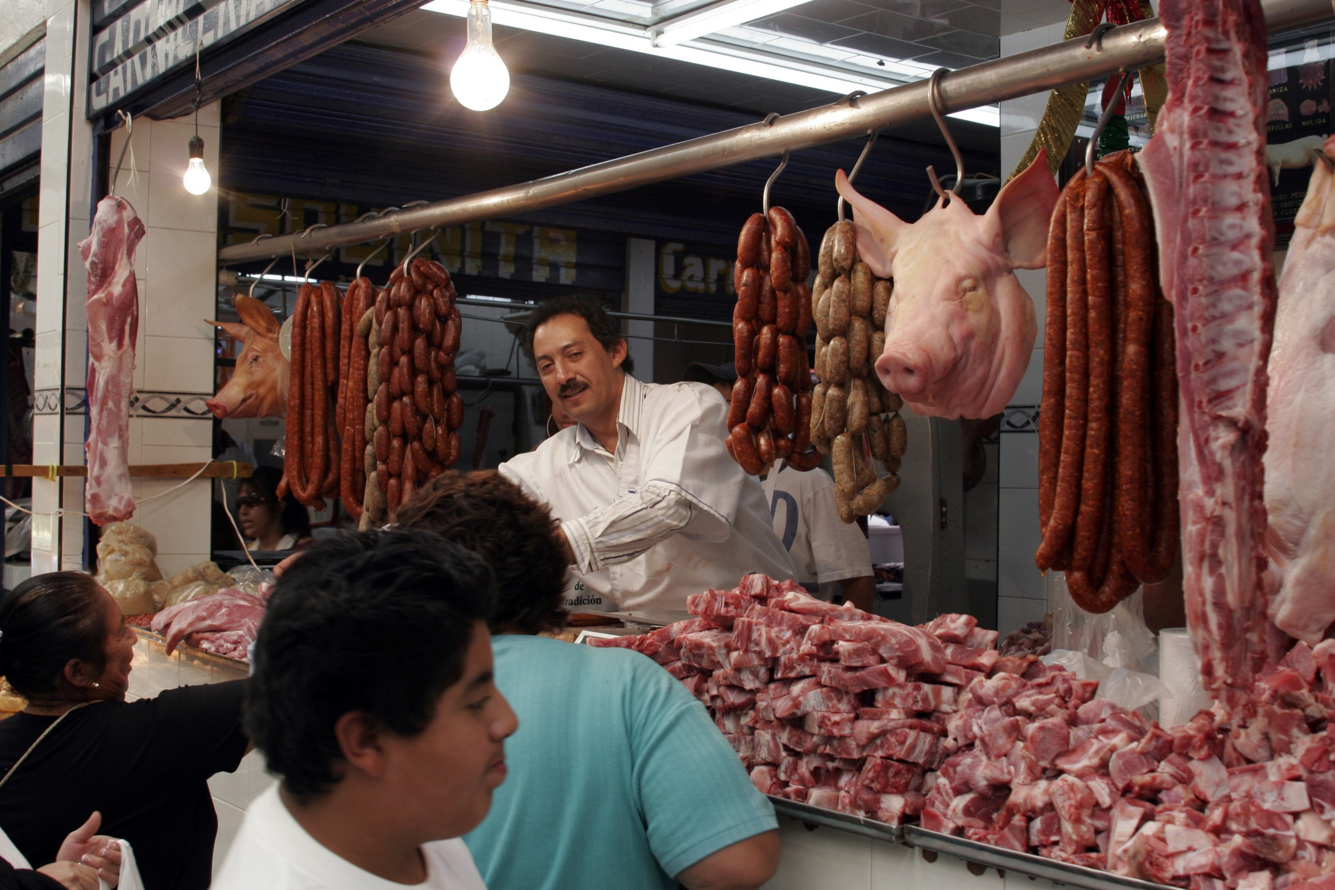

Slide 22
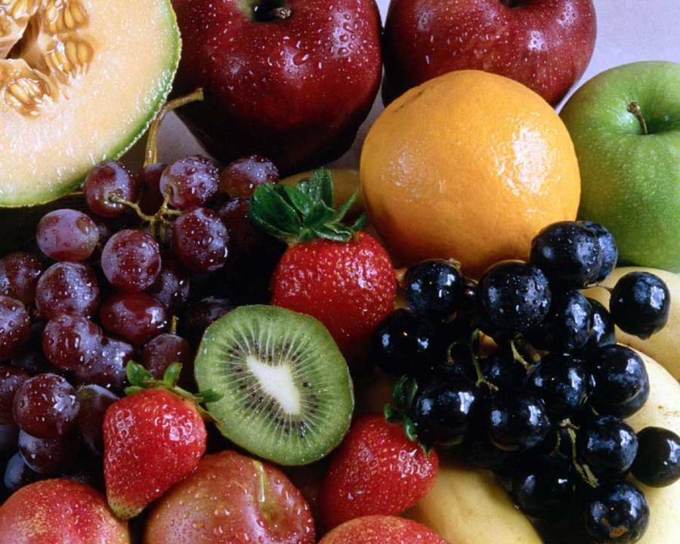
Food Cleanliness
*Always wash all vegetables and produce.
*This can easily be accomplished with fresh water and a mild detergent.

Slide 23
Cooking Meats
Cooking meats to the proper temperature is critical to reduce the risk of foodborne illnesses.
Foodborne illnesses are caused by bacteria and other microorganisms.
Cooking meats to the proper temperature will nearly eliminate the risk of food poisoning caused by meats.

Slide 24
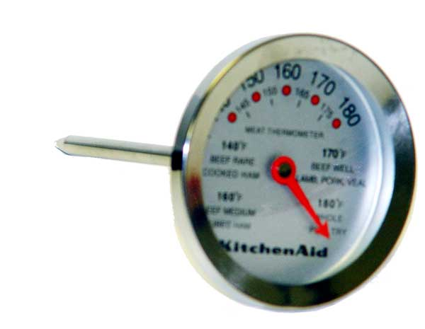
Meat Temperature
A food thermometer is a device with a probe that is inserted into meats to measure the internal temperature.
Cooking Temperatures for Beef:
  Ground beef minimum 160°F
  Rare beef: 125°F to 130°F
  Medium: 140°F to 160°F
  Well: 170°F

Slide 25
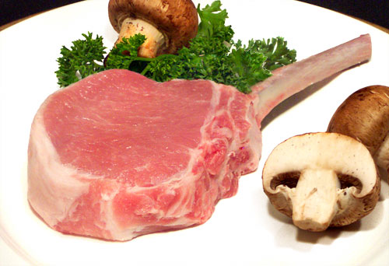
Meat Temperature, Continued
Cooking Temperatures for Pork:
  Medium: 160°F
  Well-done: 170°F
Ham: 160°F
Chicken:
  Cooked to 180°F or until juices run clear

Slide 26
