Slide 1
Public Speaking Basics
National FFA Organization Educator Resource

Slide 2

Bell ringer
Quickly write down your biggest fear. This can be anything: spiders, heights, sushi, etc.

Slide 3
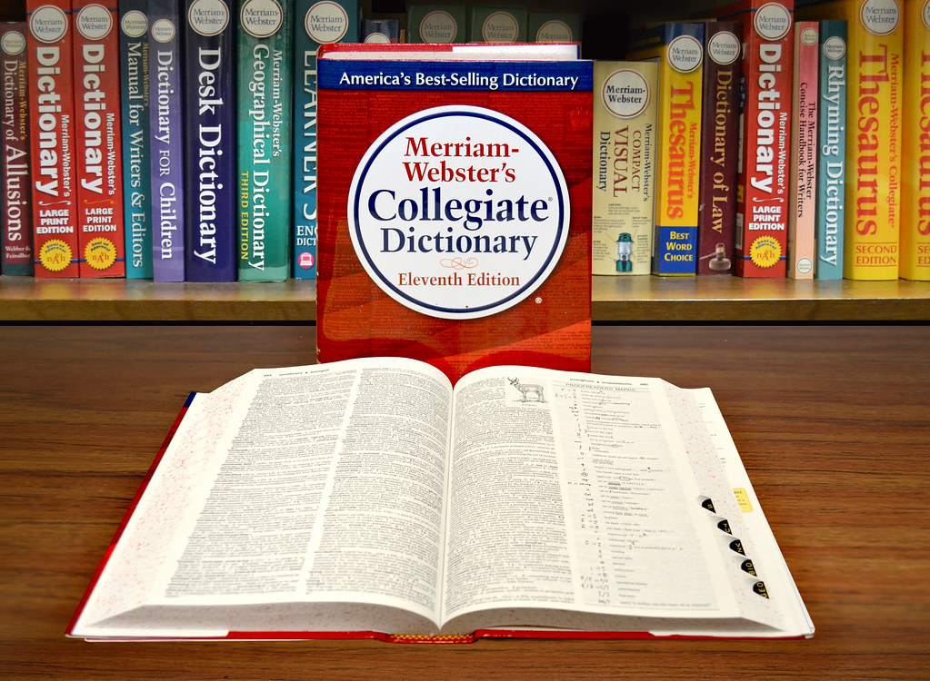
Define Public Speaking
According to Merriam-Webster:
the act or process of making speeches in public
the art of effective oral communication with an audience

Slide 4
Define Public Speaking
What do you think is the definition of public speaking?

Slide 5

How is public speaking used?
In 30 seconds, write down as many careers that you can think of that will require public speaking sometime during the job.

Slide 6
How is public speaking used?
Now pair up with a neighbor. You will have 30 seconds to compare lists and pick one career from either list. Write down an example of how that career uses public speaking.

Slide 7
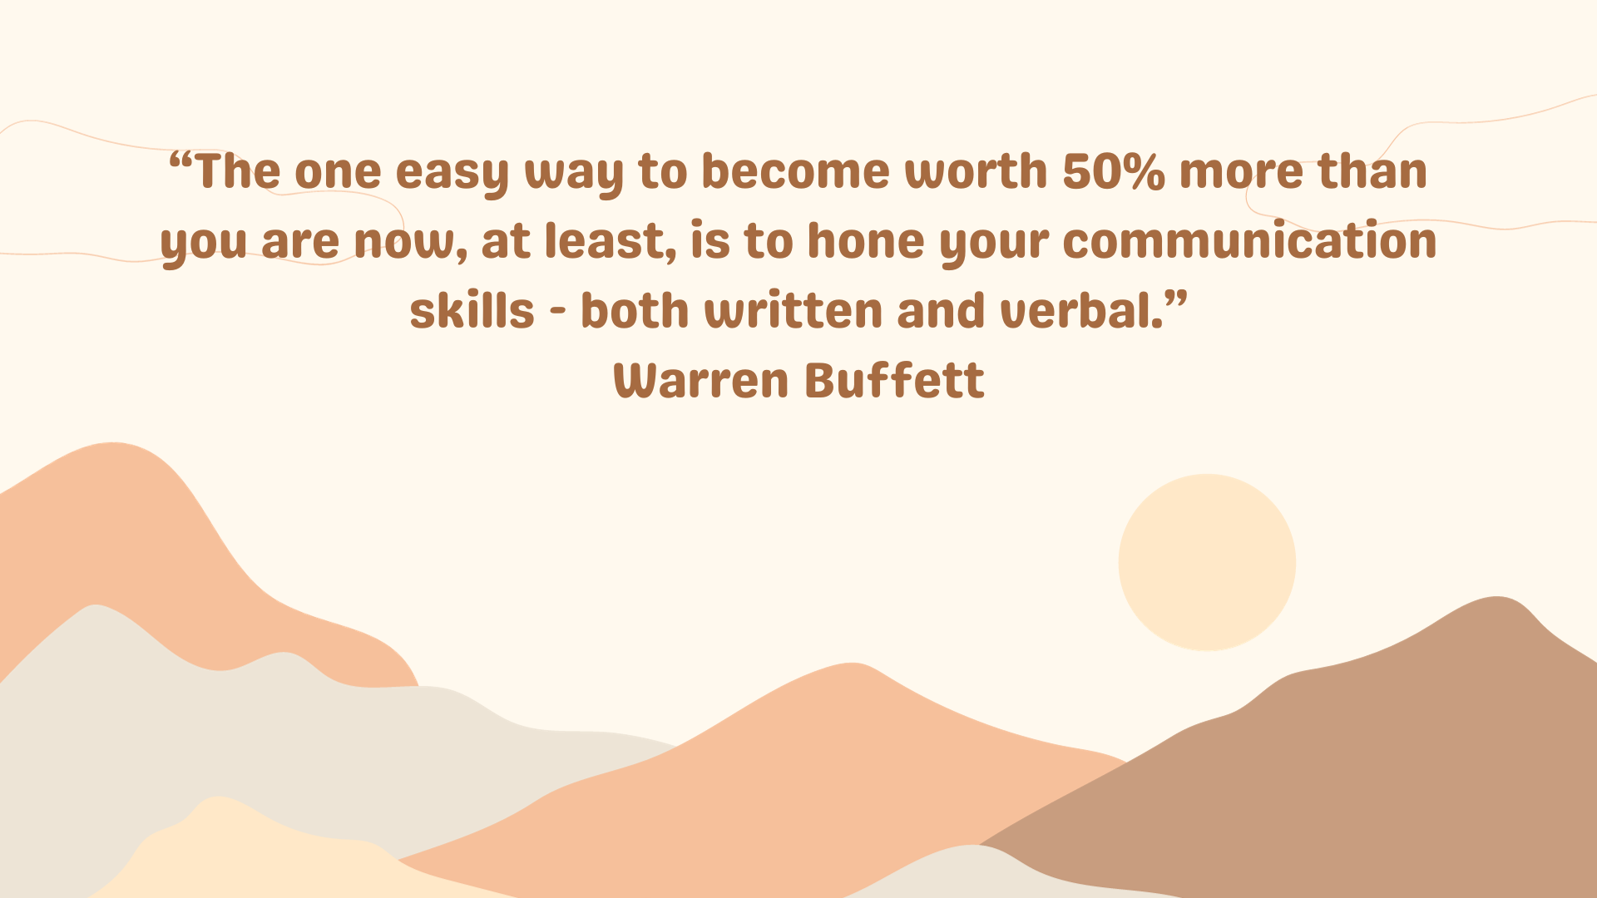
Importance of Public Speaking
Use this video to help fill in the blanks found on your graphic organizer for this lesson.

Slide 8
Types of public speaking

Slide 9
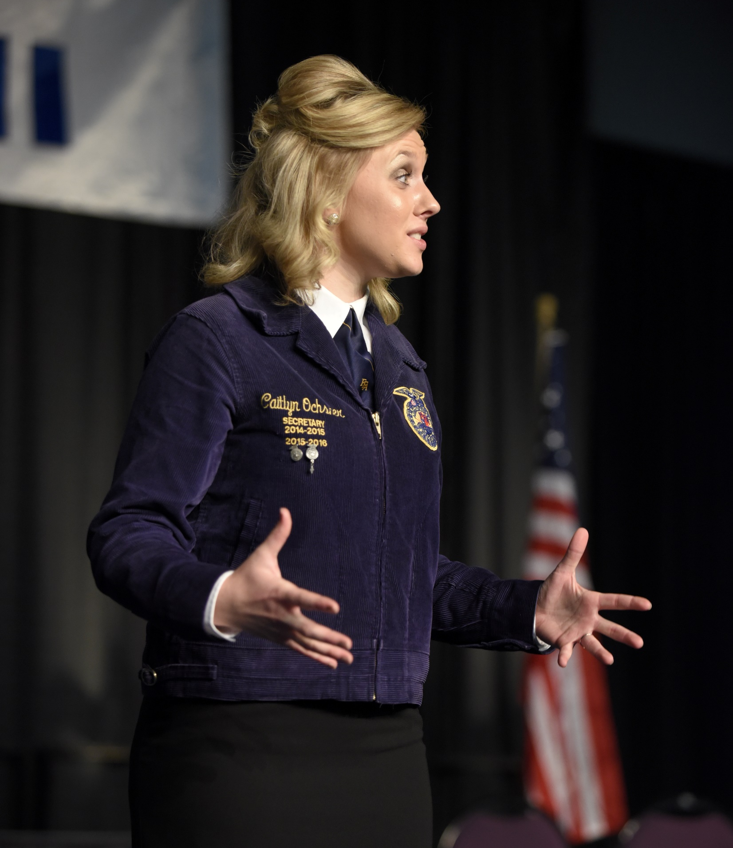
1. Informative
This type is meant to educate an audience on a particular topic or message with facts, data, statistics and researched content.
This type does not use visual aids.

Slide 10
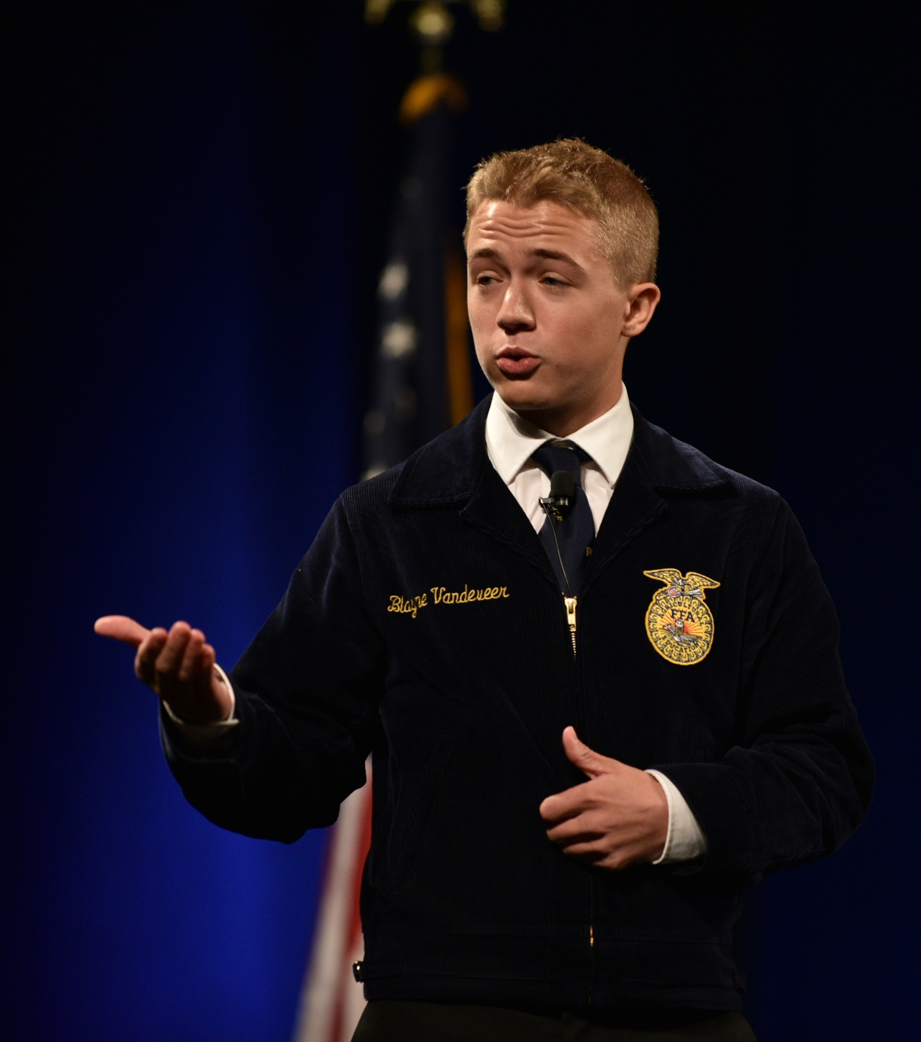
2. Persuasive
This type is used to help convince an audience that the speaker has the right opinion on a particular topic based on concrete evidence.
This type is often used in debates.

Slide 11
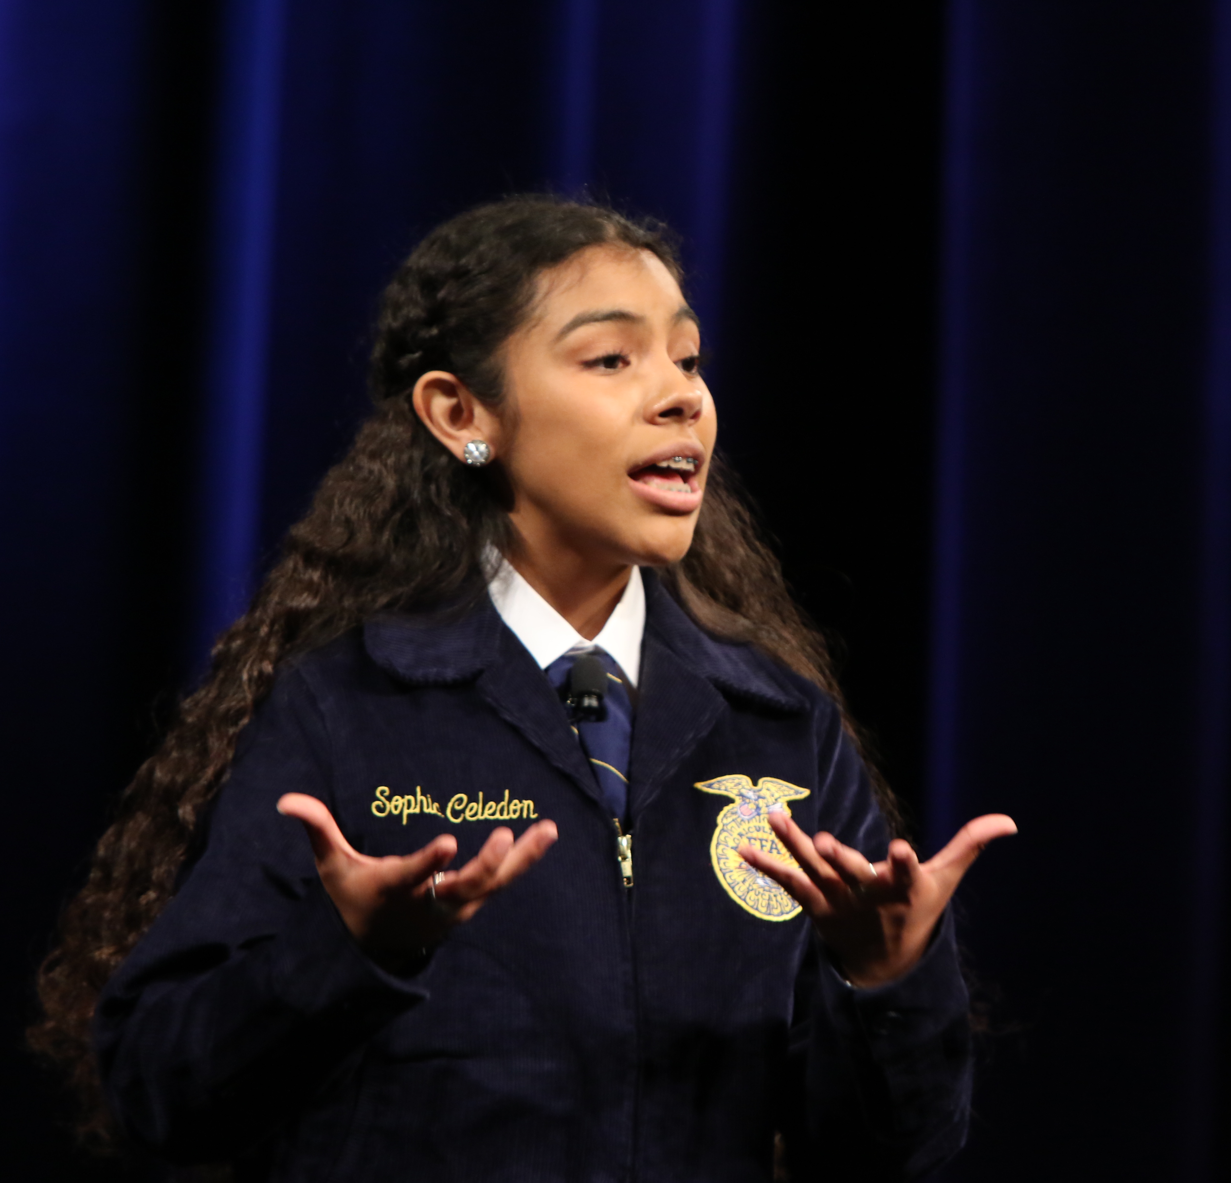
3. Entertaining
This type aims to amuse a crowd of people, is less formal and shorter than traditional speeches and will communicate emotions, often through humor and funny stories.

Slide 12
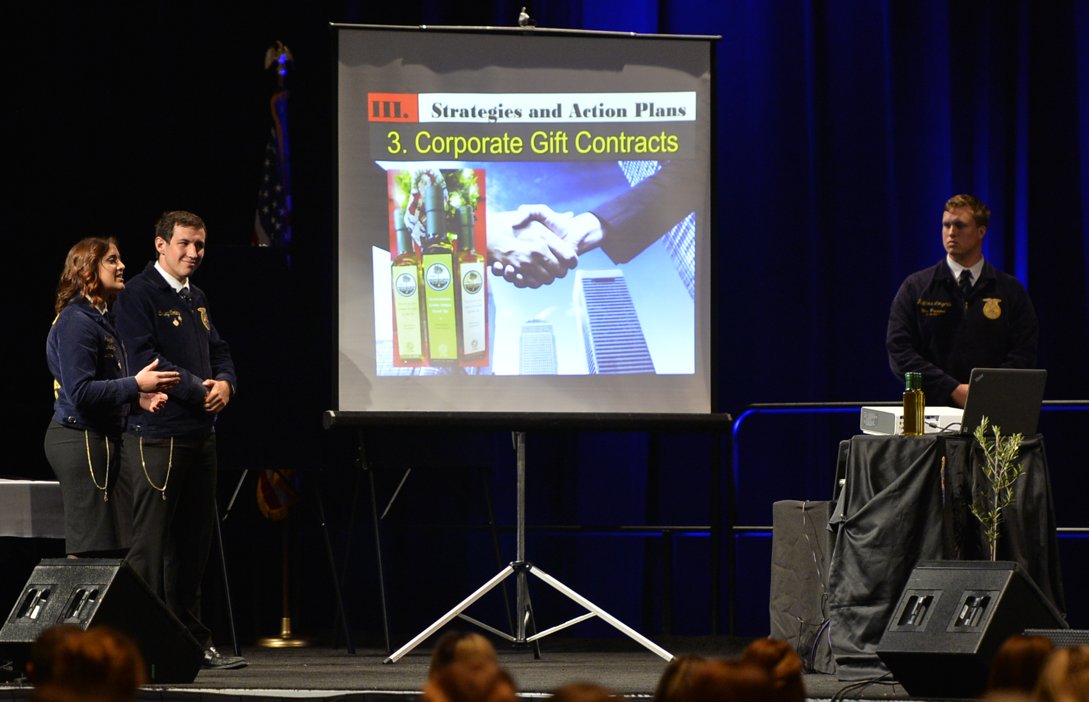
4. Demonstration
This type serves to educate an audience about a topic and often includes visual aids such as posters or objects.
Presenters will often demonstrate how to do something.

Slide 13
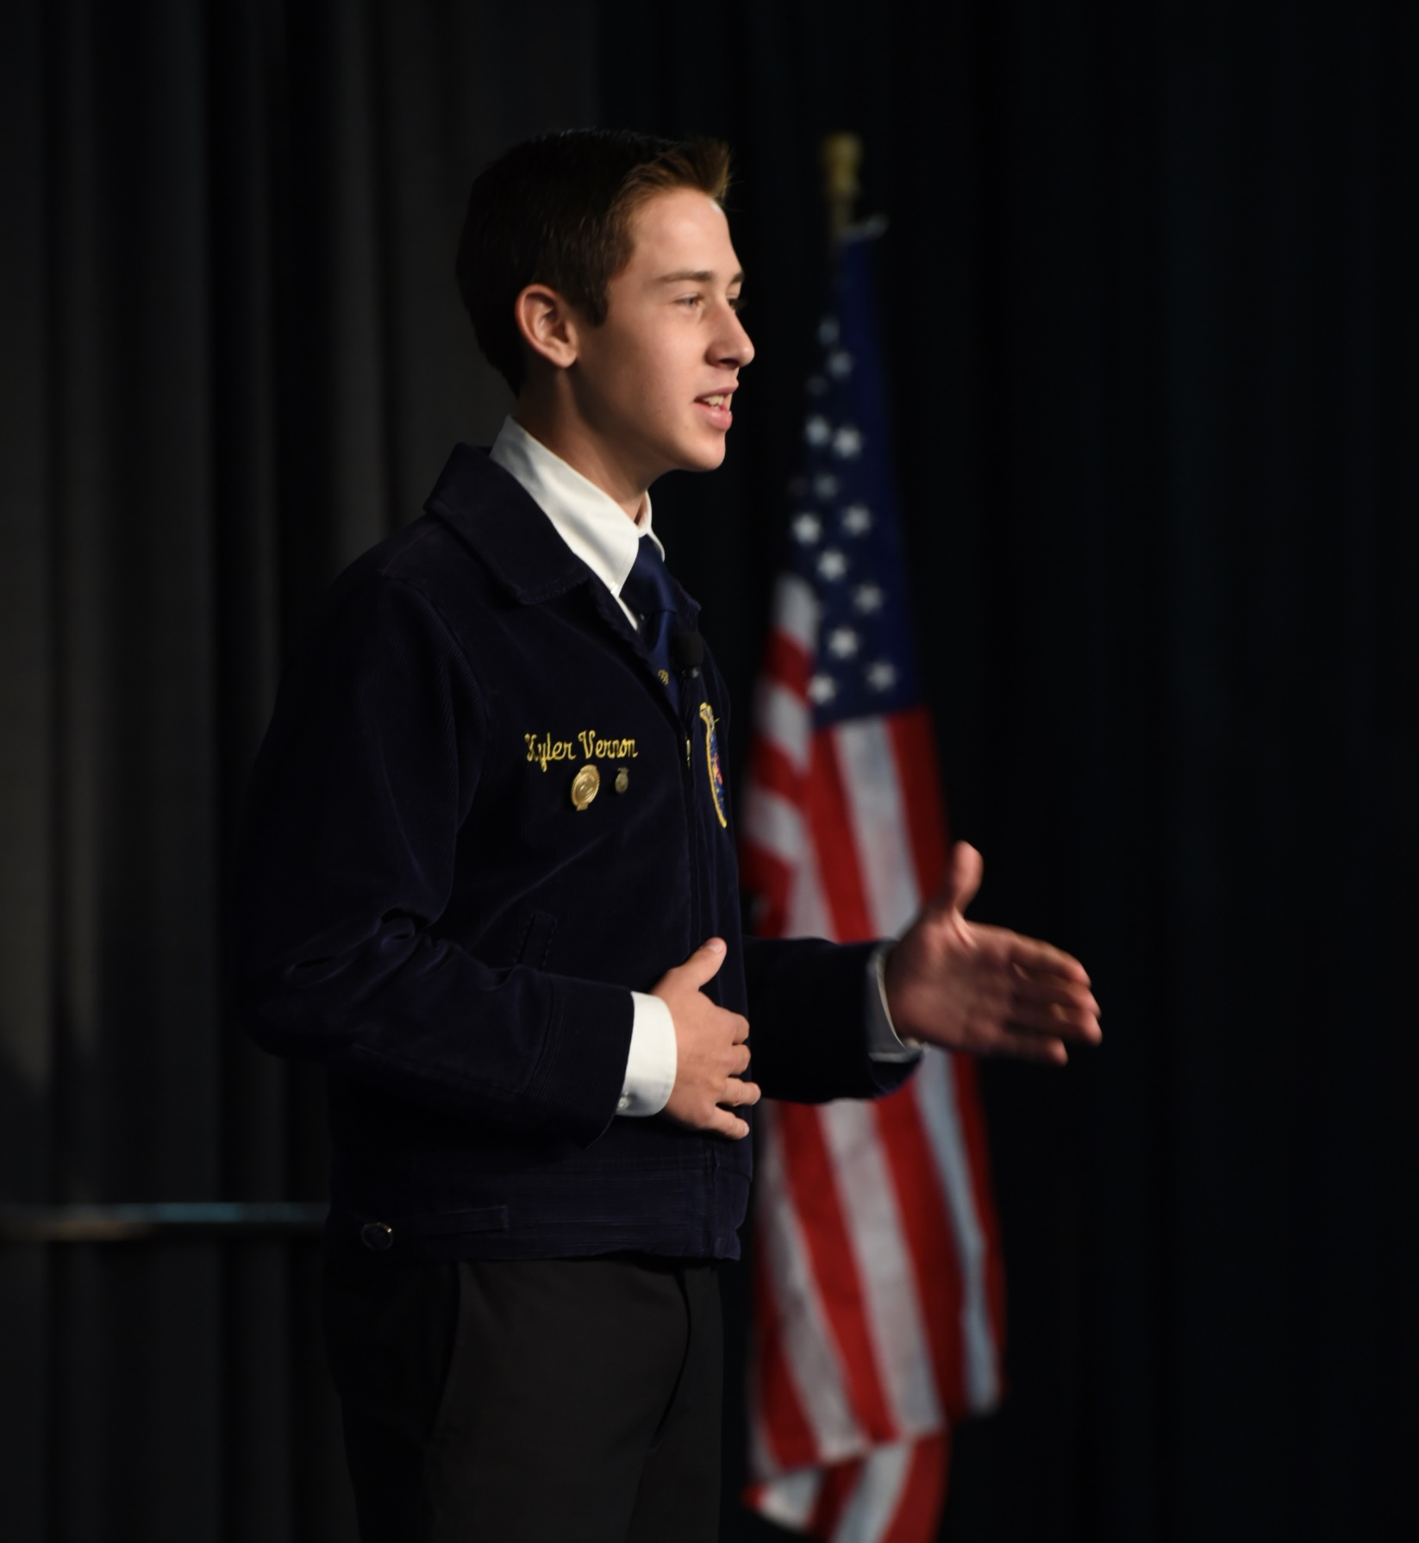
5. Impromptu
This type refers to a speech that is delivered without any prior preparation or rehearsal time.
Typically, this is a spontaneous occasion, which can be more intimidating.

Slide 14
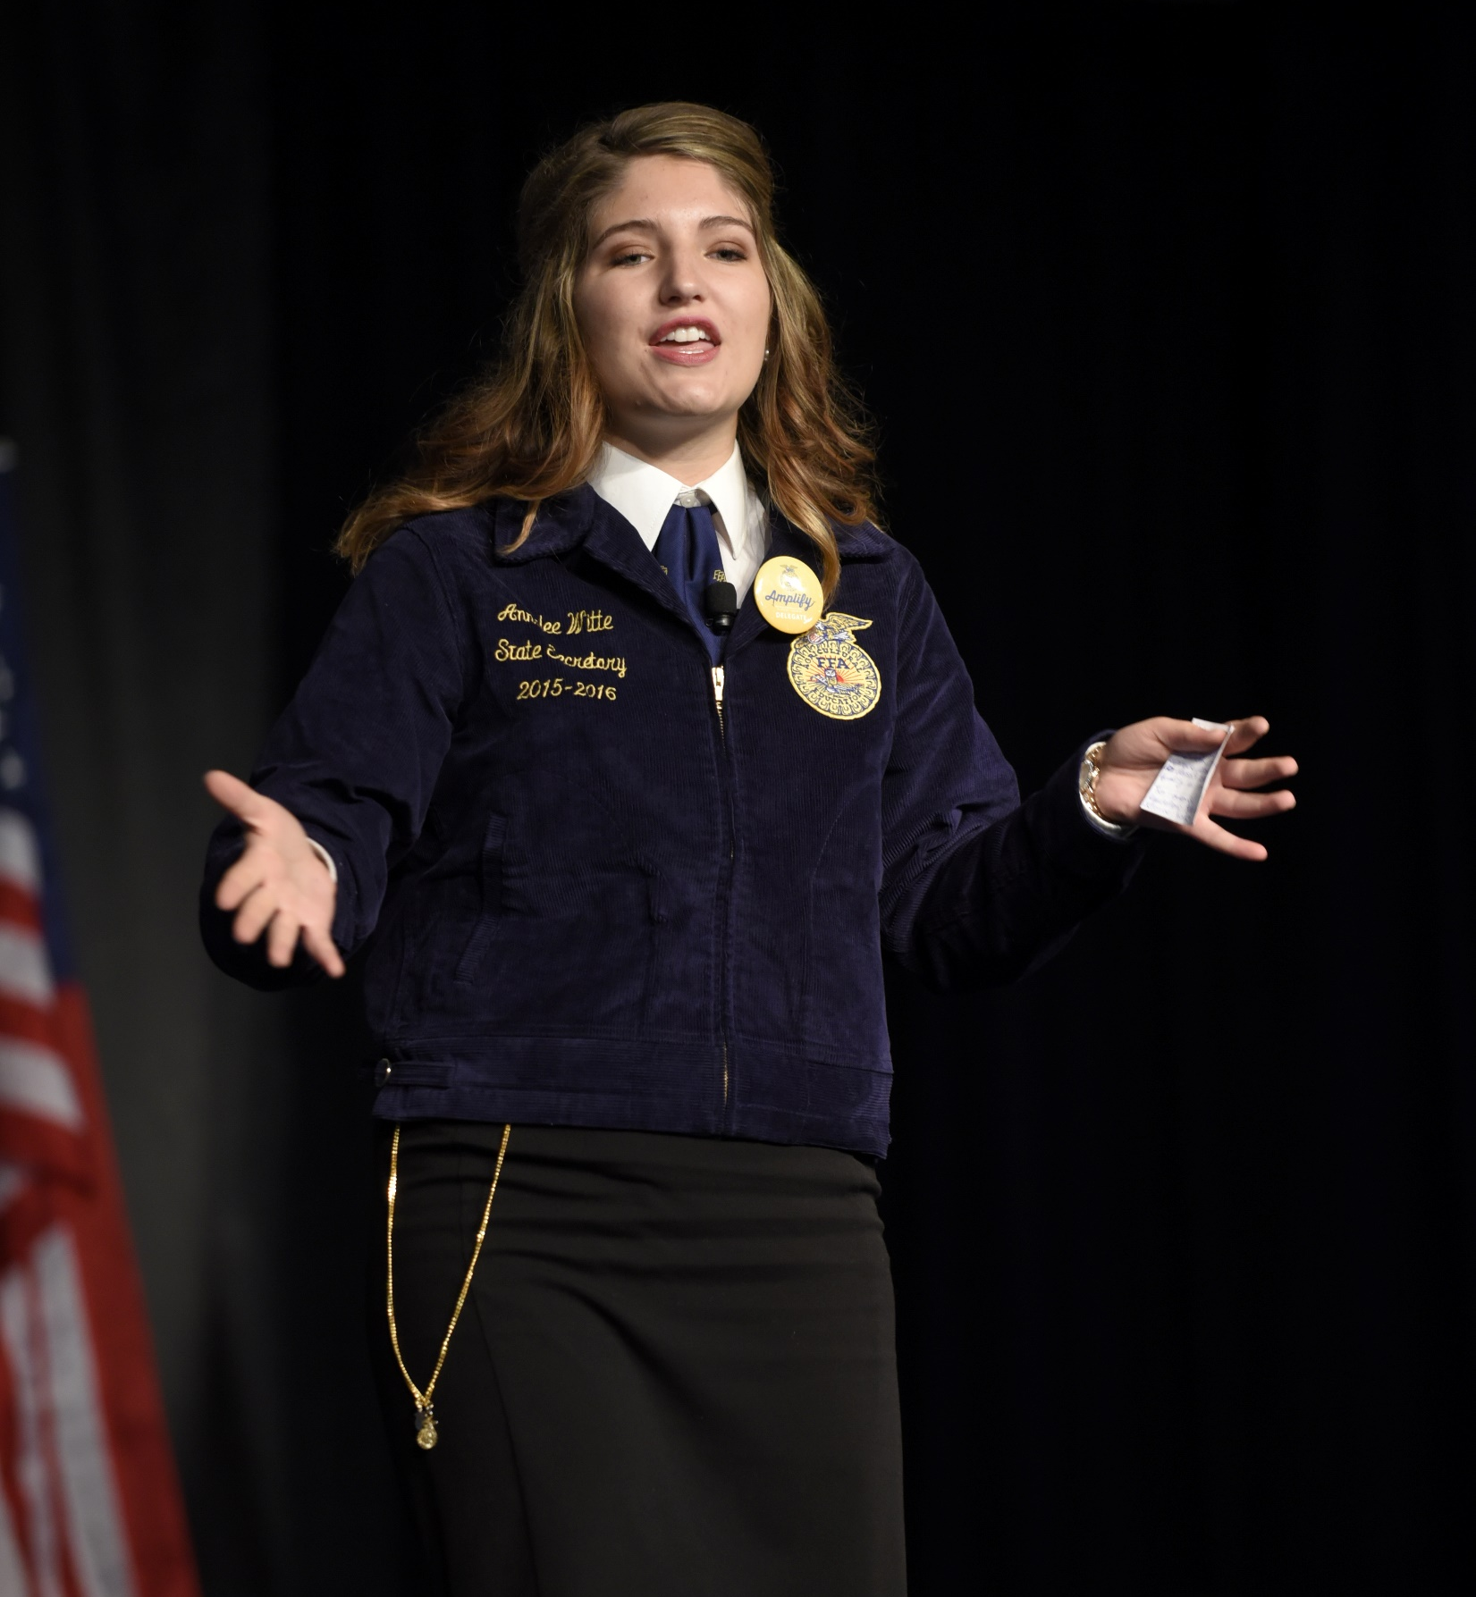
6. Motivational
This type attempts to inspire an audience and give the attendees the confidence to do something better or improve themselves.

Slide 15
Now, let’s match a type to the example.
We will look at six examples of public speaking. Work with a partner to complete Part 2 on your worksheet as we watch.
1 – https://youtu.be/1ZHTurVaGus?si=WgcmVXei2UVw7AT2
2 – https://youtu.be/Kh9GbYugA1Y?si=FwXG2iRVJwoiH3T9
3 – https://youtu.be/q0zk4Pcsl2Y?si=rXwU7jD8jiwh2q9v
4 – https://youtu.be/64ACsm9qR9o?si=tqzwqXskrg1R1FJb
5 – https://youtu.be/4xXZhXTFWnE?si=_S69jyG0LCmPSvee
6 – https://youtu.be/mfjGmBVAL-o?si=LpbN4ku0ToDlMKK0

Slide 16

Follow-Up: Review
Complete the word puzzle worksheet.

Slide 17

Exit Ticket
On a sticky note, write the type of public speaking you would be most confident doing and explain why.
Stick that note on the classroom door as you exit the class today.

