Slide 1
Sustainability in Agriculture:
Areas of Focus
National FFA Organization

Slide 2

Climate Change
Significant change in climate, including temperature, precipitation or wind, that lasts for an extended period of time
NASA: “The Earth is warming at an unprecedented rate [with] human activity [as] the principal cause.”
EPA: Changes in weather, oceans and ecosystems, such as
  Changing temperatures and rain patterns.
  Ocean temperatures, sea level and acidity all rising.
  Glacial melting.
  Changes in the frequency, intensity and duration of extreme weather events.
  Shifts in ecosystem characteristics, growing season lengths, timing of flower blooms and migration of birds.

Slide 3

Climate Change
The main focus of those in the sustainability movement is to limit the effects of human activities on the environment and global climate.
Some avenues for this include:
  Increased education about climate change and its effects.
  Government policy and planning.
  Industrial policy and cutting emissions.

Slide 4

Climate Change
Why is this an area of focus?
Why is it important?
Climate change affects all organisms on Earth.
Increased threats like floods, wildfires, higher temperatures, droughts, etc. are harmful to everyone.
As the population increases, global climate change will increase exponentially if mitigation efforts are not taken.

Slide 5

Water Conservation
Efforts to use water efficiently and avoid waste to ensure that there is an adequate supply of water for today’s needs and for the future (Washington Department of Ecology)
Earth’s water supply is the same as what was here at the beginning of the planet. It is everyone’s responsibility and duty to use water wisely, to not waste this precious resource.

Slide 6

Water Conservation
Why is this an area of focus? Why is it important?
Water is a limited resource that must be managed well.
Safe, drinkable/usable water is essential for all living things including plants, animals and people.
Demand for water is rising due to population growth, urbanization and increasing water needs from agriculture, industry and energy sectors (UN Sustainable Development Goals).

Slide 7

Soil Health
“Soil health is defined as the continued capacity of soil to function as a vital living ecosystem that sustains plants, animals and humans. Healthy soil gives us clean air and water, bountiful crops and forests, productive grazing lands, diverse wildlife and beautiful landscapes.” (USDA).
Soil health research has determined how to manage soil in a way that improves soil function (USDA).
  Maximize Presence of Living Roots
  Minimize Disturbance
  Maximize Soil Cover
  Maximize Biodiversity

Slide 8
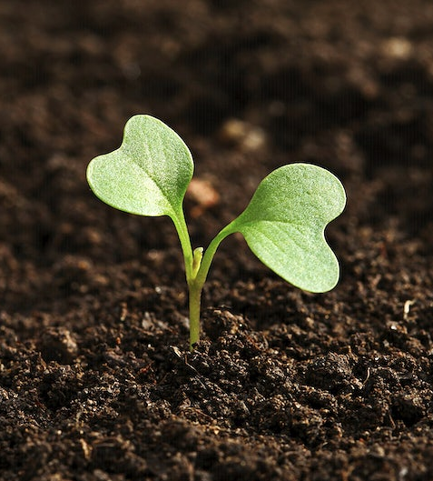
Soil Health
Why is this an area of focus?
Why is it important?
Healthy soils are the foundation of sustainable agriculture.
Healthy soils allow producers to conserve resources on their land, minimize erosion, maximize water efficiency, improve soil nutrients and save money on their inputs into the land.

Slide 9

Waste Management
Waste management refers to the practices used to manage and dispose of wastes.
Some strategies include discarding, destroying, processing, recycling, reusing or controlling wastes.
The primary objective is to reduce the number of unusable materials and to avert potential health and environmental hazards (BiologyOnline).
“Zero waste”: A target of recovering resources and sending no waste for disposal via landfill or incineration.

Slide 10
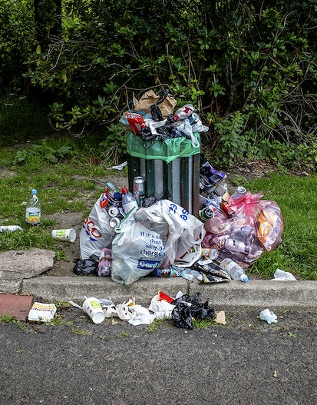
Waste Management
Why is this an area of focus?
Why is it important?
The average American produces about 4.4 pounds of trash per day (The Nature Conservancy). Reducing this amount of waste would mean less material in landfills, environments, oceans, etc.
Excessive waste contributes to pollution, climate change, and the destruction of natural resources and habitats.

