Slide 1

Sustainably Grown Standard

Slide 2
Purpose
To provide a framework and common set of requirements to demonstrate that agricultural crops have been produced in a sustainable manner
The producer must agree to a schedule of announced and unannounced audits completed by a third-party certification body.

Slide 3

Sustainability Framework
Environmental
Air Resources and Climate
  The producer protects air quality.
  Prevents air resource degradation
  Minimizes greenhouse gas emissions
Water Resources
  The producer preserves water quality.
  Prevents water resource depletion
Production System
  The producer selects crops and production systems that support soil and plant health.
  Minimizes pest pressures
  Sustains crop productivity and quality
Soil Resources
  The producer conserves soil.
  Maintains or improves soil quality

Slide 4
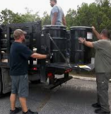

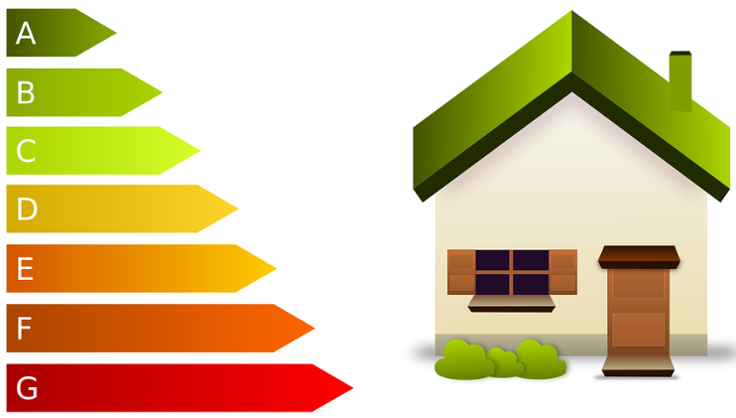
Sustainability Framework
Environmental
Ecosystem Protection
  The producer maintains or enhances species health and diversity.
  Supports habitats within the agro-ecosystem
Energy Efficiency
  The producer takes steps to minimize net energy consumption per unit production.
Integrated Waste Management
  The producer manages waste to minimize environmental harm.

Slide 5

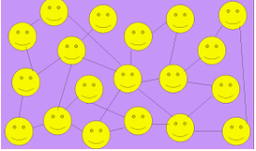
Sustainability Framework
Social
Work Agreements
  The producer fosters long-term relationships with workers.
Wages and Benefits
  Workers are dealt with fairly and honestly regarding wages and benefits.
Child and Voluntary Label
  The producer abides by child labor and forced labor prohibitions.
  Assures that workers who are minors are protected
Working Hours
  Expectations for working hours are clearly explained upon employment.

Slide 6
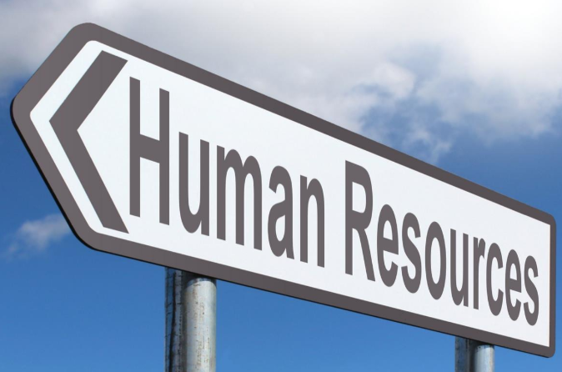
Sustainability Framework
Social
Non-Discrimination and Freedom of Association
  The producer promotes a work environment free of any type of discrimination.
Human Resource Management
  The producer has an established structure to carry out human resource management functions.
Health and Safety
  All workers should have a safe, clean and healthy work environment.
Community Relations
  The producer is a good neighbor and relates in positive ways to local and regional communities.

Slide 7
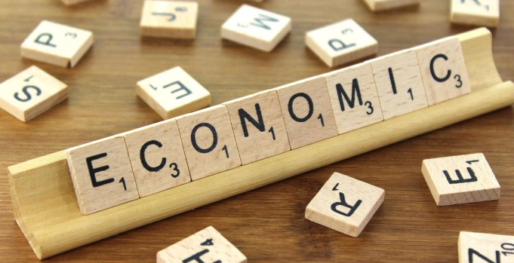
Sustainability Framework
Economic
Business Accounting, Reporting and Planning
  The producer’s accounting, reporting and planning practices support the sustainability of operations.
Continuity and Resilience
  The producer plans for continuity of operations and manages economic risks.
Product Quality and Safety
  The product meets industry quality and safety expectations.
Community Economic Engagement
  The producer contributes to local and regional social and economic development.

