Slide 1

Travel and Dining Etiquette
What foundational skills do I need for leadership?
MS 21
Stage One of Development ME

Slide 2
A Little Explanation
Dinner fork: innermost fork, used for main course
Salad fork: outer fork, used for salad
Dinner knife: knife used for meat and sometimes for spreading butter on bread
Soup spoon: spoon used for either soup or something in main course
Water goblet: water or iced tea glass, to the right of the plate
Dinner plate: largest plate, placed directly in front of person
Bread and butter plate: small plate placed to the left of the dinner plate
Napkin: cloth or absorbent paper used to protect the clothes or to wipe the lips and fingers while eating
Objective 2

Slide 3
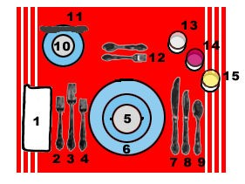
Formal Place Setting Key
Objective 2
MS 21 TM A1

Slide 4
Formal Dinner Place Setting
Formal Dinner Place Setting
Napkin
Salad Fork
Dinner or Main Course Fork
Fish Fork
Soup Bowl & Plate
Dinner Plate
Dinner Knife
Fish Knife
Soup Spoon
Bread & Butter Plate
Butter Knife
Dessert Spoon and Cake Fork
Sterling Water Goblet
Red Wine Goblet
White Wine Goblet
Objective 2
MS 21 TM A2

Slide 5
Informal Dinner Place Setting
Informal Dinner Place Setting
Napkin
Salad Fork
Dinner or Main Course Fork
Soup Bowl & Plate
Dinner Plate
Dinner Knife
Soup Spoon
Bread & Butter Plate
Butter Knife
Sterling Water Goblet
Objective 2
MS 21 TM A3

