Slide 1
Defining career success
Introduction
MS 3
Introduction to Leadership, Personal Growth, and Career Success

Slide 2
Characteristics of Career Success
What Makes a Successful Career?
  Commonly accepted characteristics of a successful career
    You enjoy the work related to your career.
    You have the skills needed to do excellent work - you are good at what you do!
    Your work is beneficial to society.
    You earn adequate money to meet your financial needs.
Objective 1
MS 3 TM A

Slide 3
Steps to Career Success
What Steps Must I Take to Achieve Career Success?
  Determine what your interests are.
    What do you like to do?
    What natural talents and strengths do you have?
    What careers would require activities related to your strengths?
Objective 2
MS 3 TM B1

Slide 4
Steps to Career Success
What Steps Must I Take to Achieve Career Success?
  Identify the skills required to achieve success in this career area.
Objective 2
MS 3 TM B2

Slide 5
Steps to Career Success
What Steps Must I Take to Achieve Career Success?
  Determine what type of education is necessary to develop the required skills.
    College—Bachelors, Masters, or Doctorate degree.
    Technical School—one or two years, Associates degree
    On-the-job training
Objective 2 MS 3 TM B3

Slide 6
Steps to Career Success
What Steps Must I Take to Achieve Career Success?
  Develop a plan with goals to help develop the skills and education required.
    What type of courses do I need to take in high school?
    What level of grades do I want to achieve?
    What schools will help train me after high school?
Objective 2
MS 3 TM B4

Slide 7
Steps to Career Success
What Steps Must I Take to Achieve Career Success?
  Put your plan into action!
Objective 2
MS 3 TM B5

Slide 8
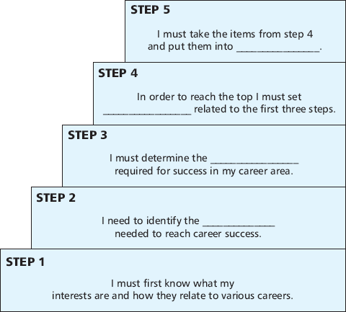
Steps to Career Success
MS 3 AS.3

