Slide 1

Defining
Problem Solving
How do I make things happen?
MS 49
Stage Three of Development
DO

Slide 2
Problem Solving
… the process by which problems are identified and solved.
Objective 1
MS 49 TM A

Slide 3
Problem-solving Process
Six steps in the problem-solving process
  Identify the problem.
  Collect all needed information.
  Guess what the solution will be.
  Test to see if your guess works.
  See what the result is.
  Retry until wanted solution is reached.
Objective 2
MS 49 TM B

Slide 4
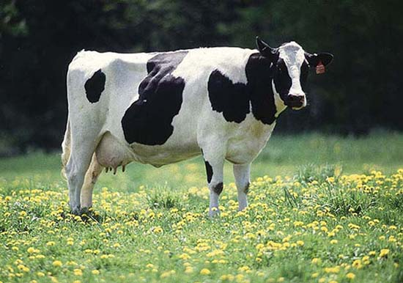
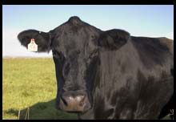
Problem: Determine whether a cow is a beef or dairy breed.
  Identify the problem.
  Collect all needed information.
  Guess what the solution will be.
  Test to see if your guess works.
  See what the result is.
  Retry until wanted solution is reached.
Objective 3
MS 49 TM C

