Slide 1

Making Natural Resources and Environmental Science Instruction More Effective and Engaging
By C. Kohn, National Science Foundation
Michigan State University
2017 National FFA Convention

Slide 2
Welcome!
Introductions (me: former farm kid, former ag teacher, current researcher, an author of AFNR).
Overview of Today
  1. The Standards - AFNR (3-Circle), The 3-Circle Model, & NGSS (3-D Learning)
  2. Sample Curriculum
  3. Current and Future Work on Curric. & Instruction
  4. The Future of Agriculture

Slide 3
Rules of Engagement
1. Assume best intentions.
2. Back all claims with evidence.
3. It is ok to question and challenge, as long the intent is to clarify.
4. It is ok to be unsure about something.
5. I know this is text-heavy and I’ll have to move too quickly.
  The intent is for you to be able to go back and dive deeper on your own at a later time.

Slide 4

Overview of
- AFNR National Academic Standards
- 3-Circle Model
- Next Generation Science Standards
What you need to know about what you need to do
Who is familiar with all three of these?

Slide 5
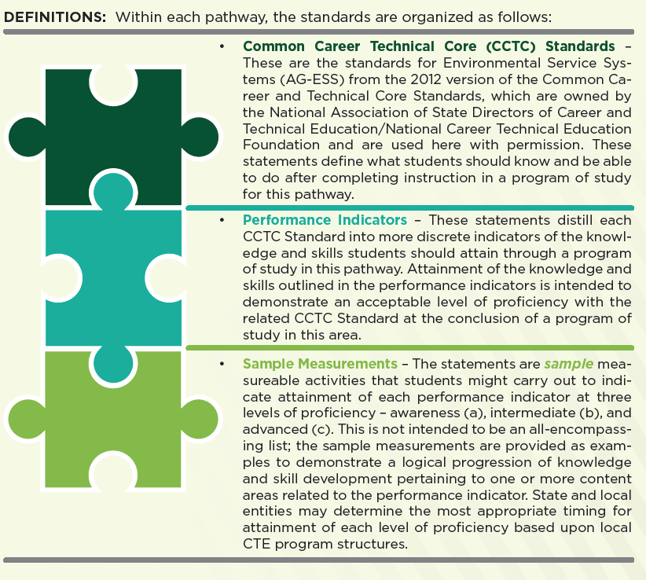
AFNR Structure & Format
AFNR 3-Level Structure
1. CCTC Standards – CTE Common Core
2. Performance Indicators – The ‘Actual Standards’
3. Sample Measurements – Hypothetical means to achieving the Performance Indicators.
  The sample measurements are divided into three progression levels:
  Awareness: comprehension of content
  Intermediate/Interaction: use of content for problem solving
  Mastery: use of content in novel, real-world situations
Notes:
AFNR and NGSS have some overlap (not perfect but very complementary).

Slide 6
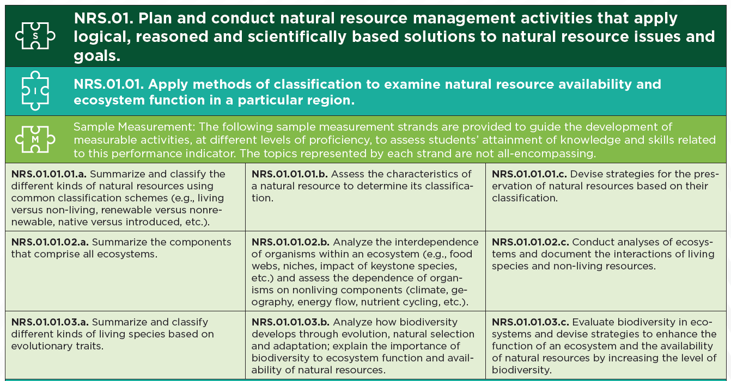
CCTC’s → P.I.’s → S.M.’s (A.I.M.)
The actual standards
Awareness
Interaction
Mastery
Notes:
The sample measurements are also reflective of problem solving approaches in education. These measurements are organized into three columns, with the leftmost column being the standards pertaining to awareness (terms, vocab, concepts, etc.). The middle column includes the intermediate concepts, which involve the application of the basic knowledge for a given Performance Indicator. The rightmost column includes the mastery concepts. These tend to focus on having students make predictions about unknown situations, apply lessons in a manner similar or identical to a workplace situation, or utilize large amounts of content to reach a conclusion. Notice that Mastery does not consist of perfect memorization of terms or concepts; this is still the Awareness level (the most basic of the three). Mastery can only come about when a student is able to apply their decision-making skills in a real-world scenario, often in a group-based situation that involves hypothesis formation, data collection & analysis, and communication of interpretations.

Slide 7
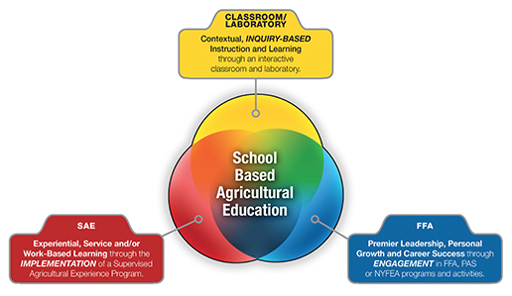
The 3-Circle Model

Slide 8
3-Circle Model
Classroom & Lab Instruction
  Standards-backed, inquiry-based instruction that is reflective of real-world scenarios and situations.
  Curriculum that begins with agricultural literacy* and proceeds to career proficiency in upper-level courses.
    Ag Literacy – systems-based learning of universal core concepts, not facts & trivia about the industry.
Career Experiential Learning (aka SAEs)
  Firsthand career experiences (shadowing, service, paid labor, research, entrepreneurship, etc.) outside of a regular class.
  Assessed as part of a course grade.
Personal Development (usually FFA in our programs)
  Opportunities for students to engage in communities of practice in which they can apply academic, career, and social knowledge to student-led situations.
  Key to integrating academic content into personal identities.

Slide 9
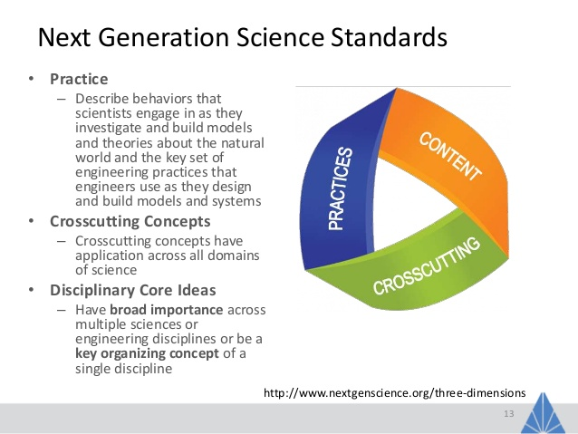
NGSS Overview
NGSS is composed of three dimensions of learning:
  1. Disciplinary Core Ideas
  2. Crosscutting Concepts
  3. Scientific/Engineering Practices
A curriculum is NOT aligned to NGSS unless it uses all three of these dimensions of learning in a coherent, continuous manner.

Slide 10
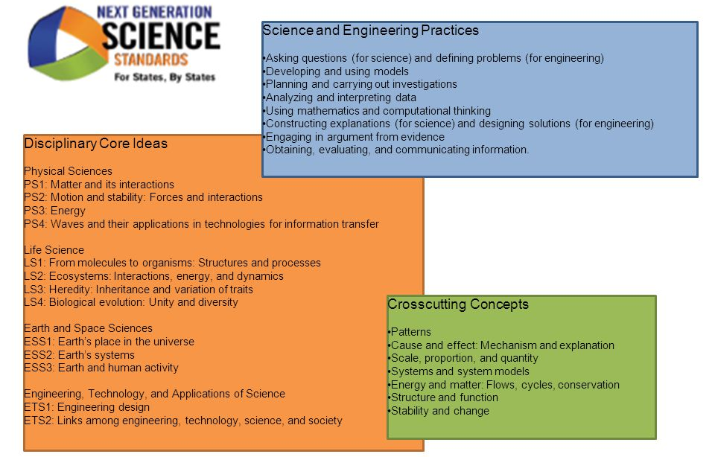
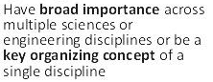
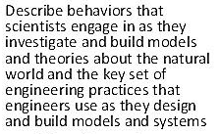

Next Generation Science Standards
Notes:
Notice that the disciplinary core ideas (what we typically think of as the ‘content standards’) are very broad. This is very intentional. Teaching a curriculum that is a ‘mile wide and an inch deep’ does almost nothing to develop scientific literacy in students, nor does that content stay with students in a reliable manner (i.e. they largely forget it once the test is done). Instead, the emphasis has shifted to allowing for deeper comprehension through 3D learning.

Slide 11
Next Generation Science Standards
NGSS is about shifting classes from “What are you studying?” to “What are you trying to figure out?”
  NGSS is a move develop scientific literacy by advancing students’ conceptual ideas and scientific practices.
  We want students to achieve proficiency in “sense-making”, or the ability to use evidence, logic, and argumentation to reach sound, valid conclusions.
If we want to minimize the likelihood of a student forming unscientific, unsubstantiated conclusions about the world around them, we need to change how we teach them science.
  NGSS is meant to reflect how these changes should occur.
Notes:
Inquiry-based learning should entail making observations and collecting data, identifying patterns in the data and observations, and developing intellectual models that can both explain what is happening as well as predict what might happen in a situation that involves similar phenomena.
Moving ‘up the triangle’ means that students are using data and observations to determine patterns. Moving ‘down the triangle’ means that students are using these patterns to construct models and explanations. Once students have succeeded in doing this, the instructor should provide an additional scenario to them to see if they can successfully address the question or problem without the direct assistance of the instructor or from scaffolding in the curriculum.

Slide 12
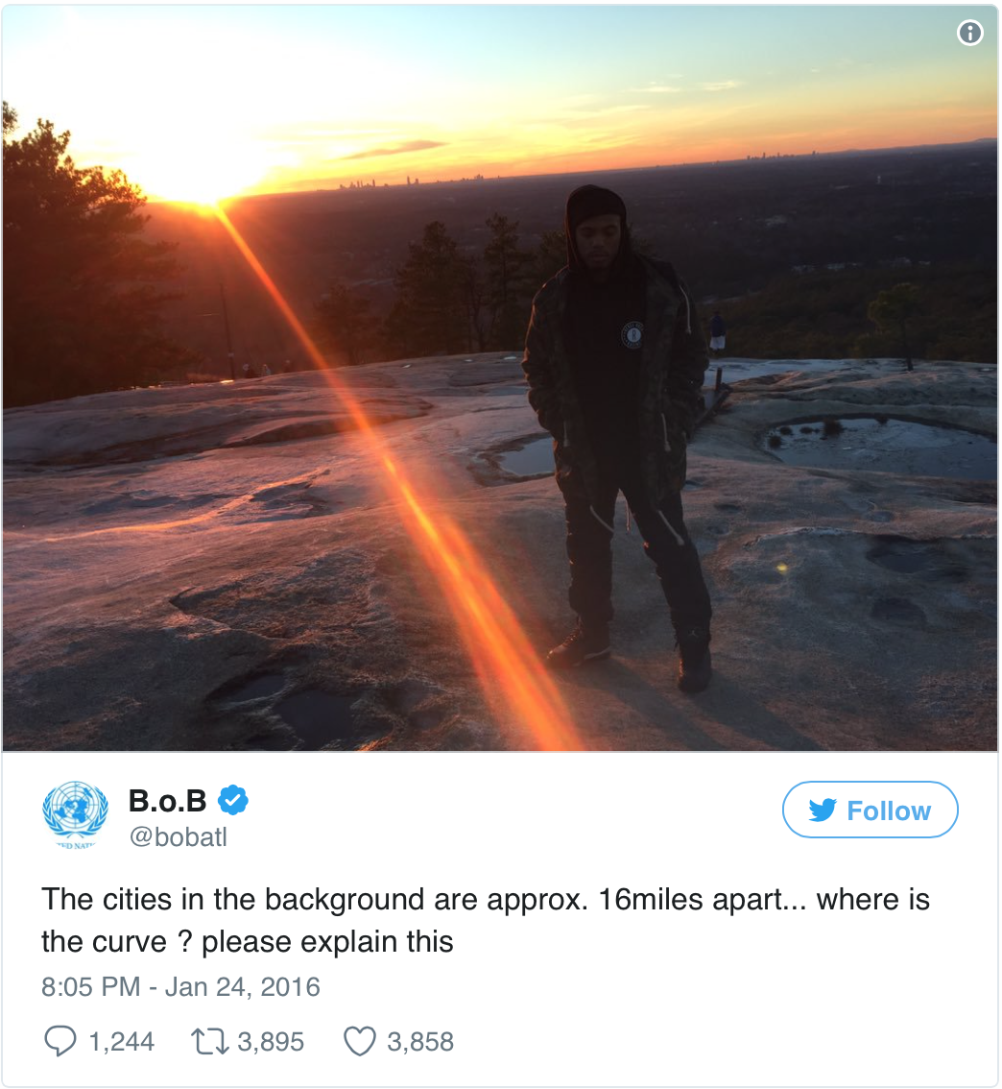
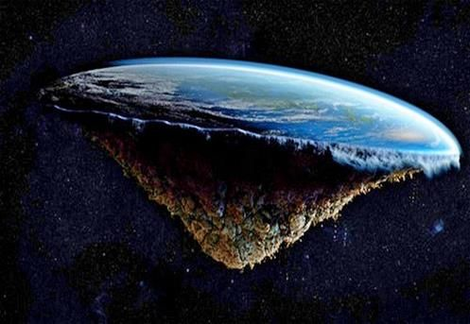
The goals of NGSS vs. “Flat-Earthers”

Slide 13
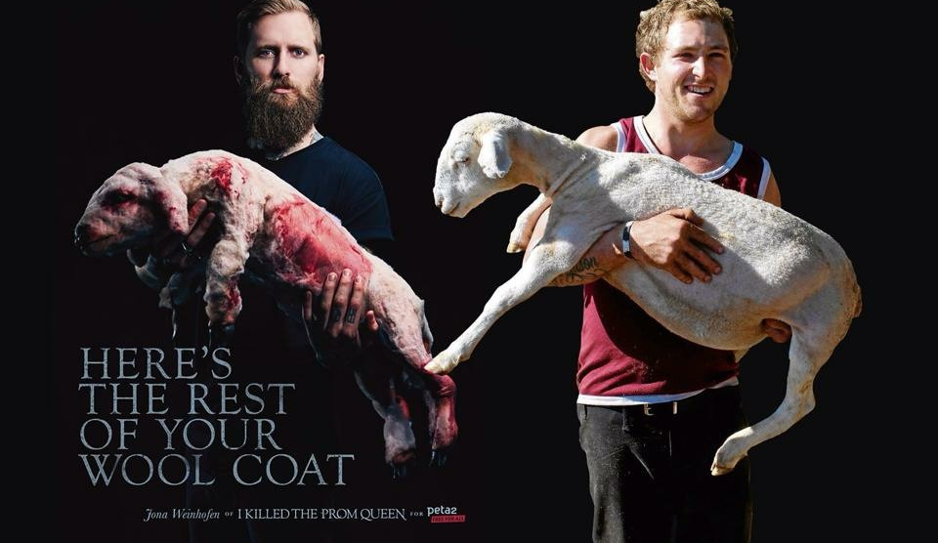
The goals of NGSS vs. PETA
Source: Daily Mail
Source: Imgur

Slide 14

Questions & Discussion

Slide 15
Aligning Curriculum and Instruction to AFNR & NGSS
What an aligned class could look like.

Slide 16
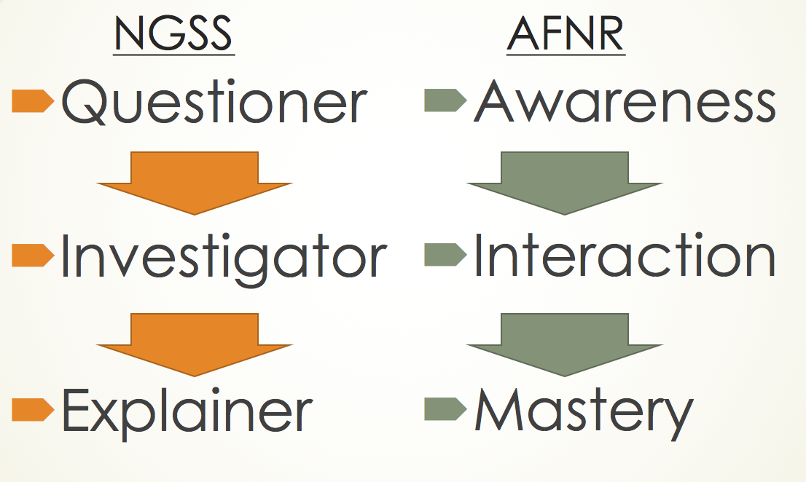
Potential Curricular Structure (w/ AFNR/NGSS Overlap)
1. Introduction (Questioner/Awareness)
  Elicit prior knowledge. Divergent Discussion & Initial Ideas.
2. Building a Knowledge Base (Questioner/Awareness)
  Core Ideas & Crosscutting Concepts. Relate back to initial ideas and confirm, reject, or modify. Formative assessment of knowledge.
3. Inquiry & Application (Investigator/Interaction)
  Apply core ideas to an inquiry-based
  investigation. Allow students to develop
  investigations in a scaffolded manner.
  Relate evidence in data to explain a
  phenomenon.
4. Assessment & Real-world Connection
(Explainer/Mastery)
  Apply content to a new, novel situation
  reflective of real world scenarios w/out
  guidance from an instructor. Explicit
  connections to careers and future
  relevance to students’ lives.

Slide 17
Why this format?
Our goal is to enable students to become sense-makers who use evidence and logic to make decisions as a result of agriscience instruction.
  Question: why would this be more effective than just telling them the ‘right answers’?
4 Guiding Questions for Sensemaking
  What are we trying to figure out? (asking questions)
  How will we figure it out? (planning and carrying out
  investigations)
  How do we keep track of what we are figuring out?
  (analyzing data, using math/comp thinking,
  developing & using models, constructing explanations,
  obtaining/evaluating/communicating info).
  How does it all fit together? What does it mean?
  (developing/using models, constructing explanations, and designing solutions).

Slide 18
Sample of Aligned Curriculum and Instruction to AFNR & NGSS
What might be a way to align to everything.

Slide 19
Potential Atmospheric Unit Curricular Structure
1. Introduction (Questioner/Awareness) – Getting them “ripe” for learning.
  Data Dive – Atmospheric Carbon Dioxide Graphs.
  Eliciting Ideas and forming hypotheses via group & divergent class discussion.
2. Building a Knowledge Base (Questioner/Awareness) - Establishing what we know and improving on our ideas of how we think things work.
  Core ideas about carbon dioxide, temperature, and climate.
  Convergent discussion and improvement/correction of initial ideas.
3. Inquiry & Application (Investigator/Interaction) – Can you use this in a real world situation? Can you apply it to solve something?
  Tabletop Climate Change Lab.
  School Bus Carbon Footprints
4. Assessment & Real-world Connection
(Explainer/Mastery) – Now you’re on your own.
  Student Individual Quiz & Group Quiz
  Career Connections – Student Interest Groups

Slide 20
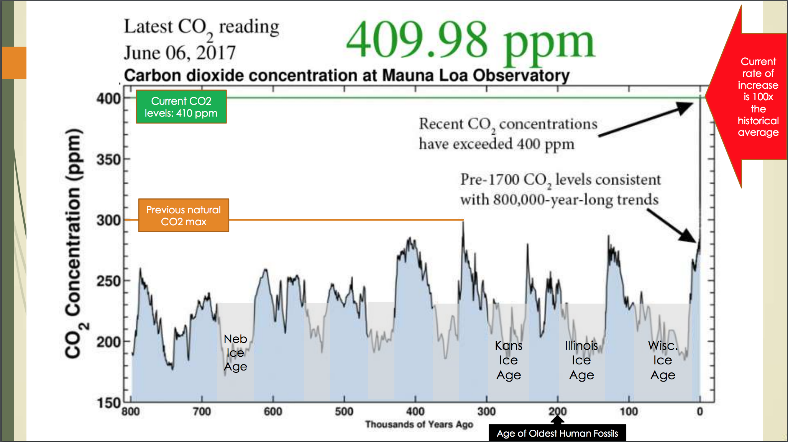
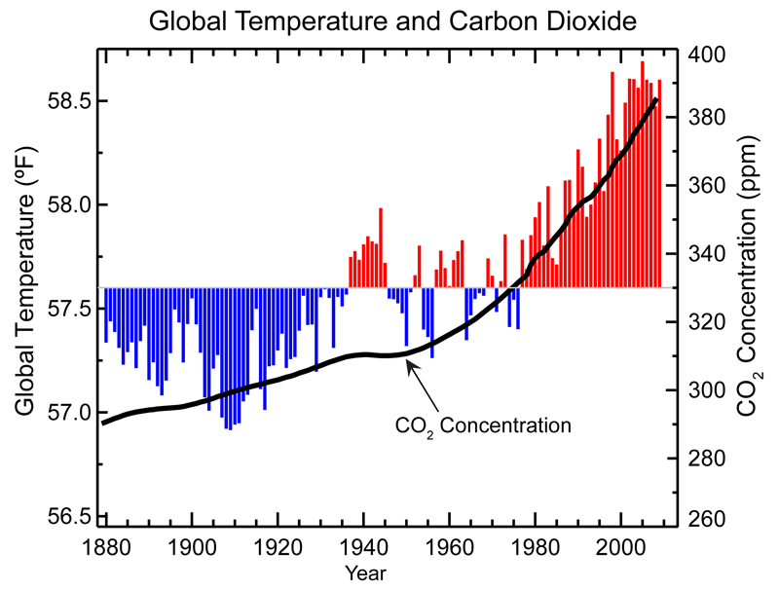
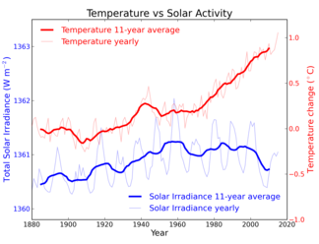
Data Dive
Activity
Look at the 3 graphs to the right.
Summarize the three most important conclusions that can be determined
by these graphs.
Develop a hypothesis to
explain your observations.
Source: Climate Central
Source: Illinois State Water Survey
Source: Climate Literacy and Energy Awareness Network (CLEAN)
Source: National Climatic Data Center

Slide 21
Divergent Discussion & 9 Talk Moves
Goal: Individual students share, expand and clarify their own thinking
  1. Time to Think: Partner Talk/Writing as Think Time/Wait Time
  2. Say More: “Can you say more about that?” “What do you mean?”
  3. So, Are You Saying…?: Paraphrasing Student Responses.
Goal: Students listen carefully to one another
  4. Who Can Rephrase or Repeat That?
Goal: Students deepen their reasoning
  5. Asking for Evidence or Reasoning: “Why do you think that?” “What’s your evidence?” “How did you arrive at that conclusion?” “Is there anything that made you think that?”
  6. Challenge or Counterexample: “Does it always work that way?” “How does that idea square with Sonia’s example?” “What if it had been a copper cube instead?”
Goal: Students think with others
  7. Agree/Disagree and Why?: “Do you agree/disagree? (And why?)” “Does anyone want to respond to that idea?”
  8. Add On: “Who can add onto the idea that Jamal is building?” “Can anyone take that a little further?”
  9. Explaining What Someone Else Means: “Who thinks they could explain in their words why Simon came up with that answer?” “Why do you think he said that?”
  Source: https://www.nsta.org/conferences/docs/2015SummerInstituteElementary/NineTalkMovesFromTERC.pdf
As a class, what can we agree on?
As a class, what are we unable to agree on?
As a class, what are our leading conclusions from the 3 graphs?
As a class, what are our leading hypotheses to explain these conclusions? What is our rationale for these hypotheses?

Slide 22
Core Concepts
What you need to know to revise your explanations.

Slide 23
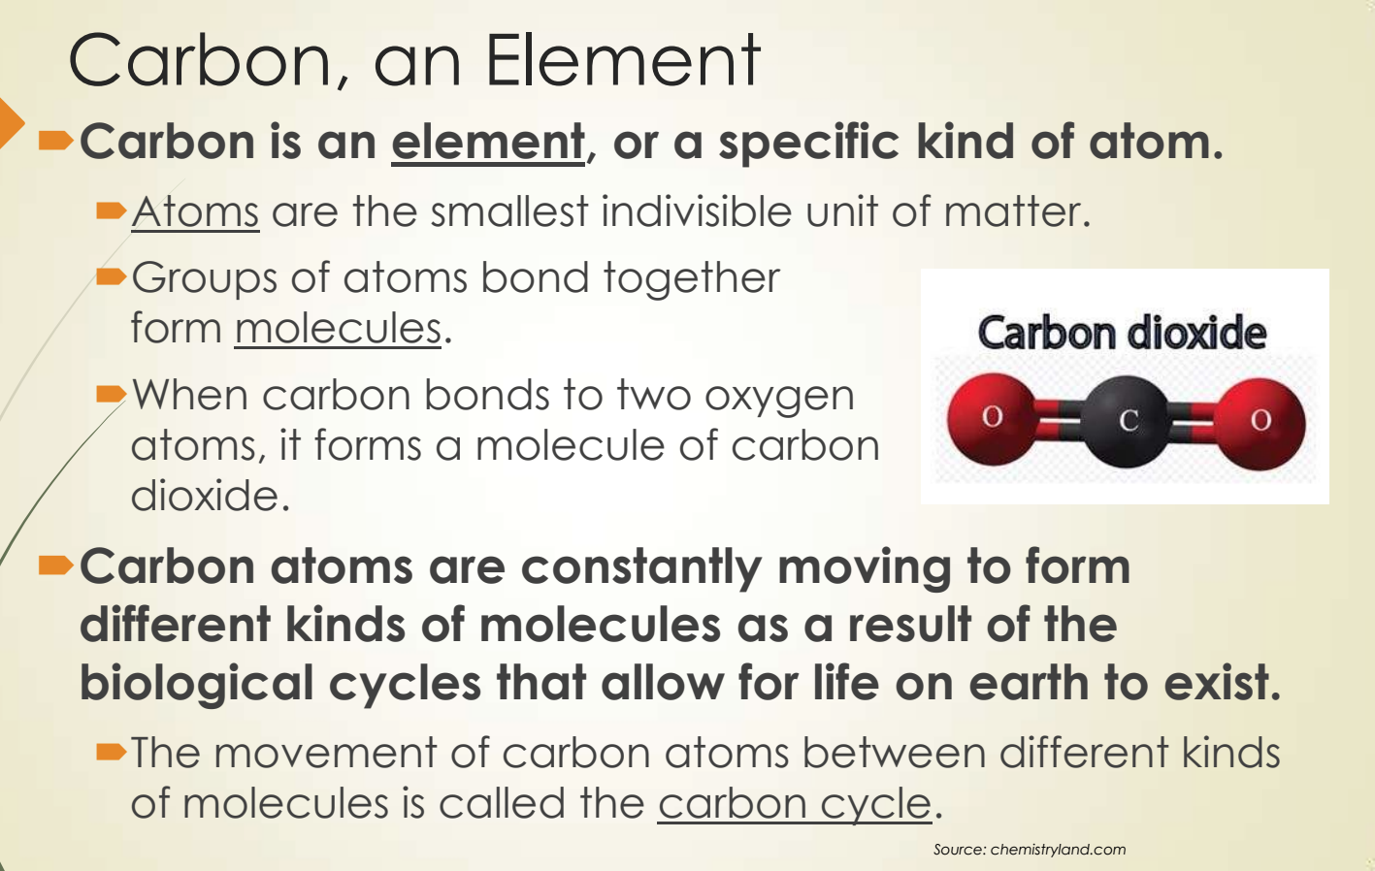

Slide 24
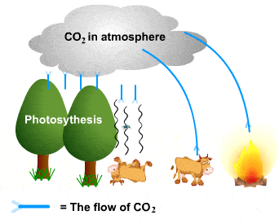
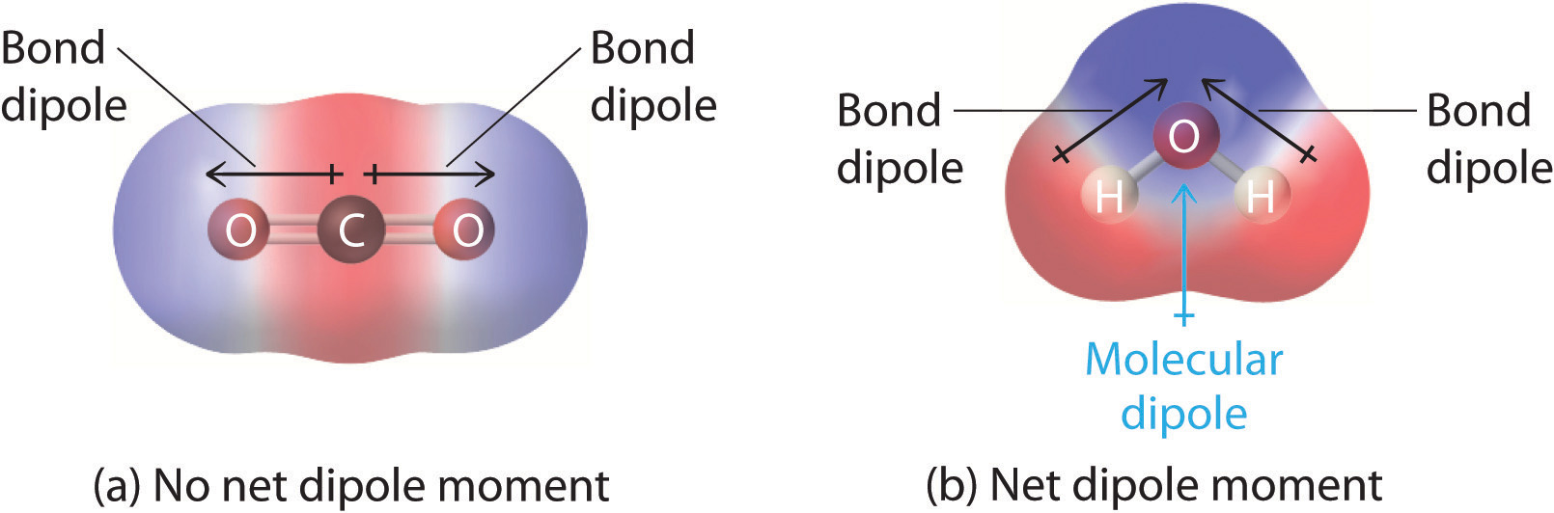
Core Concepts
CO2 is produced from burning, cellular
respiration, and from decomposition.
  If we increase the rates of burning,
  respiration, and/or decomposition,
  more CO2 will be released.
  The only way to actively remove atmospheric CO2 is via photosynthesis.
  While we can’t change the amount of carbon that exists, we can change the amounts of different kinds of carbon molecules (e.g. CO2 vs. glucose).
CO2 is a dipole molecule. This means that it has an unevenly distributed atomic charge which can scatter and reflect heat energy (just like a blanket).
  The more CO2 we have, the more heat
  is scattered back towards the earth.
We’ve known about this since 1862.
  John Tyndall published his findings on
  CO2 in the midst of the US Civil War.
Source: S-Cool
- + -
Source: Chemistry LibreTexts

Slide 25
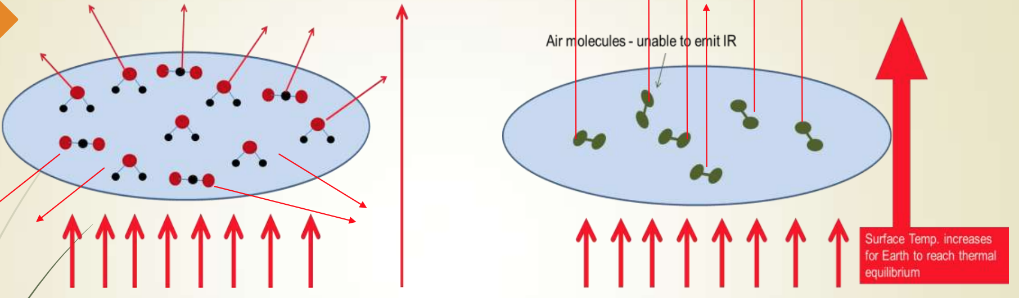
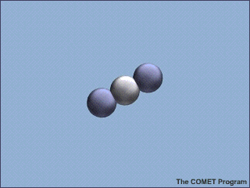
Because CO2 is dipolar, it can scatter heat energy in all directions.
  This means that ~50% of that heat is reflected back towards the earth’s surface.
  Even though N2 and O2 together comprise 99% of the atmosphere, they have little effect on temperature because they are not dipolar.
  More CO2 results in more heat retention, which warms the planet.
  Because CO2 mimics the effects of a greenhouse (allows
  light to pass but retains some of the heat), we call it a
  Greenhouse Gas.
  Water is also dipolar but has less of an impact on heat retention because it spends much less time in the atmosphere.
Source: UCAR Center for Science Education

Slide 26
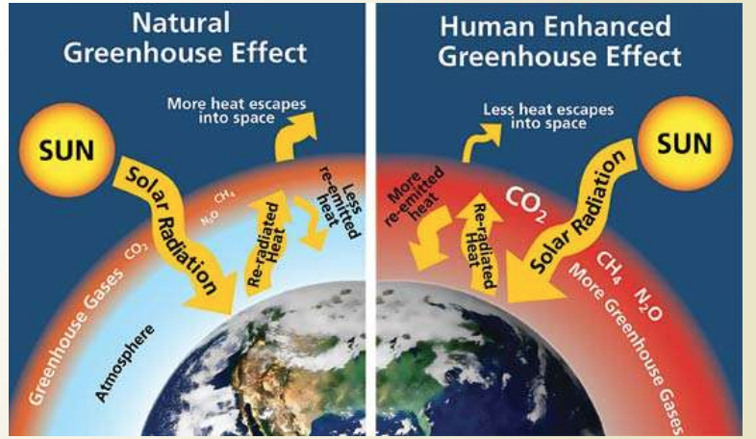
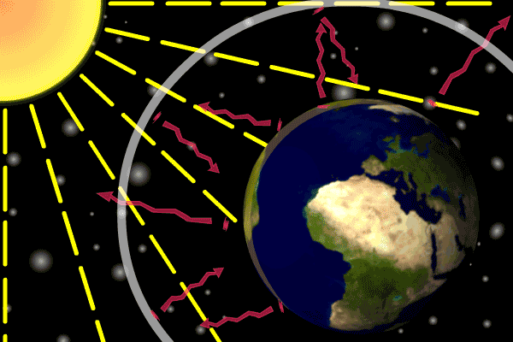
Increasing Greenhouse Gases
By increasing heat retaining gases like CO2, you also increase heat retention in the atmosphere.
  When you increase the heat retention of the atmosphere, you also change the climate.
Climate change is when the planet’s atmospheric conditions change as a result of increased heat retention due to an increase in greenhouse gases.
  Climate change was first described in 1895 when Swedish chemist Svante Arrhenius wrote about it in his paper: “On the Influence of Carbonic Acid in the Air upon the Temperature of the Ground.”
Source: Conservation in a Changing Climate
Source: A Greener Future

Slide 27
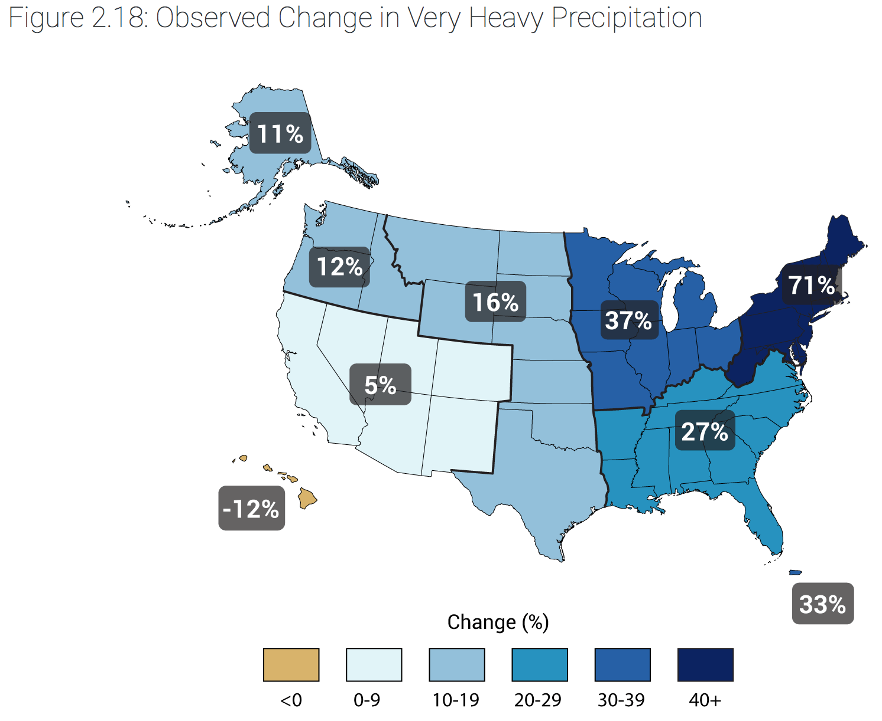
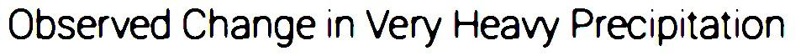
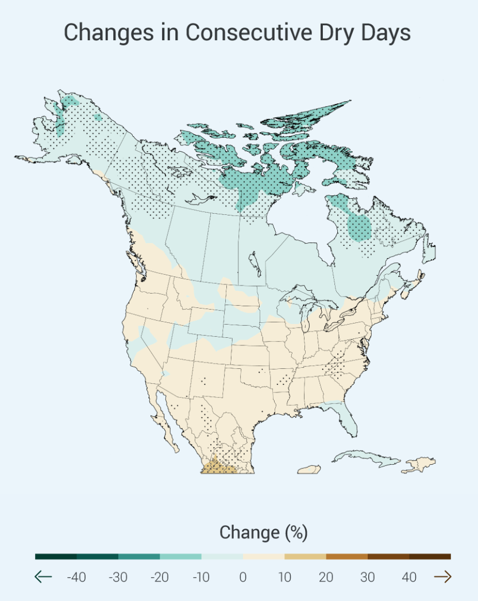
Why should we care?
Increasing the levels of greenhouse gases will increase atmospheric heat retention, which changes climate patterns.
  Large amounts of combustion (such as from the use of fossil fuels) will lead to the increase of CO2 that causes these changes.
A warmer climate can hold onto more precipitation for longer periods of time.
  This results in higher frequency of strong storms, flooding, and droughts.
  These changes reduce biodiversity, impair ecosystem services, and reduces the abilities of humans to produce food.
Source: National Climate Assessment - GlobalChange.gov

Slide 28
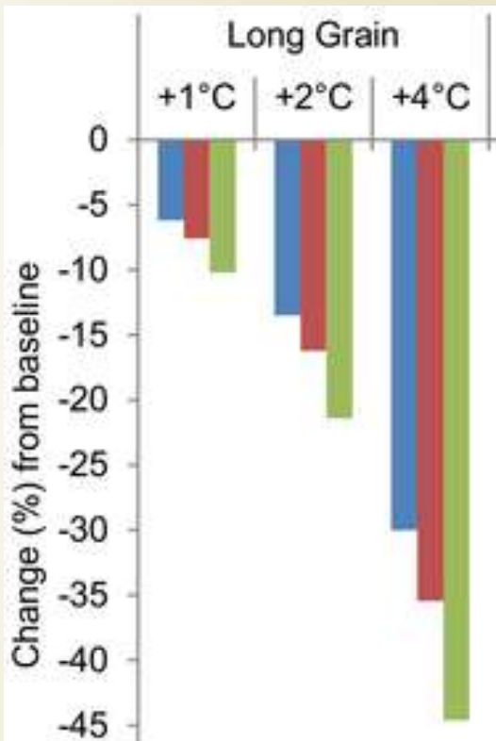
Agriculture & Climate Change
We are already seeing the effects of increased atmospheric heat retention:
Currently the US dairy industry has 1.9% production losses due to climate change, representing $670 million in losses to the industry. This will increase to 6.3%/losses of $2.2 billion by the end of the century.
An increase of 10 F in the maximum summer temperature reduces corn and soybean yields by nearly 2 tons of grain per acre. Based on 13.7 million acres of corn in the US and a July futures price of $162 per ton, that equates to a loss of $4.4 billion.
Global wheat production is estimated to fall by 6% for each 1°C
increase. The US wheat industry is worth $9 billion, so by
mid-century we could see losses of $1 billion or more.
An early thaw/freeze cycle can cause millions of dollars in losses
to fruit & berry crops. Premature budding due to a warm winter
caused $220 million in losses of Michigan cherries in 2012 in one
year alone for one state.
Climate change is projected to reduce the global area suitable
for coffee production by as much as 50% by 2050. By 2080, wild
may be become extinct. Coffee bean exports generate $20 billion/yr.
(Sources: Mauger, G., Bauman, Y., Nennich, T., & Salathé, E. (2015). Impacts of Climate Change on Milk Production in the United States. The Professional Geographer, 67(1), 121–131.
Key, N., & Sneeringer, S. (2014). Potential Effects of Climate Change on the Productivity of U.S. Dairies. American Journal of Agricultural Economics, 96(4), 1136–1156. AND Klinedinst, P. L., Wilhite, D. A., Hahn, G. L., & Hubbard, K. G. (1993). The potential effects of climate change on summer season dairy cattle milk production and reproduction. Climatic Change, 23(1), 21–36.
Mishra, V., and K. A. Cherkauer (2010), Retrospective droughts in the crop growing season: Implications to corn and soybean yield in the Midwestern United States, Agricultural and Forest Meteorology, 150(7-8), 1030–1045
Tack, J., Barkley, A., & Nalley, L. L. (2015). Effect of warming temperatures on US wheat yields. Proceedings of the National Academy of Sciences, 112(22), 6931–6936.
National Oceanic and Atmospheric Administration. 2013. Regional Climate Trends and Scenarios for the U.S. National Climate Assessment Part 3. Climate of the Midwest U.S. NOAA Technical Report NESDIS 142-3
USGCRP (2014). Hatfield, J., G. Takle, R. Grotjahn, P. Holden, R. C. Izaurralde, T. Mader, E. Marshall, and D. Liverman, 2014: Ch. 6: Agri­culture. Climate Change Impacts in the United States: The Third National Climate Assessment, J. M. Melillo, Terese (T.C.) Richmond, and G. W. Yohe, Eds., U.S. Global Change Research Program, 150-174
Robertson, P. 2015. Climate Change & Michigan Agriculture. PowerPoint Presentation, Nov. 10th, 2015.)

Slide 29
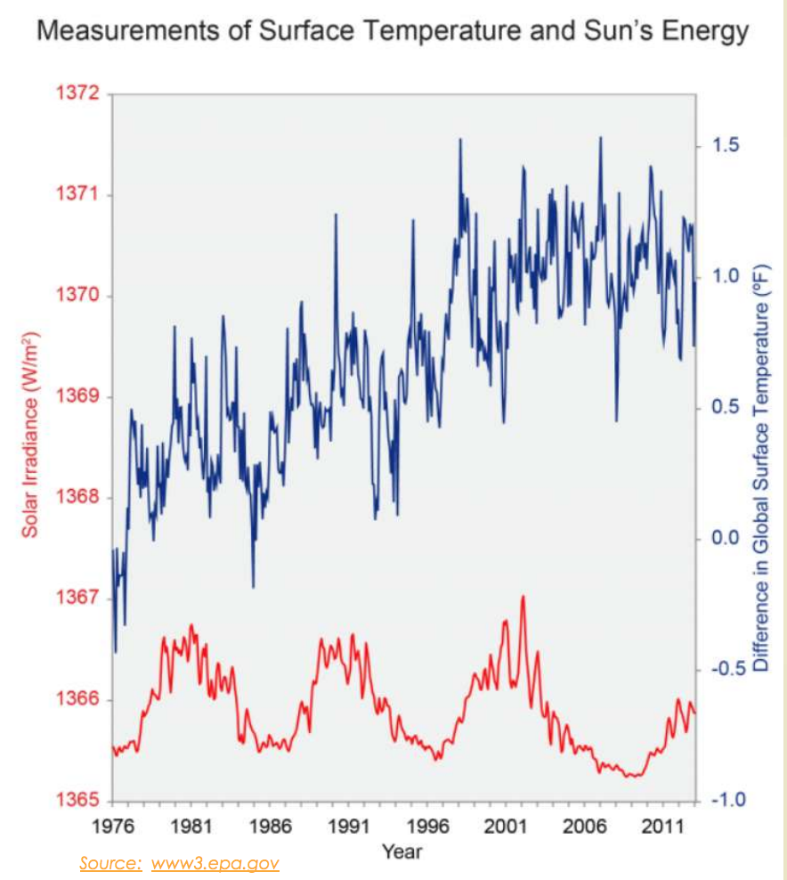
Return to Data
Dive Activity
Convergent Discussion:
  What were your original ideas?
  Have they changed in light of this information?
  Any new ideas?
  What do we still not know?

Slide 30
Inquiry-based Investigations
Testing your understanding in real-time explorations.

Slide 31
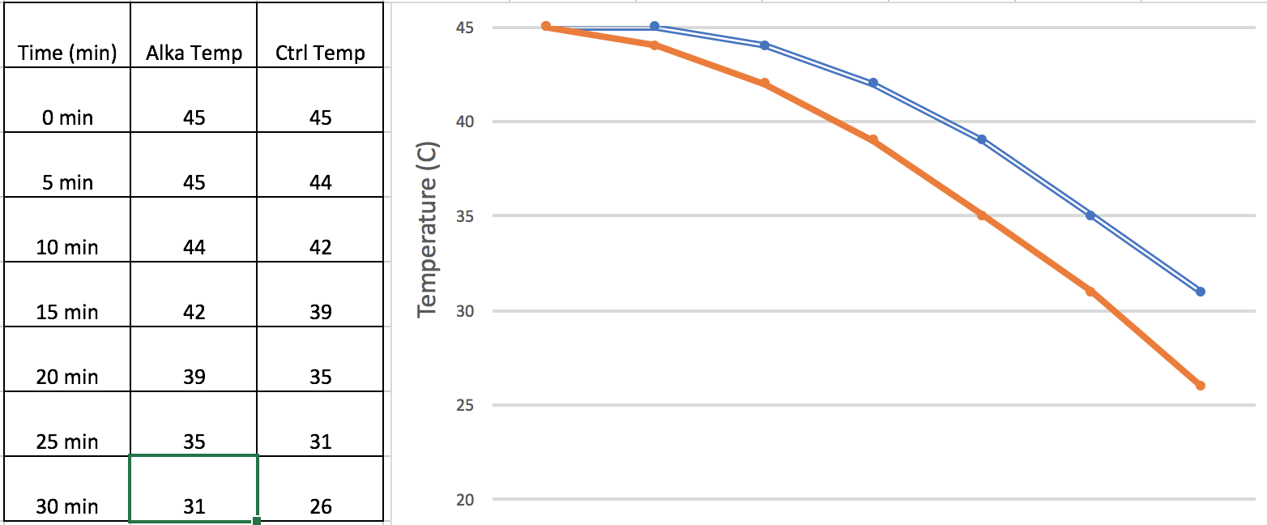
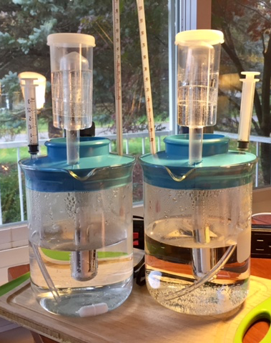
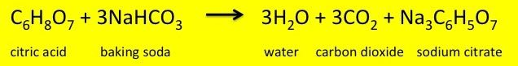
Table Top Climate Change
By adding Alka-Seltzer to water in a sealed, heated container, students can compare the effects of greenhouse gases like CO2 on temperature.

Slide 32

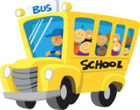
School Bus
Carbon Footprints
Basic premise:
How many trees
would it take to
absorb the CO2
emitted from the
use of a district’s
school bus fleet
in a given year?

Slide 33
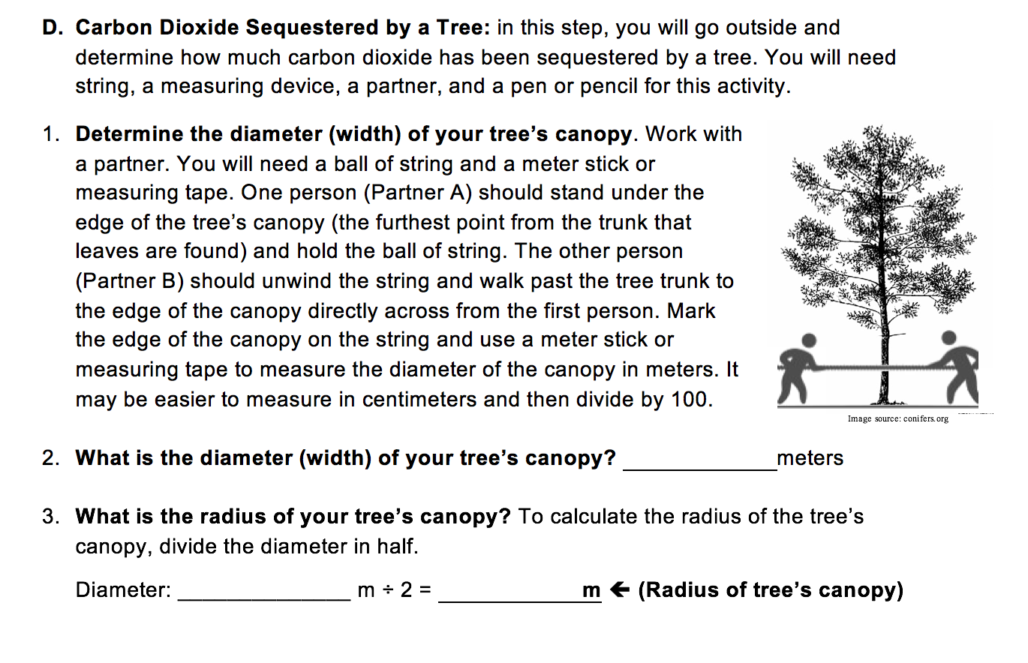
School Bus Carbon Footprints

Slide 34
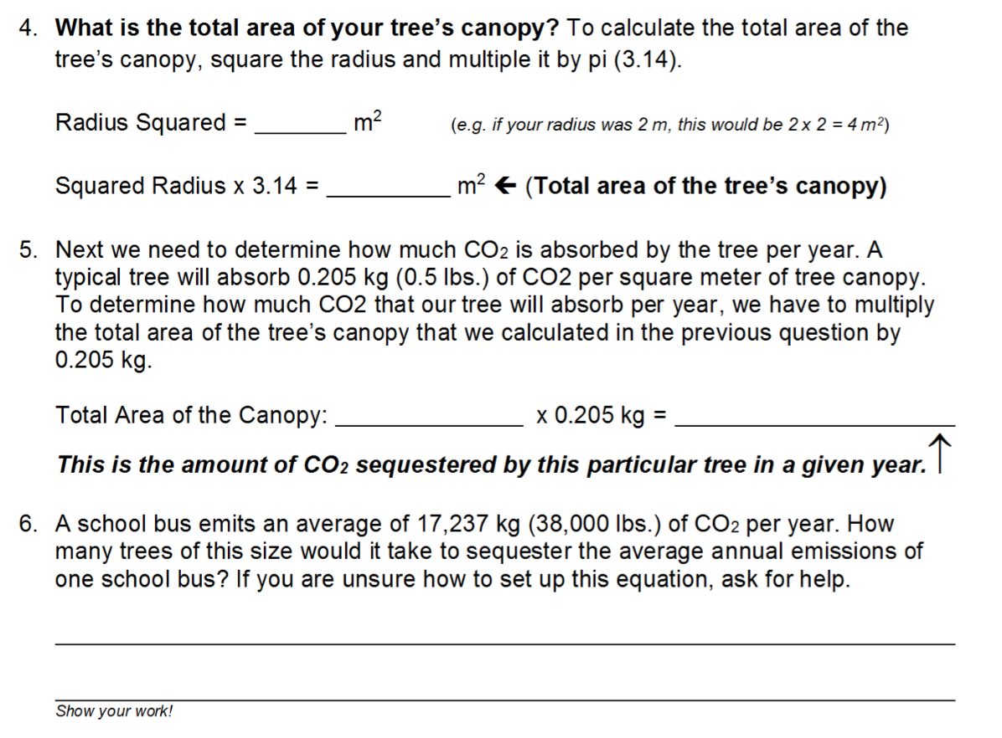
School Bus Carbon Footprints
Notes:
E.g. if a tree were 2 meters wide, it’s radius would be 1 m. It’s total area would be 3.14 sq meters and could absorb 0.7 kg of CO2 per year. It would require 24,624 trees of this size to absorb the CO2 from one school bus. A tree 6 m wide (20 ft) would have a radius of 3 m and an area of (9 x 3.14) = 28.3 sq m. It could absorb 5.8 kg of CO2 per year. It would take 2972 trees of this size to absorb the CO2 from one school bus.

Slide 35
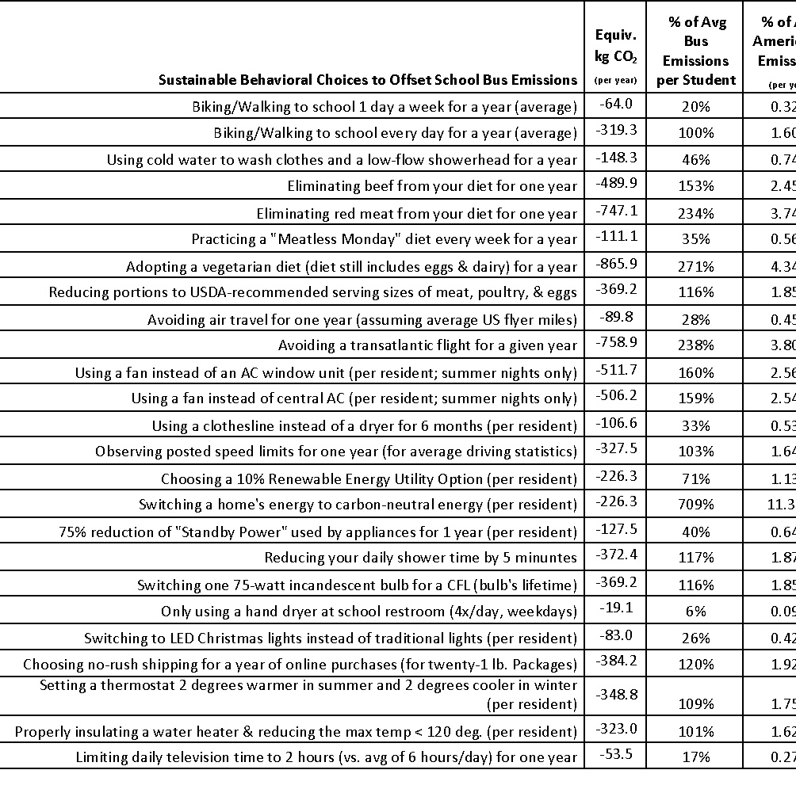
Alternatives to Buses
Clearly it would take WAY too many trees to make this a feasible option.
Are there other options?
Use the table at the right to see what else you could do.

Slide 36
Summative Assessment
Did you achieve your objectives?

Slide 37
Formative vs. Summative
Your instruction should consist of two kinds of assessment:
  Formative – ungraded or worth a small grade. Used to check for understanding as instruction is occurring and should help determine what is emphasized or re-taught during instruction. Students may be allowed to go back and revise their responses for full credit.
  Summative – final check of understanding. Worth a larger grade. Unassisted by instructor but may occur in a group setting. Should reflect big ideas and real-world relevance. Occurs at the end of instruction. Students should receive formative assessment that is similar to the summative version in earlier instruction.

Slide 38
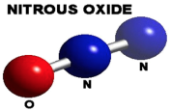
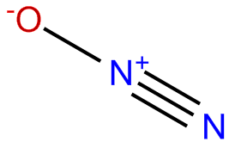
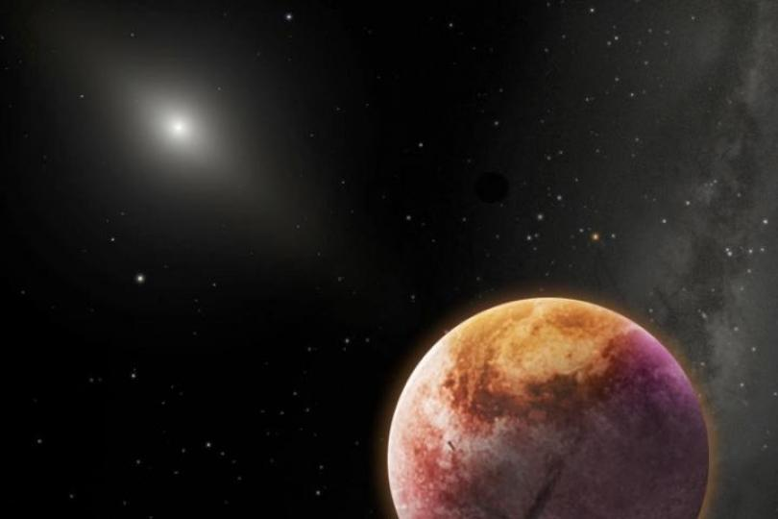
Summative
Assessment
- + +
This is Nitrous Oxide.
If we increase levels of N2O in the atmosphere of Planet X by 50%, what would happen to temperature of that planet’s atmosphere?
Explain & Justify w/ Evidence.

Slide 39
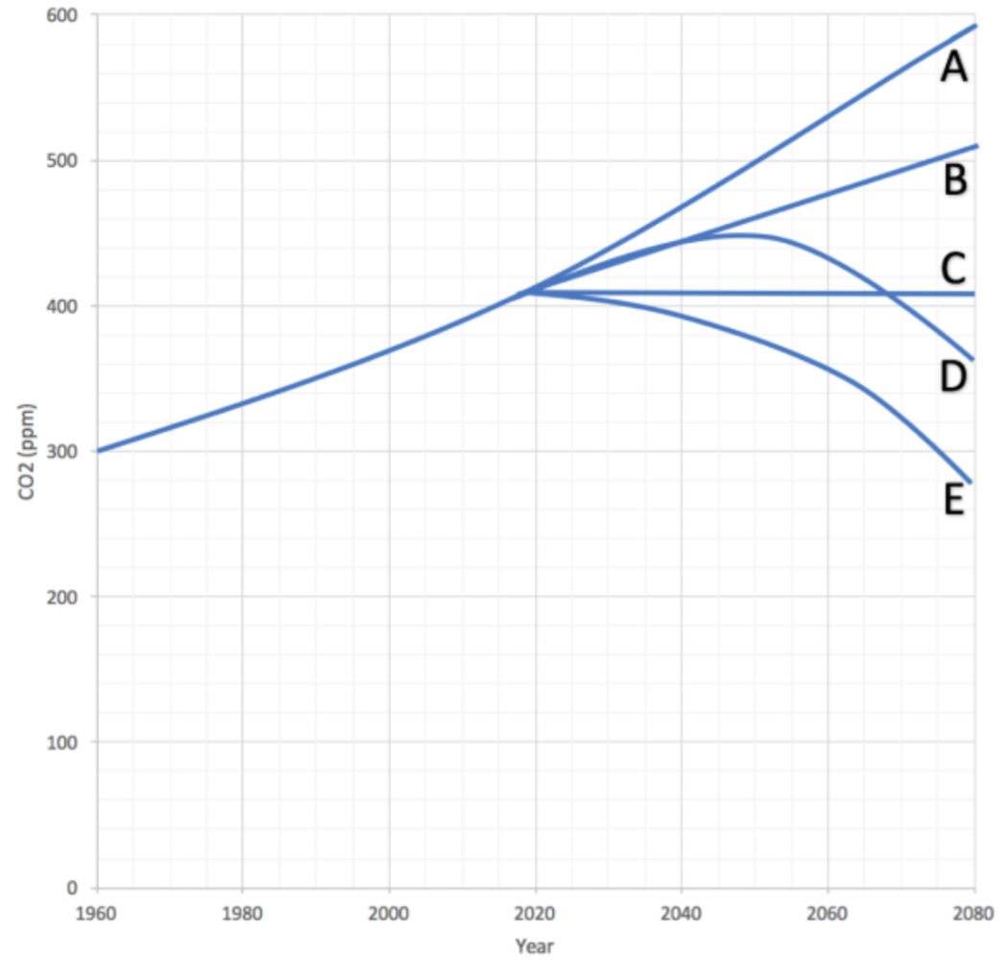
Summative
Assessment
If we were to cut fossil fuel use in half overnight (and keep our usage at this level indefinitely), what would happen to CO2 levels in the atmosphere?
Explain & Justify w/ Evidence.

Slide 40
Summative
Assessment
Is there anything that agriculture could do to make E possible?
Identify ag practices that could reduce atmospheric CO2.
  Hint: what natural process does this? How much would have to occur to lower CO2 levels?
Explain & Justify w/ Evidence.

Slide 41
Career Connections
Can you apply classroom lessons to real-world issues?

Slide 42
Career Connections
For this activity…
  Decide what your favorite ag topic is to teach (e.g. Natural Resources, Animal Science, Horticulture, etc.)
  Find other people who have the same interest.
Using what you know and internet searches (credible sites only!), determine how climate change will affect your topic and how your topic might adjust to or mitigate climate change.
  Be ready to present.

Slide 43
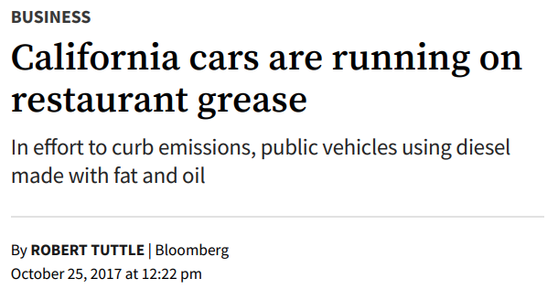
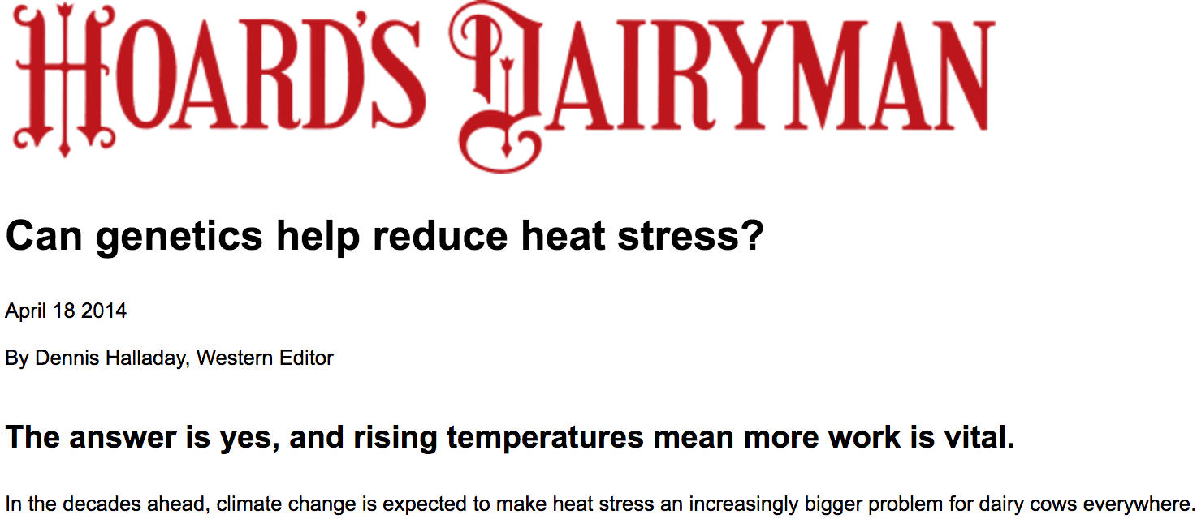
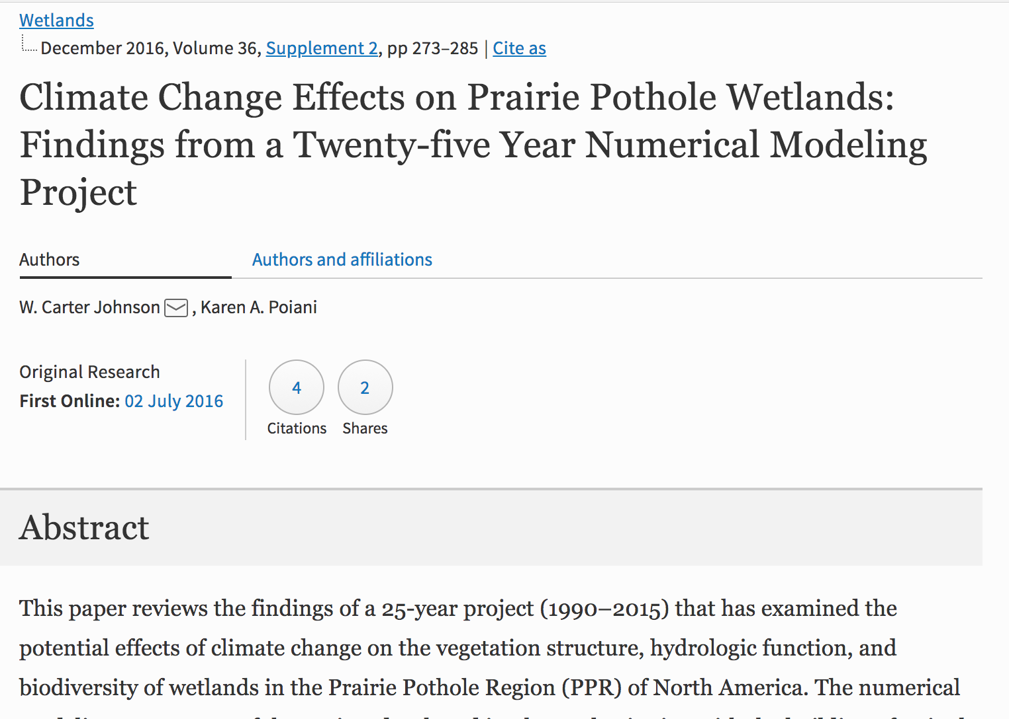
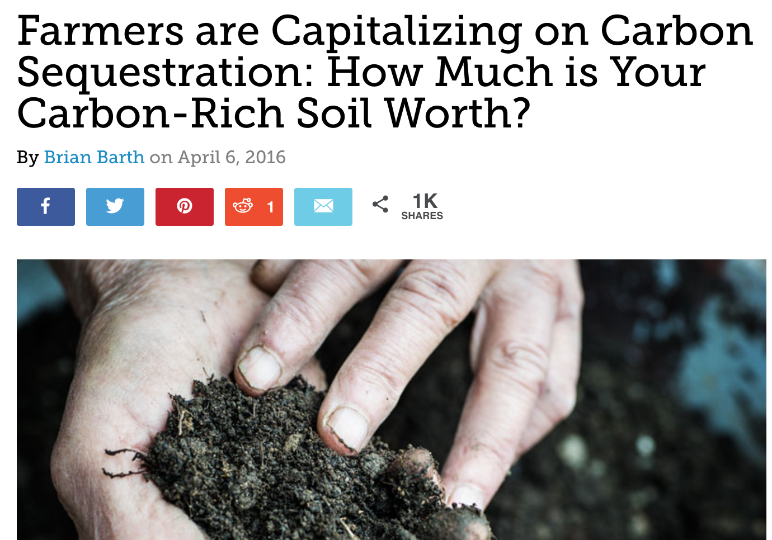
Career Connections
Possible examples

Slide 44
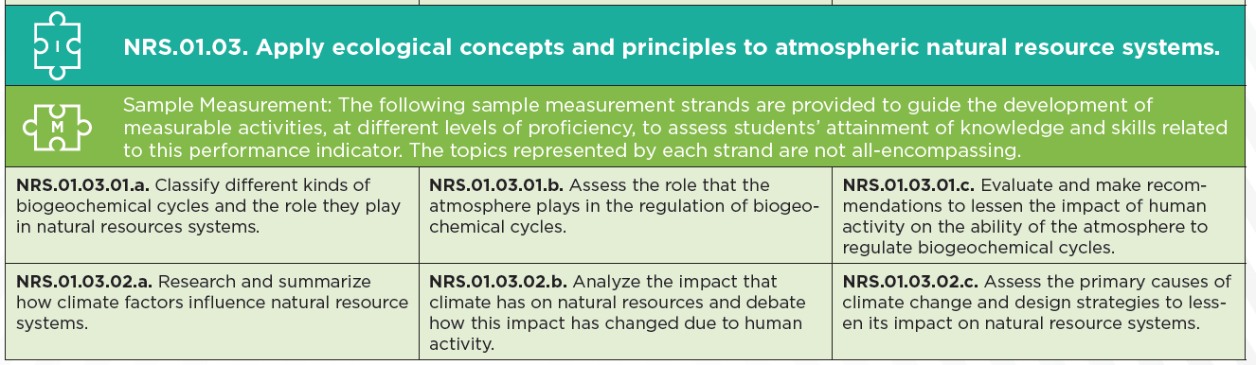
Which of these have we done?
Notes:
Notice that the disciplinary core ideas (what we typically think of as the ‘content standards’) are very broad. This is very intentional. Teaching a curriculum that is a ‘mile wide and an inch deep’ does almost nothing to develop scientific literacy in students, nor does that content stay with students in a reliable manner (i.e. they largely forget it once the test is done). Instead, the emphasis has shifted to allowing for deeper comprehension through 3D learning.

Slide 45
Which of these have we done?
Notes:
Notice that the disciplinary core ideas (what we typically think of as the ‘content standards’) are very broad. This is very intentional. Teaching a curriculum that is a ‘mile wide and an inch deep’ does almost nothing to develop scientific literacy in students, nor does that content stay with students in a reliable manner (i.e. they largely forget it once the test is done). Instead, the emphasis has shifted to allowing for deeper comprehension through 3D learning.

Slide 46
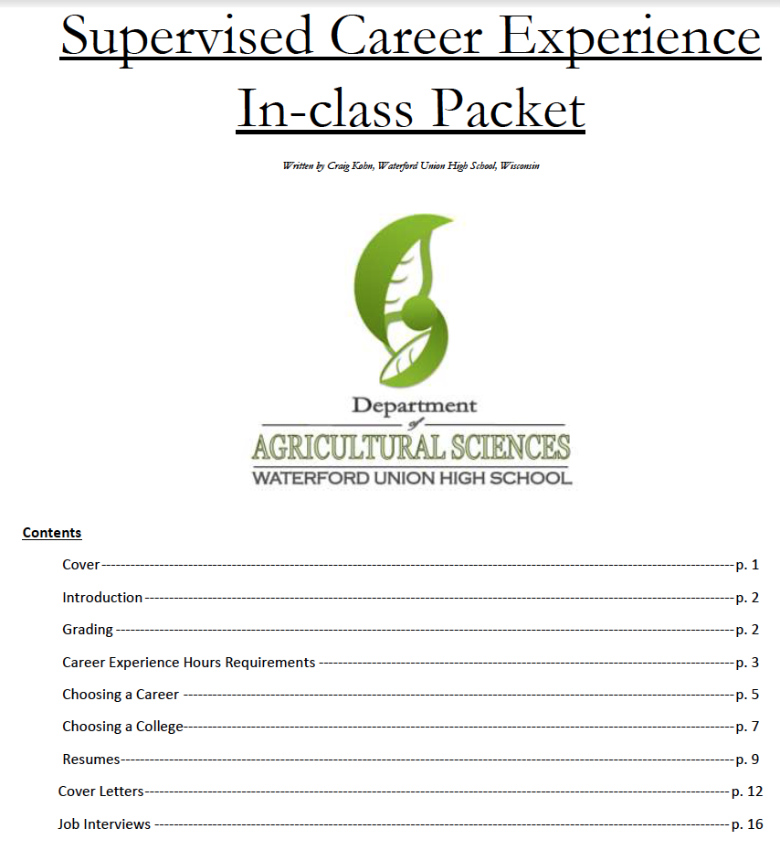
3-Circle Model Applications
Students should take what they learn in the classroom setting and apply it to real world situations (social, career, etc.).
  The 3-Circle Model aligns exceptionally well to what research in learning and education tells us about effective instruction.
The Supervised Career Experience packet may be a way to help scaffold students out-of-class learning.
  There are plenty other options too (e.g. AET, etc.)
This has classroom and SAE…but what about the 3rd circle?

Slide 47
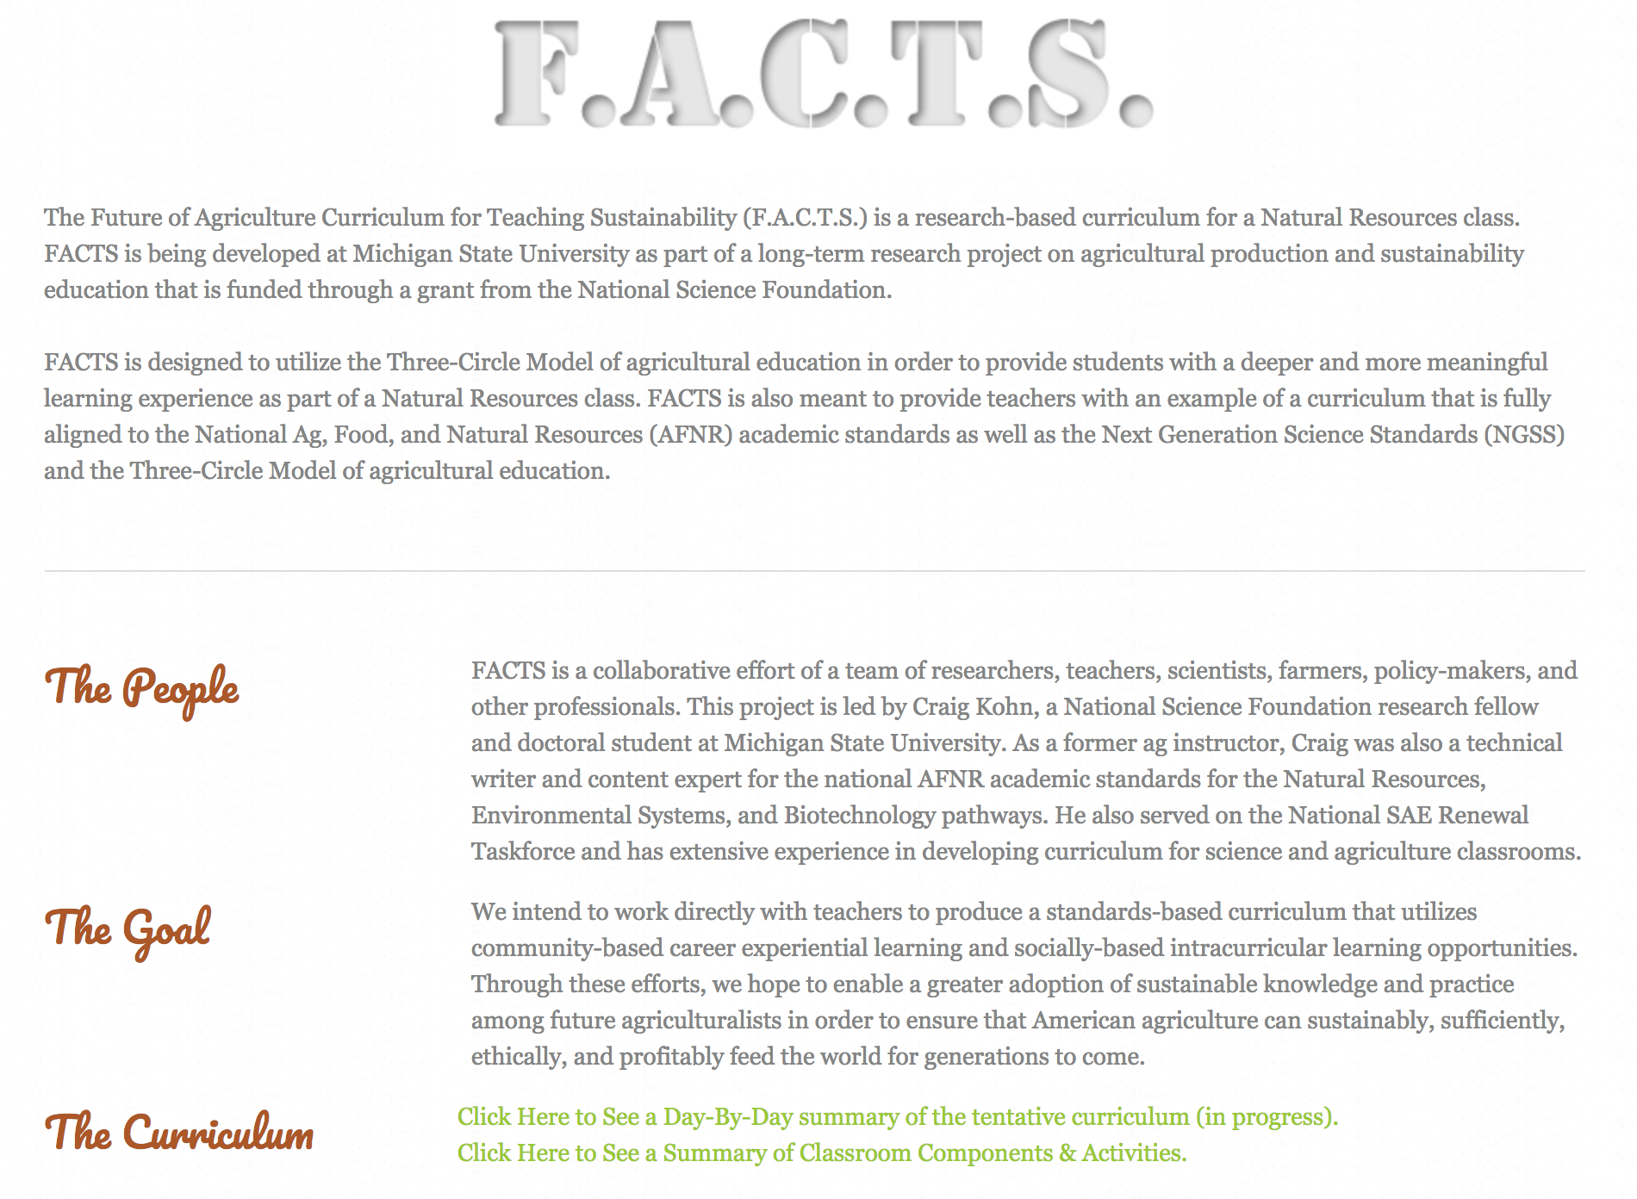
Future of Agriculture Curriculum for Teaching Sustainability
A standards-aligned, 3-Circle Model curriculum for teaching Natural Resources.
Look for the first version in 2018!

Slide 48
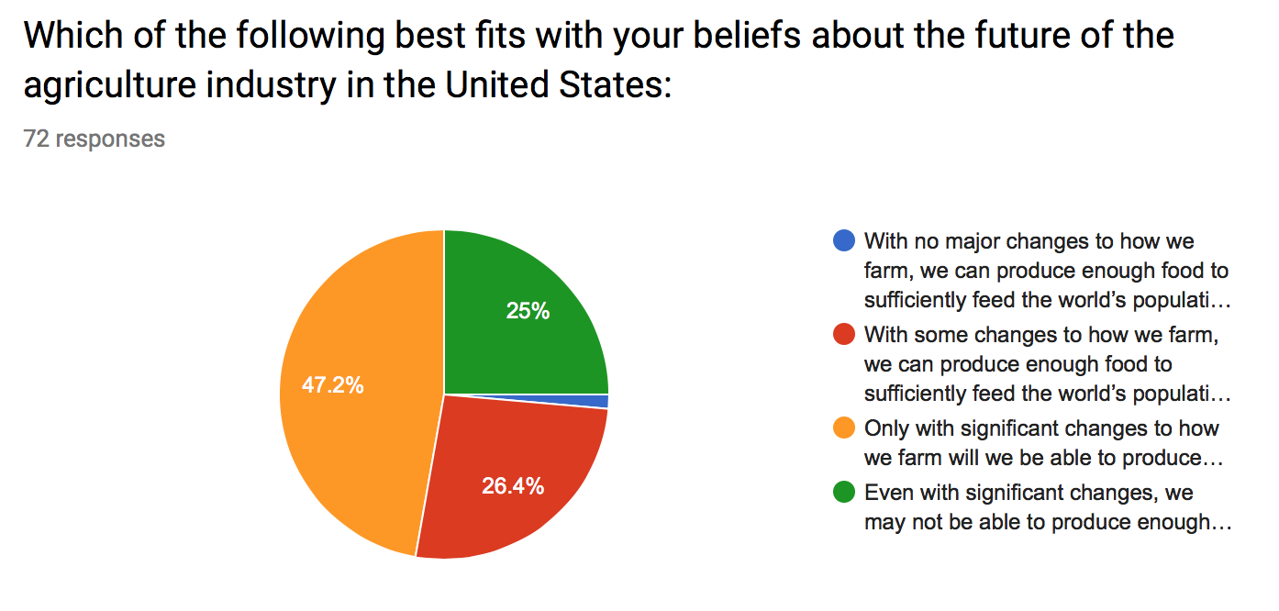
Additional NSF Research
Future of Agriculture Teacher and Producer Research – bit.ly/FutureOfAgSurvey

Slide 49
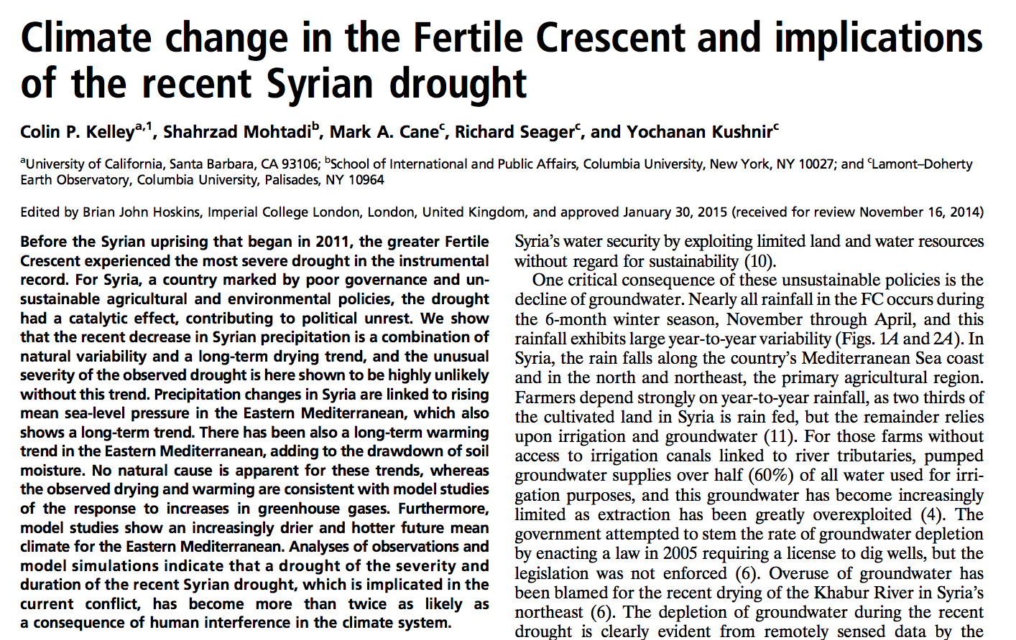
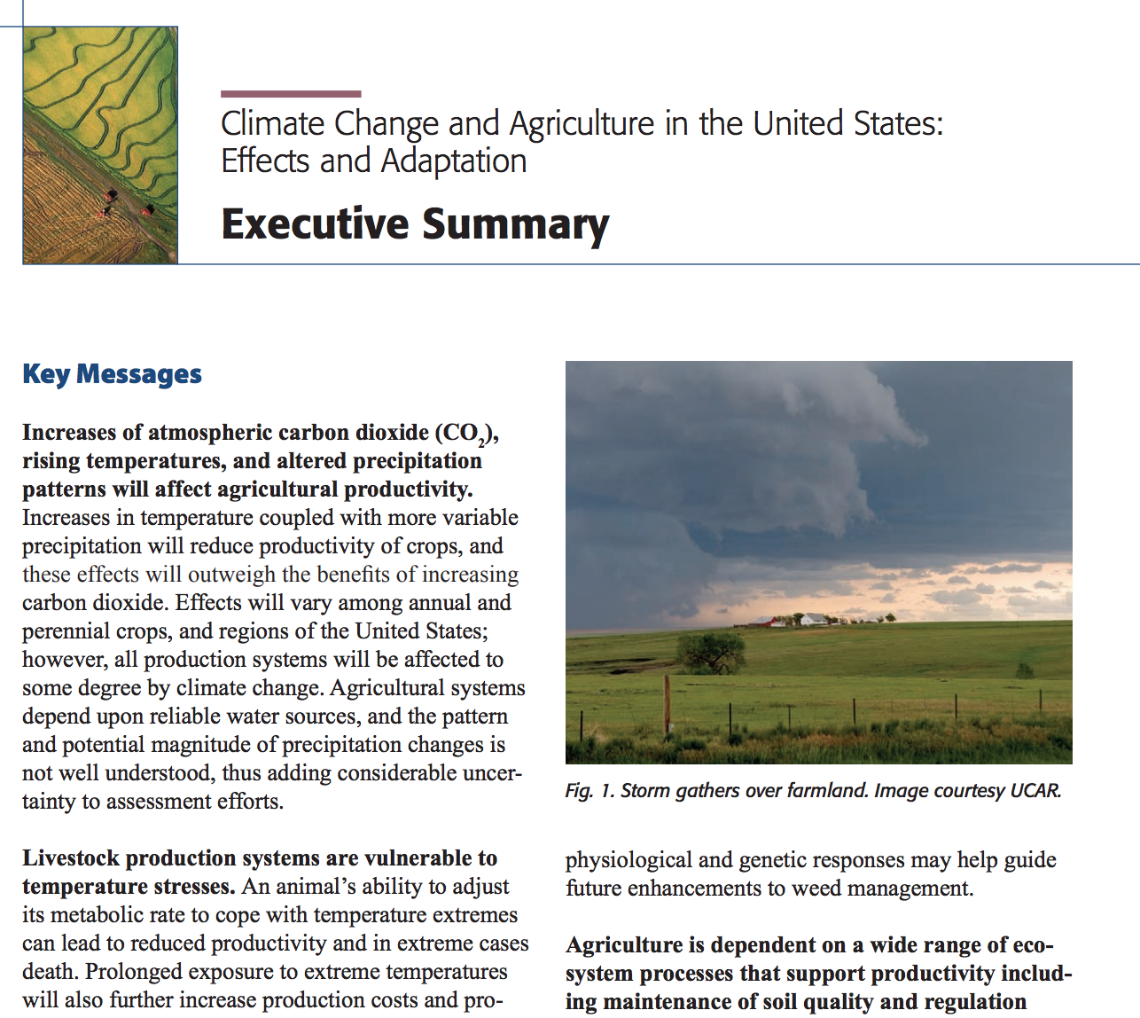
Preparing for a Challenging Future
“If you are teaching future farmers using outdated ideas from 20 years ago, you’re not preparing those individuals to succeed. If anything, you’re preparing them to fail.”

Slide 50
Additional Resources
All materials addressed today are posted at http://wuhsag.weebly.com/pd-workshops.html
Research-based curricular options for standards-alignment:
  GLBRC.org
  Carbon TIME
  F.A.C.T.S.
  Others?

