Slide 1

National Chapter Award Program

Slide 2
National Chapter Award Program
Chapter Eligibility
To qualify, the chapter must:
  Complete at least 15 activities; one for each of the five quality standards in each of the three divisions.
  Meet the minimum requirements as outlined in the National Quality FFA Chapter Standards.
Growing Leaders | Building Communities | Strengthening Agriculture
Leadership | Environmental | Support Group
Healthy Lifestyle | Human Resources | Chapter Recruitment
Scholarship | Citizenship | Safety
Personal Growth | Stakeholder Engagement | Agricultural Advocacy
Career Success | Economic Development | Agricultural Literacy

Slide 3
National Chapter Award Program
Application
The application is available at www.FFA.org/nationalchapter
Use information from your completed Program of Activities (POA)
Two forms compose the application:
  Form I
    Description of 15 activities (one activity per quality standard)
        Typically comes from the chapter’s Program of Activities
    NQCS assessment
        Chapter assessment based on rubric
        Chapter must meet minimum standards to gain access to Form II
  Form II – contains three activity write ups and photo pages per division for a total of 9 activities.

Slide 4
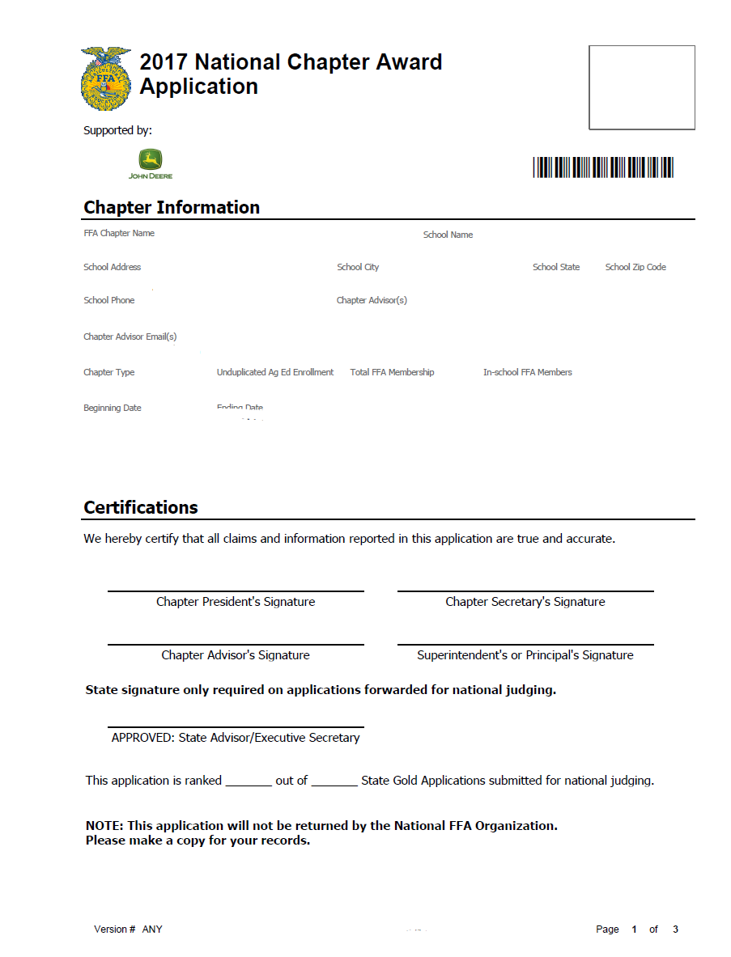
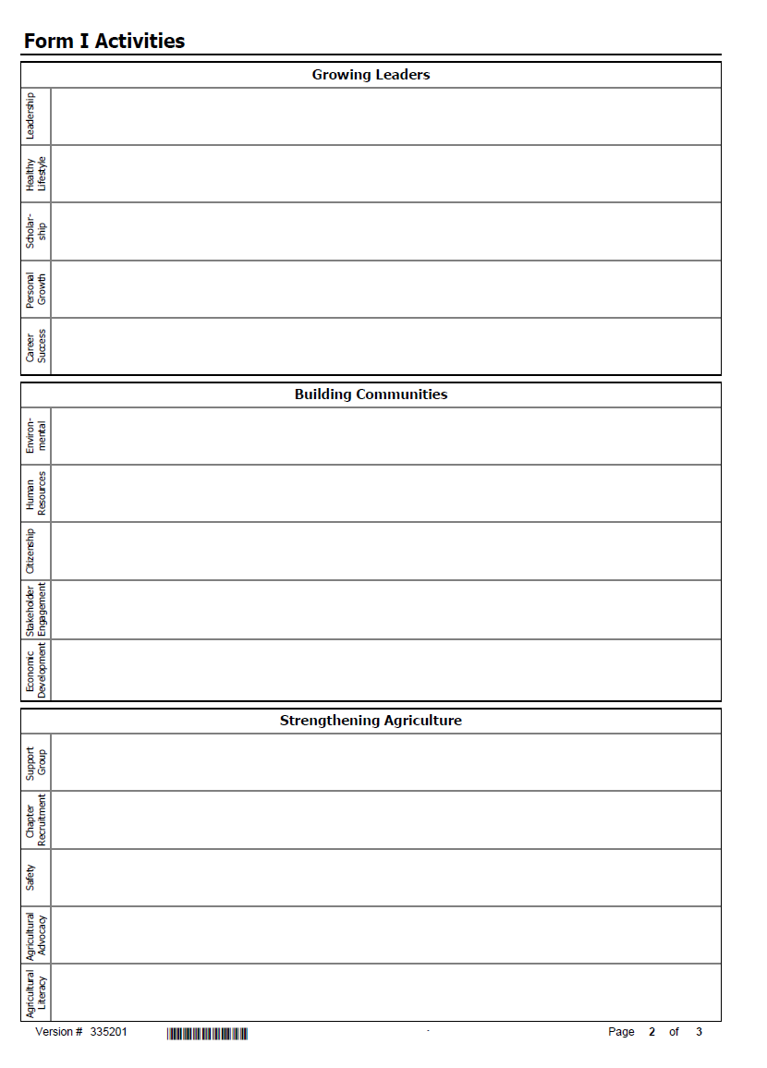
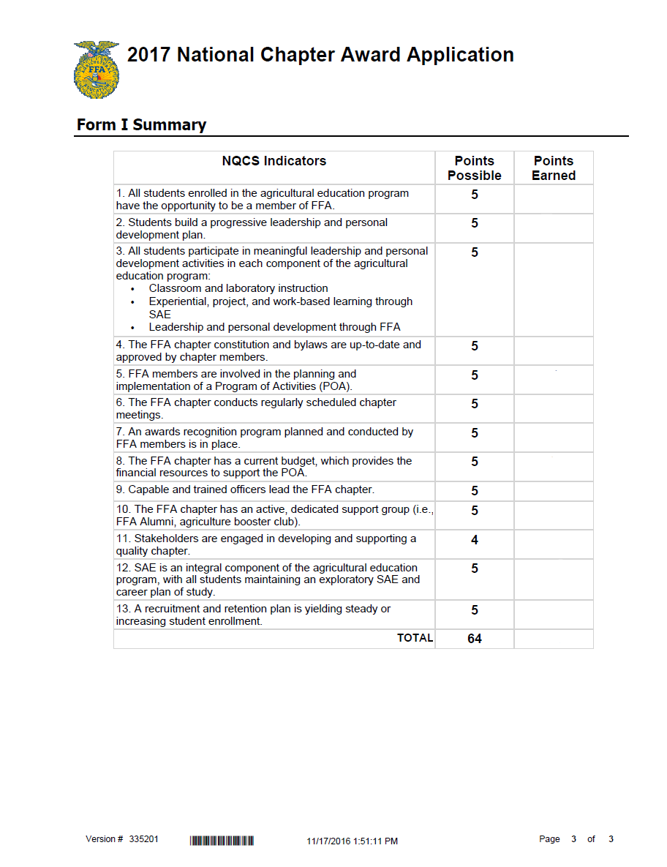
National Chapter Award Program
Form I

Slide 5

National Chapter Award Program
Form II
Activity Description: Description clearly explains the purpose and reason the chapter is implementing the activity. Description clearly answers the following questions:
  What is the purpose of this activity?
  Why is the activity taking place?
Each activity requires three goals that are well written and utilizing all five components of a SMART goal.
  S – Specific
  M – Measurable
  A – Attainable
  R – Realistic
  T – Time

Slide 6
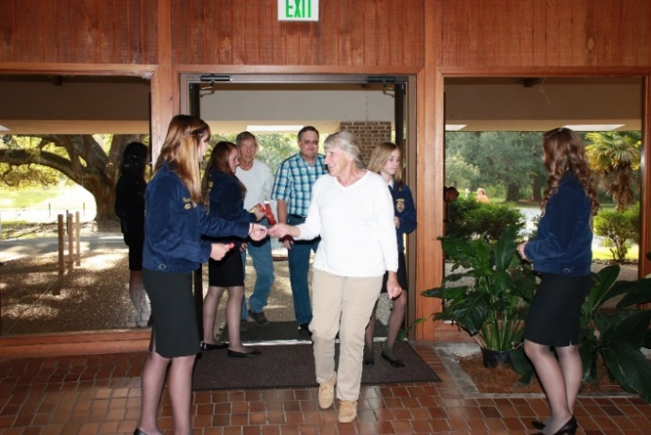
National Chapter Award Program
Form II
Plan of Action
  Clearly identifies the following items for each goal:
    What needs to be accomplished to meet this goal?
    Where will the activity take place?
    How will the chapter implement the goal to accomplish this activity?
    How will the goal be accomplished? This should include necessary steps for completion.
    Who will perform the duties to meet the goal?

Slide 7
National Chapter Award Program
Form II
Outcome: Response clearly states whether the goal was unmet, met or exceeded. If all aspects of the SMART goal were met, clearly states by how much if exceeded. If goal was unmet, circumstances or reasoning as to why is explained in detail and what would be done differently next time to meet the goal.
Advancing leaders, communities or agriculture: Response clearly states the purpose of the activity and the benefit the activity had on the leaders, community or agriculture.
Impact: Response clearly identifies and describes how the impact of the activity affected the intended audience.
Related to Quality Standard: Activity and benefits relate directly to the chosen quality standard.

Slide 8
National Chapter Award Program
Form II
Photo: A clear, high-quality photo illustrating the chapter’s activity in action is displayed.
Photo caption: A caption that clearly describes the activity is used.
Tips:
  High quality picture showing involvement, not staged
  Interesting and informative
  Do not repeat photos within application
  Photo must be of chapter activity
Spelling & Grammar: No errors or slight errors in grammar or spelling are made that district the reader from the content.

Slide 9
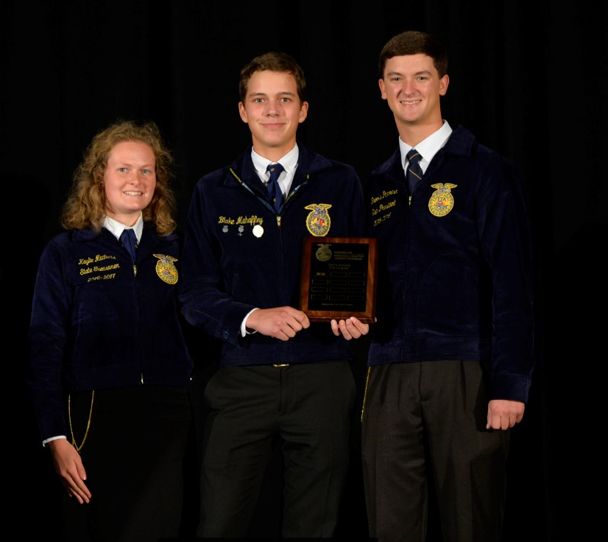
National Chapter Award Program
State Level Recognition
State Superior Chapter Award
State Gold, Silver or Bronze Awards

Slide 10
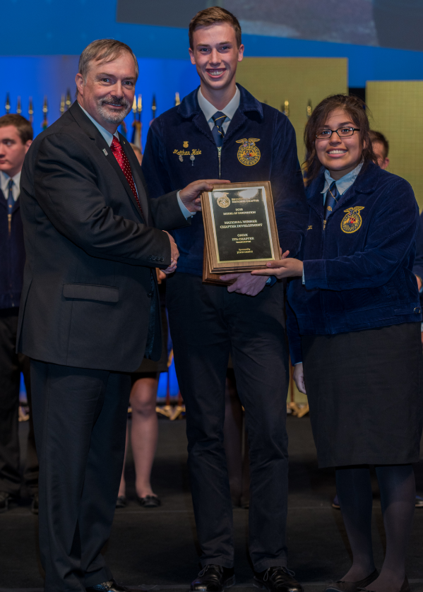
National Chapter Award Program
National Level Recognition
National 3, 2, 1-Star Awards
  Must meet Gold state level standards
  3, 2, 1-star awards with multi-year plaques and spurs
  Awarded based on the rubric
National Premier Chapter Awards
  Must meet 3 star national level standards
  Ten finalists in each of the three divisions:
      Growing Leaders, Building Communities, Strengthening Agriculture
    Finalists are selected for innovative activities
    One winner in each division is selected through a presentation/interview process at the National FFA Convention & Expo

Slide 11
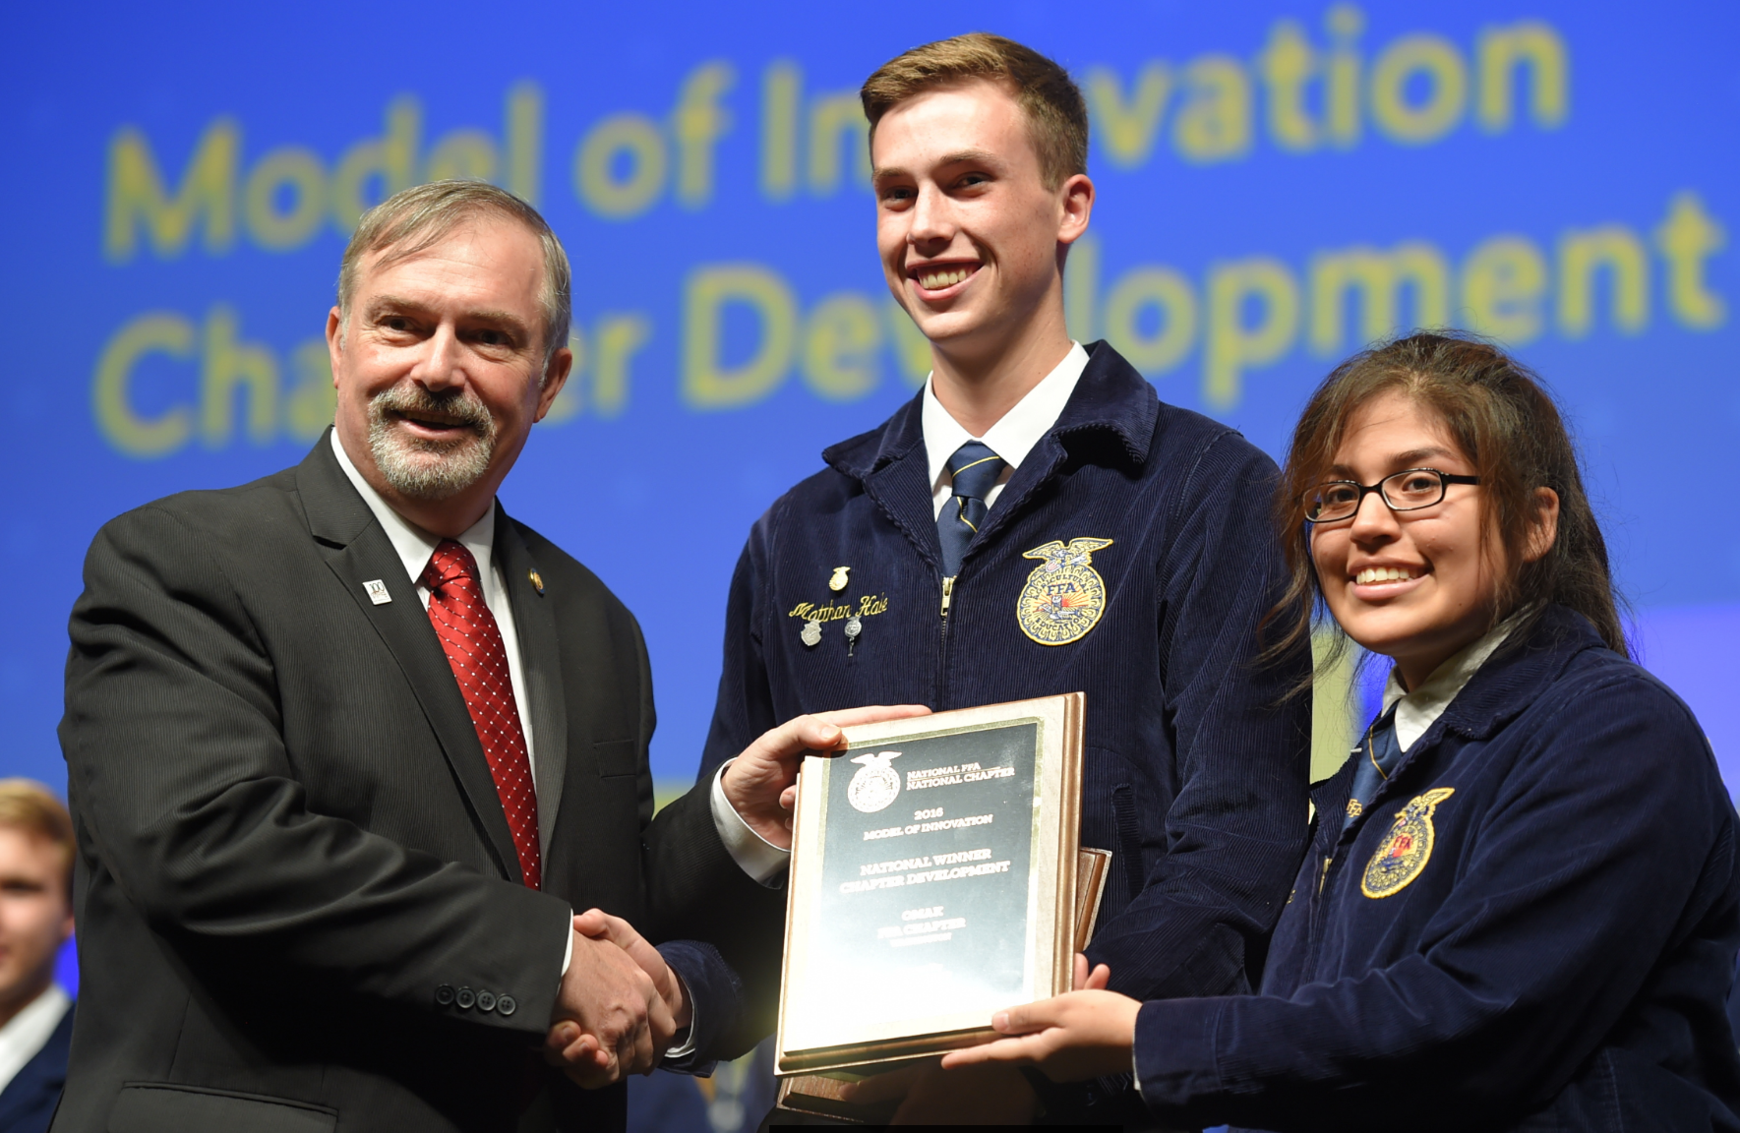
National Chapter Award Program
National Level Recognition
National Model of Excellence Award
  Must meet 3 star national level standards
  Ten finalists compete for one winner through a presentation/interview at the National FFA Convention & Expo
National Middle School Model of Excellence Award
  Must meet 3 star national level standards
  Five finalists compete for one winner
  through a presentation/interview at the
  National FFA Convention & Expo

Slide 12
National Chapter Award Program
Best Practices
Start early
Strong POA
Consult the handbook
Follow the rubric and guidelines
Use SMART goals
Be detailed and to the point
Use high quality photos, no staged photos
Use plain white paper
Check grammar and spelling
When submitting, place application in awards folder or staple the application together
Include all pages and signatures on cover page

Slide 13
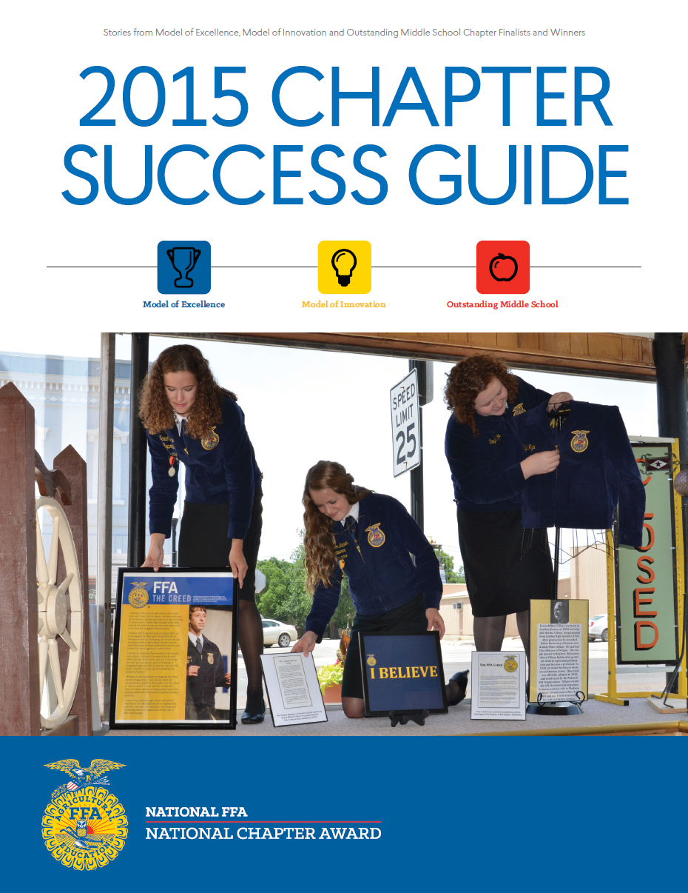
National Chapter Award Program
Additional Resources
Additional resources are available at www.FFA.org/nationalchapter
  Official handbook
  Program Overview
  Scoresheets & Rubrics
  Chapter Success Guides
  Program of Activities (POA) Resources

Slide 14
National Chapter Award Program
Questions?
Contact the National Chapter Award Program
Education Specialist
317-802-4402
nationalchapter@ffa.org

