Slide 1
National FFA
Educator Resources
Pebbles Lacross
Agriculture Educator
The Sound School New Haven, CT
Pebbles.Lacross@nhboe.net
Ashli Weinrich
National FFA Senior Educational Consultant
FFA Programs & Events Division
aweinrich@ffa.org

Slide 2
Resource Discussed
Bell Ringers for the Agricultural Science Classroom
Agriculture, Food and Natural Resources Value Chain
Sustainability in Agriculture
CDE/LDE Classroom Resources & Choice Boards
New Horizons Teaching Guides & General Activity Worksheets

Slide 3
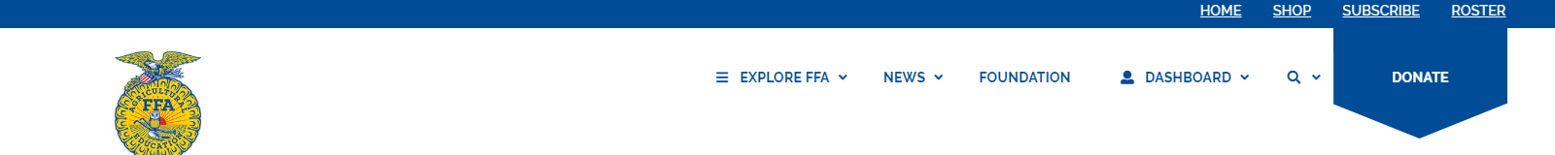
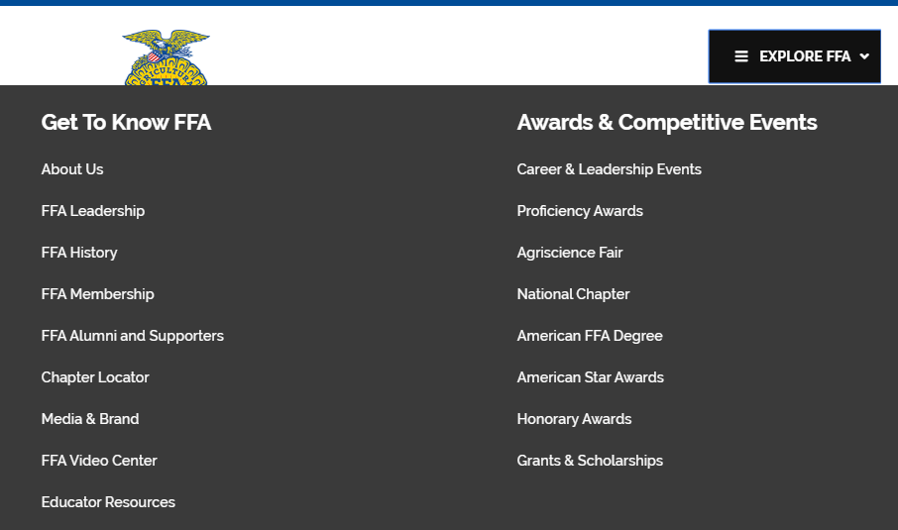
Accessing Resources
  Go to FFA.org.
  2. Click on Explore FFA in the top toolbar.
3. Select Educator Resources in the left column.
4. Use the search bar on the Educator Resources page to look up the resource or topic you are interested in.

Slide 4
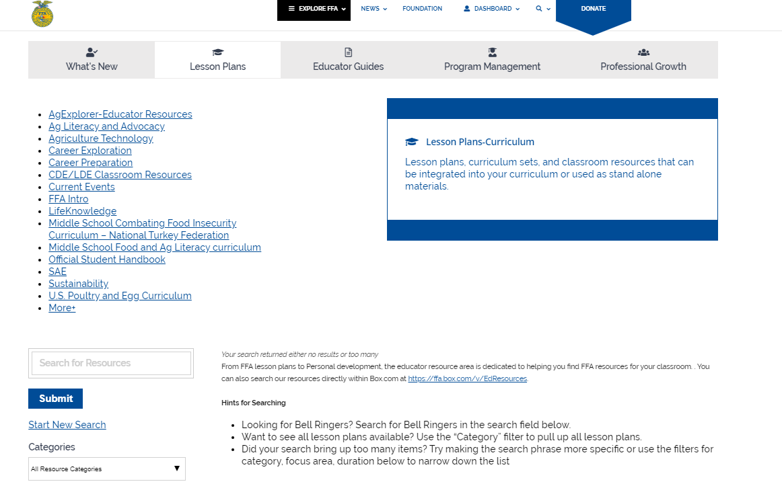
4. Use the search bar on the Educator Resources page to look up the resource or topic you are interested in.
5. Click on the Word document, PDF or folder icon associated with the resource you are interested in viewing.
6. This will re-direct you to Box (where documents are housed).
7. To view a document, just click on it to view. If you would like to download the document, select download in the top right corner.

Slide 5
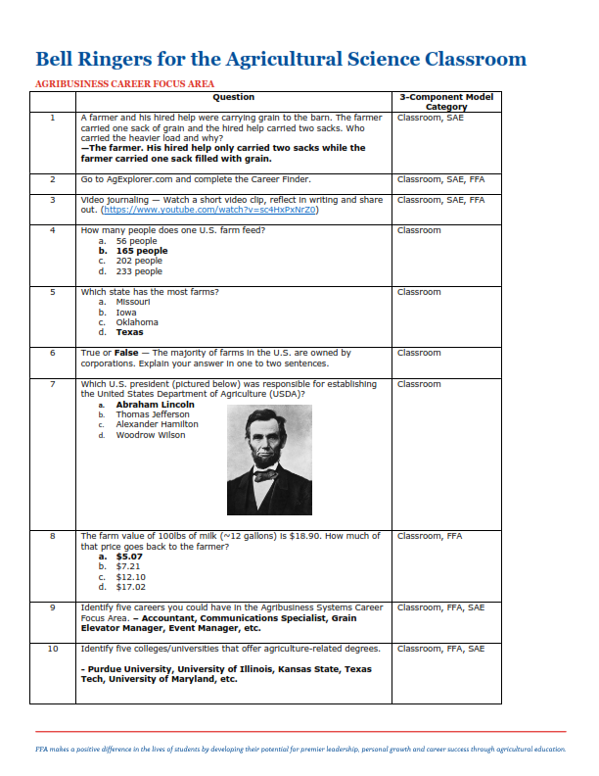
Bell Ringers for the Agricultural Science Classroom
Over 365 prompts, with answers, to get students started
Standards aligned and sorted by content area
PowerPoints divided by content area for quick implementation

Slide 6
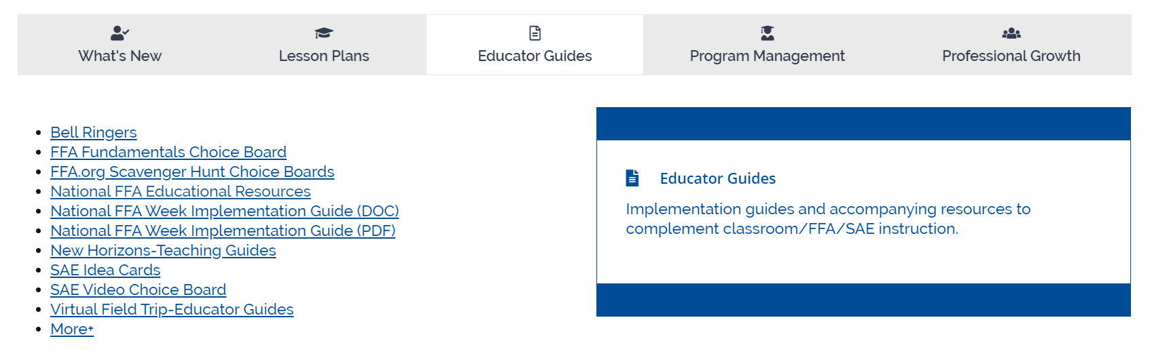
How to Access
Access the Educator Resources page on FFA.org
Select the Educator Guides tab and click “Bell Ringers”

Slide 7
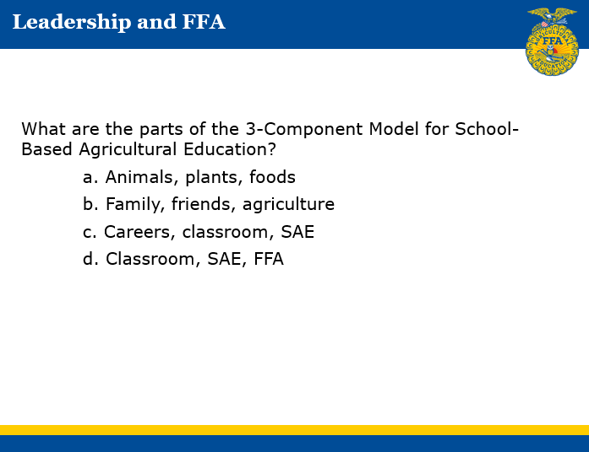
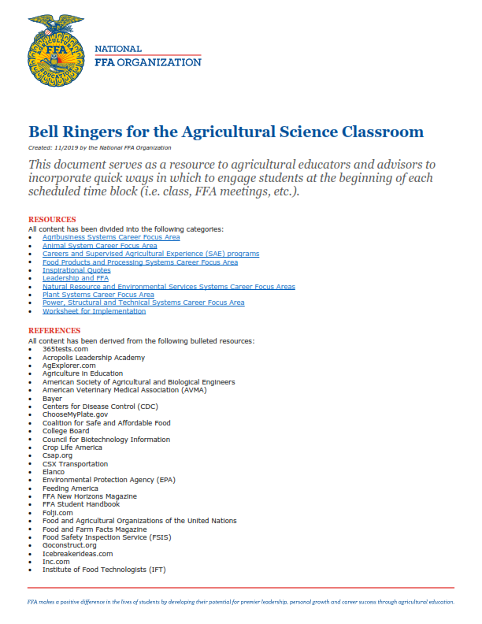
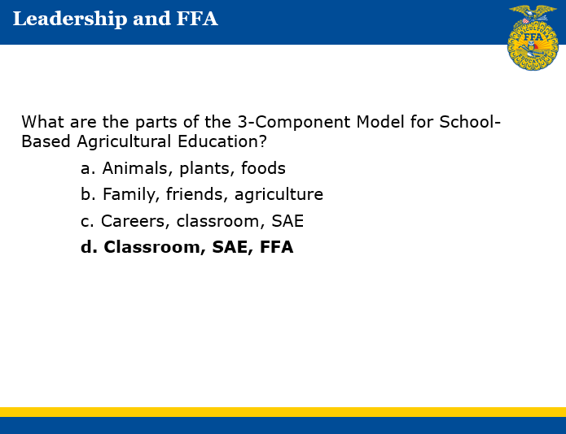

Slide 8
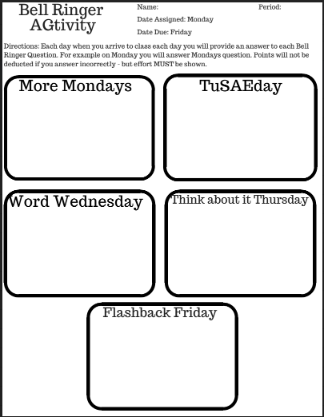
Unscramble the basic plant terminology:
wrelfo *
emts *
afle *
ootr *
rthuultroeic *
Take the Money Management Quiz:
https://sorted.org.nz/tools/money
1. Do you think the results are accurate?
2.How can this insight into your money management help you in your SAE?
The answer to the question is siviliculture, what is the question?
Which of the following is a term used in the forestry industry to describe the segment that works with maintenance and cultivation of trees?
Develop a list of everyday items that are produced from plant byproducts. You have two minutes.
You throw away the outside and cook the inside, then eat the outside and throw away the inside. What is it?
*

Slide 9
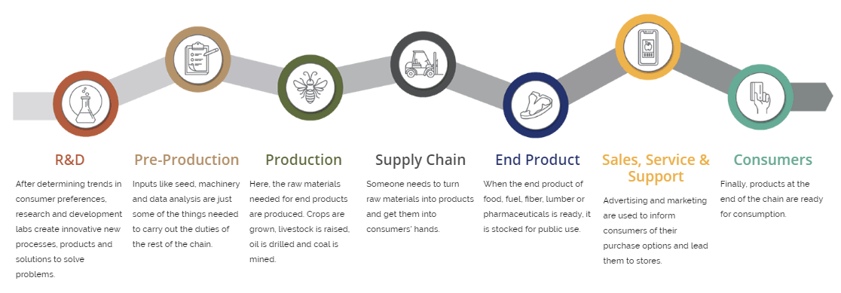
Agriculture, Food and Natural Resources Value Chain
Each icon is clickable and will take you to a page that has connections to careers, FFA, SAE and industry.
The Educator Resources button gives you access to an implementation guide as well as additional content that has been aligned with each step.
Content for each step will change twice a year
Notes:
ask ashli to click through each of these

Slide 10
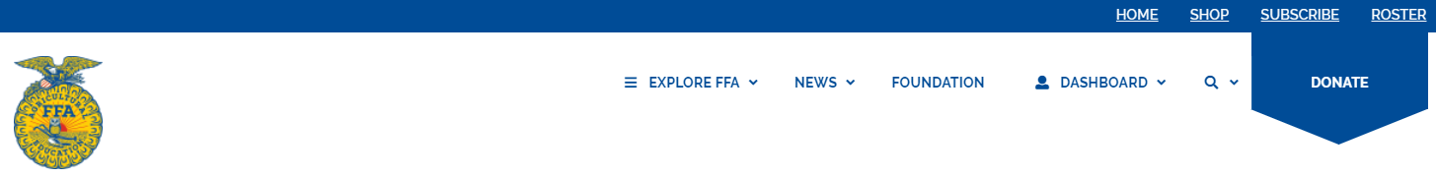
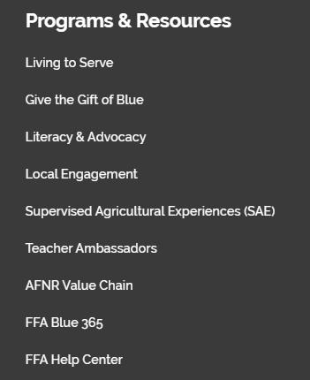
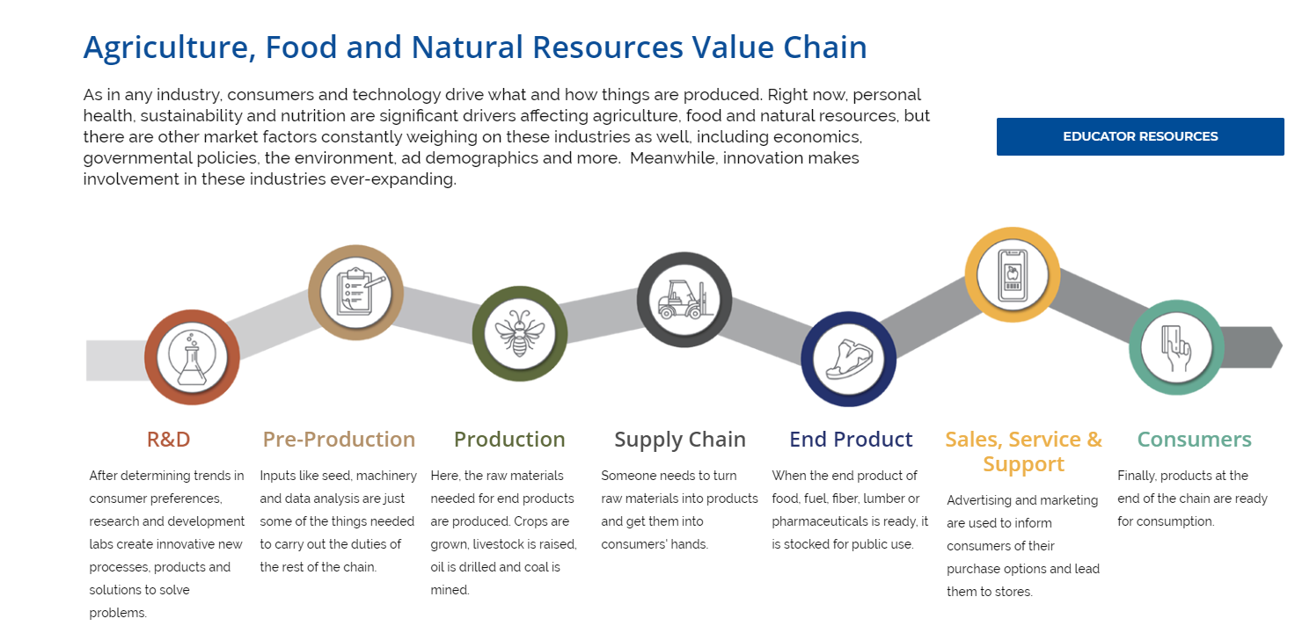
How to Access
Go to FFA.org and click Explore FFA.
Click AFNR Value Chain under Programs and Resources

Slide 11
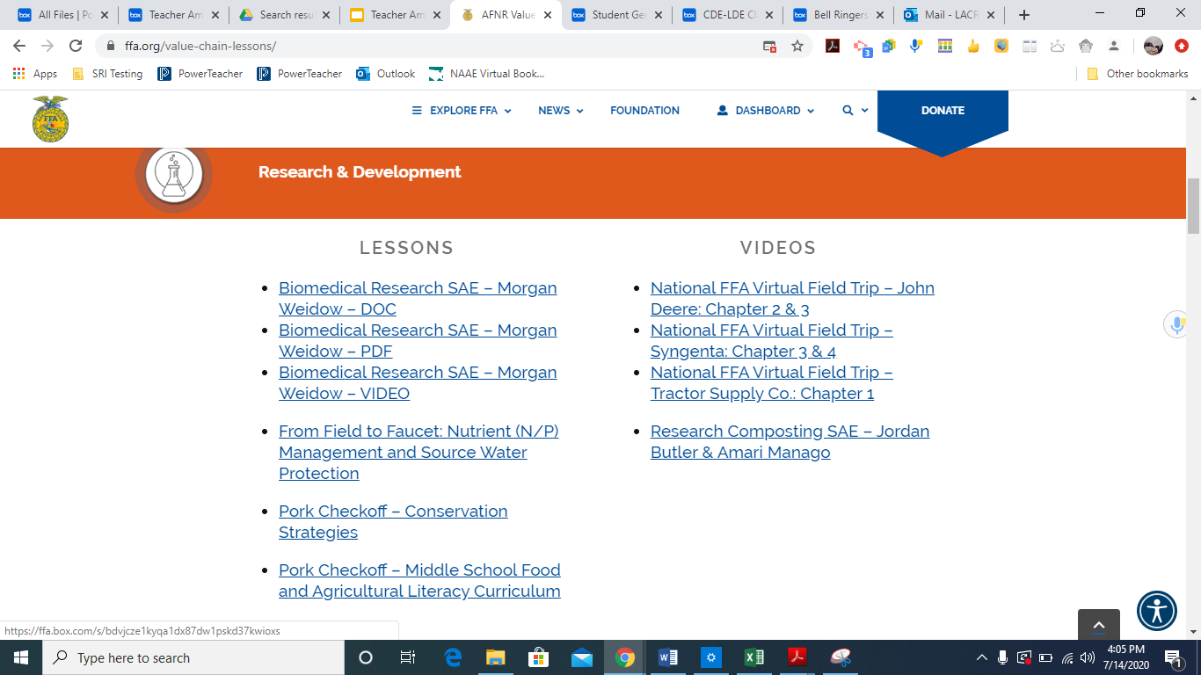
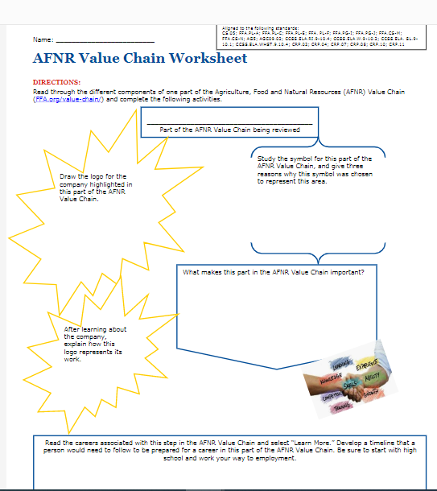
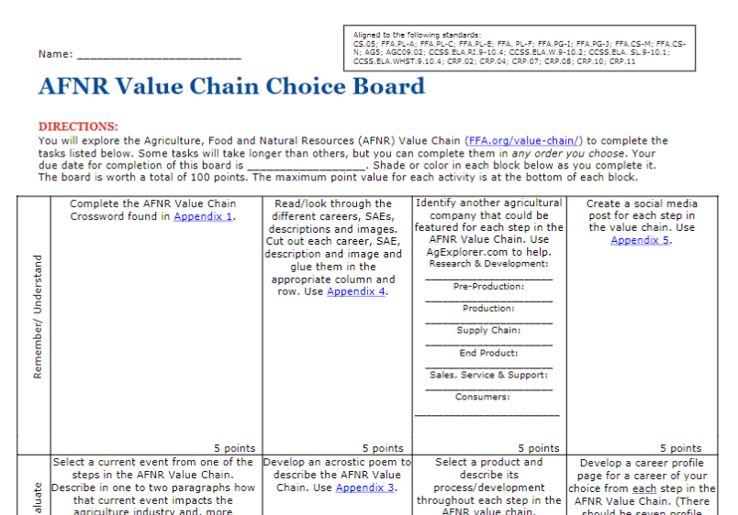

Slide 12
How to Utilize in the Classroom
New Resource
Plan to utilize by
  having students complete the AFNR value chain worksheet in groups
  gallery walk to display and share out information
  design a new product and complete each part of the value chain for that product

Slide 13
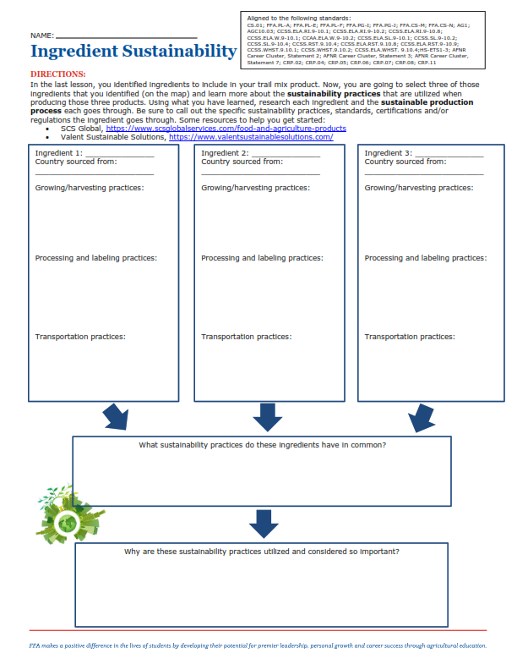
Sustainability in Agriculture – Valent USA
Eight lessons with hands-on activities
A final assessment
Ties to FFA and SAE

Slide 14
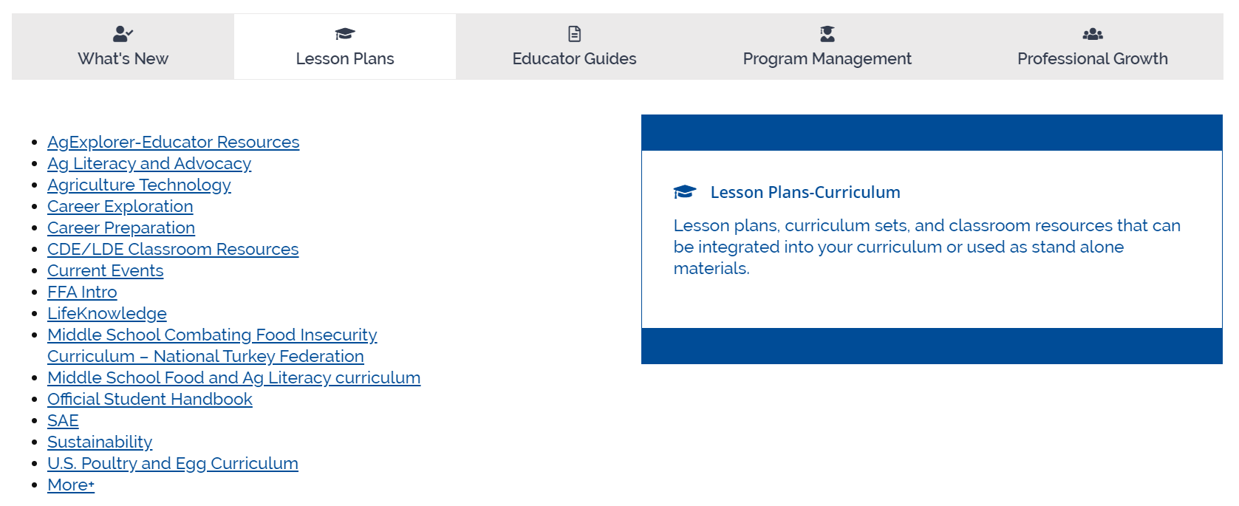
How to Access
Access the Educator Resources page on FFA.org
Select the Lesson Plans tab and click “Sustainability”

Slide 15
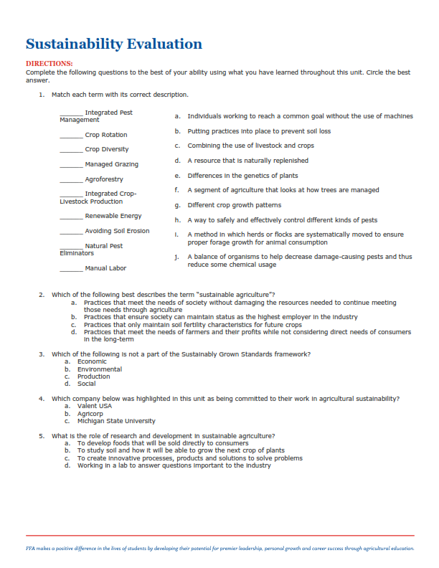
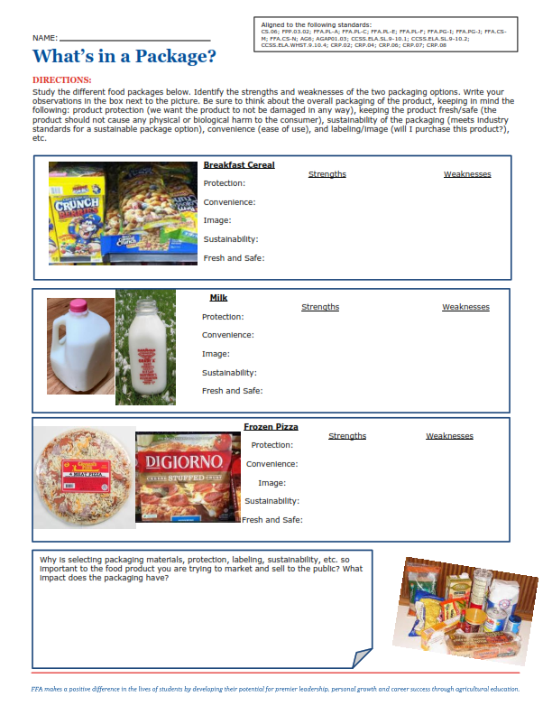

Slide 16
How to Utilize in the Classroom
New Resource
Lots of hands on activities

Slide 17
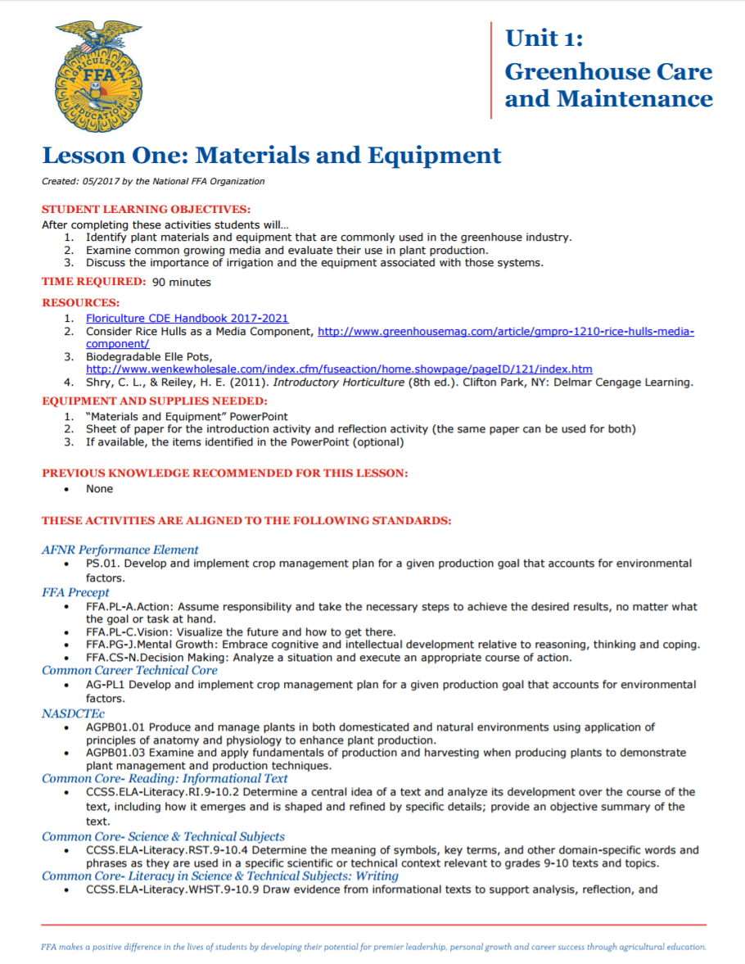
CDE/LDE Classroom Resources
Lesson plans based on CDE content
Classroom integration rather than “this is how you win”
Lessons and accompanying materials online
  Floriculture
  Nursery/Landscape
  Employment Skills

Slide 18
How to Access
Access the Educator Resources page on FFA.org
Select the Lesson Plans tab and click “CDE/LDE Classroom Resources”

Slide 19
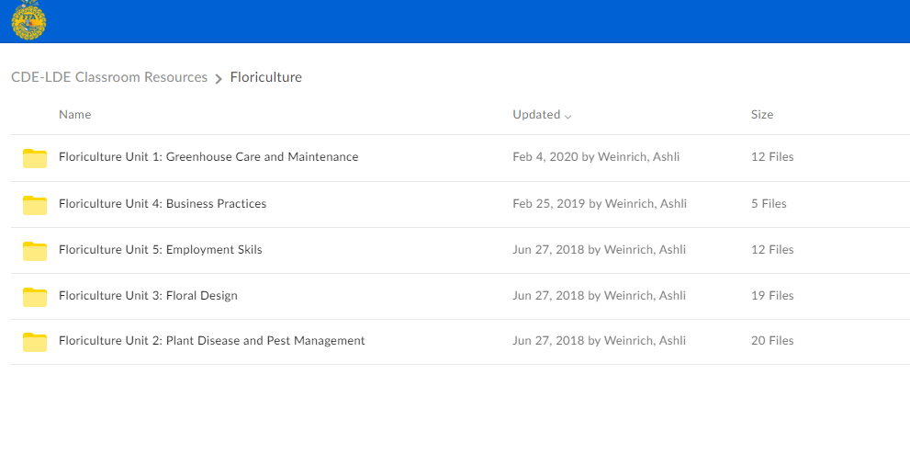

Slide 20
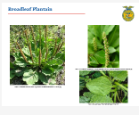
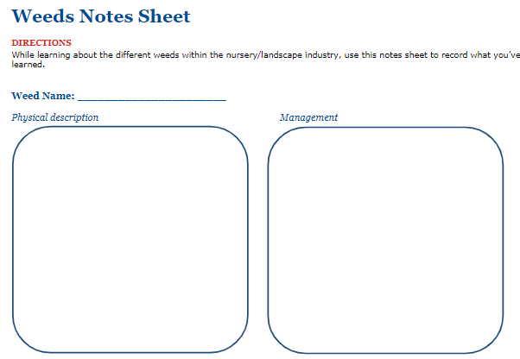
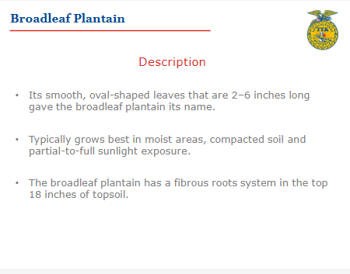
How I Utilize this resource in the Classroom
Include image
Notes:
Nursery landscape Lesson 1.2
flash cards

Slide 21
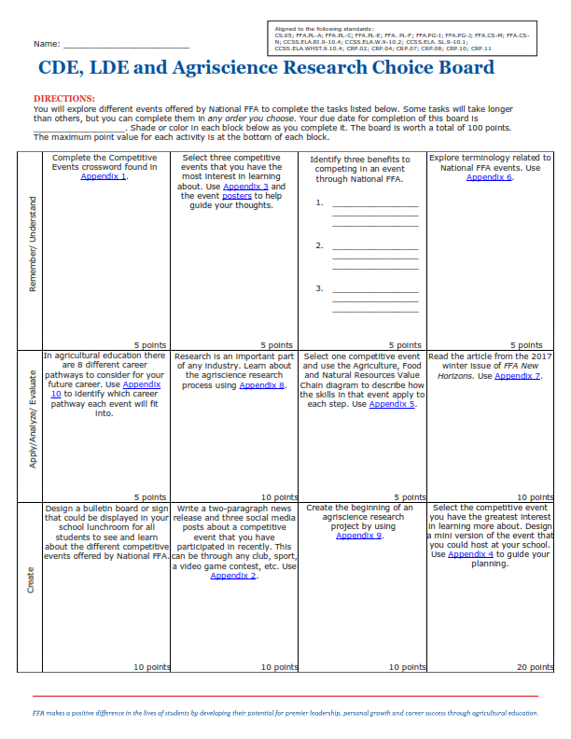
CDE, LDE and Agriscience Research Choice Board
Activities to engage students in CDE, LDE and Agriscience exploration.
Activities to allow for student personal interest.

Slide 22
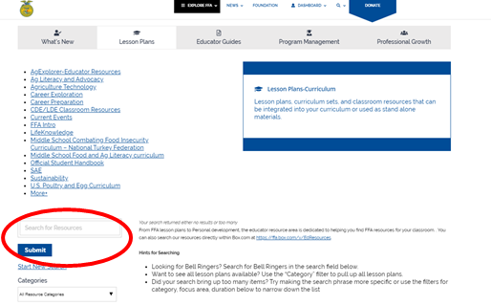
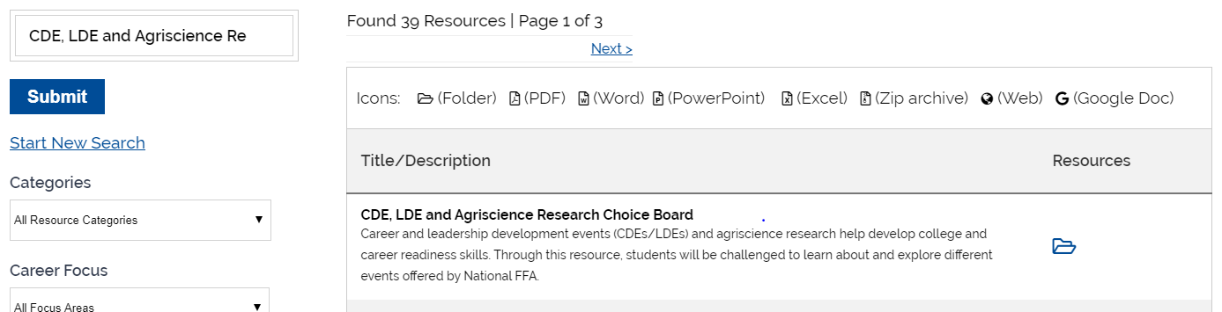
How to Access
Access the Educator Resources page on FFA.org
Use the search bar on the Educator Resources page and type in CDE, LDE and Agriscience Choice Board.

Slide 23
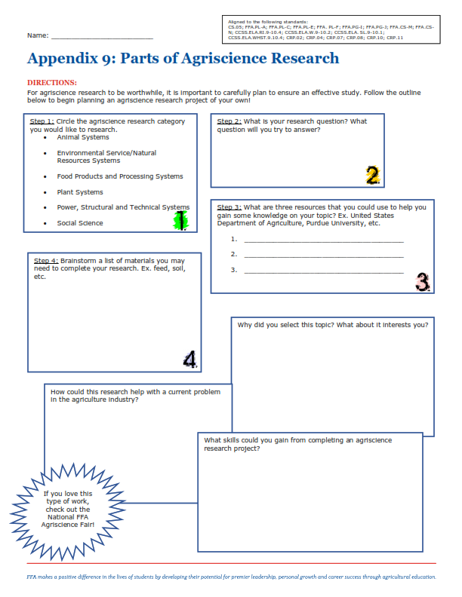
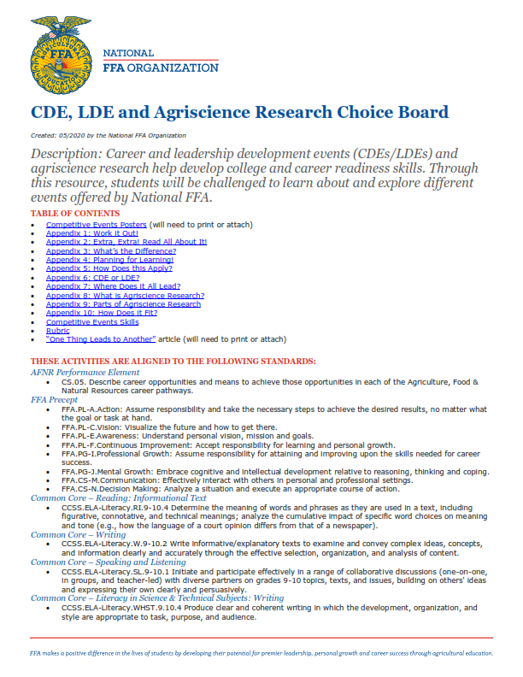

Slide 24
How to Utilize in the Classroom
FFA & CDE Fridays
  each week on friday students will complete one activity from the choice board
  great for distance learning

Slide 25
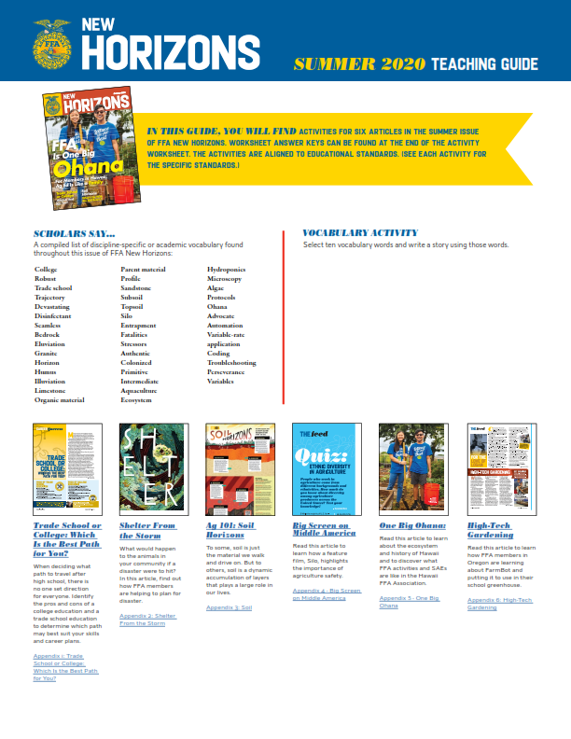
New Horizons Teaching Guide
Lessons and activities that accompany each new magazine
Turn-key
Free, downloadable online

Slide 26
How to Access
Access the Educator Resources page on FFA.org
Select the Educator Guides tab and click “New Horizons-Teaching Guides”

Slide 27
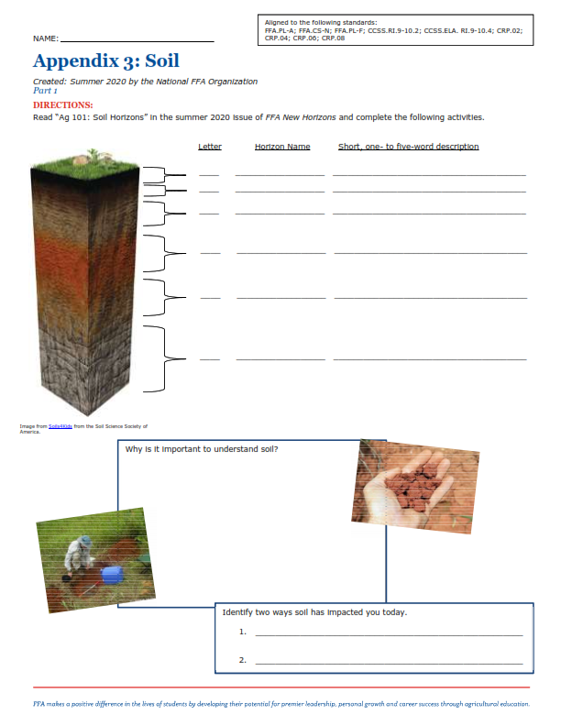
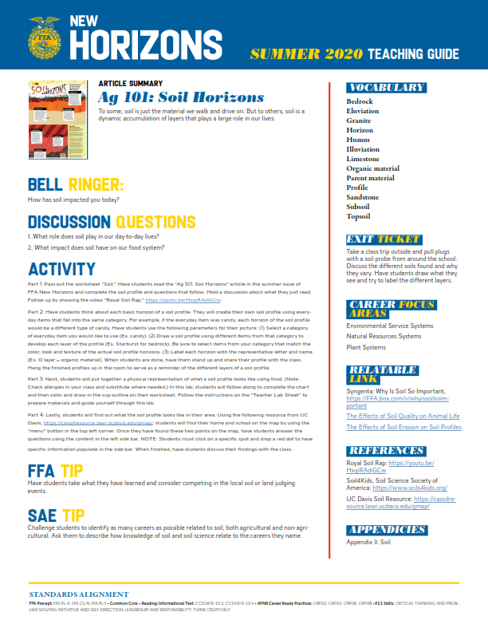

Slide 28
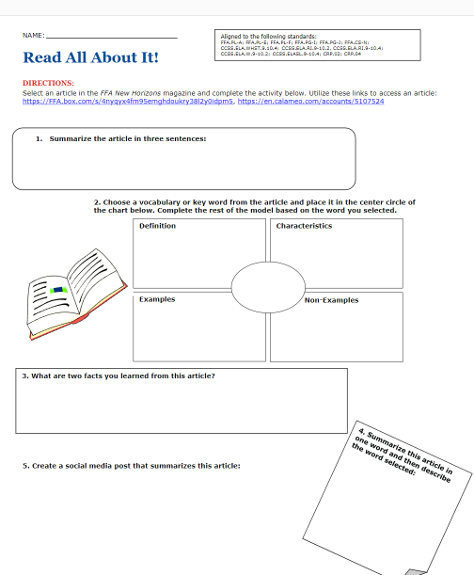
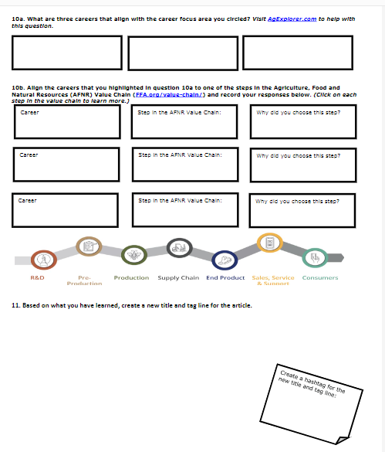
General Activity Worksheets
Notes:
love this for any article if you use newsela or readworks or any current event article

