Slide 1
Plant Identification

Slide 2
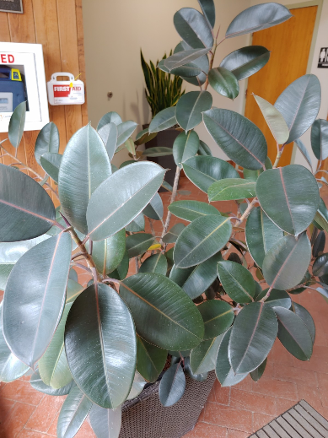
Plant Identification #1

Slide 3
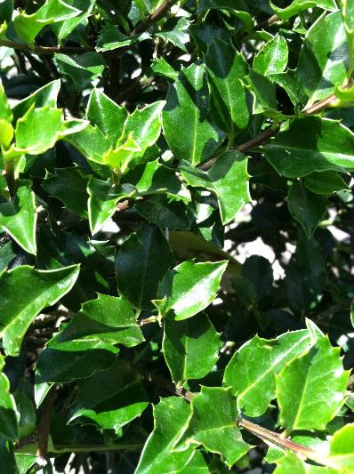
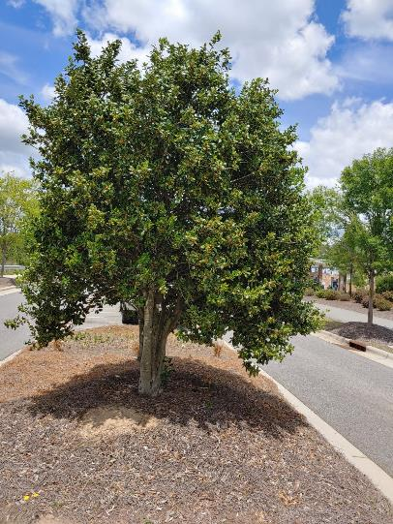
Plant Identification #2

Slide 4
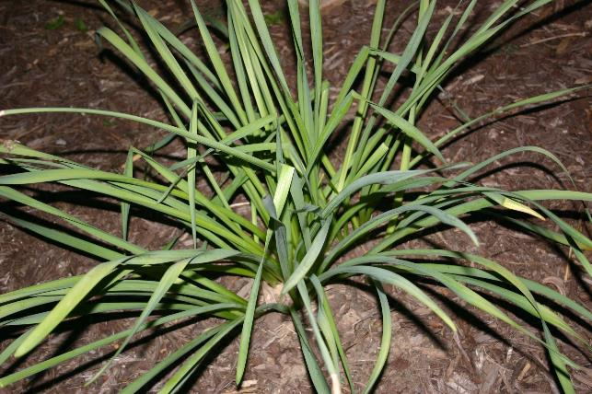
Plant Identification #3

Slide 5
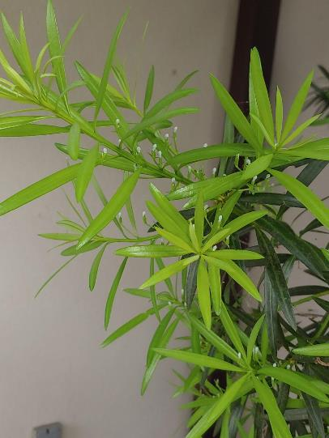
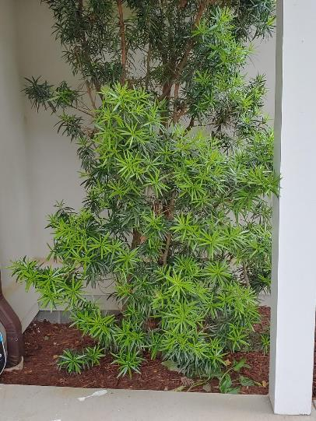
Plant Identification #4

Slide 6
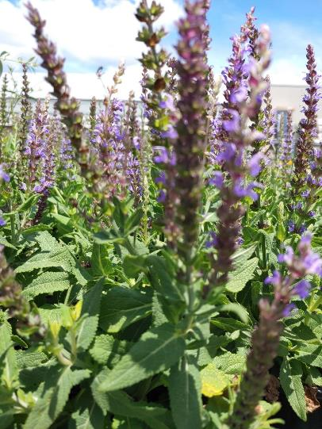
Plant Identification #5

Slide 7
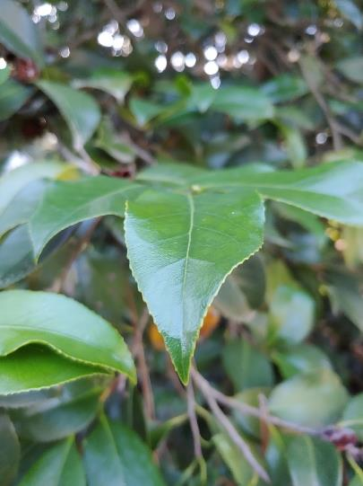
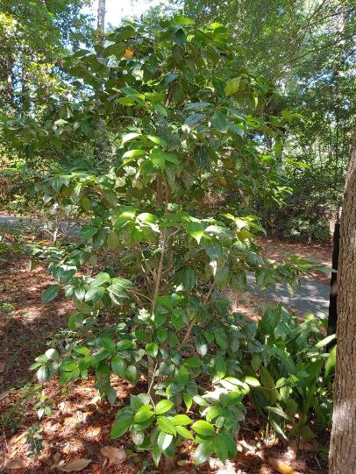
Plant Identification #6

Slide 8
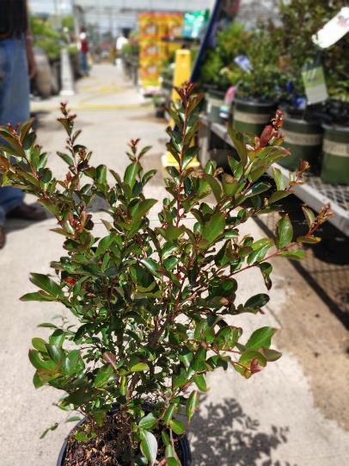
Plant Identification #7

Slide 9
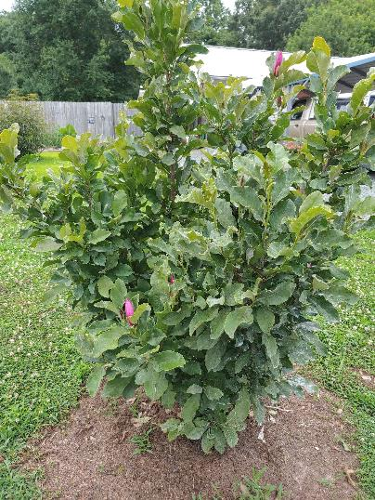
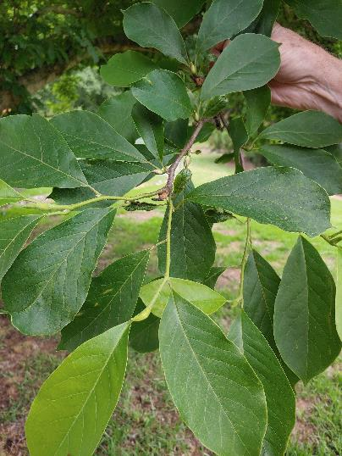
Plant Identification #8

Slide 10
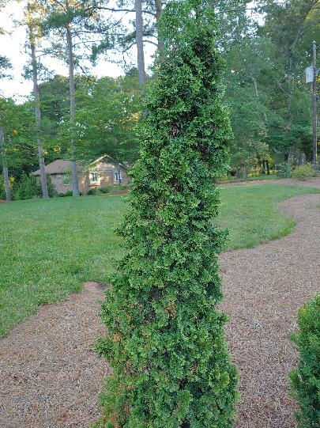
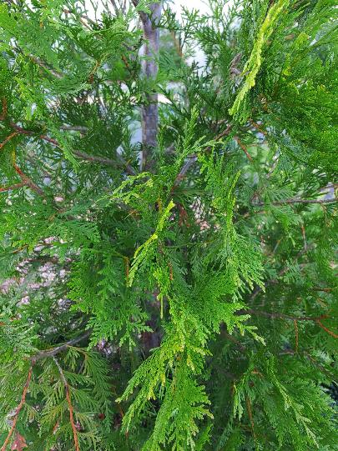
Plant Identification #9

Slide 11
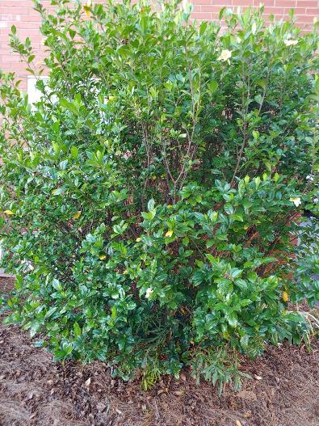
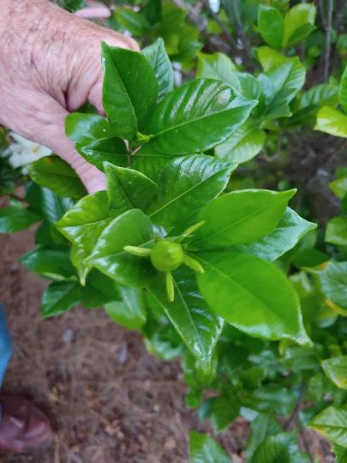
Plant Identification #10

Slide 12
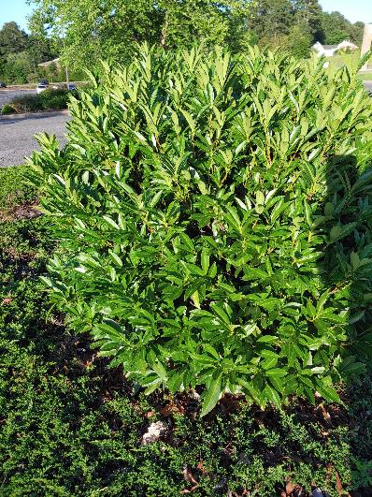
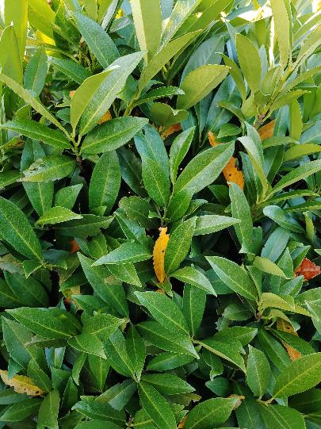
Plant Identification #11

Slide 13
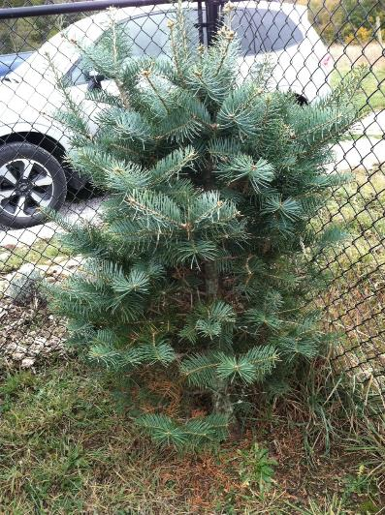
Plant Identification #12

Slide 14
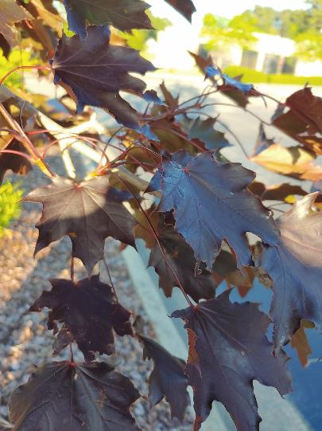
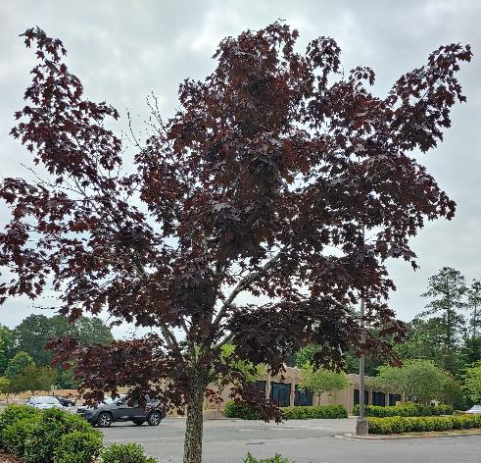
Plant Identification #13

Slide 15
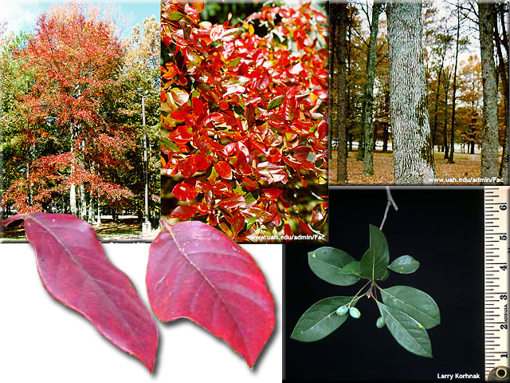
Plant Identification #14

Slide 16
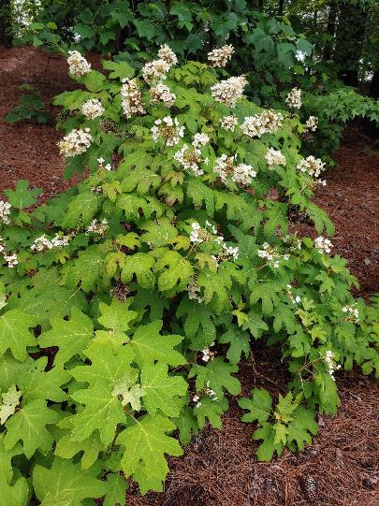
Plant Identification #15

Slide 17
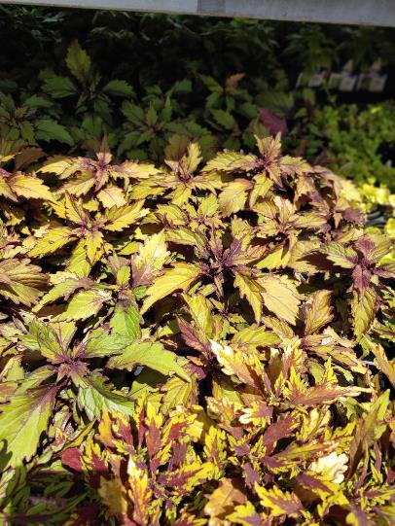
Plant Identification #16

Slide 18
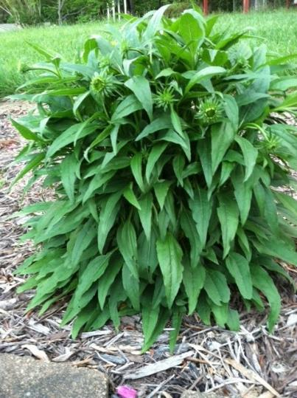
Plant Identification #17

Slide 19
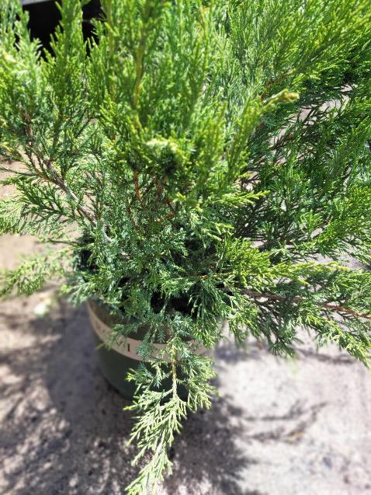
Plant Identification #18

Slide 20
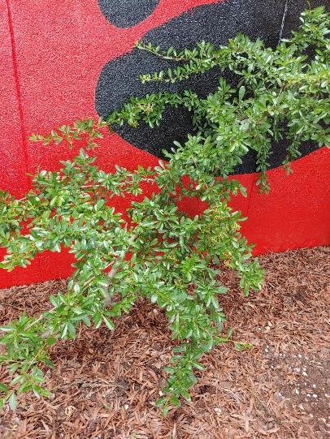
Plant Identification #19

Slide 21
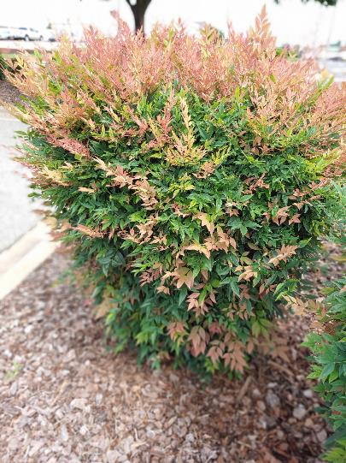
Plant Identification #20

Slide 22
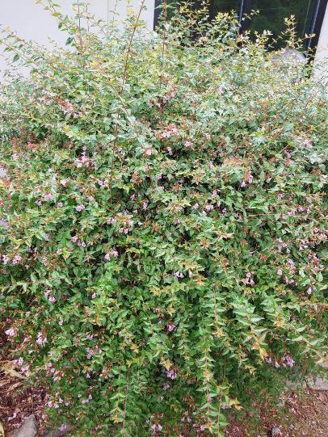
Plant Identification #21

Slide 23
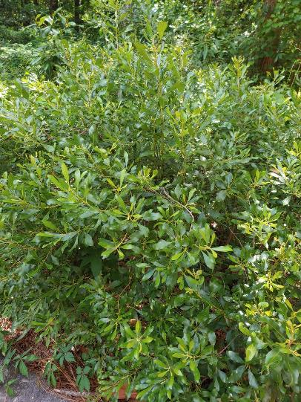
Plant Identification #22

Slide 24
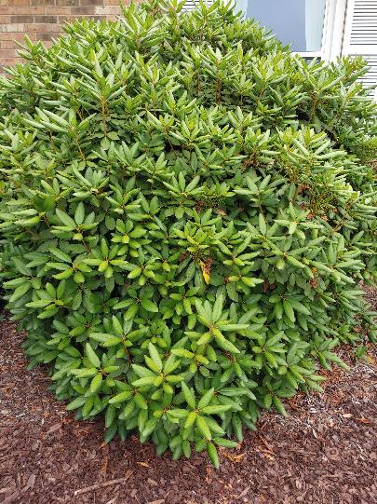
Plant Identification #23

Slide 25
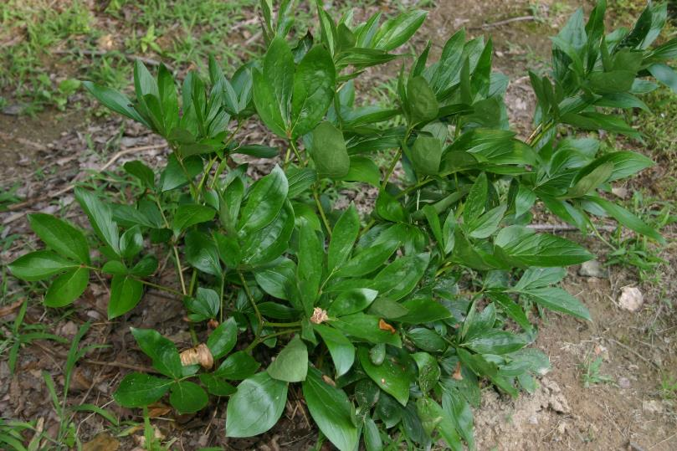
Plant Identification #24

Slide 26
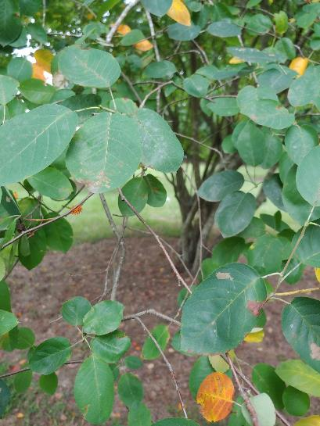
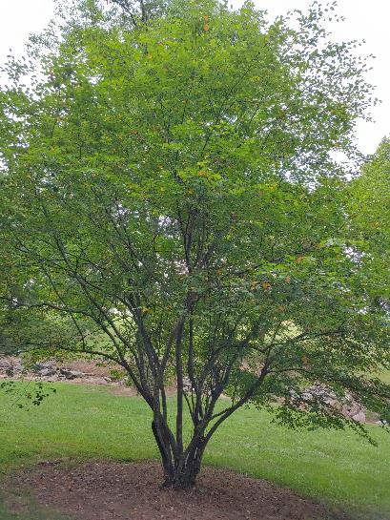
Plant Identification #25

Slide 27
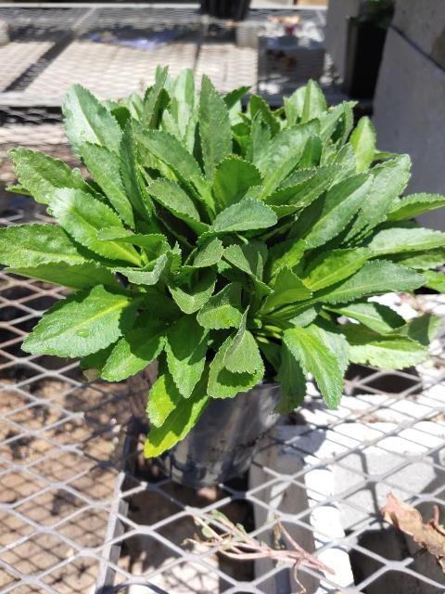
Plant Identification #26

Slide 28
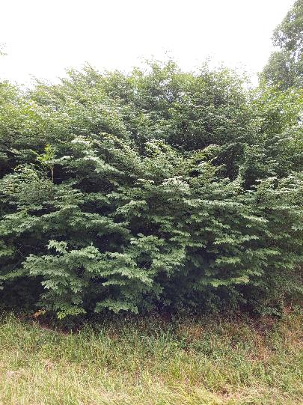
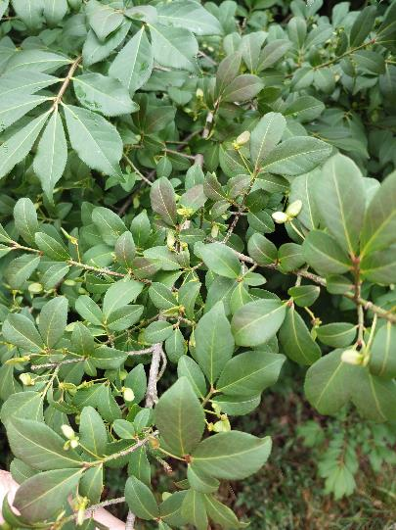
Plant Identification #27

Slide 29
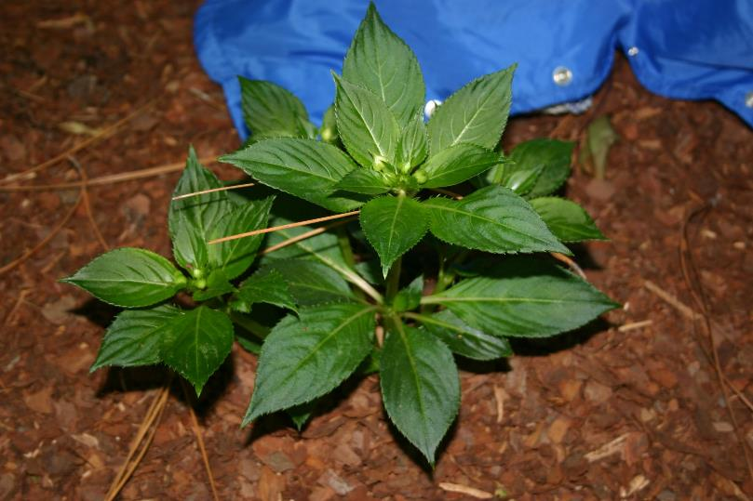
Plant Identification #28

Slide 30
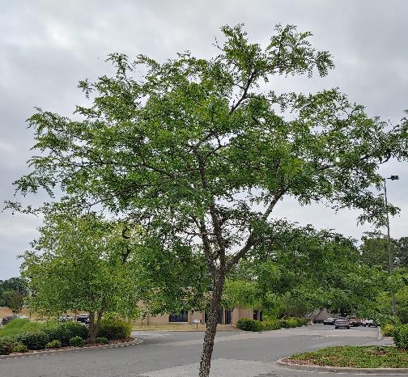
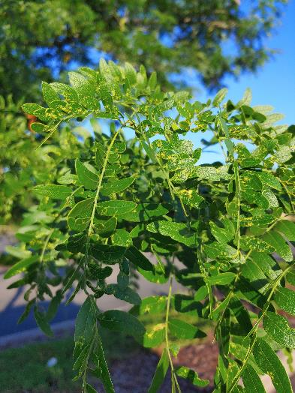
Plant Identification #29

Slide 31
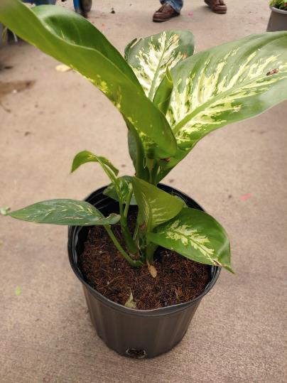
Plant Identification #30

Slide 32
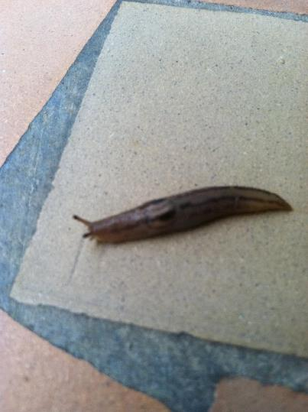
Pest, Disorders, & Beneficials #31

Slide 33
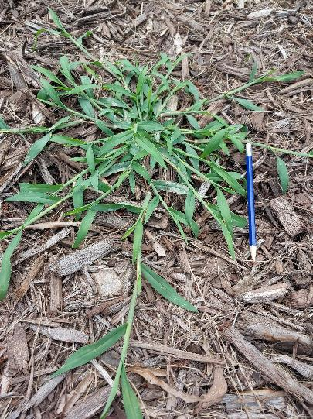
Pest, Disorders, & Beneficials #32

Slide 34
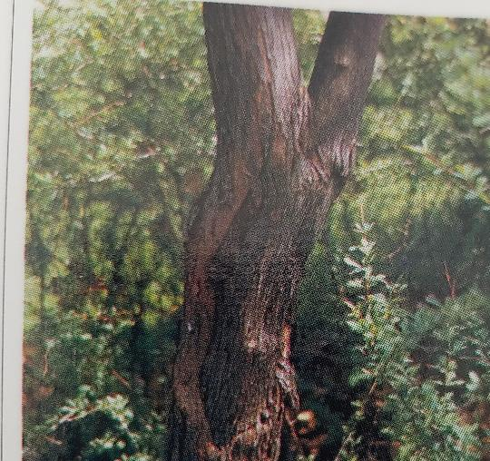
Pest, Disorders, & Beneficials #33

Slide 35
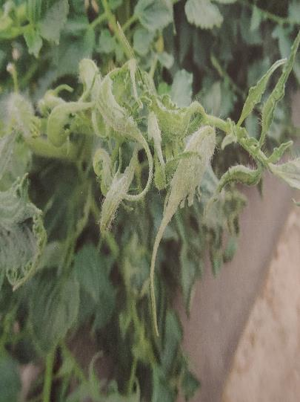
Pest, Disorders, & Beneficials #34

Slide 36
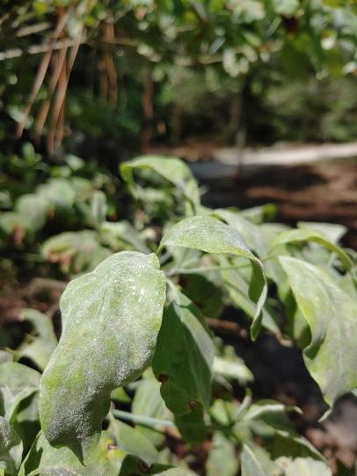
Pest, Disorders, & Beneficials #35

Slide 37
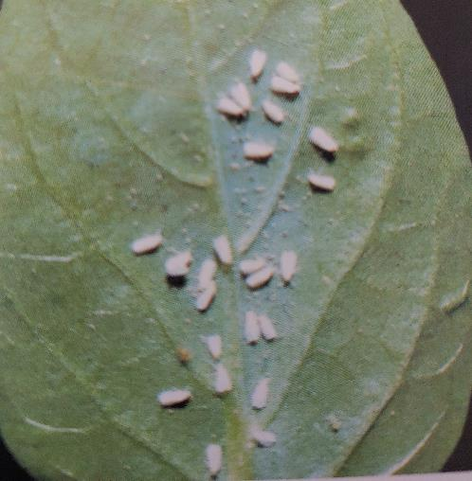
Pest, Disorders, & Beneficials #36

Slide 38
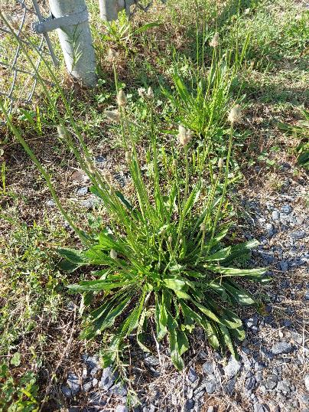
Pest, Disorders, & Beneficials #37

Slide 39
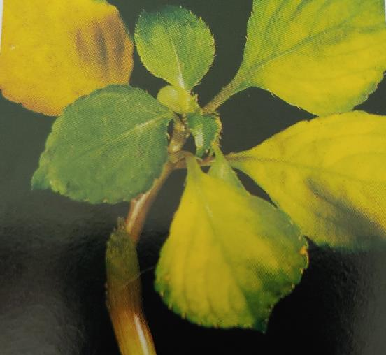
Pest, Disorders, & Beneficials #38

Slide 40
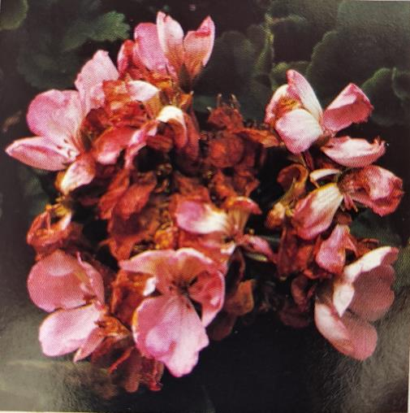
Pest, Disorders, & Beneficials #39

Slide 41

Pest, Disorders, & Beneficials #40

Slide 42

Equipment & Supplies #41

Slide 43


Equipment & Supplies #42

Slide 44

Equipment & Supplies #43

Slide 45

Equipment & Supplies #44

Slide 46

Equipment & Supplies #45

Slide 47

Equipment & Supplies #46

Slide 48

Equipment & Supplies #47

Slide 49

Equipment & Supplies #48

Slide 50

Equipment & Supplies #49

Slide 51


Equipment & Supplies 50

