Slide 1
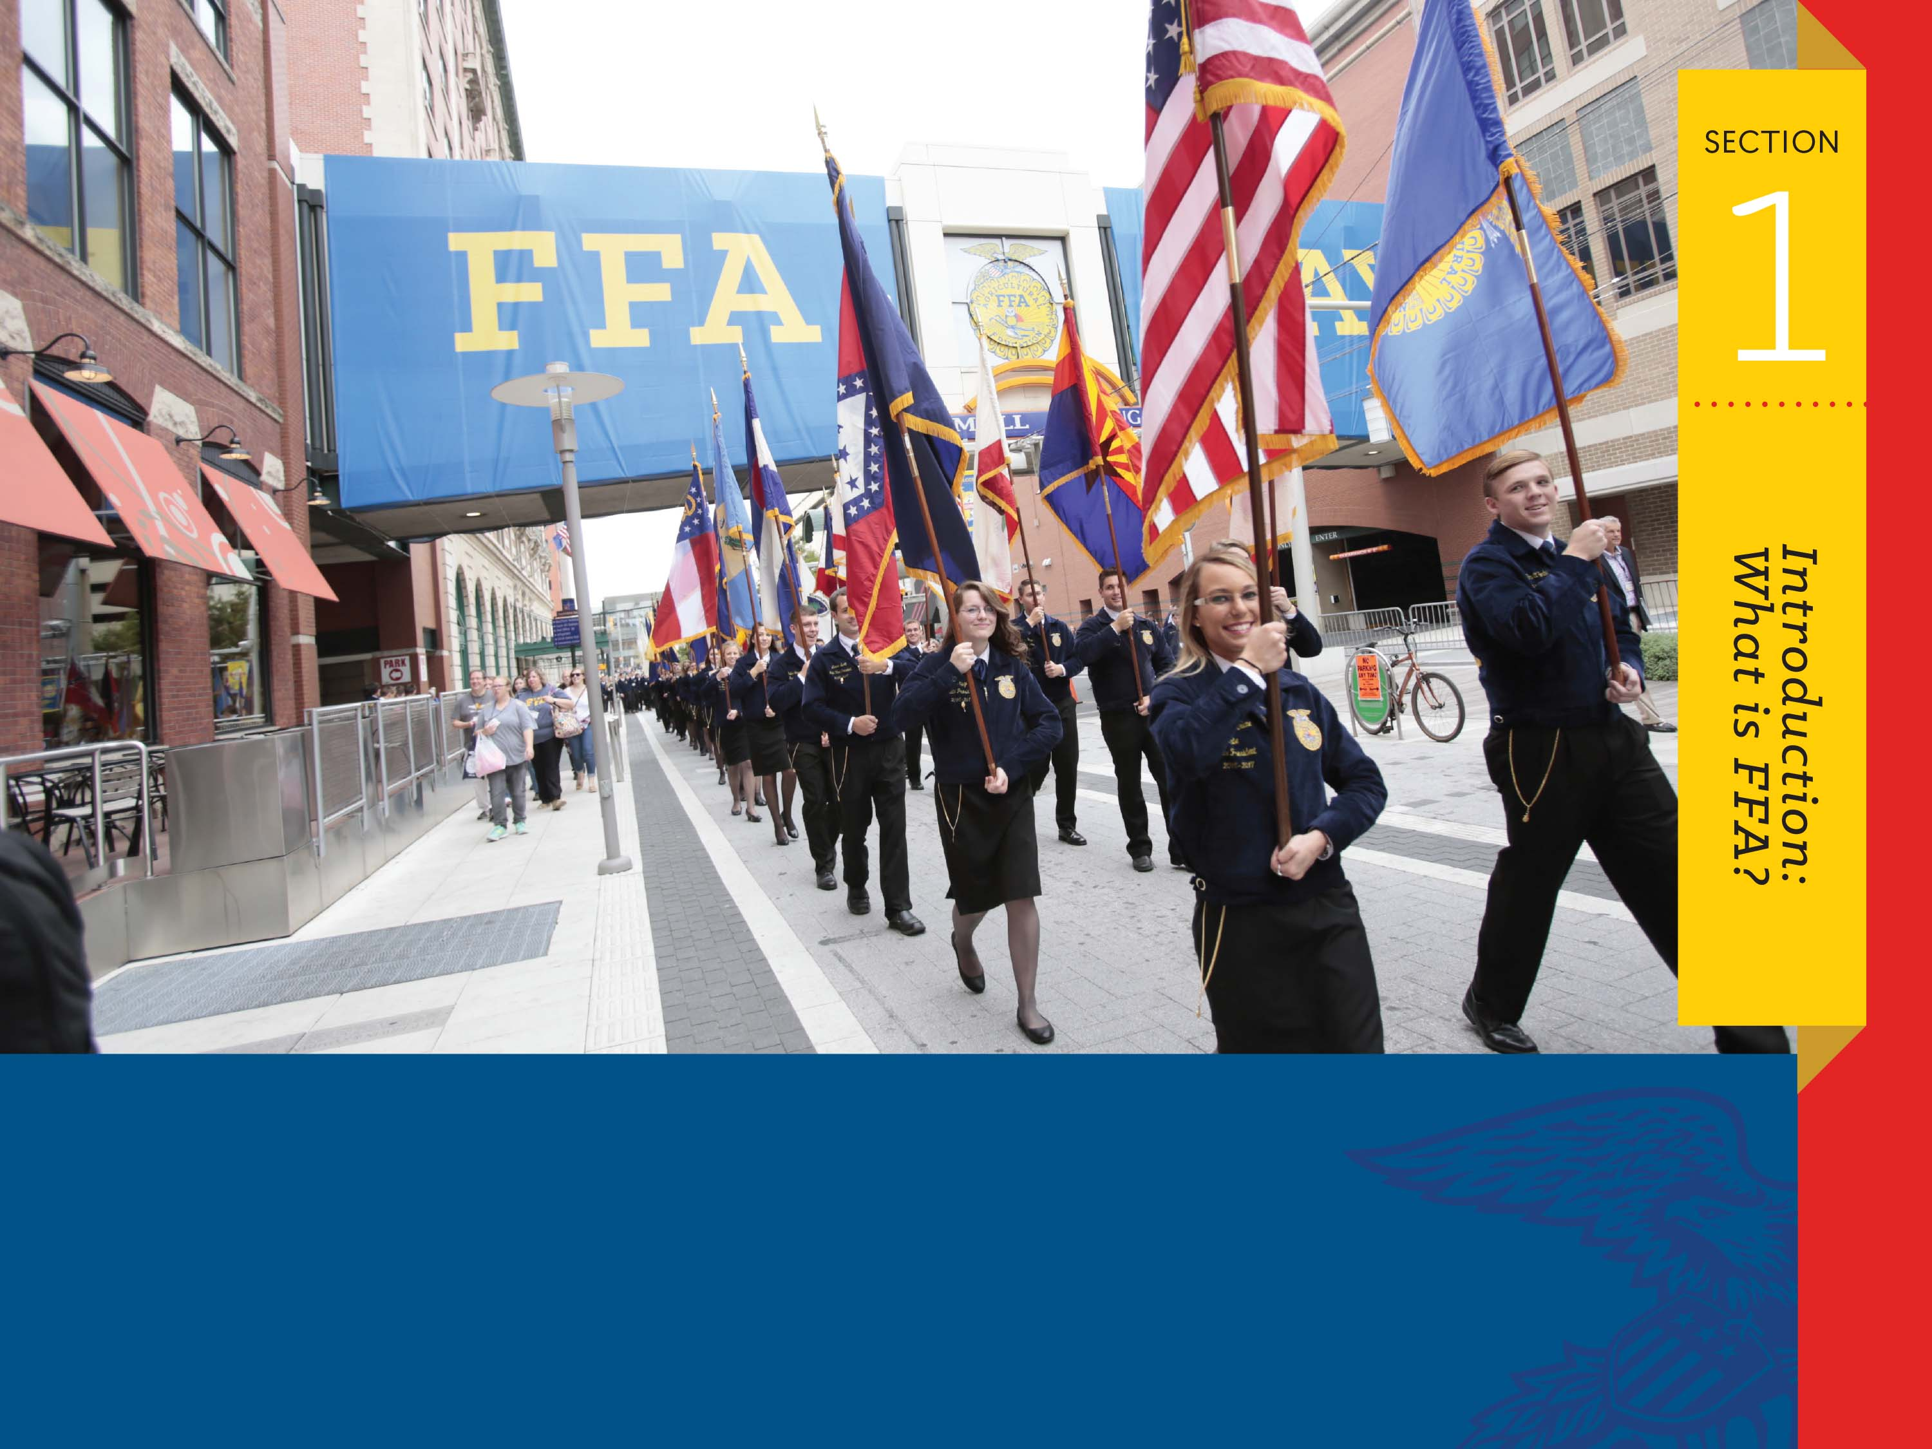
Who Are We Now?
Three-Component Model

Slide 2

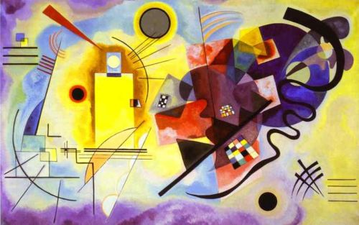
What do these have in common?
The Primary Colors

Slide 3
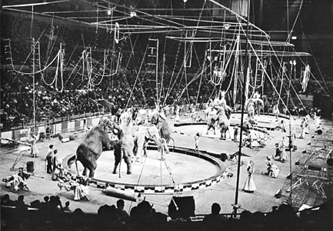
What do these have in common?
Three-Ring Circus

Slide 4
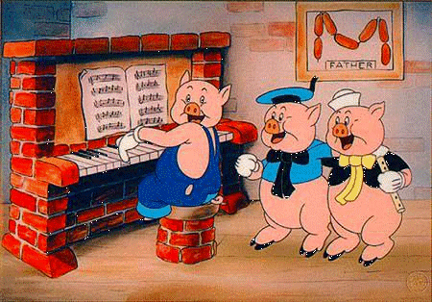
What do these have in common?
Three Little Pigs

Slide 5
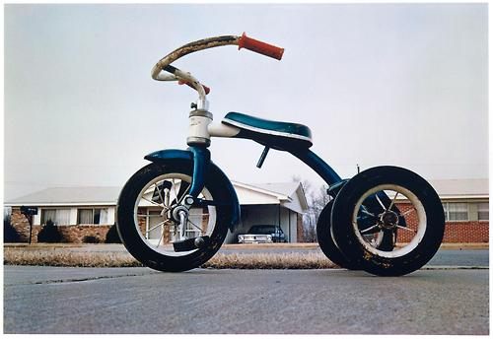
What do these have in common?
Tricycles

Slide 6
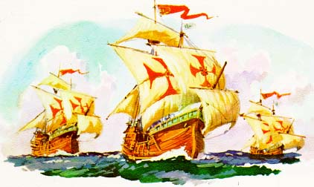
What do these have in common?
The Nina, the Pinta and the Santa Maria

Slide 7
What do these have in common?
Provide three examples of biographies of students excelling in classroom/laboratory, SAE and FFA.

Slide 8
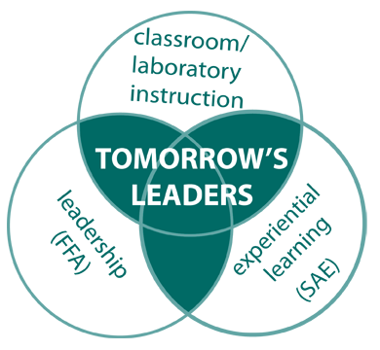
Three-Component Model
Classroom Instruction /Laboratory
FFA
Supervised
Agricultural
Experience
(SAE)

Slide 9
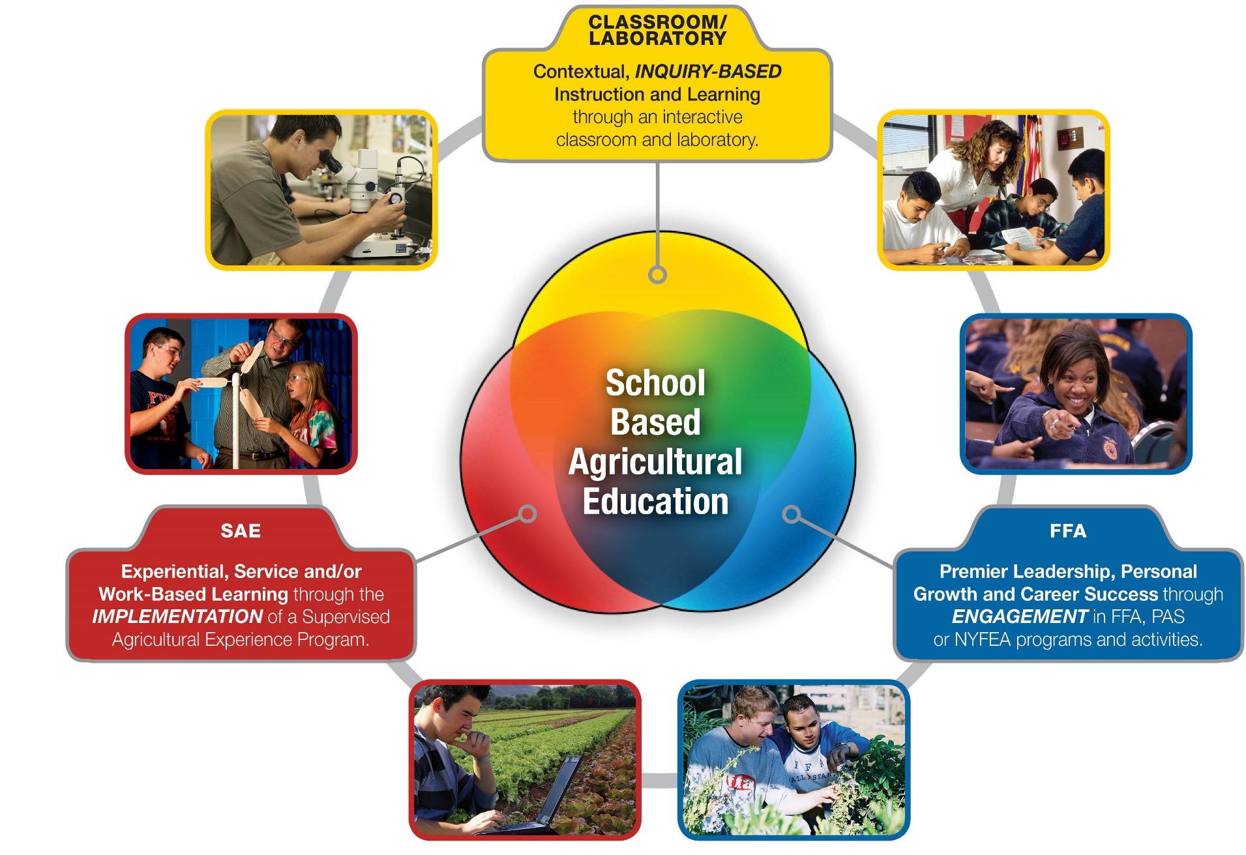
Three-Component Model

