Slide 1

Etiquette

Slide 2


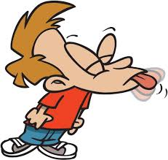
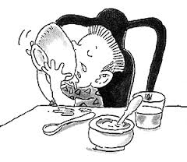

Guess Who?
Sloppy Sid
Late Larry
Disorganized David
Disrespectful Doug

Slide 3
What Is Etiquette?
Conventional requirements as to social behavior; properties of behavior; properties of conduct as established in any class or community or for any occasion.

Slide 4
Meeting People and First Impressions
Look them in the eye.
Give a firm handshake.
Greet them – “How do you do?” or “How do you do, Mrs. ______?”
When saying your name, say it slowly and clearly.
Smile!

Slide 5
Dining
Come to the table with clean hands and face.
Put your napkin on your lap.
Start eating when everyone else does – or when given the okay to start.
Stay seated and sit up straight.
Keep elbows (and other body parts) off the table while eating.
Chew with your mouth closed and don’t talk until you’ve swallowed.

Slide 6
Dining
Don’t make bad comments about the food.
Say “Please pass the…” instead of reaching.
Chat with everyone at the table.
Don’t make rude noises like burping or slurping.
Ask to be excused when finished.
Thank your host or whoever prepared the meal.
Offer to help clear the table.

Slide 7
The Good Listener
Be there
Listen carefully
Concentrate
Hear
Reconfirm
Wait
Question
Respond
Keep still

Slide 8
Using Email/Internet Communication
Let it simmer. Don’t send an email in haste when you are upset.
Your subject line is your first impression.
Grammar and word choice matter.
Be conscious of your voice. Be aware of using all caps, emoticons and text message abbreviations.
Use a salutation, closing and signature block.

Slide 9
Cell Phone
Be in control of your phone; don’t let it control you!
Speak softly.
Be courteous to those you are with; turn off your phone if it will interrupt a conversation or activity.
Watch your language, especially when others can overhear you.

Slide 10
Cell Phone
Avoid talking about personal problems in a public place.
If your phone must be on and it could bother others, use the silent ring mode and move away to talk.
Don’t make calls in a library, theater, church, or from your table in a restaurant.
Don’t text during class or a meeting at your job.
Private info can be forwarded, so don’t text it.
NEVER drive and use your phone at the same time.

Slide 11
Common Etiquette Practices:
Show respect to others.
Remove hats in public buildings.
Excuse oneself when leaving an individual or group.
Dress appropriately for the occasion.

