Slide 1

Our History
The Beginning: NFA and FFA

Slide 2

NFA and FFA
FFA
NFA
Both

Slide 3
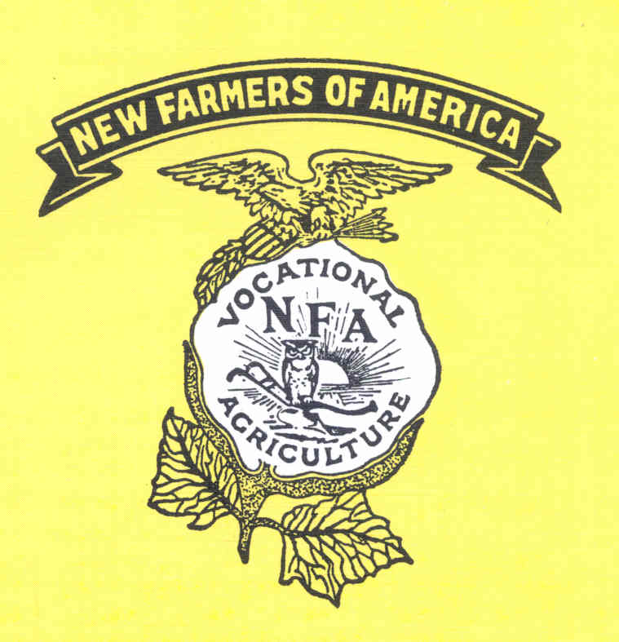

NFA and FFA

Slide 4
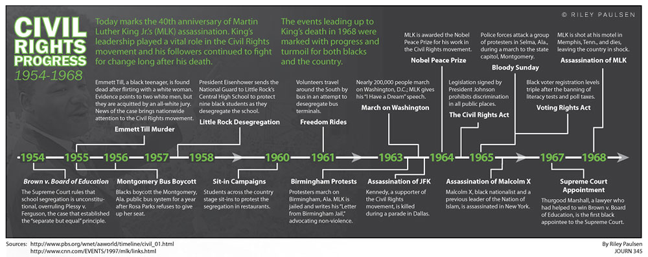
1965 – NFA and FFA Merge
What was happening in the U.S.?

Slide 5
NFA and FFA
Visit:
  Fields – “New Farmers of America: 25 Years of Accomplishment” – https://ncffa.org/Web%20Files/ncHistory/NFA/25%20Years%20Of%20Accomplishment.pdf
  North Carolina FFA Association – “New Farmers of America” – https://ncffa.org/about-us/history/new-farmers-of-america-nfa1/

