Slide 1

Our History
First Leaders

Slide 2

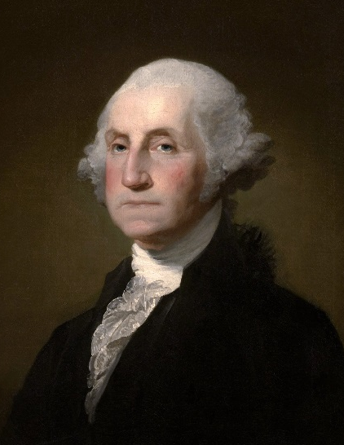
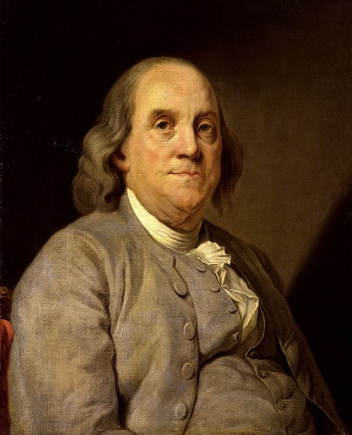
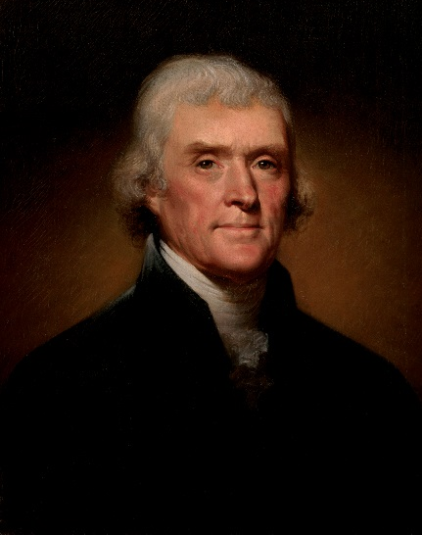
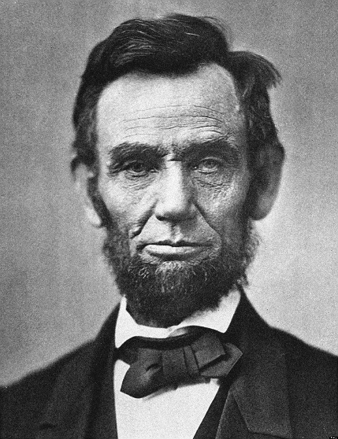
Founding Fathers
View:
  History Channel’s
  “American Revolution History” http://www.history.com/topics/american-revolution/american-revolution-history/videos/founding-fathers-of-innovation

Slide 3
First Leaders
David Simmons
Harry Oscar Sampson
G.W. Owens
Henry C. Groseclose
J.R. Thomas
Charles Homer Lane
Harvey Owen Sargent
E.M. Tiffany

