Slide 1
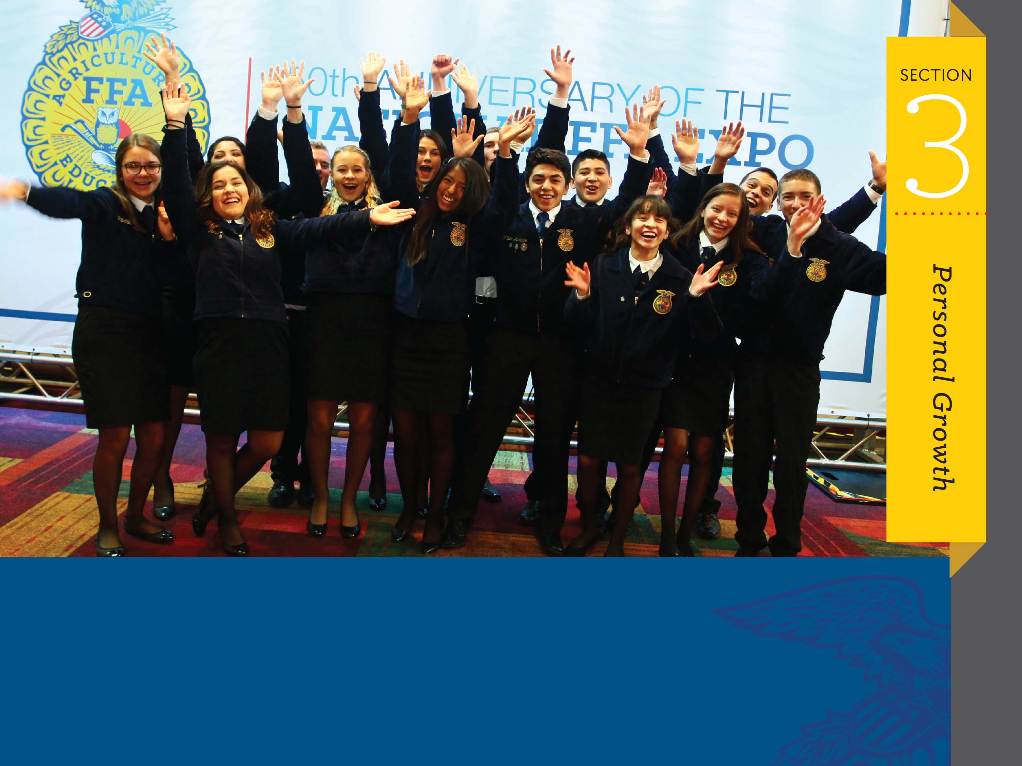
Agricultural Literacy and Advocacy

Slide 2

What is advocacy?
Advocacy is the act of pleading for, supporting or recommending.

Slide 3
Why do we advocate?
Knowing ourselves and others means nothing if it doesn’t lead to action. Our cities, states, country, and world need people who are active voters, engaged in issues, and looking for answers to societal challenges – people who stand for something. Leaders make a difference by having their voices heard.

Slide 4
Why do we advocate?
Telling our story of agriculture is critical. FFA members are not only consumers now but will be powerful influencers of consumer awareness.

Slide 5
Who should we advocate?
You
Me
US!

Slide 6
How do we advocate?
Skills of advocates:
Think critically. Approach decisions with an open mind and addressed with calculated thought.

Slide 7
How do we advocate?
Skills of advocates:
Grow a broadened perspective. Allow yourself to see different cultures, educations and experiences. It can help build a robust understanding of consumer preferences, opinion and emotions.

Slide 8
How do we advocate?
Skills of advocates:
Effectively analyze and use resources. Information is abundant and diverse. It is our responsibility to determine the usability and scientific basis of such resources.

Slide 9
How do we advocate?
Skills of advocates:
Brainstorm solutions. Opportunities for innovation and experiences in advocacy can empower you to envision a sustainable future.

Slide 10
How do we advocate?
Skills of advocates:
Collaborative conversations. Have educated and balanced conversations with consumers.

Slide 11
How can we advocate today?
How can you advocate today?
  Yourself
  Your chapter
  To your community
  To your government

