Slide 1

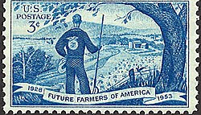

Making and Presiding Over a Motion
Al Gage, CPP, PRP, PAP
Superintendent, CCM LDE
President,
American Institute of Parliamentarians
Kay Allison Crews, CPP, PRP, AP
Member, Parli Pro LDE
FFA Parliamentarian to the National
Convention Delegates
Past President,
American Institute of Parliamentarians
Notes:
AL:
Hi – I’m Al Gage. I am currently the National President of the American Institute of Parliamentarians, Past President of the Society of Ag Ed Parliamentarians, A Past State Officer from Arizona, An Honorary American Degree Holder and the current Superintendent of the Conduct of Chapter Meetings Leadership Development Event.
I’m here with my friend and colleague Kay Crews. Kay, why don’t you introduce yourself?
KAY:
Hi! I’m Kay Crews, a Certified Professional Parliamentarian and Professional Registered Parliamentarian from Dallas. I’m a member of the Parliamentary Procedure LDE team, and I’m going to be serving the FFA House of Delegates as their parliamentarian this year!
Al and I are going to give you a brief session on Presiding over a Motion – a skill that is essential in parliamentary procedure, and one you might find useful in other organizations besides FFA!

Slide 2
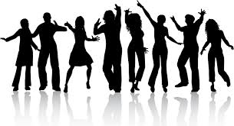
What is a Motion?
Notes:
AL:
But before you can preside over it, you have to know what you’re presiding over?
So what IS a motion?

Slide 3
What is a Motion?
A motion is a
proposal
made by a member
that the body
take an action.
Notes:
AL:
A motion is a proposal. It bring up a substantive question as a new subject for the meeting to discuss.
Only members have the right to make a motion
And a motion is a proposal that the organization take an action – to raise funds for a project, to take part in a service activity, or to study the best way to balance your budget.
Motions start with the words “I move that….” or “I move to….”

Slide 4
Introducing a Motion
MAKE the motion
SECOND the motion
STATE the question
Notes:
AL: There are six steps to handling a motion. Kay will explain those six steps.
KAY:
As Al told you, motions are made by members. Once a member has been recognized by the Chair, the member makes the motion, by saying “I move that….”
Another member seconds the motion. A second indicates that person thinks that it is a good idea to debate this motion. It does NOT mean that the seconder is in favor of it, or will vote for it.
While the maker is making the motion and the seconder is seconding the motion, the maker can change the wording if he would like. Sometimes a helpful friend will suggest an improvement, and at this point, the maker is free to take that suggestion (or not!). These are sometimes called “friendly amendments” when offered at this point of the process.
After the motion has been seconded, the Chair states the question – that means that the Chair repeats the motion so that everyone knows what is about to be debated. After this point, there are no more “friendly amendments” and all amendments or changes to the motion must be voted on by the assembly! That is because once the presiding officer has STATED the question, it now belongs to the full assembly, and not just to the maker.
Another special note for our FFA friends – when stating the motion, the Chair says “It is moved and seconded that…..” I frequently hear FFA presiders say “It is properly moved and seconded that….” and that “properly” is IMPROPER!

Slide 5
Considering a Motion
DEBATE the motion
PUT the question to a vote
ANNOUNCE the results of the vote
Notes:
KAY:
Now that the motion has been introduced, it is time to consider it. Considering a motion has three additional steps –
Debate the motion.
Debate is limited to two debates per person not to exceed 10 minutes and a member may not pass or yield their time to another member.. The chair should recognize the maker of the motion first and then alternate between the pros and cons in recognizing debaters.
After debate has ended the Chair will repeat the question – putting it to a vote. This marks at least the third time that the assembly has heard the motion, and they should have a clear idea what they are voting on. As a presiding officer, one of your fundamental duties is to ensure that every member understands what they are voting on before they cast their vote. So repeat the question and say “Are you ready for the questions?” or “Is there any further debate?”

Slide 6
Considering a Motion
DEBATE the motion
PUT the question to a vote
ANNOUNCE the results of the vote
Unanimous Consent
Voice Vote
Rising Vote
Counted Vote
Notes:
At this point, the Chair can take the vote in one of four ways. The least complex is to ask for Unanimous Consent – “Is there any objection to [repeat the motion]?”… “Hearing no objection, we will….[state effect].”
To take a voice vote, the presiding officers says “Those in favor, say Aye!” and “Those opposed, say No!” Please remember that we are people, not horses, and we do not ever say Nay!
If the results of a voice vote are unclear, the presiding officer can ask a rising vote– which he need not count! Just take a quick look and see if it is clear from the members standing. Finally, if the rising vote is unclear, the presider should count the vote. It is the Chair’s (other) fundamental duty to ensure that the results are correct.

Slide 7
Considering a Motion
DEBATE the motion
PUT the question to a vote
ANNOUNCE the results of the vote
Notes:
Once the Chair has taken the vote, he announces the vote in three steps:

Slide 8
Considering a Motion
DEBATE the motion
PUT the question to a vote
ANNOUNCE the results of the vote
Which side “has it”
Whether the motion is adopted or lost
The effect of the vote
Notes:
Which side has it, the ayes or noes.
Whether the motion is adopted or defeated.
What action will result from the vote.

Slide 9
Introducing a Motion
A member makes the motion
  “I move to participate in the Ag-Day Jubilee in April”
  “I move to adopt the following resolution . . .”
Another seconds it
  Anyone may say “Second!” or “I second the motion!” without seeking recognition
The chair states the question on the motion
  “It is moved and seconded to participate in the Ag-Day Jubilee in April.”
Notes:
AL:
Now, Kay is going to propose a motion, and I will preside over it. With just the two of us, I’m going to allow Kay to second her own motion. You usually don’t get to do that in a meeting!

Slide 10
Considering a Motion – Unanimous Consent
Members debate (if debatable)
  Members seek recognition
The chair puts the question to a vote
  “The question is on the motion to participate in the Ag-Day Jubilee in April…. Is there any objection to participate in the Ag-Day Jubilee?”
The chair announces the result of the vote
  “There is no objection, and we will participate in the Ag-Day Jubilee!”
Notes:
AL:
Kay, as the maker of the motion, would you like to debate it?
KAY:
Ag-Day is a fun event that lets others know about FFA. Please join me in supporting this motion!
AL:
The question is on the motion to participate in the Ag-Day Jubilee in April…. Is there any objection to participate in the Ag-Day Jubilee?
“There is no objection, and we will participate in the Ag-Day Jubilee!”

Slide 11
Considering a Motion – Voice Vote
Members debate (if debatable)
  Members seek recognition
The chair puts the question to a vote
  “The question is on the motion to participate in the Ag-Day Jubilee in April….
  All in favor, say Aye [pause]
  All opposed, say No” [pause]
The chair announces the result of the vote
  “The ayes have it, the motion is adopted, and we will participate in the Ag-Day Jubilee” [or]
  “The noes have it, the motion is lost, and the we will not participate in the Ag-Day Jubilee”
Notes:
AL:
Kay, as the maker of the motion, would you like to debate it?
KAY:
Ag-Day is a fun event that lets others know about FFA. Please join me in supporting this motion!
AL:
Seeing no further debate, The question is on the motion to participate in the Ag-Day Jubilee in April….
All in favor, say Aye [pause]
All opposed, say No” [pause]
The ayes have it, the motion is adopted, and the motion to participate in the Ag-Day Jubilee in April is adopted.

Slide 12
Considering a Motion – Rising Vote
Members debate (if debatable)
  Members seek recognition
The chair puts the question to a vote
  “The question is on the motion to participate in the Ag-Day Jubilee in April….
  All in favor, please rise. [pause] Be seated.
  All opposed, please rise. [pause] Be seated.”
The chair announces the result of the vote
  “Those in favor have it, the motion is adopted, and we will participate in the Ag-Day Jubilee” [or]
  “Those opposed have it, the motion is lost, and we will not participate in the Ag-Day Jubilee”
Notes:
AL:
Kay, as the maker of the motion, would you like to debate it?
KAY:
Ag-Day is a fun event that lets others know about FFA. Please join me in supporting this motion!
AL:
All in favor, please rise. [pause] Be seated.
All opposed, please rise. [pause] Be seated.”
“Those in favor have it, the motion is adopted, and we will participate in the Ag-Day Jubilee”

Slide 13
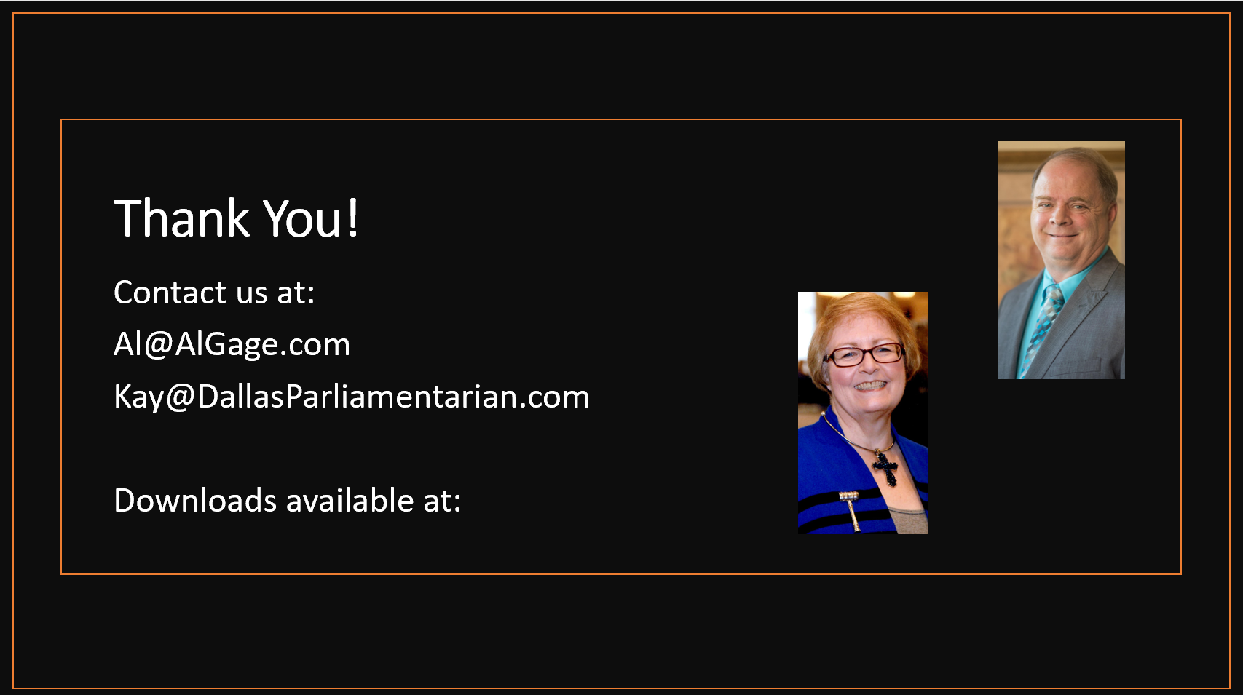
Google Classroom
Notes:
We hope you have enjoyed this brief look at making and presiding over a motion.
Two handouts are available, as are these slides and our presenter’s notes. Go to your Google Classroom for the handouts.

